Slide 2
Brain Imaging Data Structure @ FPPW
department of data analysis
research group: neurostat
Han Bossier – NIMP: 23/11/2017

Slide 3
Challenge of science

Slide 4
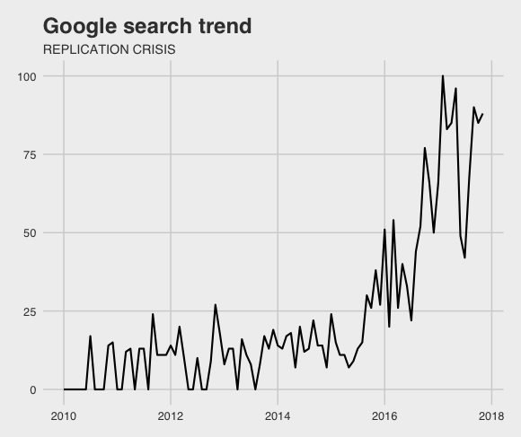
Challenge(s) of reproducible science
Awareness across space/time
Publishers (i.e. Nature) Special issue →
Public interest (i.e. Google)
Notes:
Awareness and initiatives for promoting reproducible research:
Publishers
Public interest
Researchers (Twitter)
Funding

Slide 5
Challenge(s) of reproducible science
Awareness across space/time
Publishers (i.e. Nature) Special issue (May 2017)
Public (i.e. Google)

Slide 6
Challenge(s) of reproducible science
Researchers (i.e. Twitter)
Funding (i.e. FWO)
Notes:
FWO:
Second article of general regulations states that FWO mandates should publish their publications with Open Access.

Slide 7
Neuroscience
Poldrack et al. (2017): problematic research practices and possible solutions.
Flexibility and exploration in data analysis 6912 unique analysis pipelines (Carp, 2012)
Low statistical power (neuropowertools.org) If really needed: more liberal statistical thresholds
Notes:
Psychology
Neuroscience
Flexibility:
- pre-registration of method and analysis plan

Slide 8

Neuroscience: PRP
Software errors →
Insufficient study reporting OHBM: guidelines on best practices
Multiple comparisons → data sharing: removing false positives with MA

Slide 9
Data sharing
Prerequisite: organized projects
Behavioural experiments:
Open Science Framework (osf.io)
Project management: https://eglerean.wordpress.com/2017/05/24/project-management-data-management/
Notes:
Off course, all use already open science framework

Slide 10
Behavioural experiments
Before sharing comes organizing
Project management: https://eglerean.wordpress.com/2017/05/24/project-management-data-management/
Data sharing: Open Science Framework (osf.io)

Slide 11
neuroimaging
Datasets: larger (storage + more files)
Data management > project management
Most use own (non-) structure
Uniform standard necessary to share and re-use data
Enter BIDS
Notes:
Neuroimaging:
Need to sort data management before doing project management.

Slide 12
Brain Imaging Data Structure

Slide 13
Overview: BIDS
A proposed standard to organize human neuroimaging datasets (fMRI, resting state, diffusion, etc.).
Collaborative effort:
5000 researchers
+/- 40 example datasets
27 authors from different labs/regions on first proposal
Krzysztof (Chris) Gorgolewski main developer/author Credits for parts of this presentation: OHBM – 2016.

Slide 14
Main selling points
Heterogeneity in data management causes:
problems for sharing data (internally AND externally)
errors from inputting manual metadata
complexity in tools for QC and validation

Slide 15

Who is it for?
You!
Organizing data (on your own) takes time.
Going back to project.
Lab PI
PhD/post-doc moves during (or after) project.
Pipeline developers, database curators, collaborators, data analysts, etc.

Slide 16
Principles
Keep it simple
Goal != efficiently store, but describing + standardizing the raw data
Don’t reinvent the wheel.
Filenames: give meaning to life
Re-use existing formats
NifTi, JavaScript Object Notation (JSON), Tab Separated Value (TSV) text files
80/20 rule
Notes:
80/20: standard works for 80% of the MRI experiments, using only 20% effort. (?)
Raw data: not the derived results!

Slide 17
how
Notes:
Hierarchical folder structure with 4 levels:
MRI acquisition
Session
Subject
Dataset

Slide 18
MRI acquisition

Slide 19
metadata

Slide 20
Top level
Notes:
Missing values should be coded as n/a

Slide 21
Getting BIDS compatible
Step 1: convert DICOM to NifTi
Step 2: structure, rename and copy files demo
Step 3 + 4: add remaining (meta)data (subject variables, descriptions, experimental paradigm, etc.)
Step 5: validate the dataset!

Slide 22
Demo @FPPW

Slide 23
Step 1 + 2
Goal
convert DICOM data from scanners in Ghent to BIDS
Aim
ease of adoption
minimal requirements (avoid installation of wonky programs)
What
convert DICOM to NifTI + JSON
folder structure + correct names
How
PowerShell or bash scripts + dcm2niix
Notes:
David

Slide 24
Progress
User requirements
download scripts
install tool (dcm2niix)
basic knowledge of PowerShell/bash
provide global variable names
https://github.com/NeuroStat/CustomFormatBIDS

Slide 25
My questions
Level of interest
Level of automatization
ATM: user needs to provide info + manually check
heudiconv: https://github.com/nipy/heudiconv
How do your folders/names look like?
Testing: please copy and keep original data as back-up

Slide 26
Validator
Browser
http://incf.github.io/bids-validator/

Slide 27
Extra questions
Ask David! ;-)

Slide 28
References
Slides: https://www.slideshare.net/chrisfilo1/the-brain-imaging-data-structure-ohbm-2016
Carp, J. (2012). On the plurality of (methodological) worlds: Estimating the analytic flexibility of fmri experiments. Frontiers in Neuroscience, 6(OCT), 1–13. http://doi.org/10.3389/fnins.2012.00149
Gorgolewski, K. J., Auer, T., Calhoun, V. D., Craddock, R. C., Das, S., Duff, E. P., … Poldrack, R. A. (2016). The brain imaging data structure, a format for organizing and describing outputs of neuroimaging experiments. Scientific Data, 3, 160044. http://doi.org/10.1038/sdata.2016.44
Poldrack, R. A., Baker, C. I., Durnez, J., Gorgolewski, K. J., Matthews, P. M., Munafò, M. R., … Yarkoni, T. (2017). Scanning the horizon: towards transparent and reproducible neuroimaging research. Nature Reviews Neuroscience, 18(2), 115–126. http://doi.org/10.1038/nrn.2016.167

Slide 29

< Han Bossier > < PhD Student > department of data-analysis E Han.Bossier@ugent.be W https://github.com/NeuroStat/CustomFormatBIDS @HBossier www.ugent.be

