Slide 1
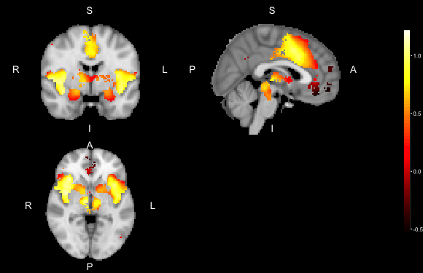
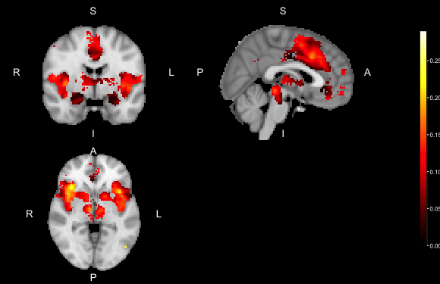

observed effect (B*)
between-study variability ${(τ}_{DL}^{2})$

