Slide 1
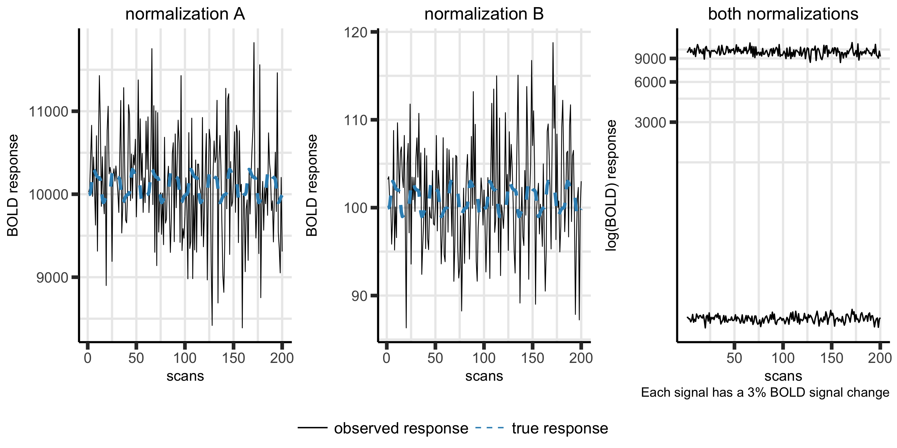

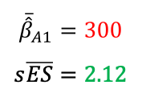
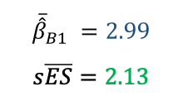

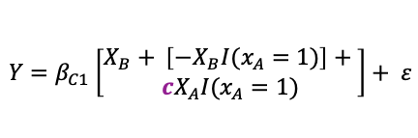
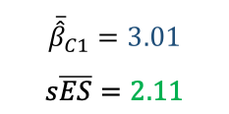
$$N=50$$
1 subject
group level model:
$$Y_{A}={β_{A1}X}_{A}+ε$$
$$Y_{B}={β_{B1}X}_{B}+ε$$
$$Y=β_{C1}\left[\begin{aligned}X_{B}+ \left[−X_{B}I(x_{A}=1)\right]+ \\ {cX}_{A}I(x_{A}=1)\end{aligned}\right]+ ε$$
1000 simulations
$${\overline{\hat{β}}}_{A1}=300$$
$$s\overline{ES}=2.12$$
$${\overline{\hat{β}}}_{B1} =2.99$$
$$s\overline{ES}=2.13$$
$${\overline{\hat{β}}}_{C1}=3.01$$
$$s\overline{ES}=2.11$$

