Slide 1
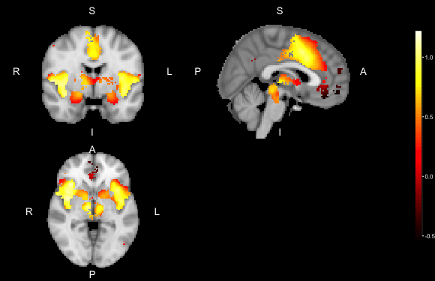
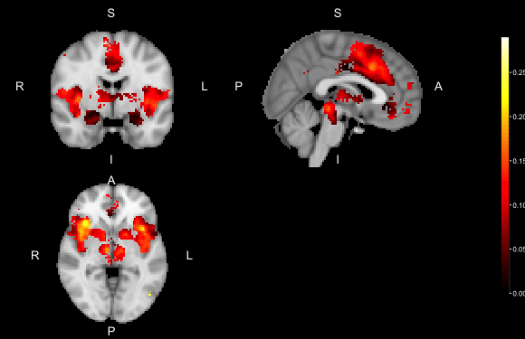

observed effect (b*)
between-study variability ${(τ}_{DL}^{2})$

