Slide 1
PYTHON LIBRARIES PANDAS [DATA COLLECTION / ANALYSIS]

Slide 2
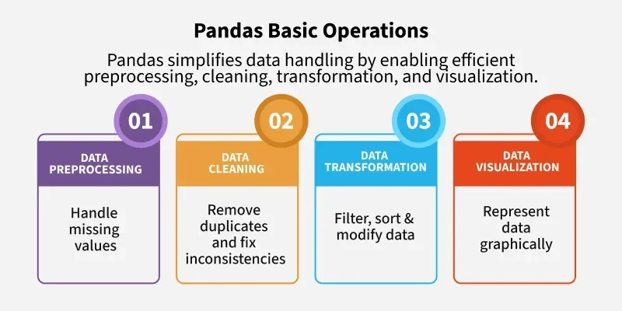
PANDAS [DATA COLLECTION / ANALYSIS]

Slide 3
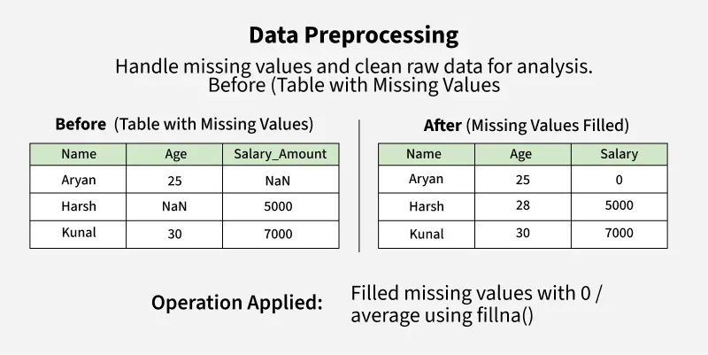
PANDAS [DATA COLLECTION / ANALYSIS]

Slide 4
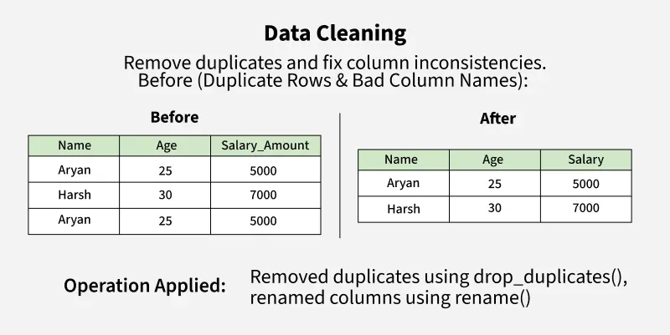
PANDAS [DATA COLLECTION / ANALYSIS]

Slide 5
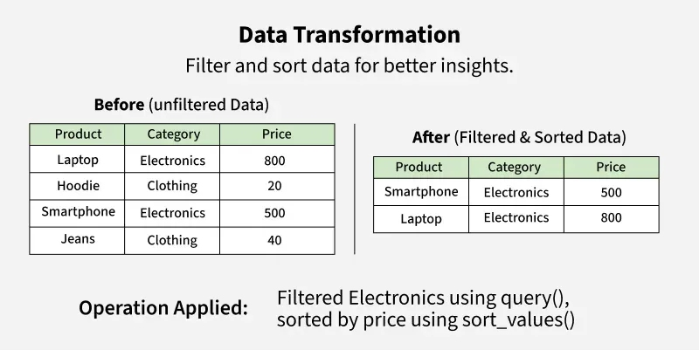
PANDAS [DATA COLLECTION / ANALYSIS]

Slide 6
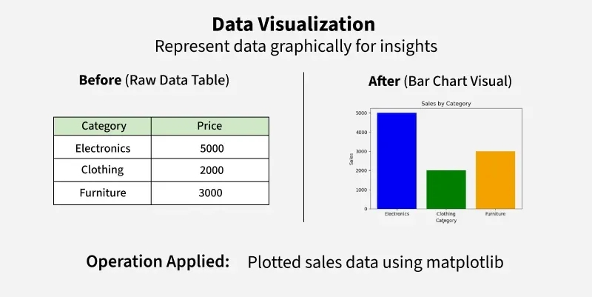
PANDAS [DATA COLLECTION / ANALYSIS]

Slide 7
PANDAS [DATA COLLECTION / ANALYSIS]
Creating a Pandas DataFrame
Pandas DataFrame comes is a powerful tool that allows us to store and manipulate data in a structured way, similar to an Excel spreadsheet or a SQL table.
DataFrame is similar to a table with rows and columns. It helps in handling large amounts of data, performing calculations, filtering information with ease.
Creating an Empty DataFrame
Once Pandas is installed, import it in your applications by adding the import keyword:
import pandas as pd
df = pd.DataFrame()
print(df)

Slide 8
PANDAS [DATA COLLECTION / ANALYSIS]
Creating a DataFrame from a List
import pandas as pd
lst = ['Geeks', 'For', 'Geeks', 'is', 'portal', 'for', 'Geeks']
df = pd.DataFrame(lst)
print(df)
Creating DataFrame from dict of Numpy Array
import numpy as np
import pandas as pd
data = np.array([[1, 2, 3], [4, 5, 6], [7, 8, 9]])
df = pd.DataFrame(data, columns=['A', 'B', 'C'])
print(df)

Slide 9
PANDAS [DATA COLLECTION / ANALYSIS]
Pandas Read CSV File
CSV files are the Comma Separated Files. It allows users to load tabular data into a DataFrame, which is a powerful structure for data manipulation and analysis.
import pandas as pd
# reading csv file
df = pd.read_csv("people.csv")
print(df)
Pandas Read Excel File
import pandas as pd
df = pd.read_excel('Example.xlsx')
print(df)

