Slide 1

DATA PRE-PROCESSING TECHNIQUES / PIPELINES FOR AI MODELS

Slide 2




SOURCES OF NEURO IMAGING DATASETS
ADNI-1, ADNI-2, ADNI-GO, ADNI-3
OASIS 1, OASIS 2
PPMI

Slide 3





NEURO IMAGING DATA PRE-PROCESSING TOOLS

Slide 4
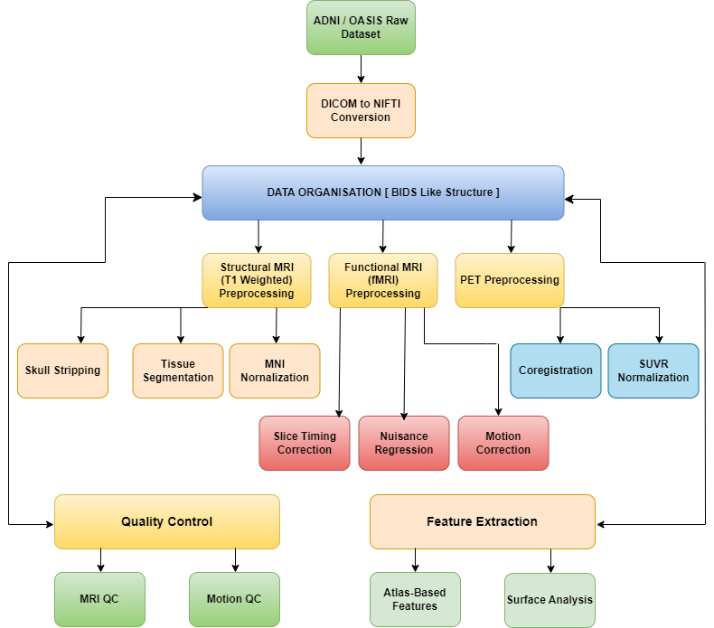
DATA PRE-PROCESSING [PURE PYTHON APPROACH]

Slide 5
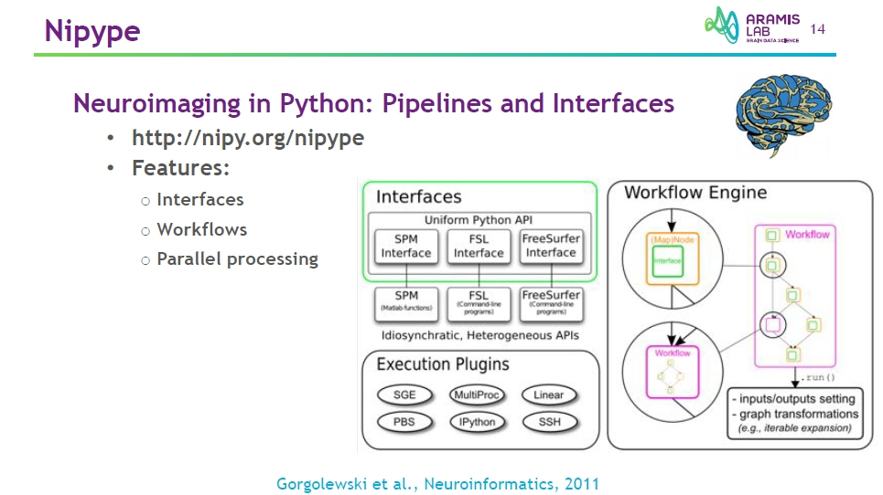
NEURO IMAGING DATA PRE-PROCESSING LIBRARY [ Nipype ]

Slide 6
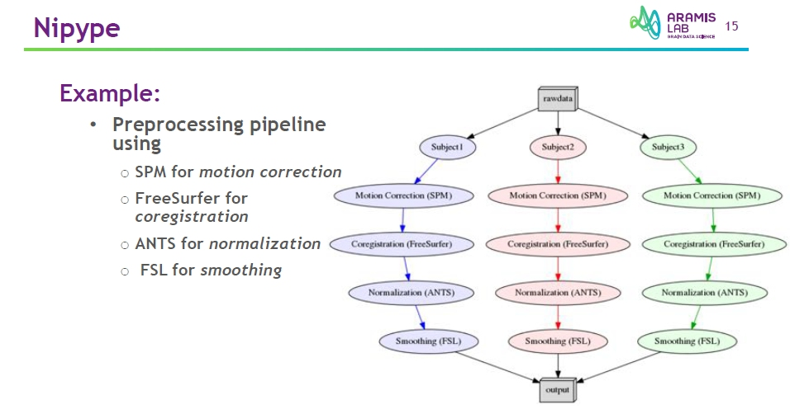
NEURO IMAGING DATA PRE-PROCESSING LIBRARY [ Nipype ]

Slide 7
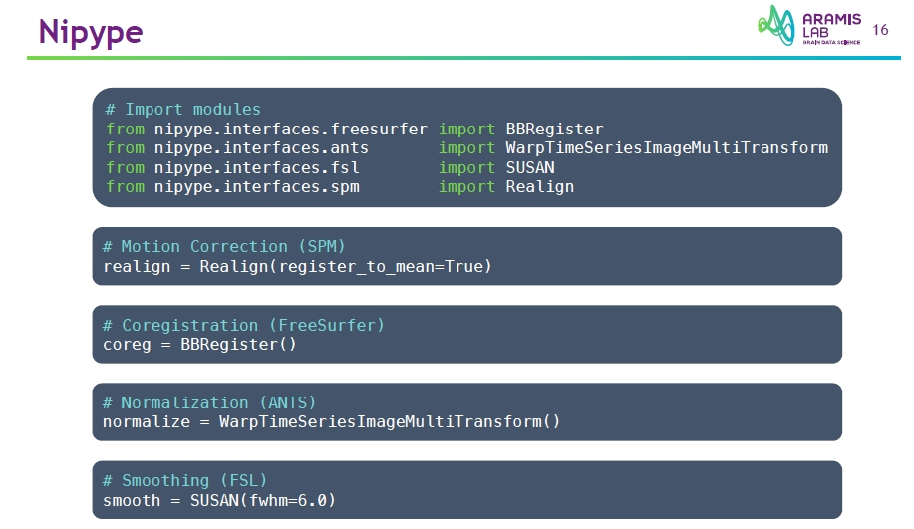
NEURO IMAGING DATA PRE-PROCESSING LIBRARY [ Nipype ]

Slide 8
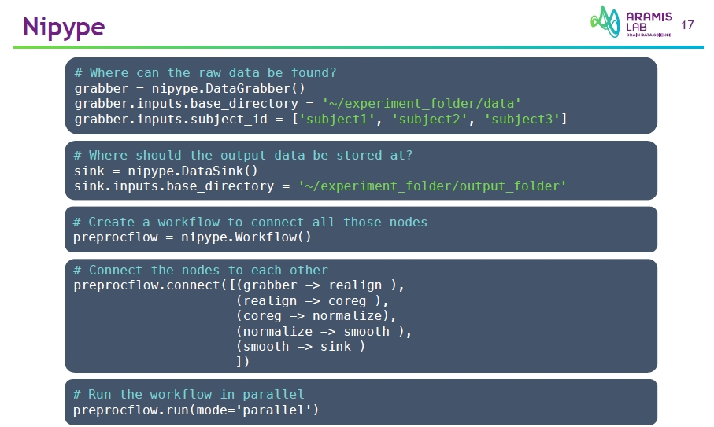
NEURO IMAGING DATA PRE-PROCESSING LIBRARY [ Nipype ]

Slide 9
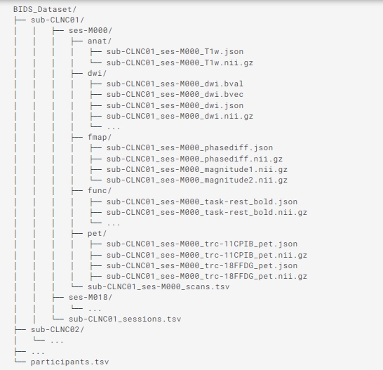
NEURO IMAGING DATA PRE-PROCESSING STRUCTURE

Slide 10
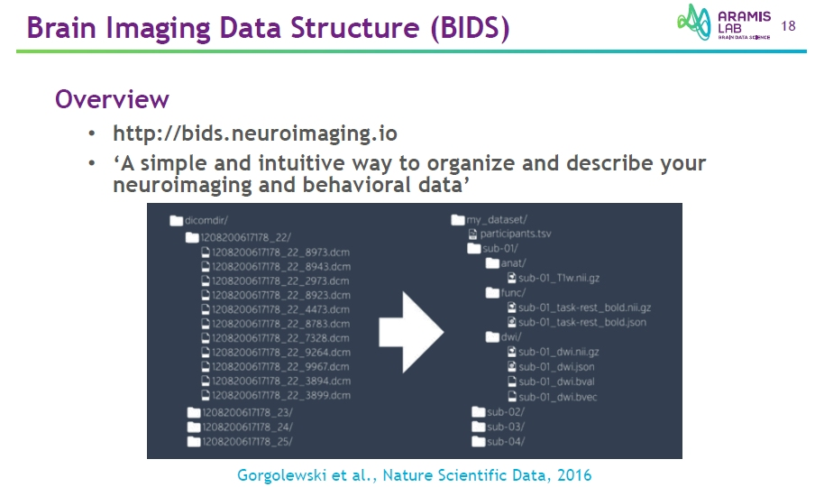

Slide 11
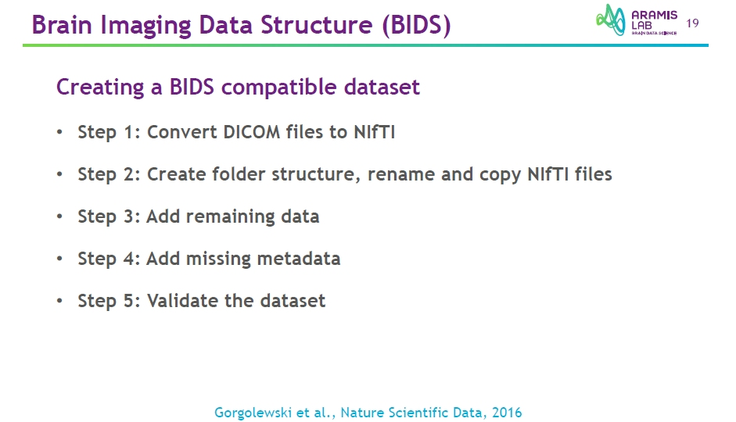

Slide 12
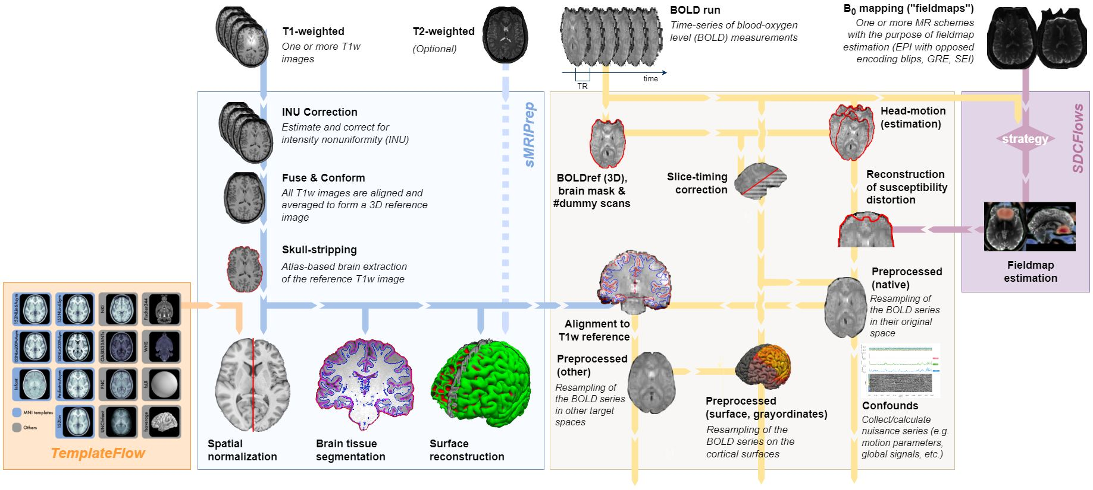
NEURO IMAGING DATA PRE-PROCESSING PIPELINES [ fMRIPrep ]

Slide 13
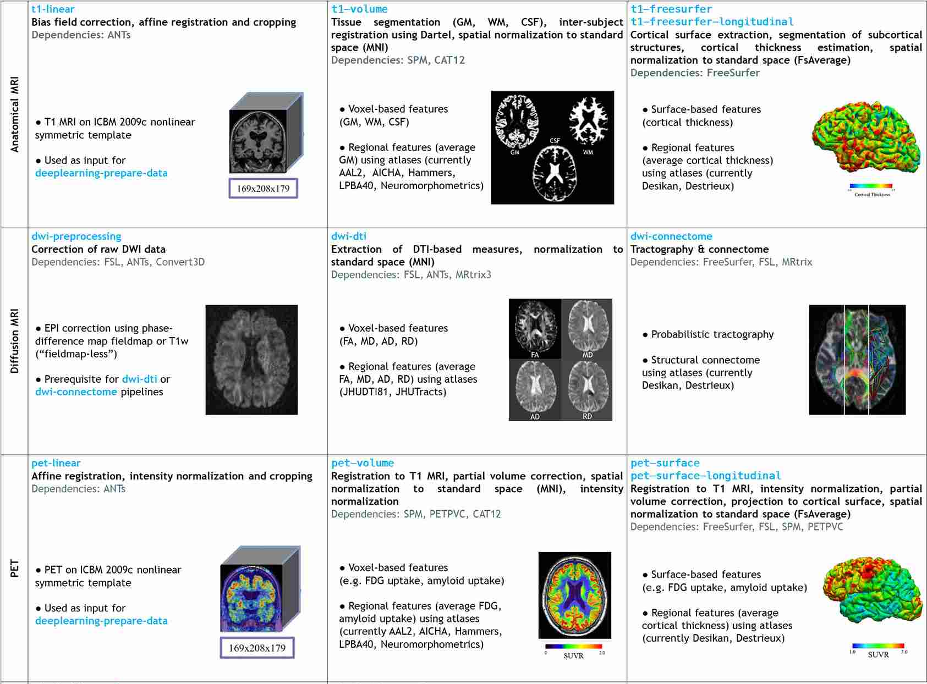
NEURO IMAGING DATA PRE-PROCESSING PIPELINES [ Clinica ]

Slide 14
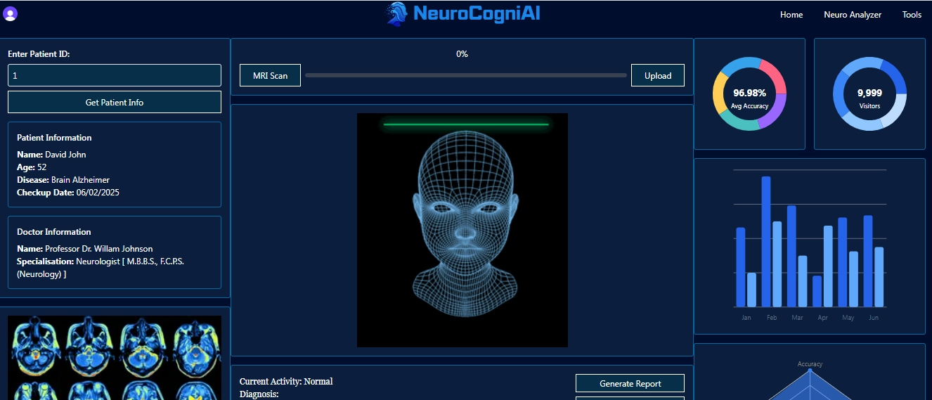
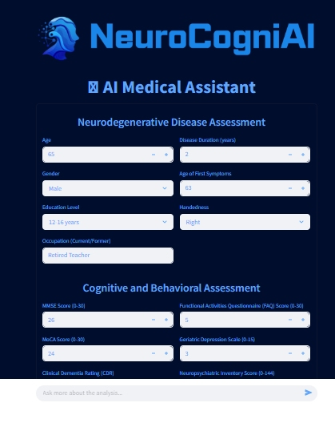
NEUROCOGNI AI MODELS & TOOLKIT

Slide 15
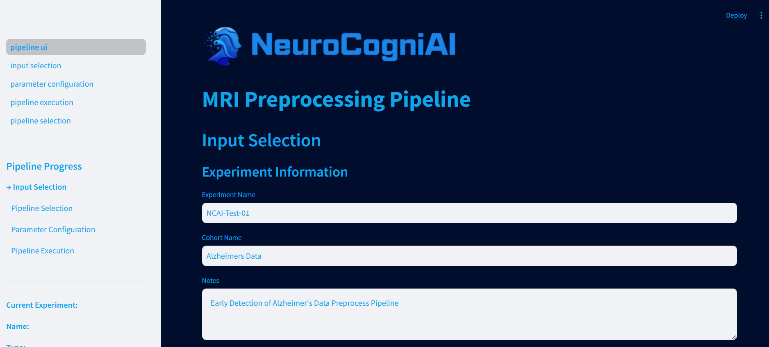
NEUROCOGNI AI PREPROCESSING TOOLKIT

Slide 16
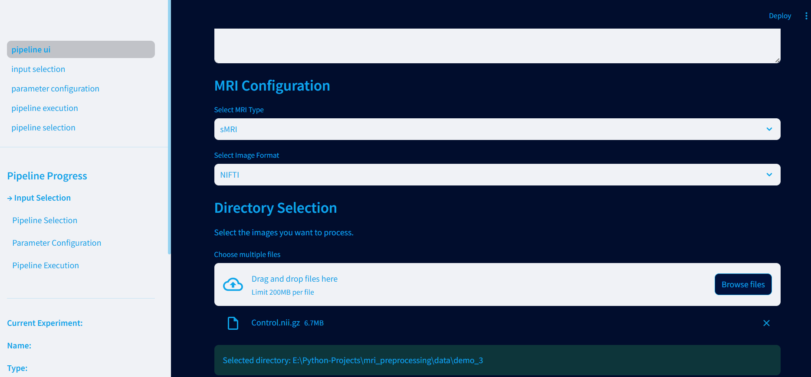
NEUROCOGNI AI PREPROCESSING TOOLKIT

Slide 17
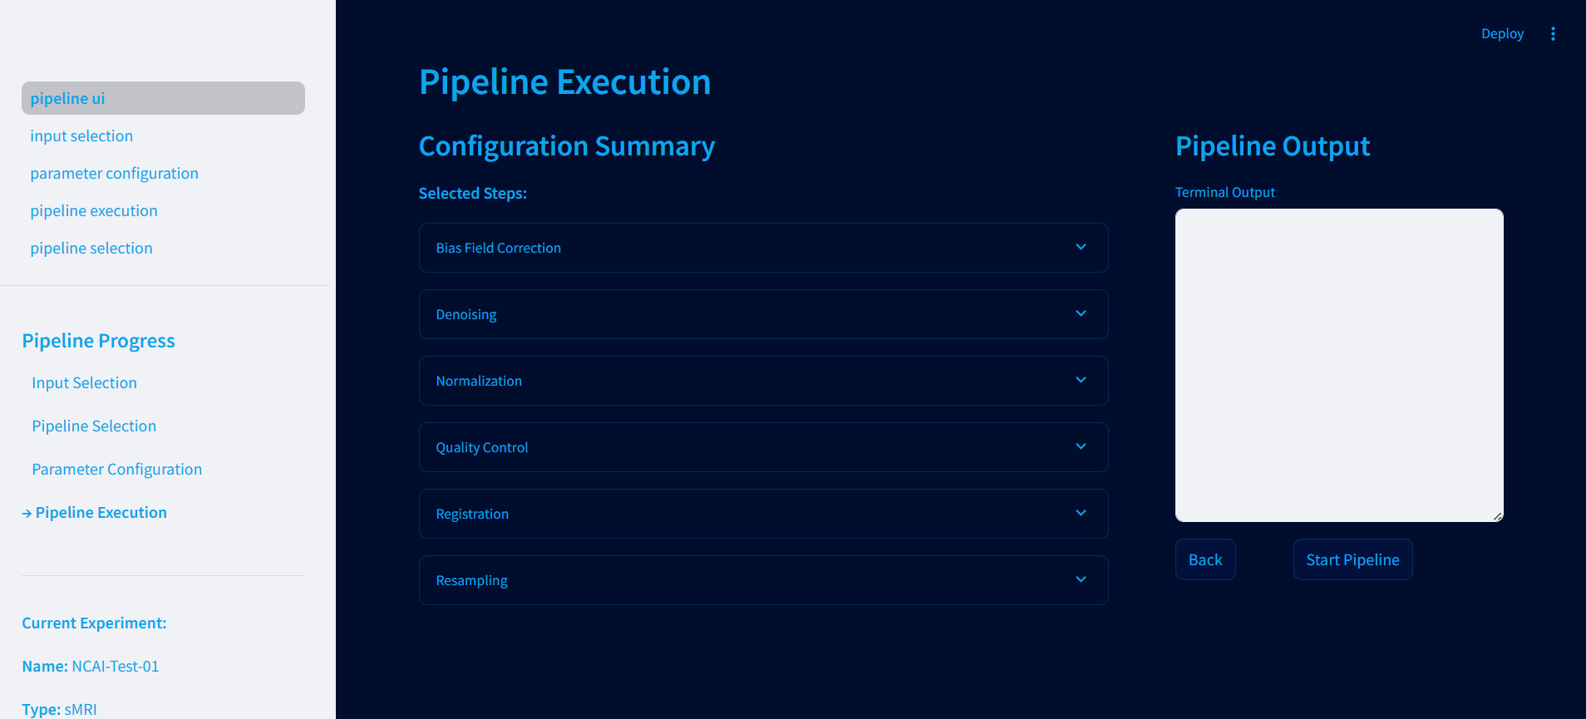
NEUROCOGNI AI PREPROCESSING TOOLKIT

Slide 18
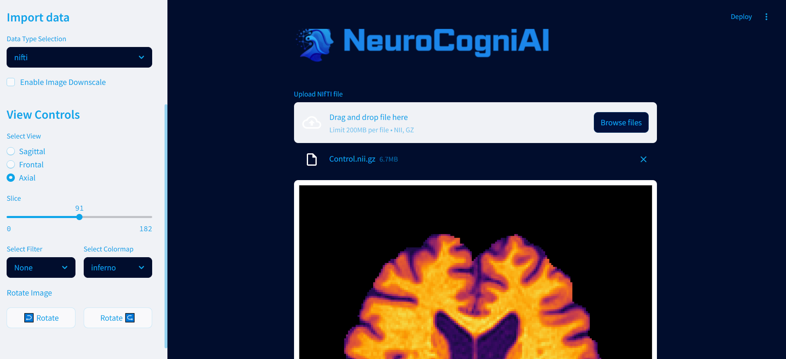
NEUROCOGNI AI MRI 3D VIEWER

Slide 19
