Slide 1

ARTIFICIAL INTELLIGENCE IN DEEP LEARNING / GENERATIVE / AGENTIC AI MODELS

Slide 2


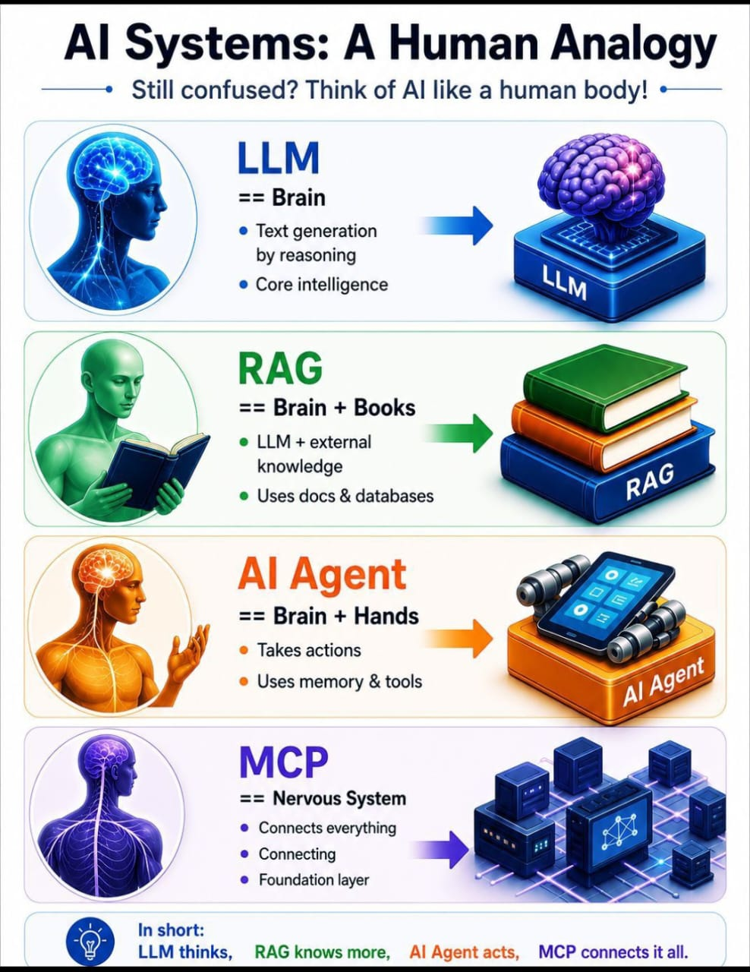

AI SYSTEMS ARCHITECTURE

Slide 3
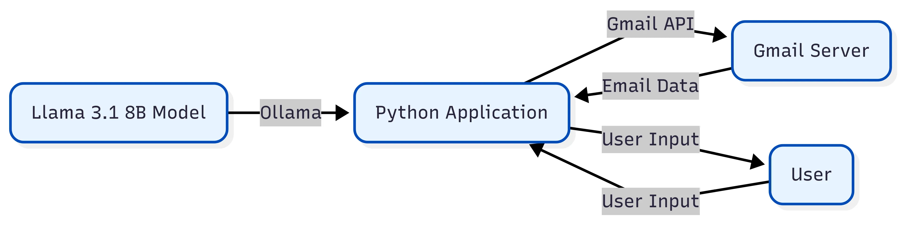
OLLAMA SERVER ARCHITECTURE

Slide 4
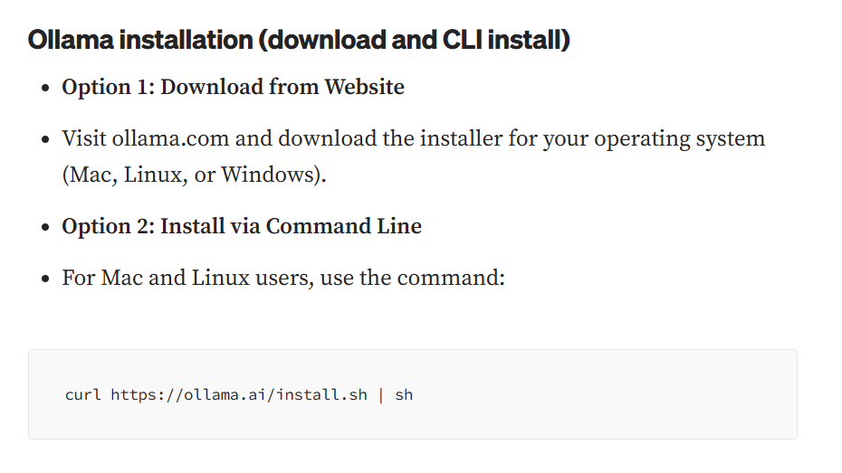
https://www.glukhov.org/llm-hosting/ollama/ollama-cheatsheet/
OLLAMA SERVER INSTALLATION GUIDE
CHEAT SHEET:

Slide 5
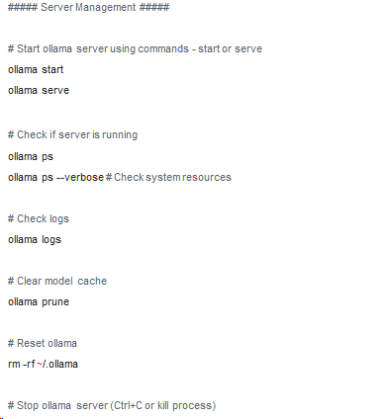
OLLAMA SERVER CHEAT SHEET

Slide 6
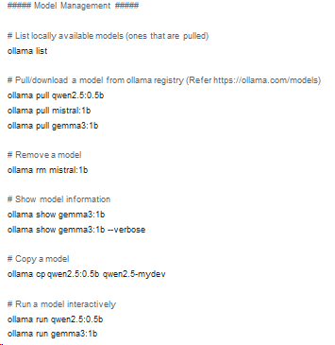
OLLAMA SERVER CHEAT SHEET

Slide 7
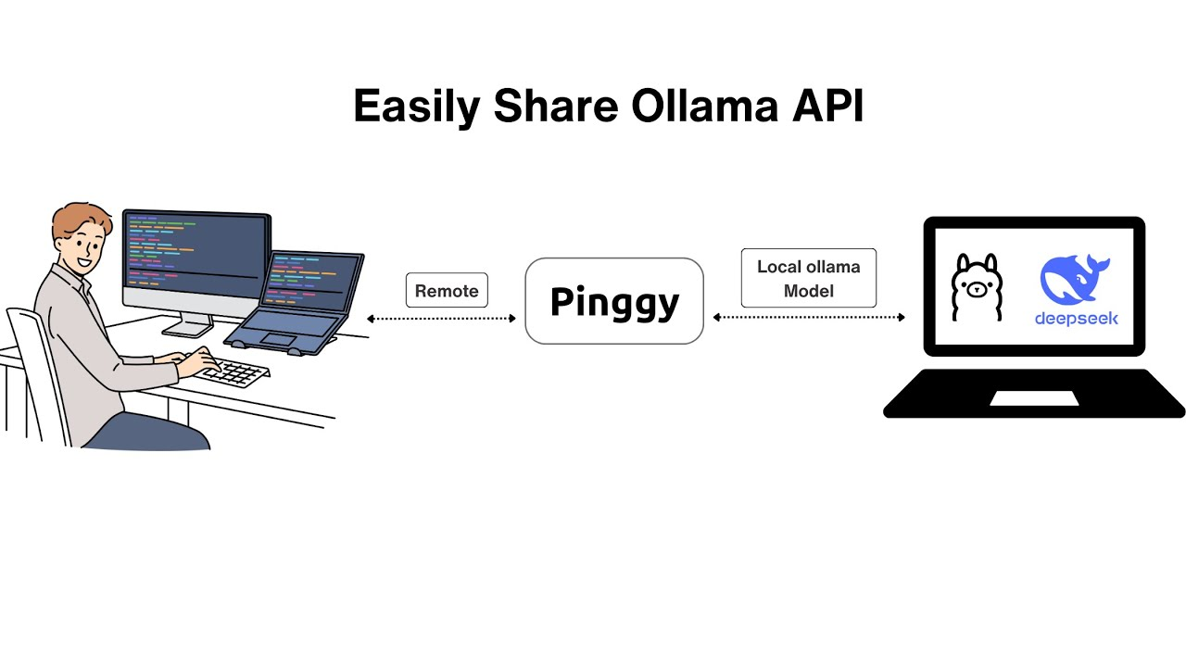
OLLAMA SERVER ARCHITECTURE

