Slide 1

ARTIFICIAL INTELLIGENCE IN DEEP LEARNING / GENERATIVE / AGENTIC AI MODELS

Slide 2



MRI-BASED PET AMYLOID SYNTHESIS

Slide 3
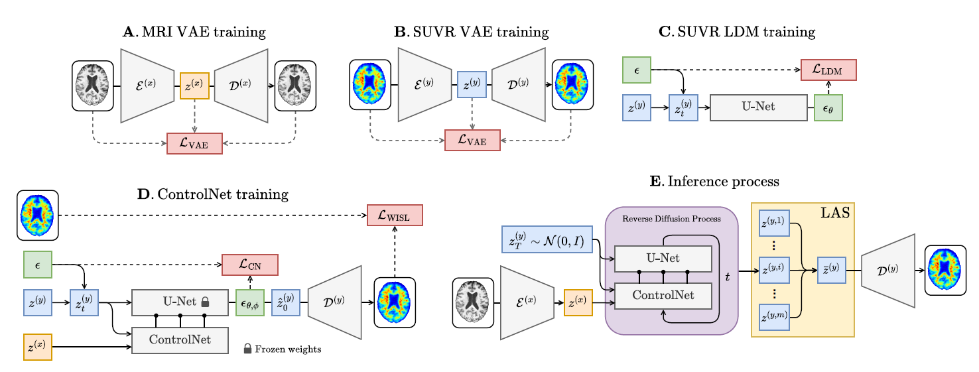
MRI-BASED PET AMYLOID SYNTHESIS

Slide 4
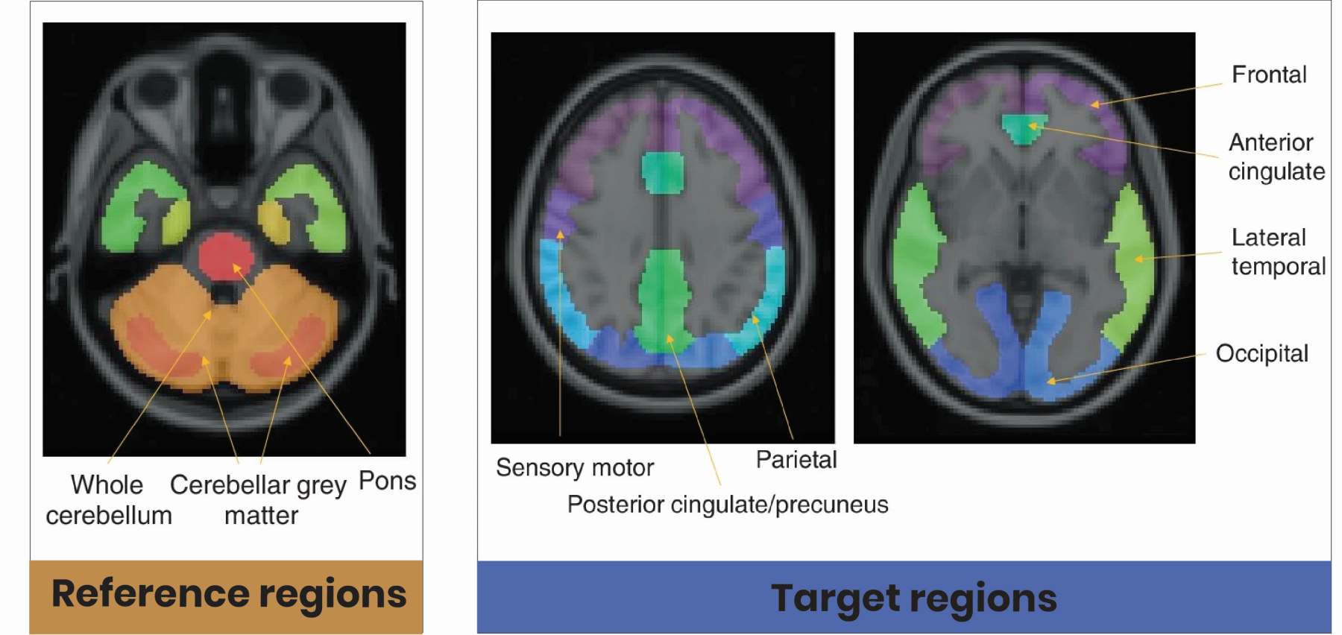
MRI-BASED PET AMYLOID SYNTHESIS & QUANTIFICATION

Slide 5
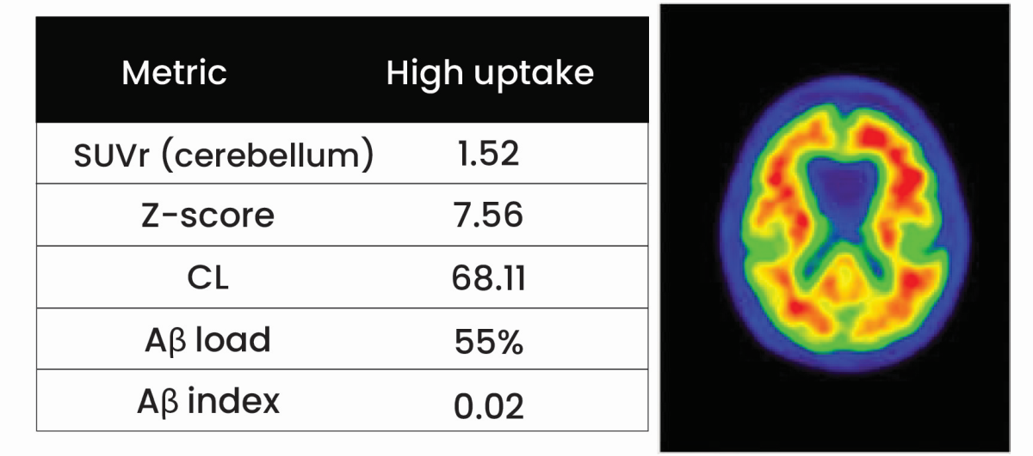
MRI-BASED PET AMYLOID SYNTHESIS & QUANTIFICATION

Slide 6
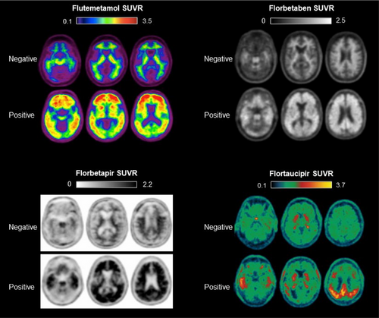
MRI-BASED PET AMYLOID SYNTHESIS & QUANTIFICATION

Slide 7
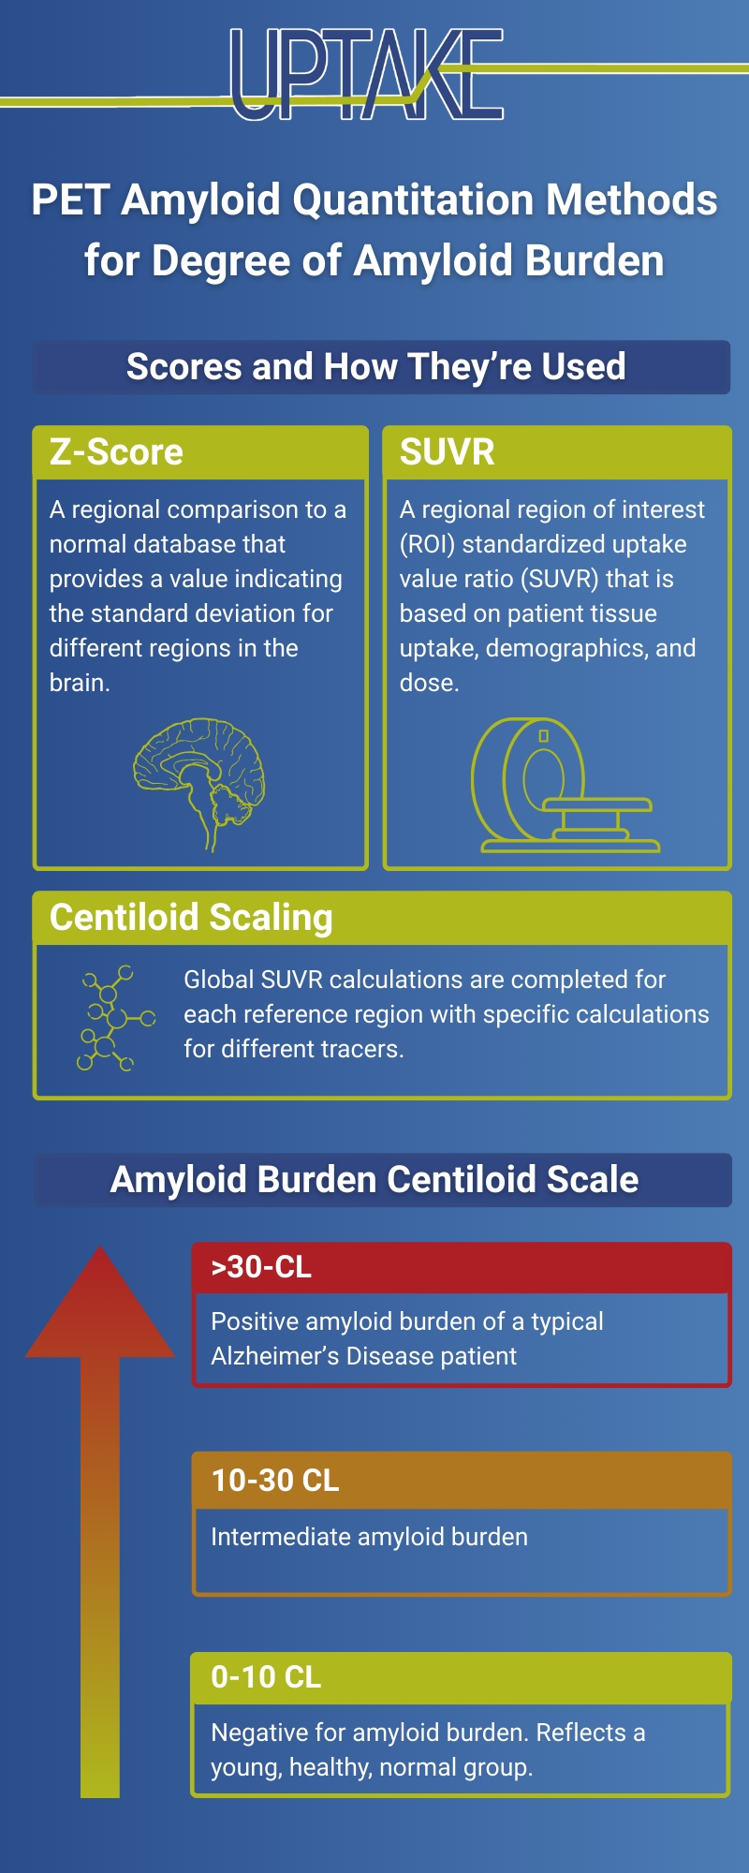
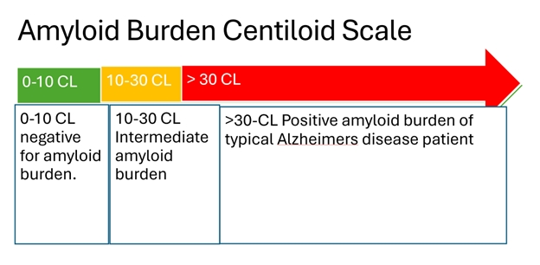
MRI-BASED PET AMYLOID QUANTIFICATION METHODS / SCALING

Slide 8
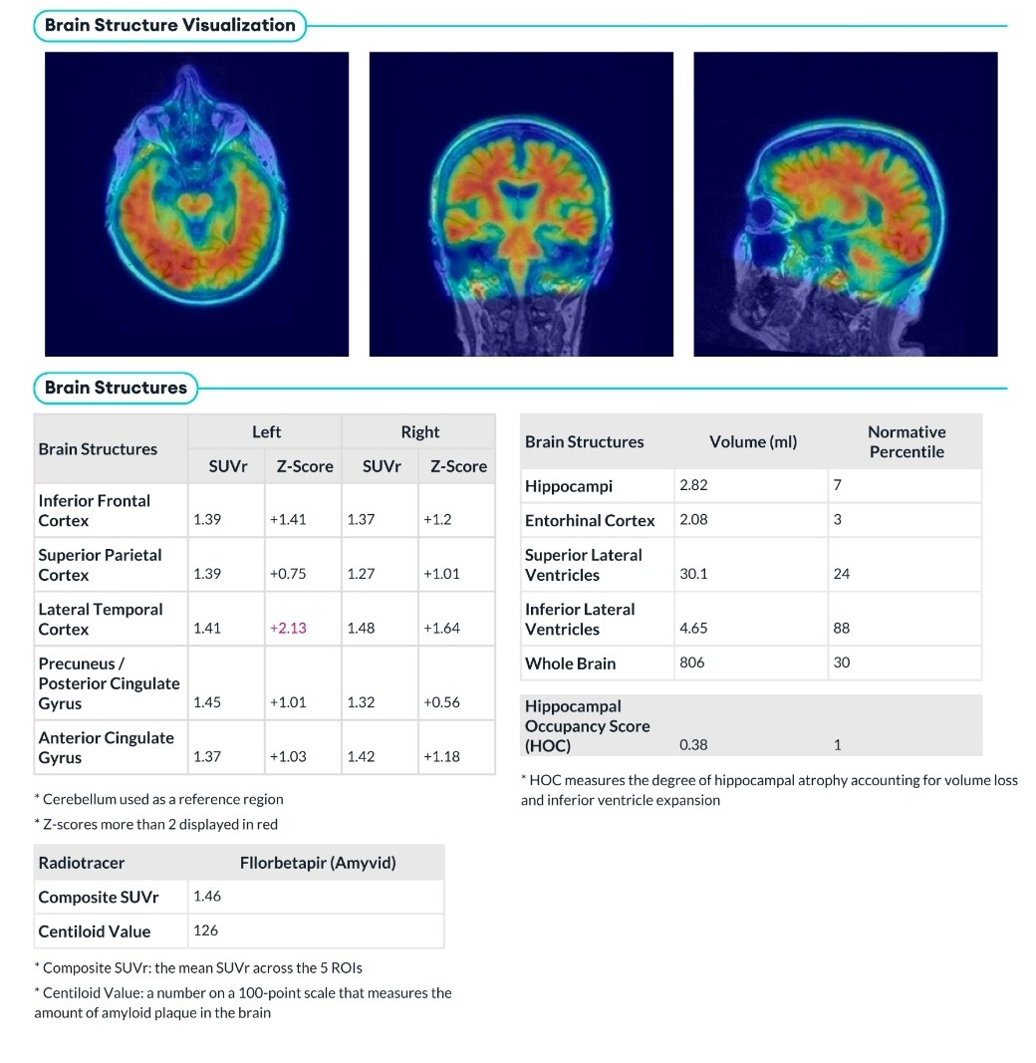
MRI-BASED PET AMYLOID QUANTIFICATION METHODS / SCALING

Slide 9
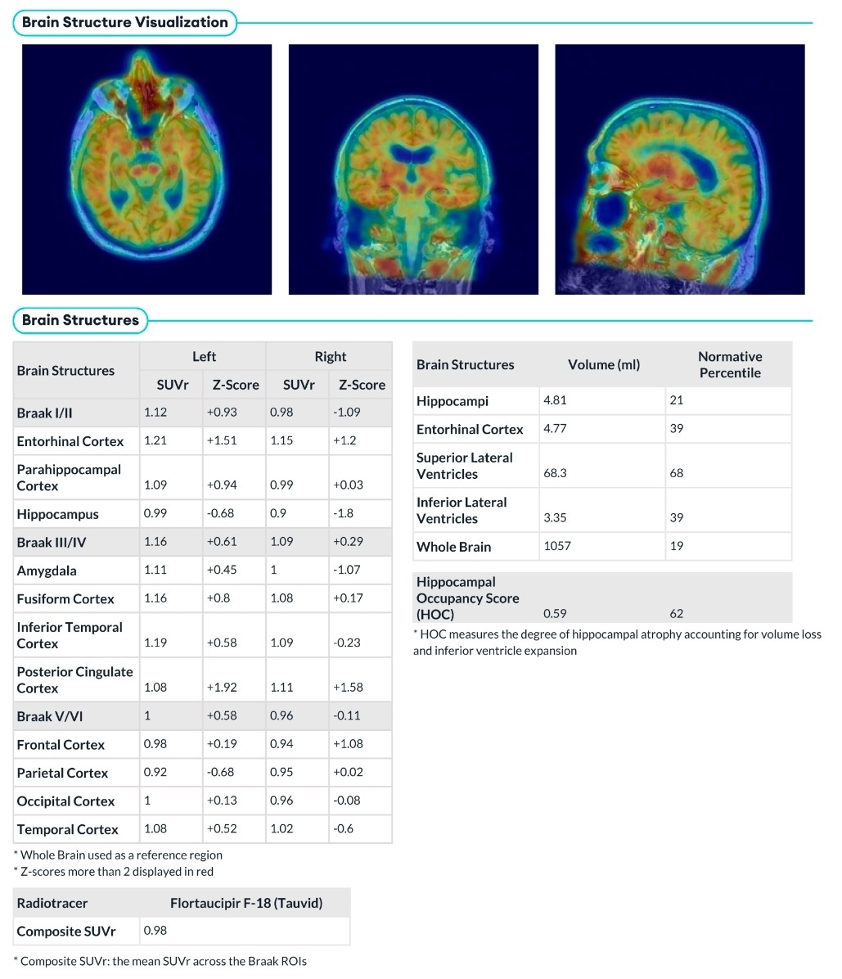
MRI-BASED PET AMYLOID QUANTIFICATION METHODS / SCALING

Slide 10
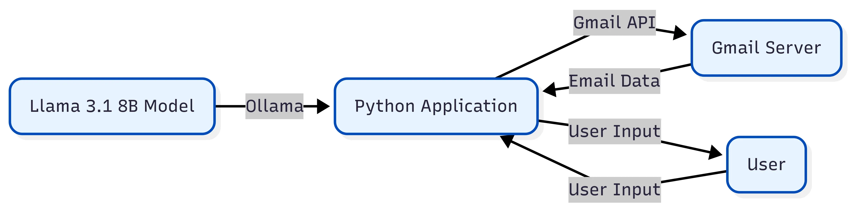
OLLAMA SERVER ARCHITECTURE

Slide 11
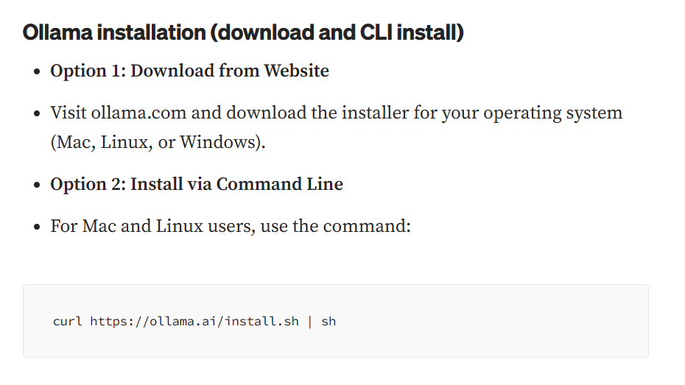
https://www.glukhov.org/llm-hosting/ollama/ollama-cheatsheet/
OLLAMA SERVER INSTALLATION GUIDE
CHEAT SHEET:

Slide 12
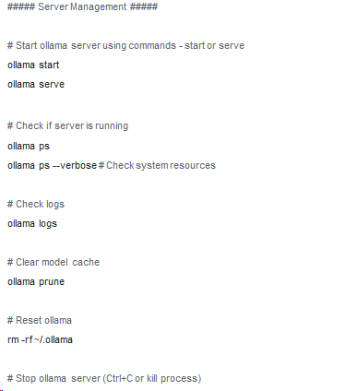
OLLAMA SERVER CHEAT SHEET

Slide 13
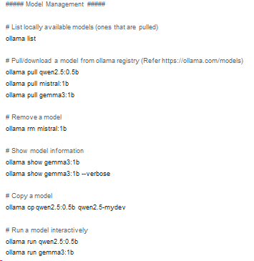
OLLAMA SERVER CHEAT SHEET

Slide 14
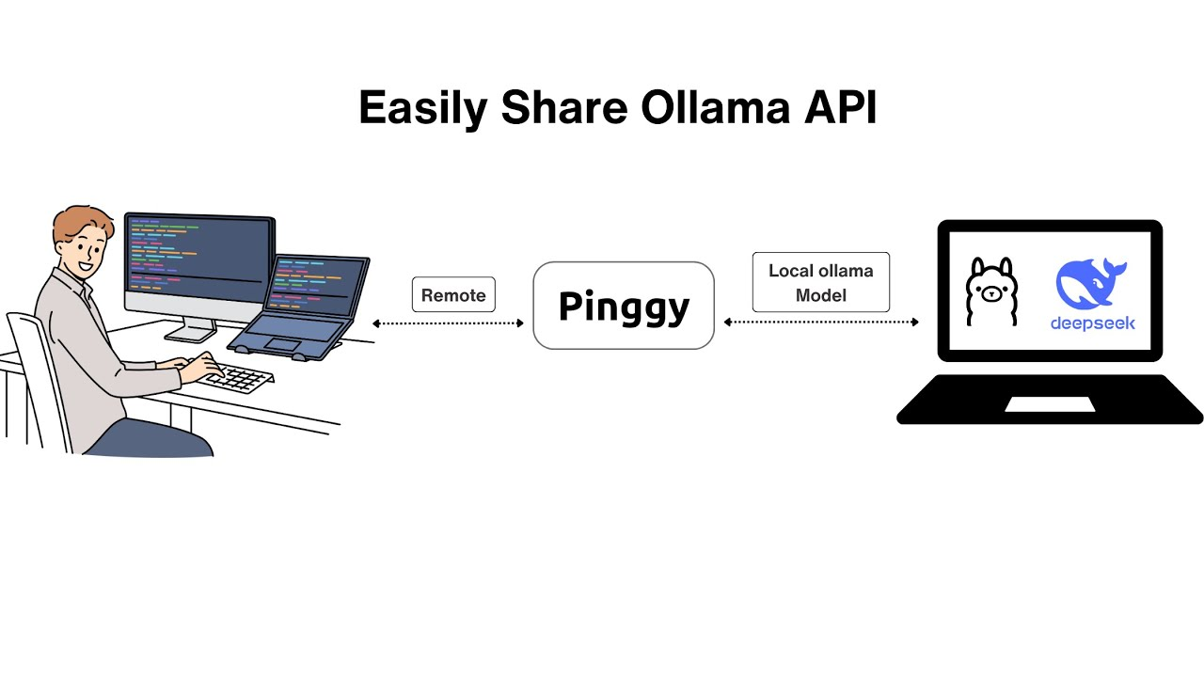
OLLAMA SERVER ARCHITECTURE

