Slide 1

DATA PRE-PROCESSING TECHNIQUES / PIPELINES FOR AI MODELS

Slide 2
NEURO IMAGING DATA PRE-PROCESSING
AGENDA ITEMS:
Converting DICOM to NIFTII Format By Using
“MRIcroGL” Voxel based Neuroimaging Tool
Pipeline for PET Amyloid, Tau Tangles & Neurodegeneration
Quantification By Using PET & MRI
Alzheimer Dataset [ADNI-4] & GAAIN For PET Amyloid, Tau
Tangles and MRI
N8N Workflow for building AI Agents

Slide 3
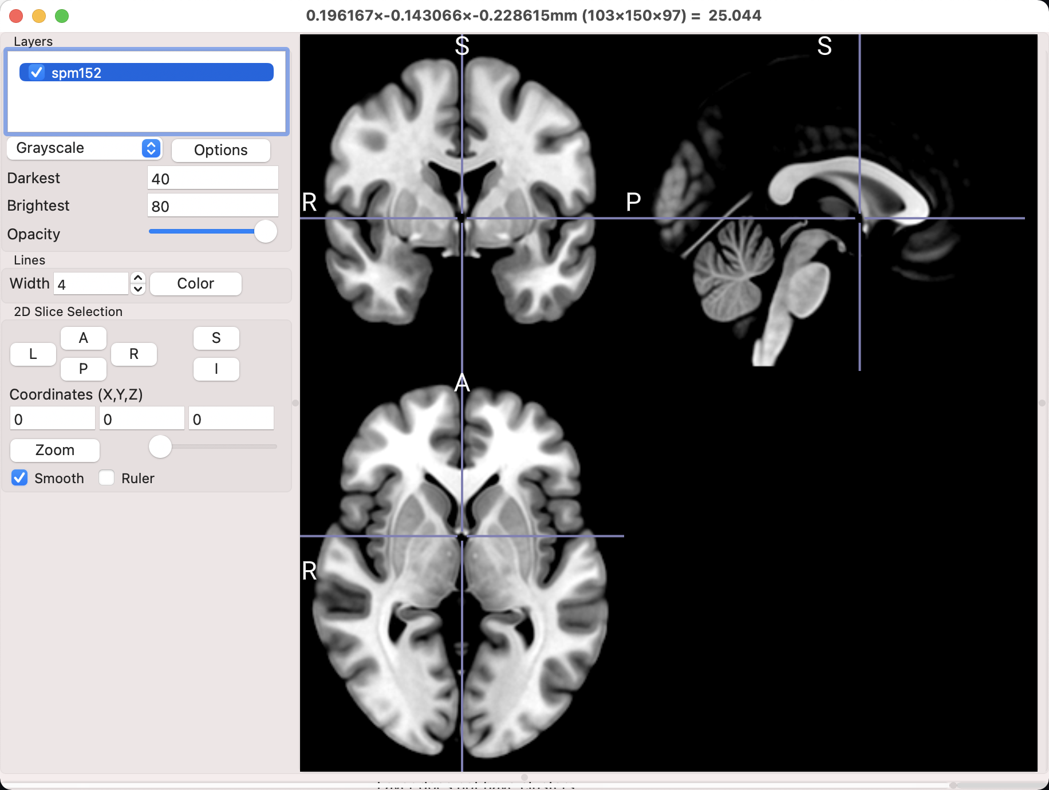

Slide 4
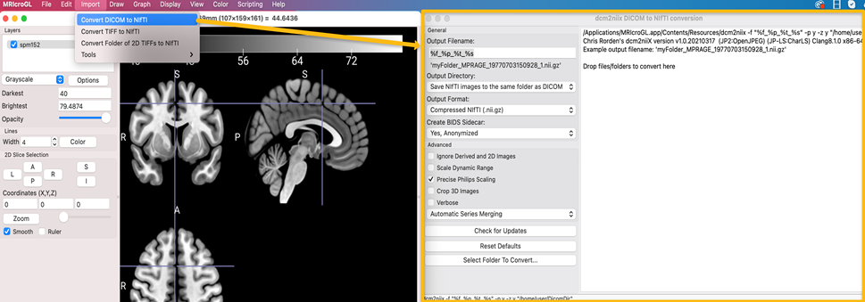

Slide 5
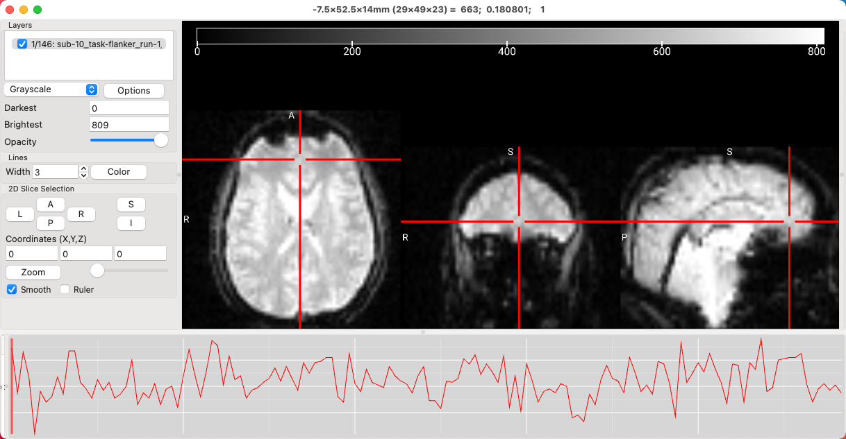

Slide 6
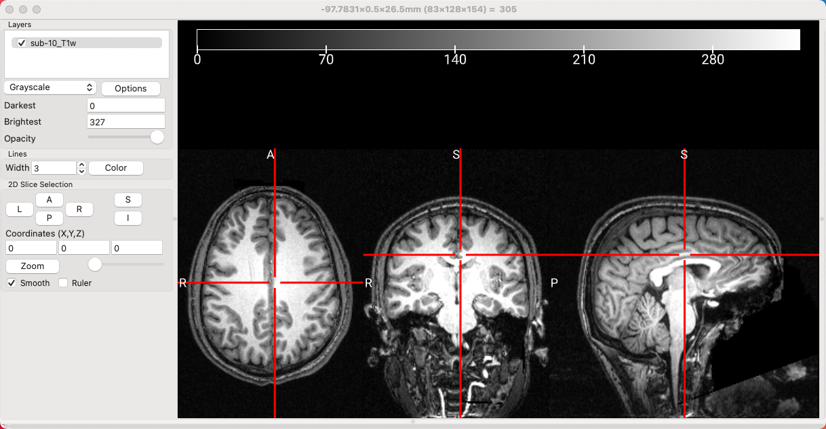

Slide 7
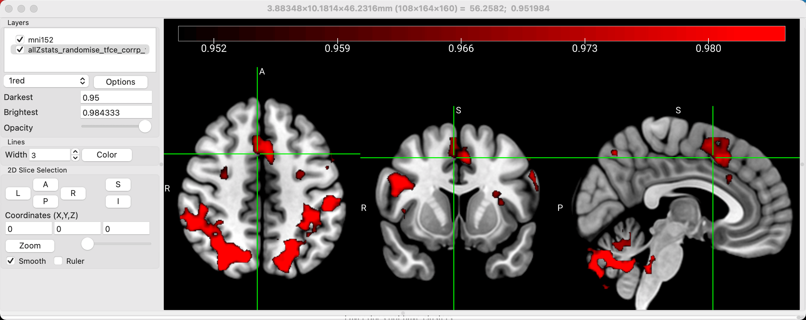

Slide 8
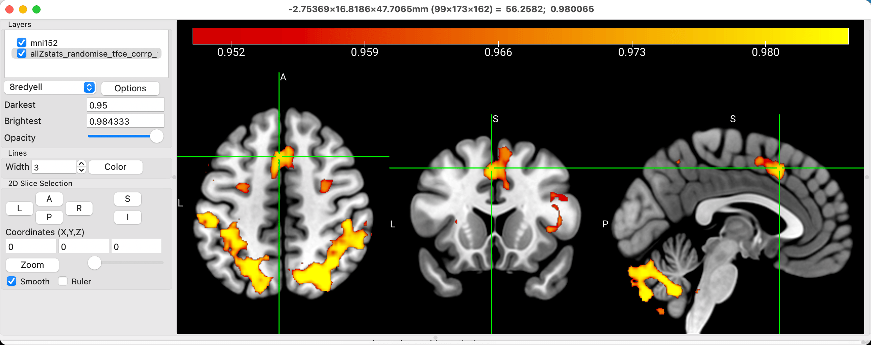

Slide 9
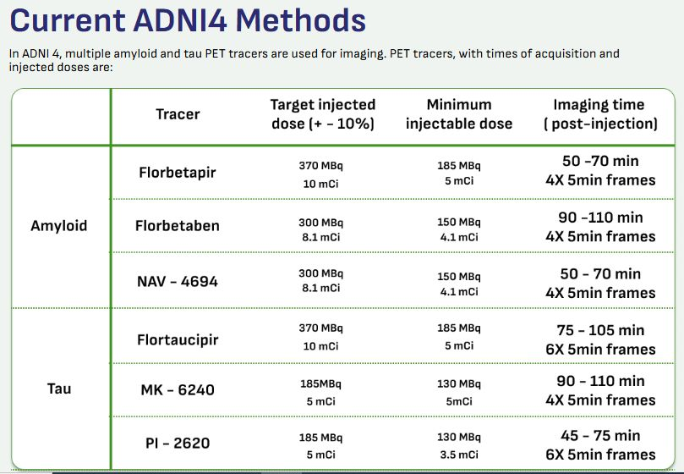
NEURO IMAGING DATASET [ADNI / GAAIN]

Slide 10
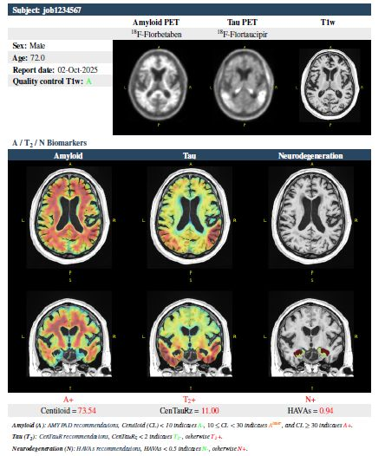

Slide 11
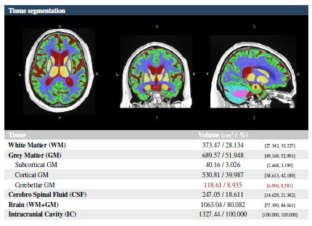

Slide 12
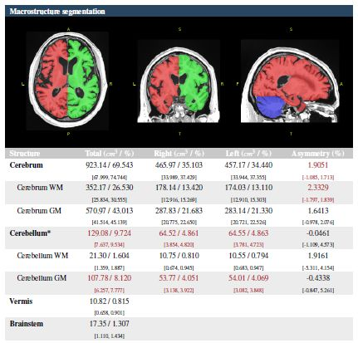

Slide 13
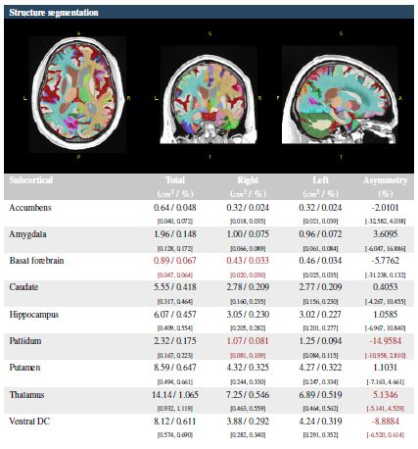

Slide 14
