Slide 1
PYTHON LIBRARIES NUMPY [NUMERICAL PYTHON]

Slide 2
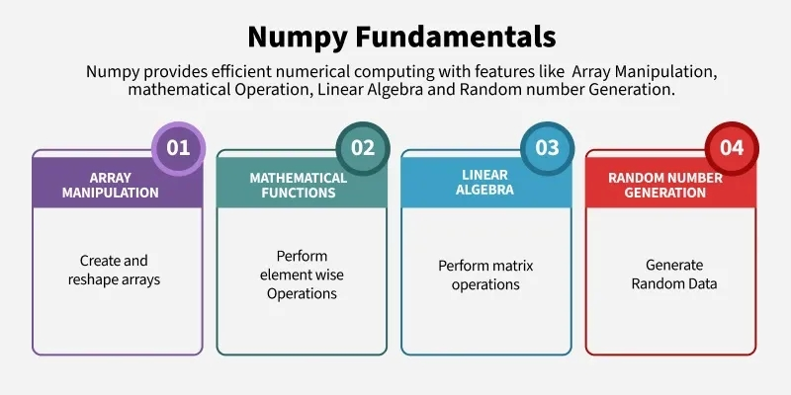
NUMPY [NUMERICAL PYTHON]

Slide 3
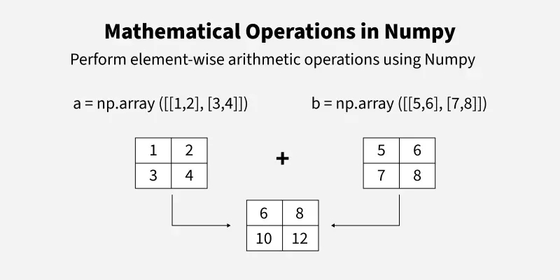
NUMPY [NUMERICAL PYTHON]

Slide 4
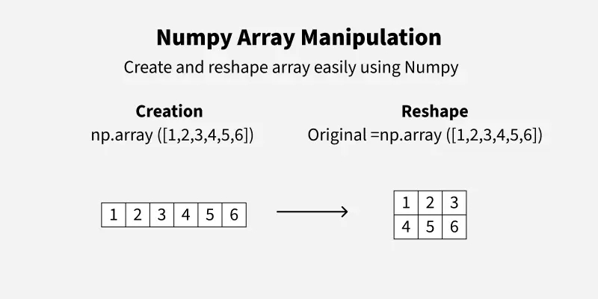
NUMPY [NUMERICAL PYTHON]

Slide 5
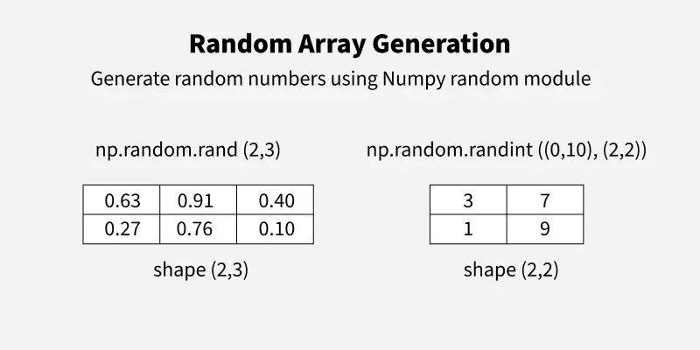
NUMPY [NUMERICAL PYTHON]

Slide 6
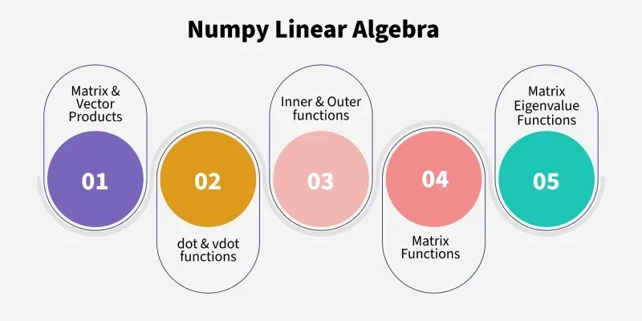
NUMPY [NUMERICAL PYTHON]

Slide 7
NUMPY [NUMERICAL PYTHON]
Numpy Package is used to perform a wide range of numerical operations, including:
Creating and manipulating arrays.
Performing element-wise and matrix operations.
Generating random numbers and statistical calculations.
Conducting linear algebra operations.
Working with Fourier transformations.
Handling missing values efficiently in datasets.
INSTALLATION:
If you have Python and PIP already installed on a system, then installation of NumPy is very easy.
Install it using this command:
pip install numpy

Slide 8
NUMPY [NUMERICAL PYTHON]
Import NumPy
import numpy as np
my_list = [1, 2, 3, 4, 5]
numpy_array = np.array(my_list)
print("Simple NumPy Array:",numpy_array)
Initialize a Python NumPy Array Using Special Functions
NumPy provides several built-in functions to generate arrays with specific properties.
np.zeros(): Creates an array filled with zeros.
np.ones(): Creates an array filled with ones.
np.full(): Creates an array filled with a specified value.
np.arange(): Creates an array with values that are evenly spaced within a given range.
np.linspace(): Creates an array with values that are evenly spaced over a specified interval.

Slide 9
NUMPY [NUMERICAL PYTHON]
import numpy as np
zeros_array = np.zeros((2, 3))
ones_array = np.ones((3, 3))
constant_array = np.full((2, 2), 7)
range_array = np.arange(0, 10, 2) # start, stop, step
linspace_array = np.linspace(0, 1, 5) # start, stop, num
print("Zero Array:","\n",zeros_array)
print("Ones Array:","\n",ones_array)
print("Constant Array:","\n",constant_array)
print("Range Array:","\n",range_array)
print("Linspace Array:","\n",linspace_array)

Slide 10
NUMPY [NUMERICAL PYTHON]
Create Python Numpy Arrays Using Random Number Generation
NumPy provides functions to create arrays filled with random numbers.
np.random.rand(): Creates an array of specified shape and fills it with random values sampled from a uniform distribution over [0, 1).
np.random.randn(): Creates an array of specified shape and fills it with random values sampled from a standard normal distribution.
np.random.randint(): Creates an array of specified shape and fills it with random integers within a given range.
import numpy as np
random_array = np.random.rand(2, 3)
normal_array = np.random.randn(2, 2)
randint_array = np.random.randint(1, 10, size=(2, 3))
print(random_array)
print(normal_array)
print(randint_array)

Slide 11
NUMPY [NUMERICAL PYTHON]
Create Python Numpy Arrays Using Matrix Creation Routines
NumPy provides functions to create specific types of matrices.
np.eye(): Creates an identity matrix of specified size.
np.diag(): Constructs a diagonal array.
np.zeros_like(): Creates an array of zeros with the same shape and type as a given array.
np.ones_like(): Creates an array of ones with the same shape and type as a given array.
import numpy as np
identity_matrix = np.eye(3)
diagonal_array = np.diag([1, 2, 3])
zeros_like_array = np.zeros_like(diagonal_array)
ones_like_array = np.ones_like(diagonal_array)
print(identity_matrix)
print(diagonal_array)
print(zeros_like_array)
print(ones_like_array)

Slide 12
NUMPY [NUMERICAL PYTHON]
Numpy Array Indexing
Array Indexing in NumPy is used to access or modify specific elements of an array. It allows to retrieve data from arrays by specifying the positions (indices) of elements.
Accessing 1D Array
import numpy as np
# Create a 1D NumPy array with five elements
arr = np.array([10, 20, 30, 40, 50])
# Access and print the first element of the array
print(arr[0])
Access 2-D Array
import numpy as np
# Define a 2D array
matrix = np.array([[1, 2, 3], [4, 5, 6], [7, 8, 9]])
# Access the element at row 1, column 2
print(matrix[1, 2])

Slide 13
NUMPY [NUMERICAL PYTHON]
Accessing 3D Arrays
A 3D array can be visualized as a stack of 2D arrays. We need three indices:
Depth: Specifies the 2D slice.
Row: Specifies the row within the slice.
Column: Specifies the column within the row.
import numpy as np
cube = np.array([[[1, 2, 3],
[4, 5, 6],
[7, 8, 9]],
[[10, 11, 12],
[13, 14, 15],
[16, 17, 18]]])
# Access the element at depth 1, row 2, column 0
print(cube[1, 2, 0])

Slide 14
NUMPY [NUMERICAL PYTHON]
Slicing Arrays
We can extract a subset of elements using the start:stop:step syntax:
import numpy as np
# Create a 1D NumPy array with six elements
arr = np.array([0, 1, 2, 3, 4, 5])
# Use slicing to access a subset of the array
print(arr[1:4])
For multidimensional arrays, slicing can be applied to each dimension:.
import numpy as np
# Create a 2D NumPy array (matrix) with three rows and three columns
matrix = np.array([[1, 2, 3], [4, 5, 6], [7, 8, 9]])
# Use slicing to extract a submatrix
print(matrix[0:2, 1:3])

Slide 15
NUMPY [NUMERICAL PYTHON]
Check Number of Dimensions?
NumPy Arrays provides the ndim attribute that returns an integer that tells us how many dimensions the array have.
import numpy as np a = np.array(42) b = np.array([1, 2, 3, 4, 5]) c = np.array([[1, 2, 3], [4, 5, 6]]) d = np.array([[[1, 2, 3], [4, 5, 6]], [[1, 2, 3], [4, 5, 6]]]) print(a.ndim) print(b.ndim) print(c.ndim) print(d.ndim)

