Slide 1

NEUROIMAGING LLM MODEL / AGENT – DRIVEN IDE FOR AI INTERPREATION & BUILDING AI APPS

Slide 2
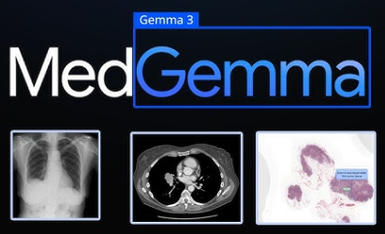
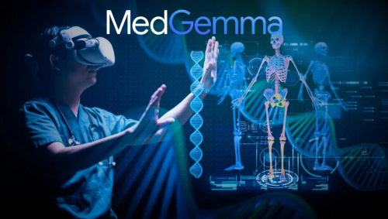
NEUROIMAGING MRI / FMRI / CT SCAN / X-RAYS INTERPRETATION

Slide 3
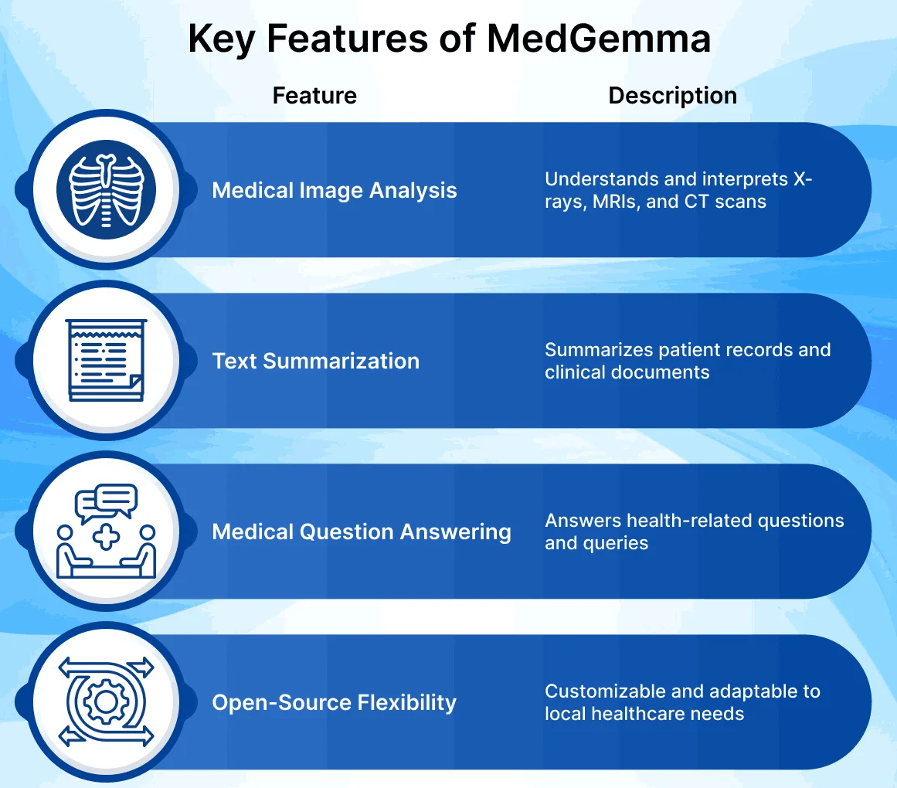
NEUROIMAGING MRI / FMRI / CT SCAN / X-RAYS INTERPRETATION

Slide 4
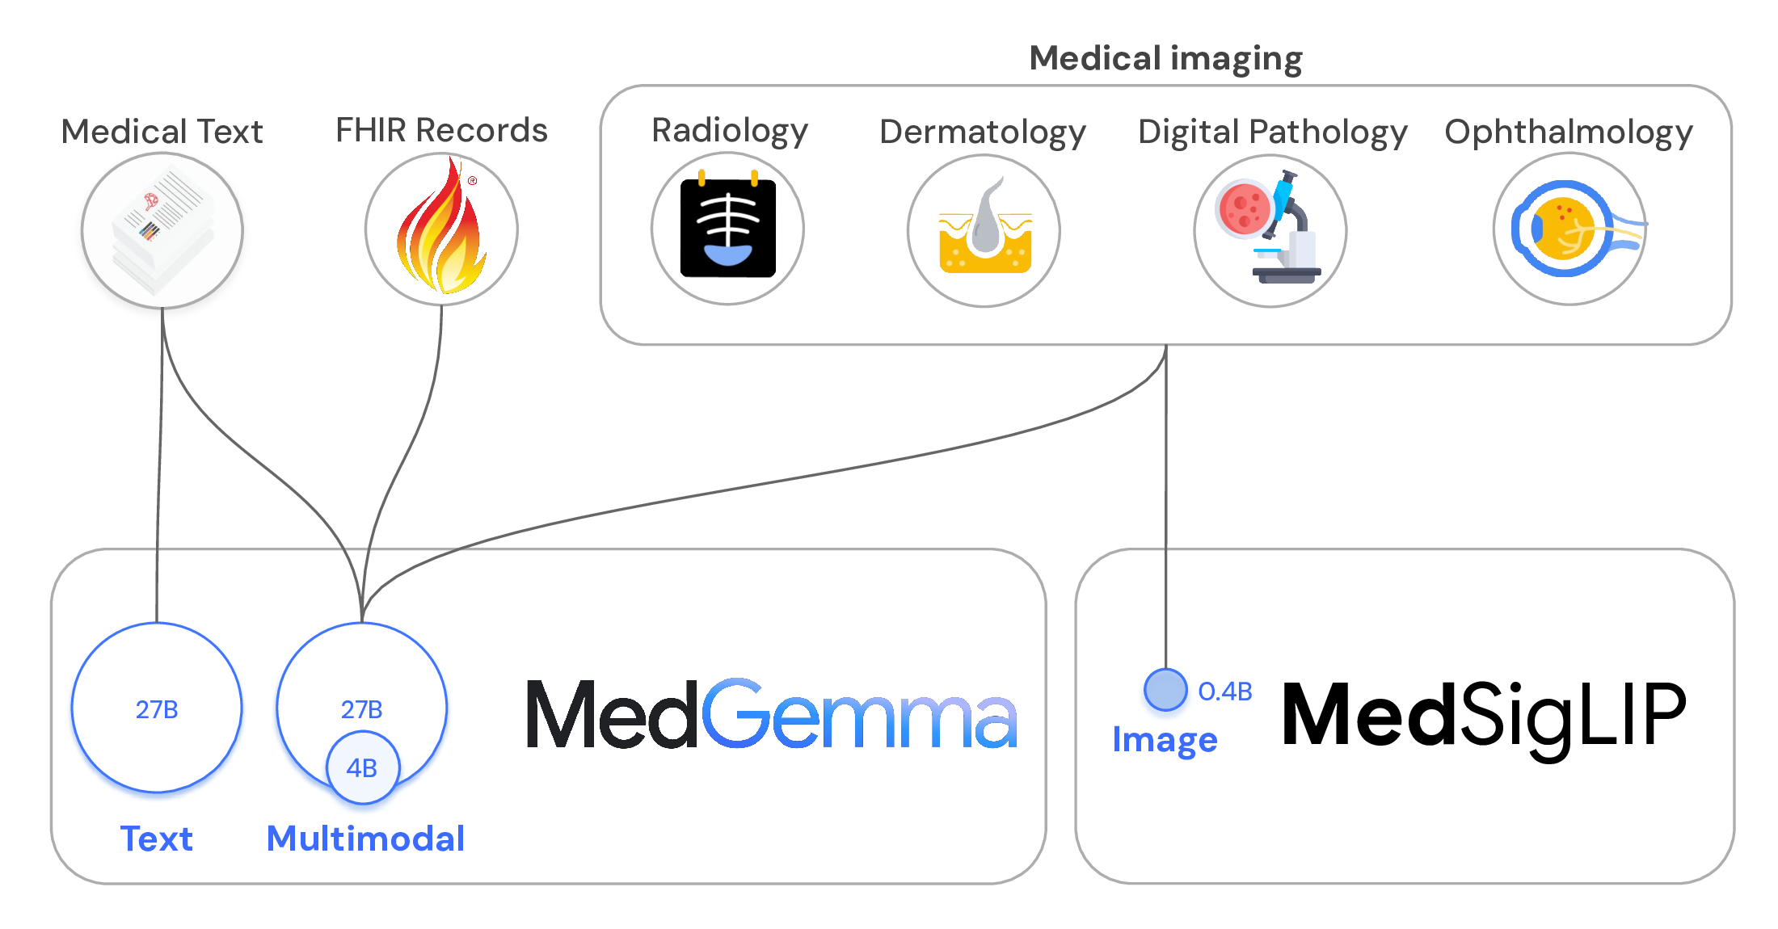
NEUROIMAGING MRI / FMRI / CT SCAN / X-RAYS INTERPRETATION

Slide 5
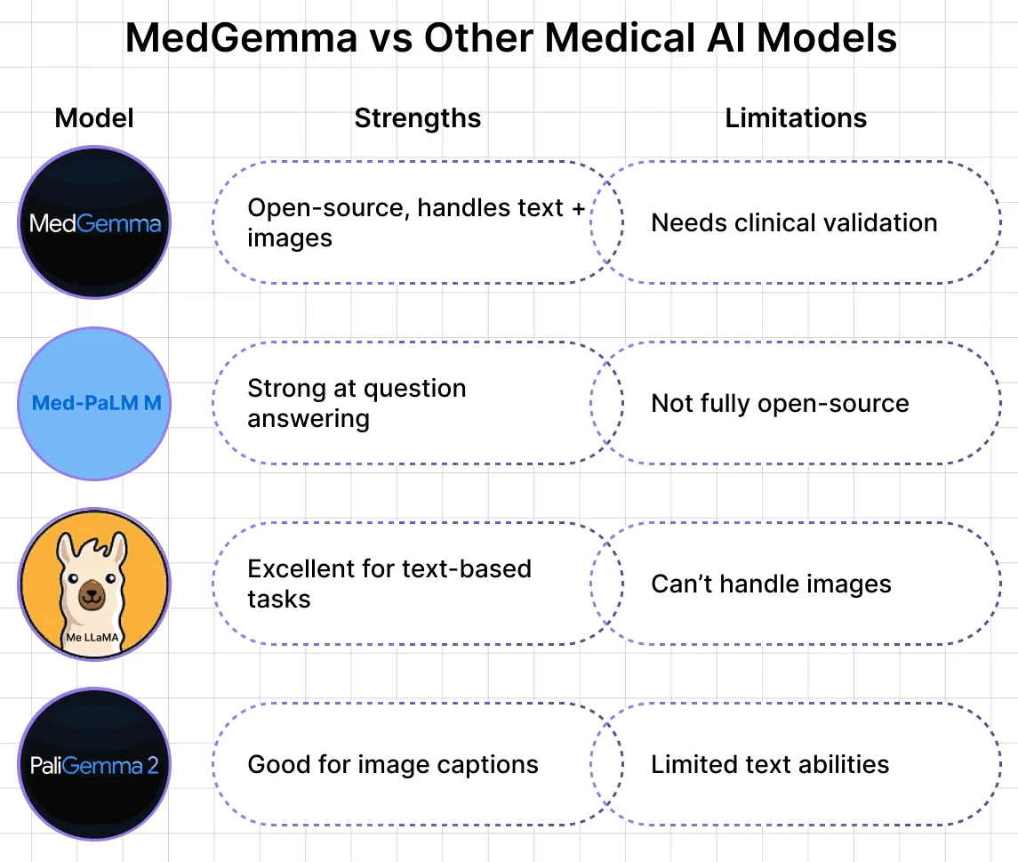
NEUROIMAGING MRI / FMRI / CT SCAN / X-RAYS INTERPRETATION

Slide 6
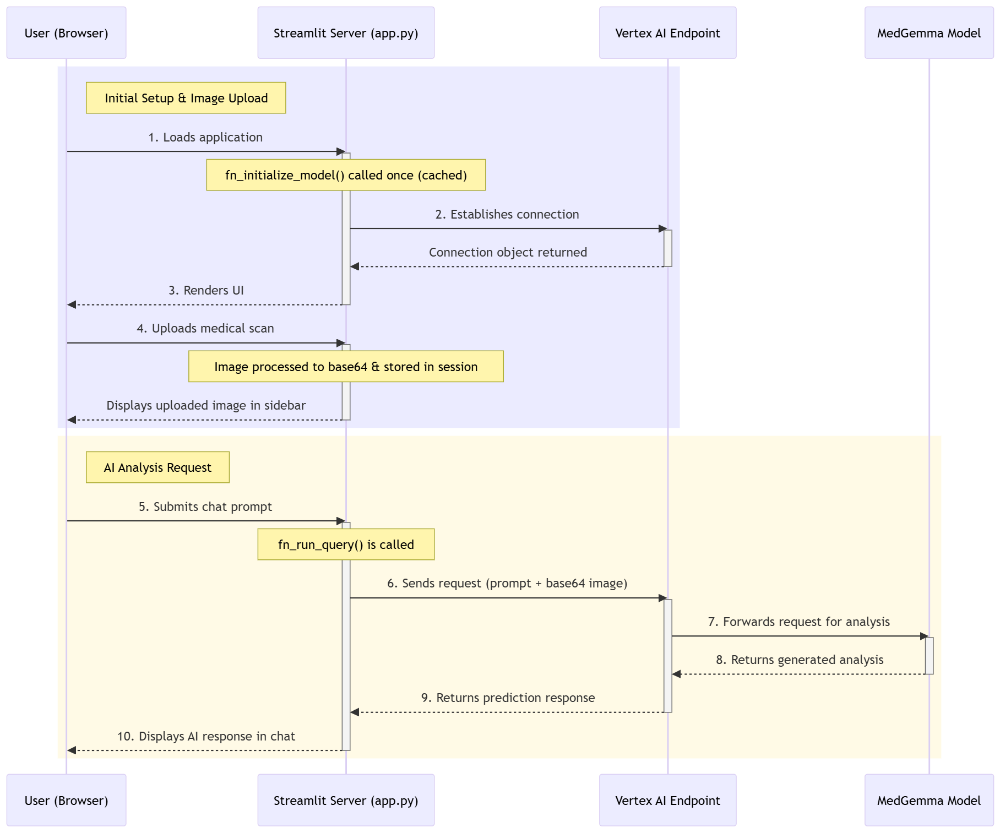
NEUROIMAGING MRI / FMRI / CT SCAN / X-RAYS INTERPRETATION

Slide 7
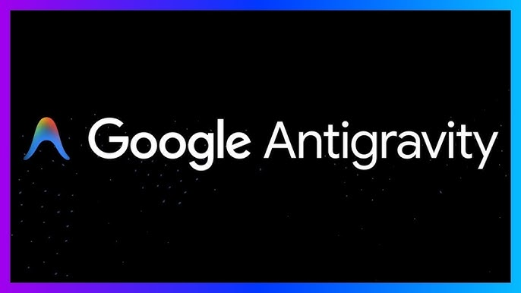
GOOGLE ANTIGRAVITY [AGENT – DRIVEN ] IDE

Slide 8
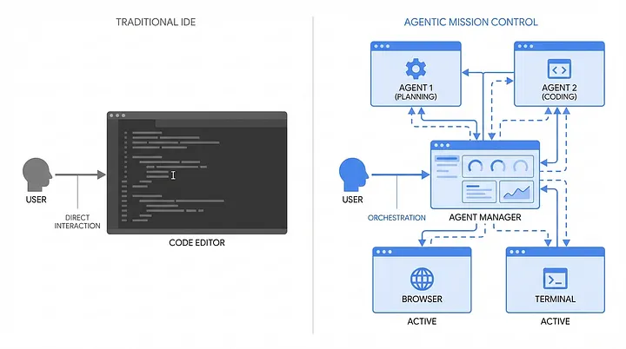
GOOGLE ANTIGRAVITY [AGENT – DRIVEN ] IDE

Slide 9
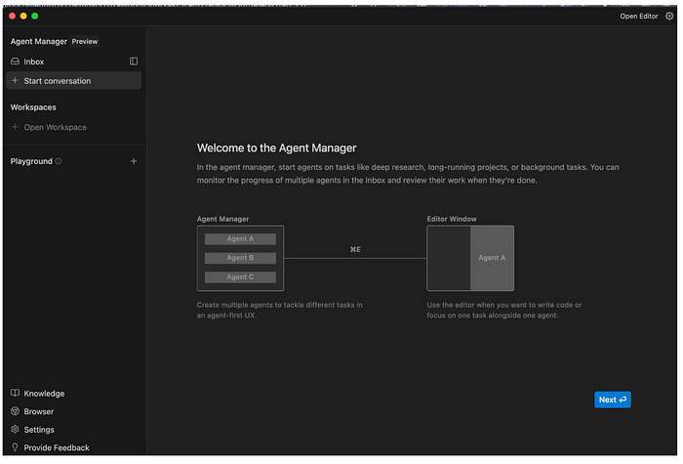
GOOGLE ANTIGRAVITY [AGENT – DRIVEN ] IDE

Slide 10
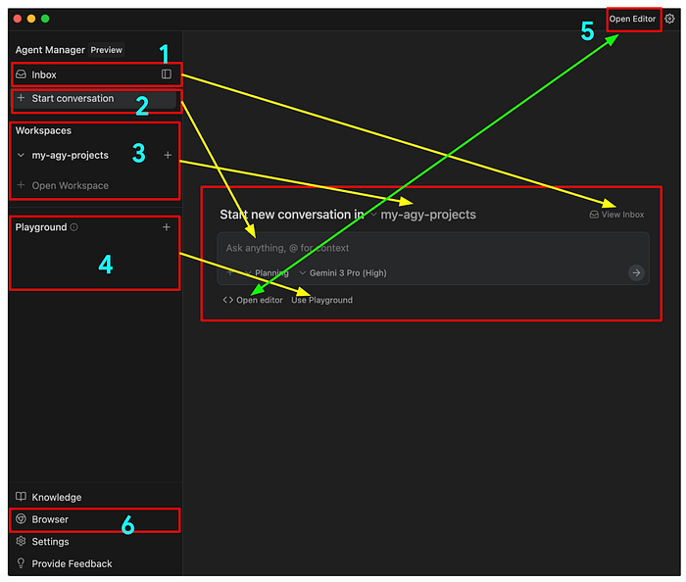
GOOGLE ANTIGRAVITY [AGENT – DRIVEN ] IDE

