Slide 1

Neuro Healthcare Data Exploration & Augmentation For Saudi AI Training Program

Slide 2
NeuroCogniAI is the rising star Canadian-based AI Company trailblazing initiative poised to redefine neurodegenerative disease Diagnosis & Prognosis Solutions like Alzheimer’s, Parkinson’s, and Brain Tumors etc. by synergizing advanced AI algorithms with cutting-edge neuroimaging methodologies. Our proposed solution introduces a novel approach that leverages cutting-edge artificial intelligence (AI) and neuroimaging techniques to revolutionize Alzheimer’s disease detection and diagnosis.

Slide 3

SAUDI AI TRAINING PROGRAM [NEUROCOGNI AI]
NeuroCogni AI recently launched a dedicated Saudi AI mentorship program for AI / Medical Students, Doctors and Medical Practitioners, which will create leaders in the field of AI by giving them training and practical, real world experience.
Our internationally experienced AI professionals will look to impart knowledge to aspiring Saudi students in the areas of AI programming, deep learning, harnessing the power of AI for business transformation, etc.

Slide 4
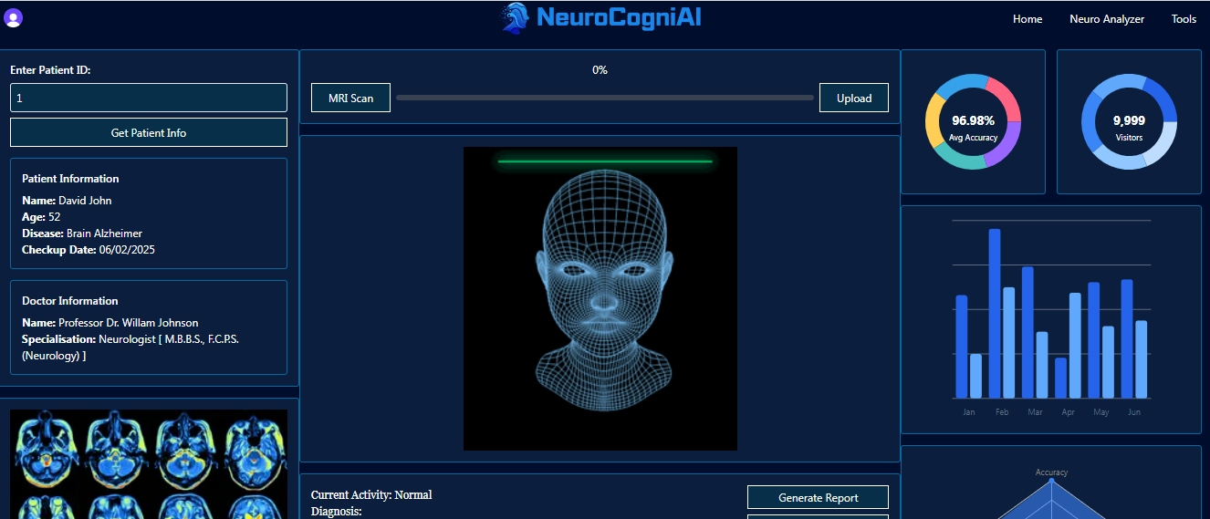
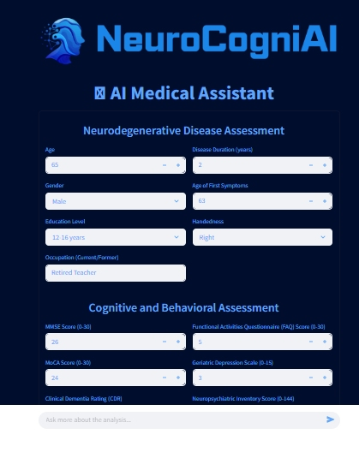
NEUROCOGNI AI MODELS & TOOLKIT

Slide 5
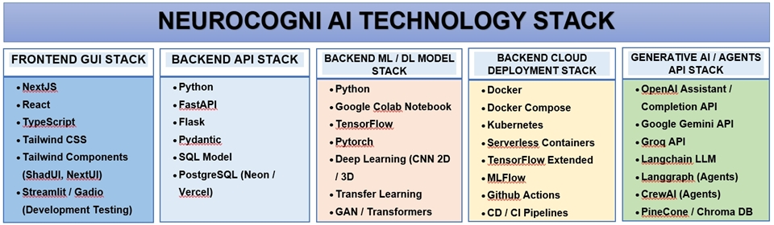

Slide 6




SOURCES OF NEURO IMAGING DATASETS
ADNI-1, ADNI-2, ADNI-GO, ADNI-3
OASIS 1, OASIS 2
PPMI

Slide 7





NEURO IMAGING DATA PRE-PROCESSING TOOLS

Slide 8
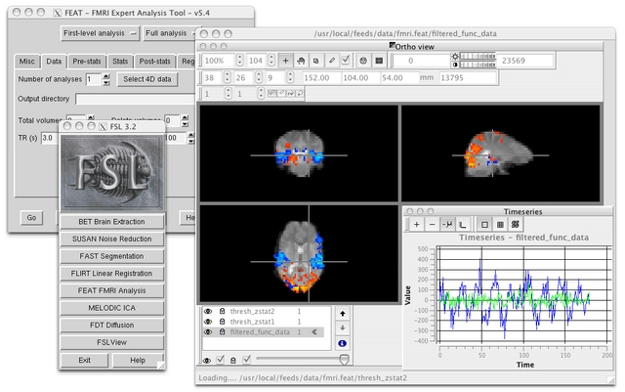
NEURO IMAGING DATA PRE-PROCESSING TOOLS [ FSL ]

Slide 9
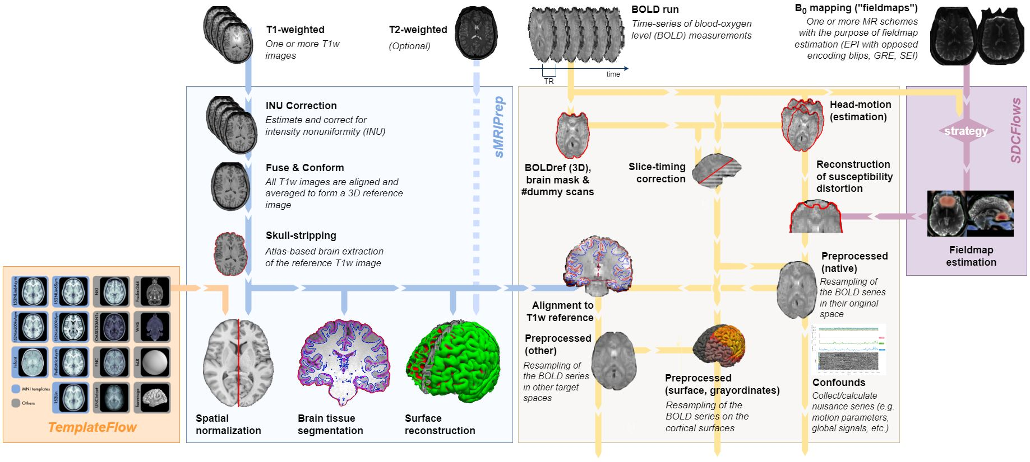
NEURO IMAGING DATA PRE-PROCESSING TOOLS [ fMRIPrep ]

Slide 10
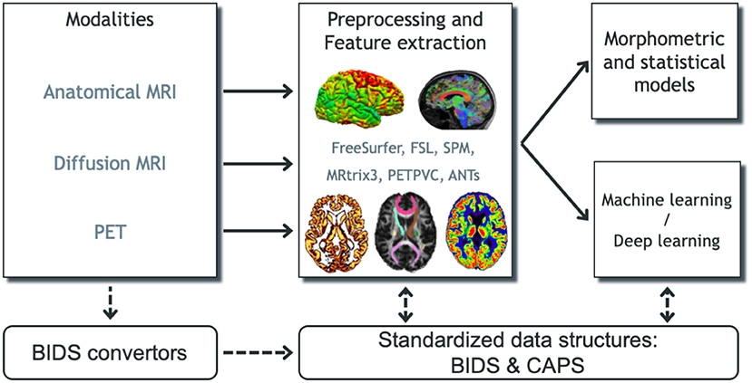
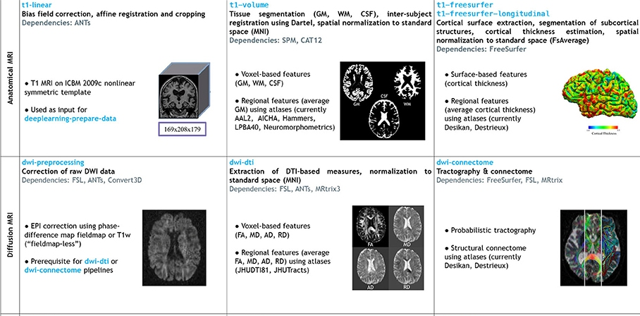
NEURO IMAGING DATA PRE-PROCESSING TOOLS [ Clinica ]

Slide 11
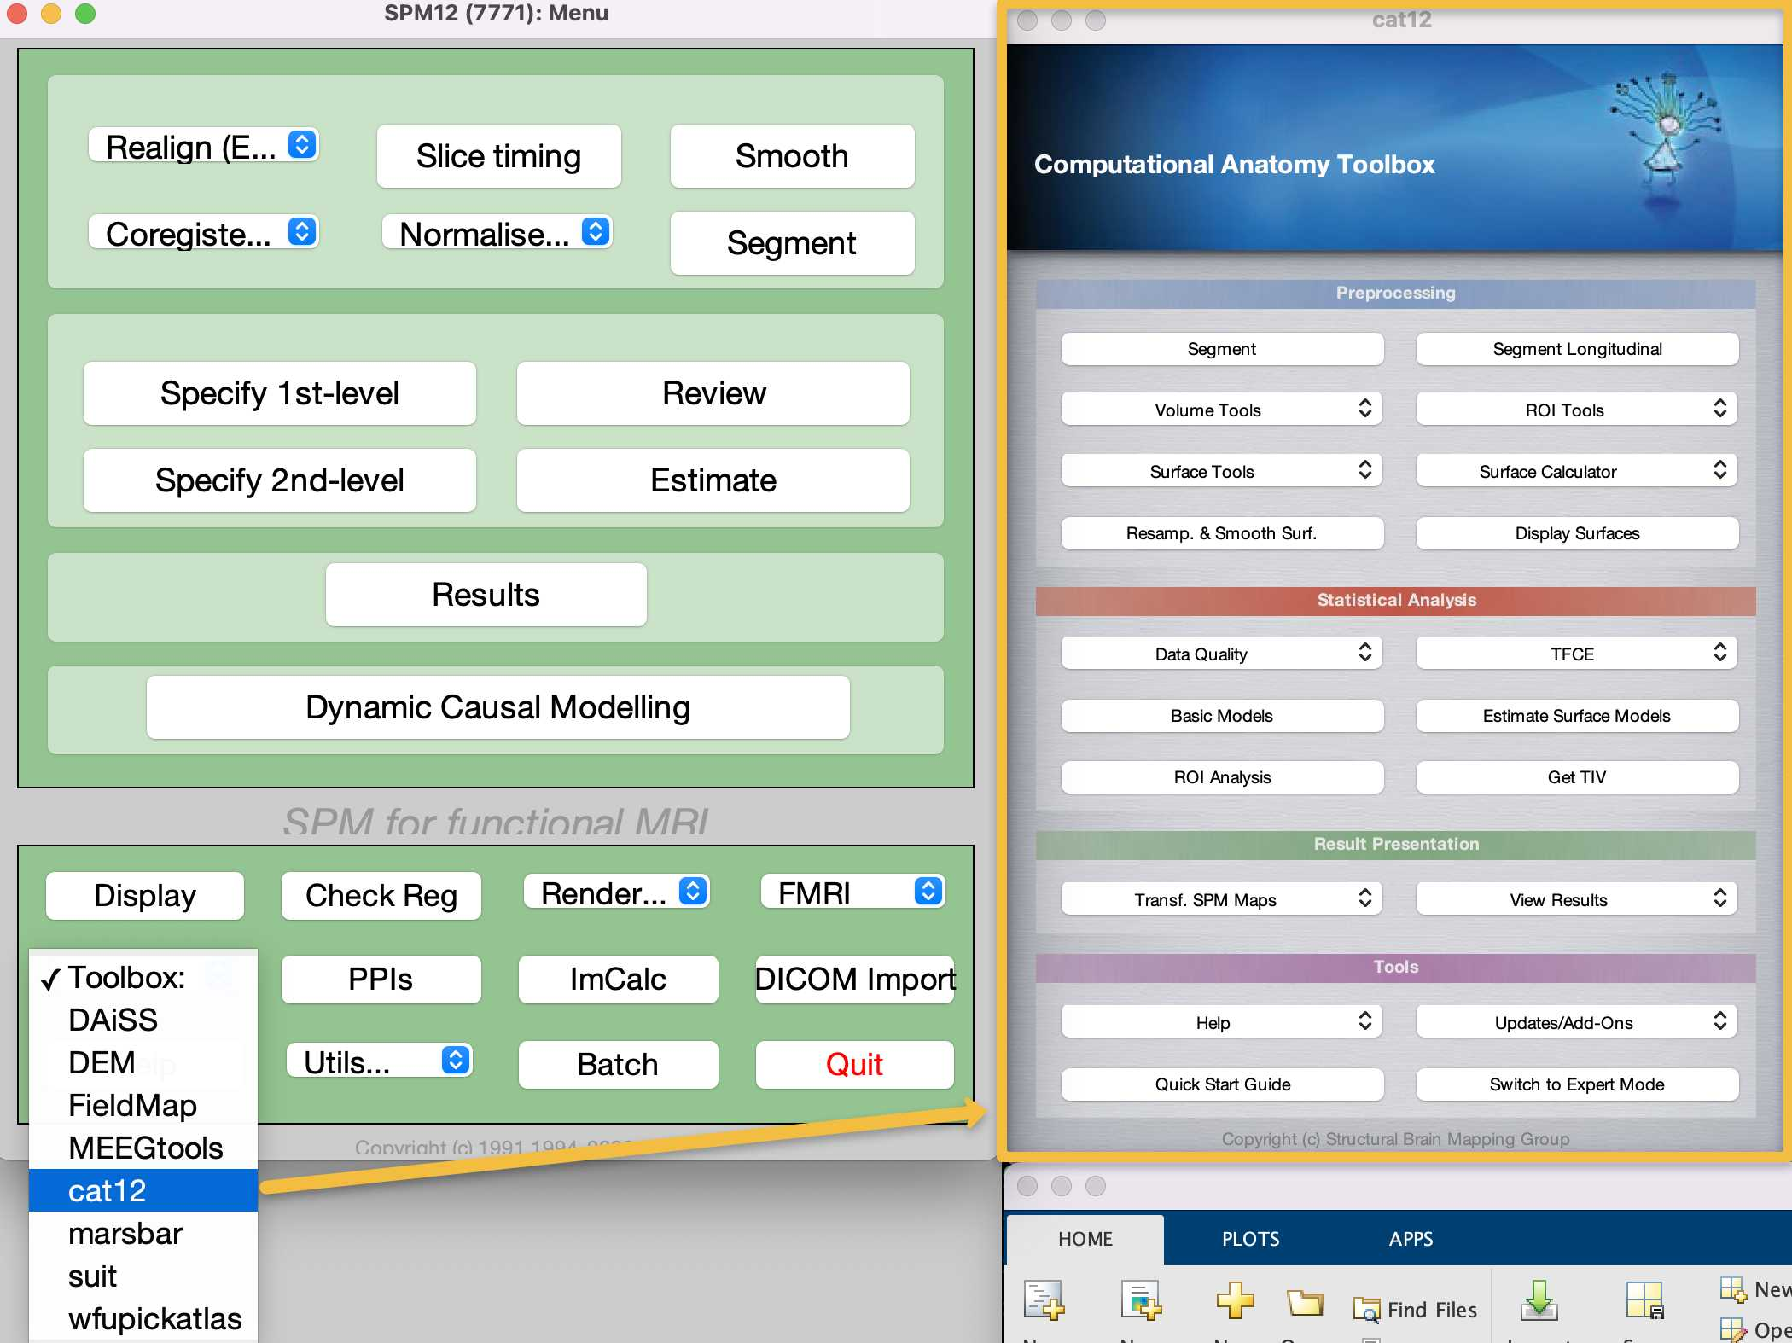
NEURO IMAGING DATA PRE-PROCESSING TOOLS [ CAT 12 ]

Slide 12
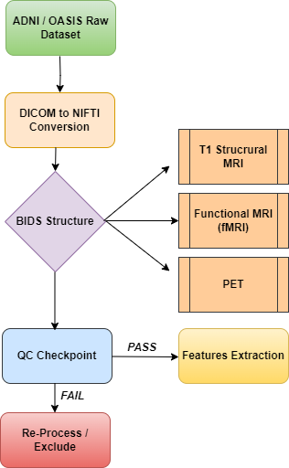
DATA PRE-PROCESSING FLOWCHART

Slide 13
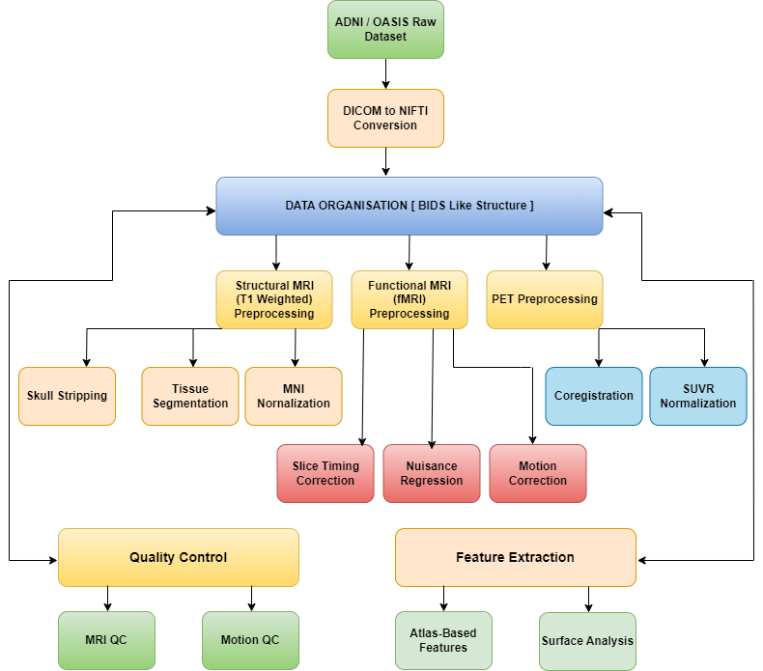
DATA PRE-PROCESSING [PURE PYTHON APPROACH]

Slide 14
COMPARISON OF NEURO IMAGING TOOLS FOR DATA PRE-PROCESSING APPROACH
TOOL OVERVIEW
FEATURE | CLINICA | fMRIPrep
Primary Focus | Multimodal AD biomarkers (T1/PET/DWI) | fMRI-specific preprocessing
ADNI / OASIS Optimization | Built-in ADNI / OASIS converters & pipelines | Generic (requires manual BIDS conversion)
License | Open Source (MIT) | Open Source (BSD-3-Clause)
Language | Python | Python (with NiPype)
Container Support | Docker/Singularity | Docker/Singularity
COMPUTATIONAL REQUIREMENTS
RESOURCE | CLINICA | fMRIPrep
CPU | 4+ cores (SPM/CAT12 are single-threaded) | 8+ cores (parallelized)
RAM | 8GB (T1), 16GB (PET) | 16GB+ (fMRI)
Disk | 50GB/subject (multimodal) | 30GB/subject (fMRI-only)
Runtime | ~6h/subject (T1+PET) | ~8h/subject (fMRI+FreeSurfer)
DATA HANDLING
ASPECT | CLINICA | fMRIPrep
Input Format | Direct ADNI / OASIS → BIDS conversion | Requires pre-converted BIDS
Output Format | CAPS (Clinica Archive Processing Structure) | BIDS Derivatives
Longitudinal Support | Native (cross-sectional + longitudinal) | Limited (per-session processing)

Slide 15
COMPARISON OF NEURO IMAGING TOOLS FOR DATA PRE-PROCESSING APPROACH
PREPROCESSING PIPLINES [ Structural MRI (T1- Weighted) ]
FEATURE | CLINICA | fMRIPrep
Segmentation | SPM12/CAT12 tissue classification | FreeSurfer recon-all
Normalization | DARTEL to MNI | ANTs/FLIRT to MNI
PREPROCESSING PIPLINES [ Structural fMRI (T1- Weighted) ]
FEATURE | CLINICA | fMRIPrep
Slice Timing | Not native (requires extension) | Automatic (from BIDS metadata)
Motion Correction | SPM-based | FSL MCFLIRT
Denoising | Manual integration (e.g., AROMA) | Built-in ICA-AROMA
Surface Analysis | Limited | Native FreeSurfer integration
QUALITY CONTROL
FEATURE | CLINICA | fMRIPrep
Reports | HTML (CAT12 QC) + CSV metrics | Interactive HTML (MRIQC integration)
Motion Metrics | Limited | Framewise displacement, DVARS
Visualization | SPM-style checkreg | Nilearn-based plots

Slide 16
LINKS FOR DIFFERENT SOURCES OF NEURO IMAGING DATASETS
https://adni.loni.usc.edu/ [ADNI Datasets]
https://sites.wustl.edu/oasisbrains/home/oasis-1/ [OASIS Datasets]
https://www.ppmi-info.org/access-data-specimens/ [PPMI Datasets]
https://openneuro.org/datasets/ds000102/versions/00001 [OpenNero FMRI datasets]
https://www.nitrc.org/top/toplist.php?type=downloads [Top Neuro Tools Download]

