Slide 1

MRI-BASED PET AMYLOID SYNTHESIS & QUANTIFICATION FOR EARLY ALZHEIMER DETECTION

Slide 2



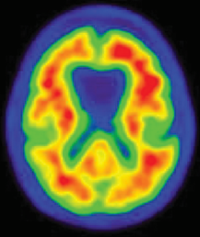
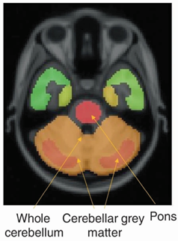


Early Alzheimer's Detection: MRI-Based PET Amyloid Synthesis Architecture
NCAI Data Preprocessing Pipeline
PREDICTED SYNTHETIC PET
NCAI
DEEP LEARNING MODEL
Structural MRI (sMRI)
High-resolution mapping of hippocampal and cortical atrophy.
Pattern Recognition / PET Synthesis Engine
The Breakthrough: Bridges the gap between low-cost MRI and expensive PET scans, identifying patterns invisible to the human eye.

Slide 3
DATA SETS OF ALZHEIMER’S BIOMARKERS FOR MRI-BASED PET SYNTHESIS
BIOMARKER CLASS | NO OF SUBJECTS [n] | CLASS DISTRIBUTION | AGE (Years) Mean ± S.D. | EDUCATIONAL LEVEL (Years) Mean ± S.D. | MALE / FEMALE (n%) | RACE (White, Black, Asian, American, Indian, Pacific, Multirace) | CDR (0.0, 0.5, 1.0, 2.0, 3.0) | MRIs Available (T1, T2, FLAIR)
ALZHEIMERS DISEASE NEUROIMAGING INITIATIVE [ ADNI ]
AMYLOID-NEGATIVE | 726 | 51.71% | 72.23 ± 7.53 | 16.56 ± 2.44 | M=370, 50.96% | 632, 56, 17, 3 , 1, 11 | 399, 299, 27, 1, 0 | 726, 725, 350
 |  |  |  |  | F=356, 49.04%
AMYLOID-POSITIVE | 678 | 48.29% | 74.79 ± 7.57 | 16.06 ± 2.68 | M=332, 48.97% | 614,39,12,0,1,10 | 178, 379, 112, 7, 1 | 678, 678, 330
 |  |  |  |  | F=346, 51.03%
OPEN ACCESS SERIES OF IMAGING STUDIES [ OASIS ]
AMYLOID-NEGATIVE | 631 | 65.59% | 68.80 ± 8.62 | 16.10 ± 2.50 | M=267, 42.31% | 520, 104, 4, 1 , 0, 2 | 591, 37, 3, 0, 0 | 629, 586, 398
 |  |  |  |  | F=356, 49.04%
AMYLOID-POSITIVE | 331 | 34.41% | 74.55 ± 6.79 | 15.90 ± 2.76 | M=158, 47.73% | 300, 28, 2, 0, 0, 1 | 194, 96, 36, 4, 1 | 329, 304, 227
 |  |  |  |  | F=346, 51.03%
NATIONAL ALZHEIMERS COORDINATING CENTER [ NCCA ]
AMYLOID-NEGATIVE | 2311 | 55.12% | 70.28 ± 8.83 | 16.21 ± 2.85 | M=1073, 46.43% | 1899, 237, 62, 22 , 3, 65 | 1231, 788, 194, 64, 33 | 129, 0, 0
 |  |  |  |  | F=1238, 53.57%
AMYLOID-POSITIVE | 1882 | 44.88% | 71.51 ± 8.75 | 16.25 ± 2.75 | M=908, 48.25% | 1723, 87, 27, 5, 0, 29 | 325, 884, 470, 147, 56 | 79, 0, 0
 |  |  |  |  | F=974, 51.75%
ANTI-AMYLOID TREATMENT IN ASYMTOMATIC ALZHEIMER’S DISEASE [ A4 ]
AMYLOID-NEGATIVE | 3156 | 70.53% | 70.89 ± 4.49 | 16.57 ± 2.83 | M=1277, 40.46% | 2846, 127, 136, 7 , 2, 2 | 3156, 0, 0, 0, 0 | 623, 624, 104
 |  |  |  |  | F=1879, 49.04%
AMYLOID-POSITIVE | 1319 | 29.47% | 72.23 ± 4.94 | 16.62 ± 2.85 | M=544, 41.24% | 1236, 32, 34, 2, 0, 6 | 1319, 0, 0, 0, 0 | 1156, 1156, 280
 |  |  |  |  | F=775, 51.03%

Slide 4
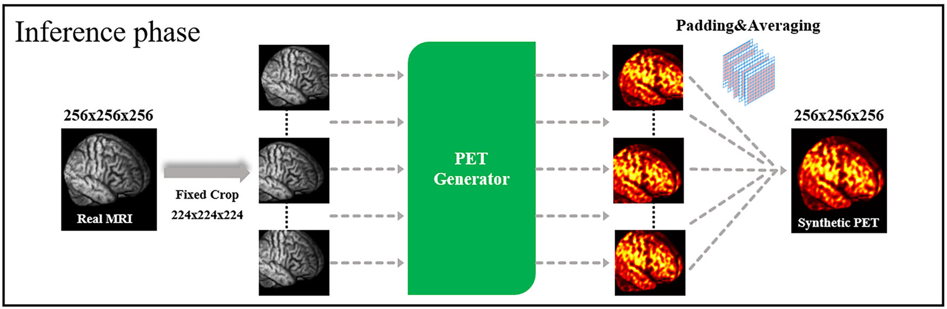
MRI-BASED PET AMYLOID SYNTHESIS WORKFLOW

Slide 5
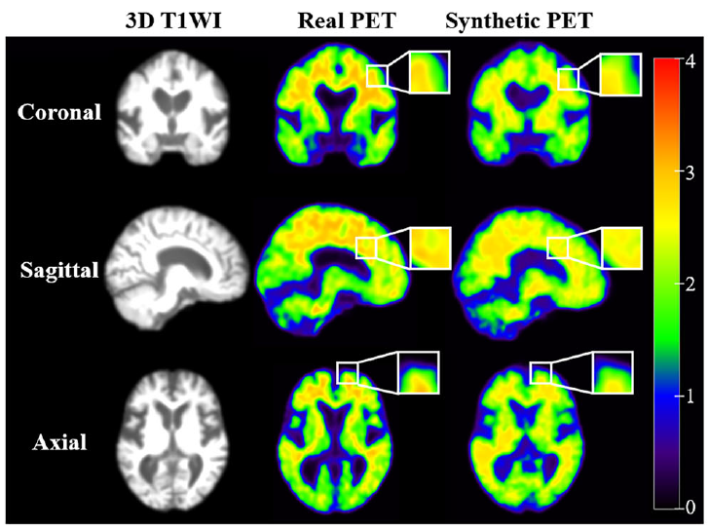
MRI-BASED PET AMYLOID SYNTHESIS

Slide 6
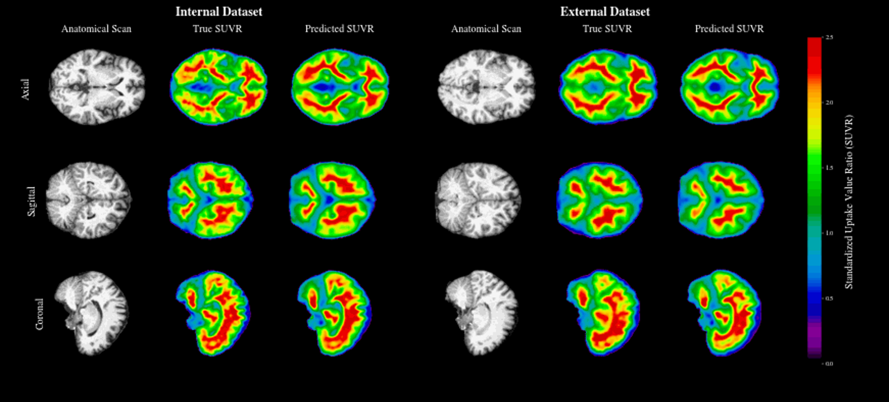
MRI-BASED PET AMYLOID SYNTHESIS

Slide 7
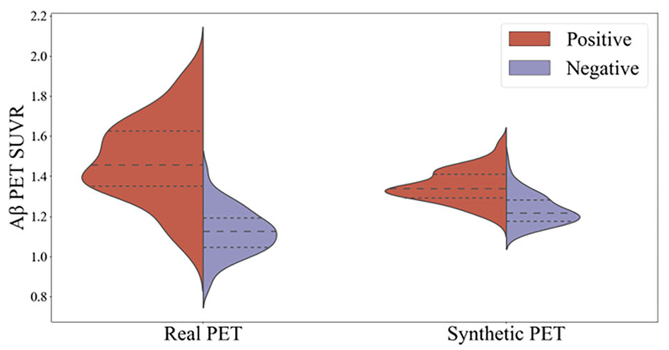
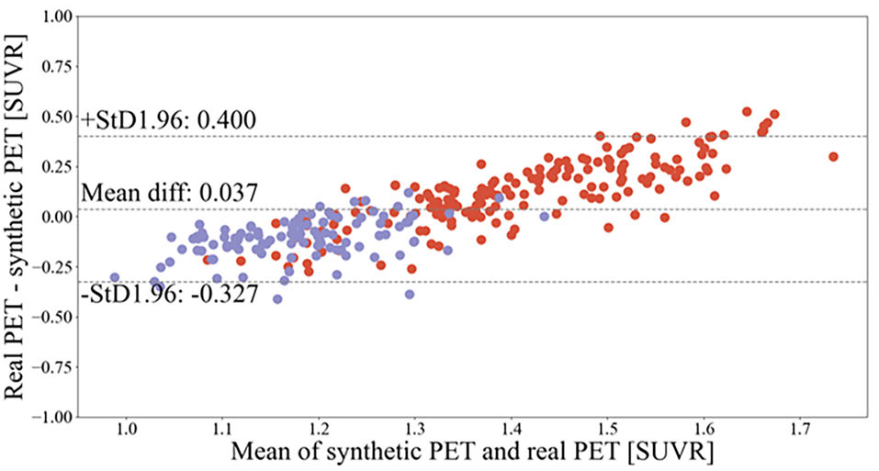
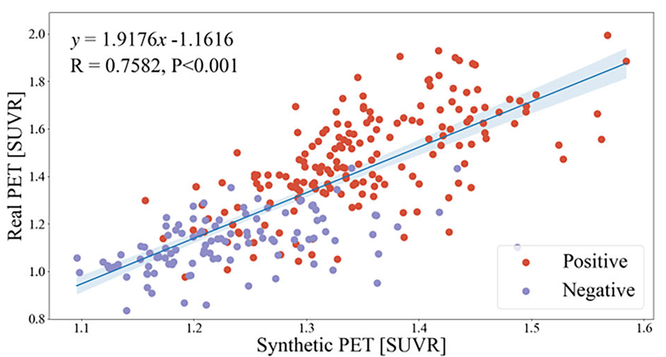
MRI-BASED PET AMYLOID SYNTHESIS

Slide 8
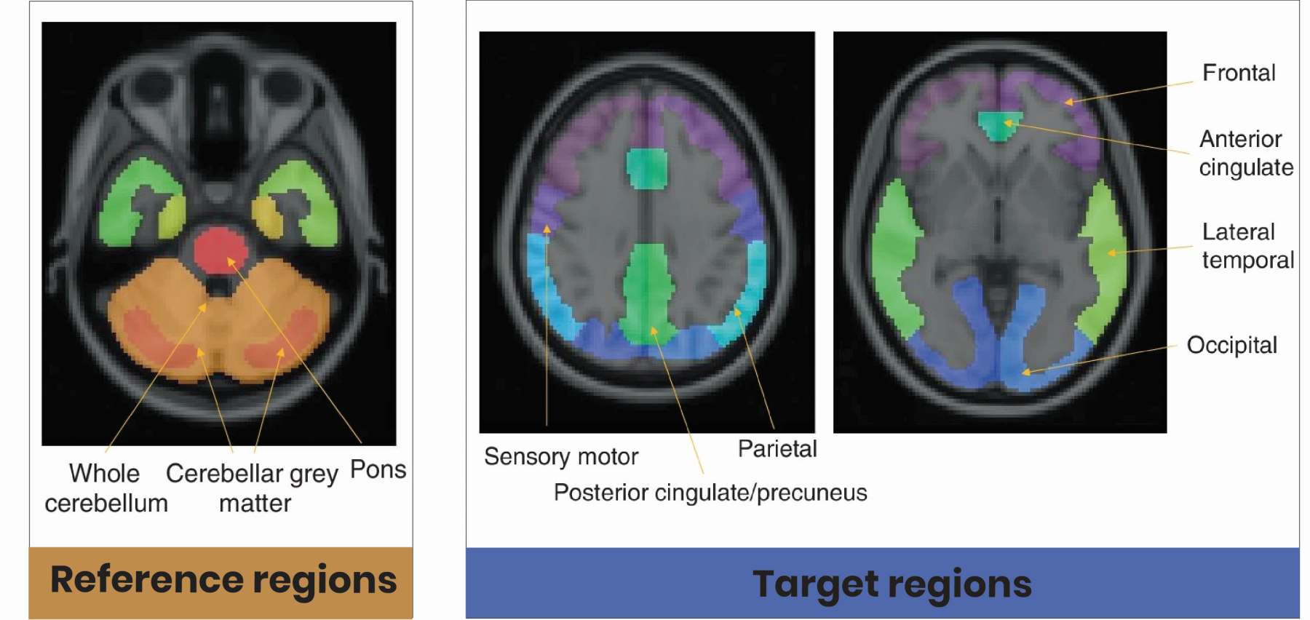
MRI-BASED PET AMYLOID QUANTIFICATION

Slide 9
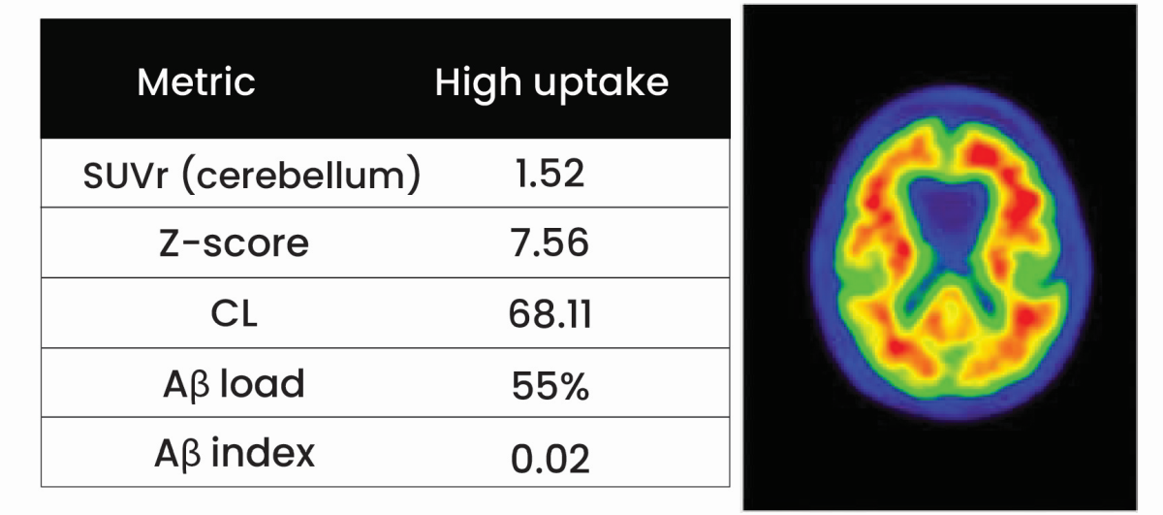
MRI-BASED PET AMYLOID QUANTIFICATION

Slide 10
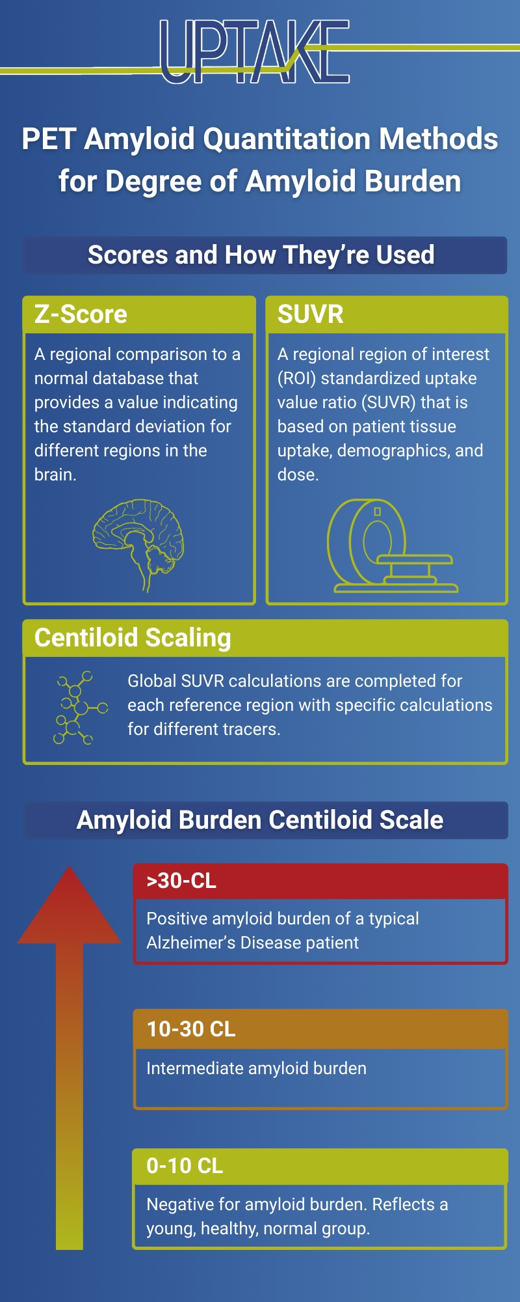
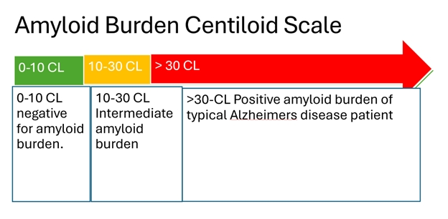
MRI-BASED PET AMYLOID QUANTIFICATION METHODS / SCALING

