Slide 1
MACHINE LEARNING MODELS EVALUATION METRICS / FUNCTIONS

Slide 2
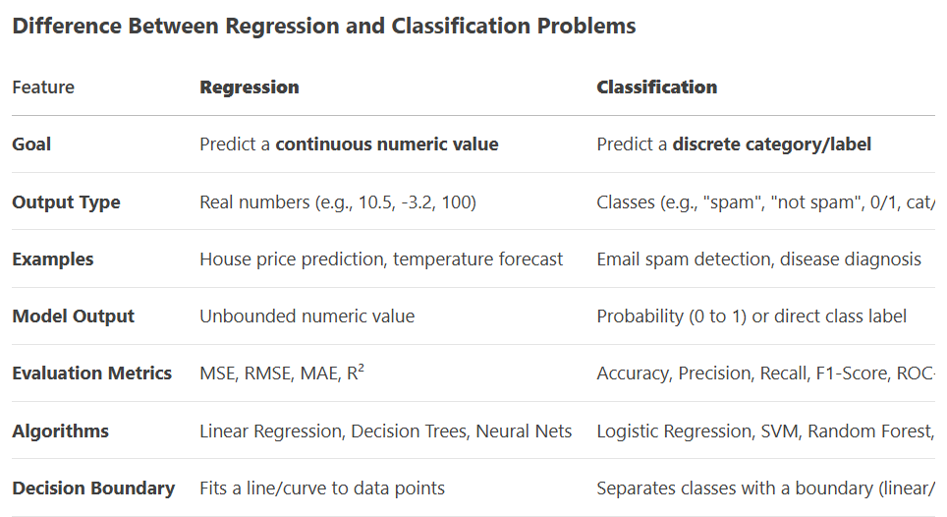
Regression / Classification Problems

Slide 3
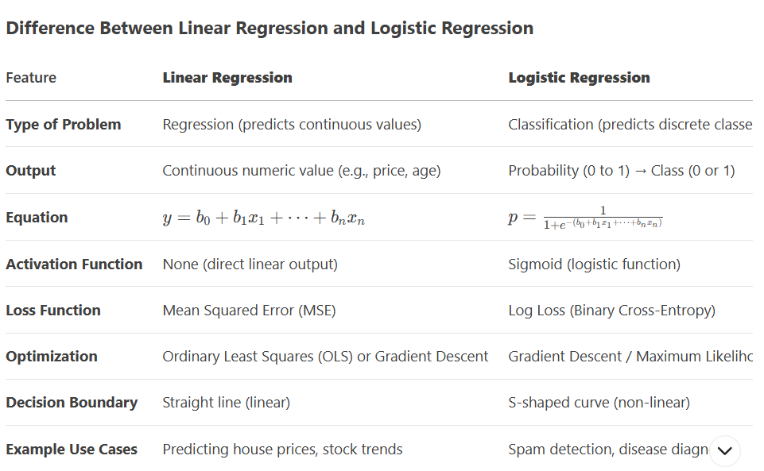
Linear Regression / Logistic Regression

Slide 4
Evaluation Metrics for Classification Models
When to Use Accuracy
Balanced datasets: When classes are roughly equal in size.
Simple benchmarks: Quick evaluation of model performance.
When to Avoid Accuracy
Imbalanced datasets: For example, if 95% of examples are negative, a model that always predicts negative will have 95% accuracy but is useless.
Cost-sensitive scenarios: When false positives and false negatives have different consequences (e.g., medical testing).

Slide 5
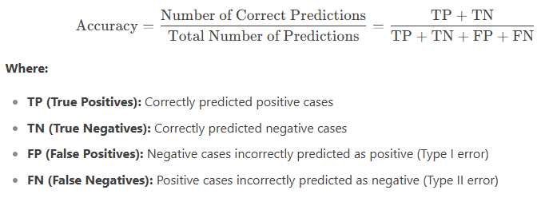
Evaluation Metrics for Classification Models
Accuracy: Accuracy is the ratio of correctly predicted instances to the total instances. It is a simple metric but can be misleading in imbalanced datasets.

Slide 6
Evaluation Metrics for Classification Models
When to Use Accuracy
Balanced datasets: When classes are roughly equal in size.
Simple benchmarks: Quick evaluation of model performance.
When to Avoid Accuracy
Imbalanced datasets: For example, if 95% of examples are negative, a model that always predicts negative will have 95% accuracy but is useless.
Cost-sensitive scenarios: When false positives and false negatives have different consequences (e.g., medical testing).

Slide 7
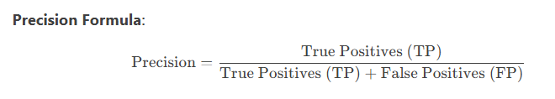
Evaluation Metrics for Classification Models
Precision: The ratio of true positives to the sum of true positives and false positives. It answers how many selected items are relevant.
Interpretation:
True Positives (TP): Correctly predicted positive cases.
False Positives (FP): Negative cases incorrectly predicted as positive (Type I Error).
Precision answers: "Of all the instances predicted as positive, how many are actually positive?"

Slide 8
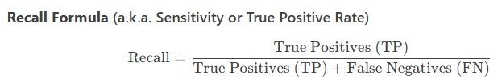
Evaluation Metrics for Classification Models
Recall: The ratio of true positives to the sum of true positives and false negatives. It answers how many relevant items are selected.
Interpretation
True Positives (TP): Correctly predicted positive cases.
False Negatives (FN): Positive cases incorrectly predicted as negative (Type II Error).
Recall answers: "Of all the actual positive instances, how many did we correctly predict?"

Slide 9
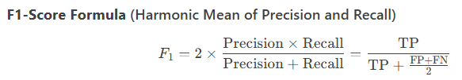
Evaluation Metrics for Classification Models
F1 Score: The harmonic mean of precision and recall. It balances precision and recall.
Interpretation
Balances Precision and Recall: Harmonic mean (punishes extreme values more than arithmetic mean).
Range: 0 (worst) to 1 (best).
Answers: "What is the tradeoff between precision and recall?"

Slide 10
Evaluation Metrics for Regression Models
Mean Absolute Error (MAE)
MAE measures the average magnitude of errors in a set of predictions, without considering their direction.
Mean Squared Error (MSE)
MSE measures the average of the squares of the errors. It penalizes larger errors more heavily.
Root Mean Squared Error (RMSE)
RMSE is the square root of MSE and provides a measure of the standard deviation of residuals.
R-squared (Coefficient of Determination)
R-squared measures the proportion of the variance in the dependent variable that is predictable from the independent variables.

Slide 11
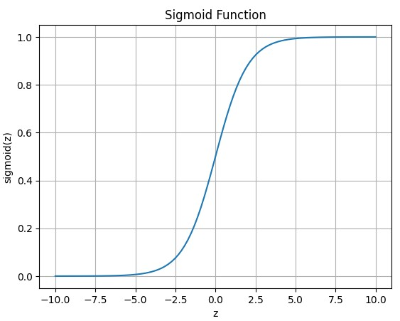
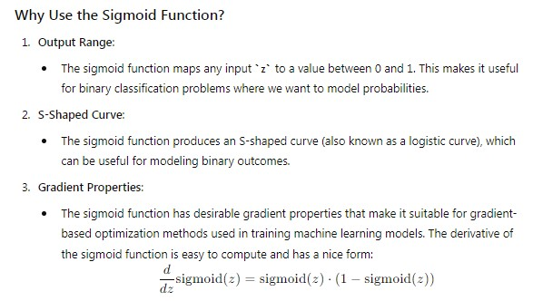
SIGMOID FUNCTION
The sigmoid function is often used in binary classification models to map predicted values (logits) to probabilities. It squashes the output to a range between 0 and 1, making it interpretable as a probability.

Slide 12
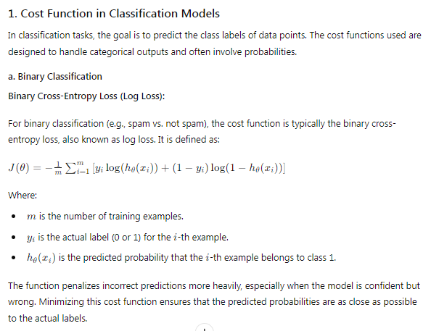
COST / LOSS FUNCTION
The cost function, or loss function, measures how well the model’s predictions match the actual values. For logistic regression, the cost function is the Binary Cross-Entropy Loss.

Slide 13
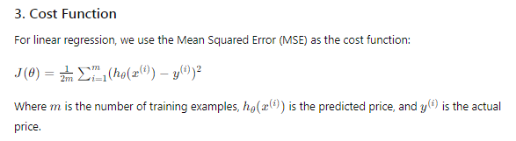
COMPONENTS OF SUPERVISED MACHINE LEARNING
Cost Function (Loss Function):
The cost function measures how well the model's predictions match the actual labels in the training data OR Cost (or loss) functions measure how wrong a machine learning model's predictions are compared to the actual values. It quantifies the error between the predicted and actual outputs. Common cost functions include Mean Squared Error (MSE) for regression tasks and Cross-Entropy Loss for classification tasks.

Slide 14
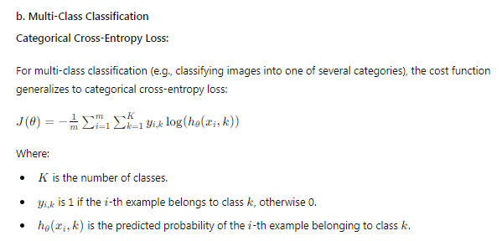
COST / LOSS FUNCTION

Slide 15
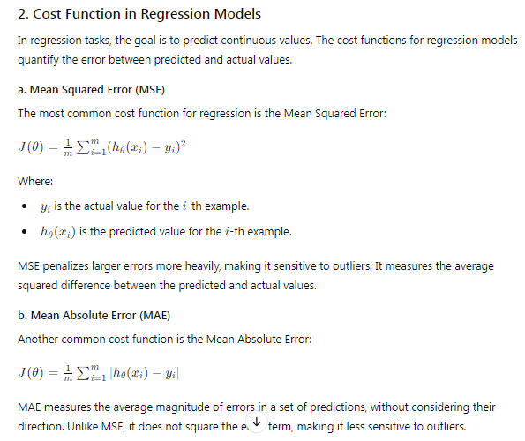
COST / LOSS FUNCTION

Slide 16
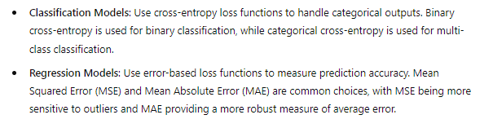
COST / LOSS FUNCTION

Slide 17
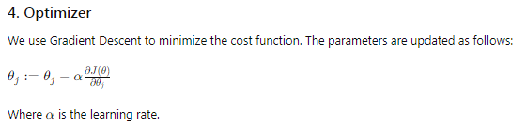
EVALUATION FUNCTIONS
Optimizer:
Optimizers are algorithms used to minimize the cost function by updating the model parameters. In logistic regression, Gradient Descent is commonly used. There are various types of gradient descent optimizers, including:
Batch Gradient Descent
Stochastic Gradient Descent (SGD)
Mini-Batch Gradient Descent

Slide 18
EVALUATION FUNCTIONS
Sigmoid Function: Maps logits to probabilities, essential for binary classification.
Cost Function: Measures the error between predicted probabilities and actual labels; binary cross-entropy is used for logistic regression.
Optimizer: Updates model parameters to minimize the cost function. Gradient Descent and its variants are commonly used optimizers.

