Slide 1

DATA PRE-PROCESSING TECHNIQUES FOR AI MODELS

Slide 2




SOURCES OF NEURO IMAGING DATASETS
ADNI-1, ADNI-2, ADNI-GO, ADNI-3
OASIS 1, OASIS 2
PPMI

Slide 3





NEURO IMAGING DATA PRE-PROCESSING TOOLS

Slide 4
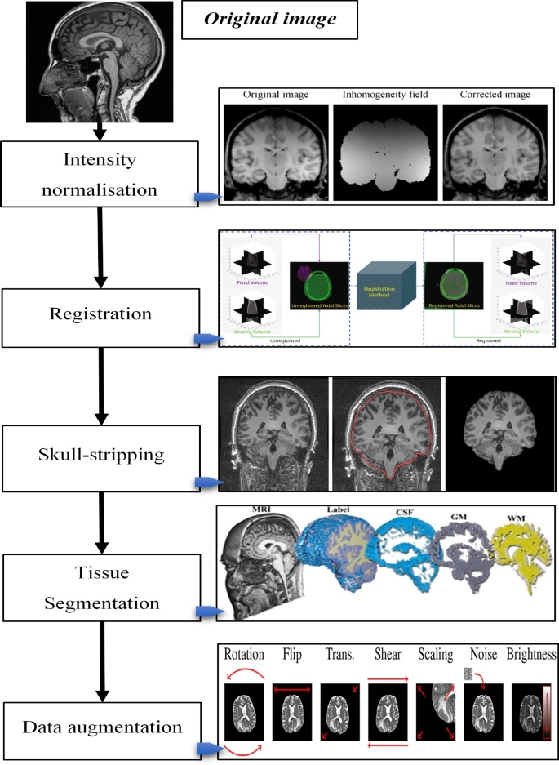
DATA PRE-PROCESSING STEPS FOR NEURO IMAGING DATASETS

Slide 5
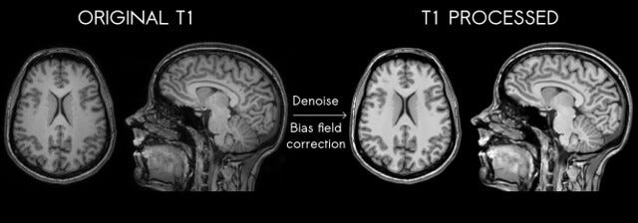
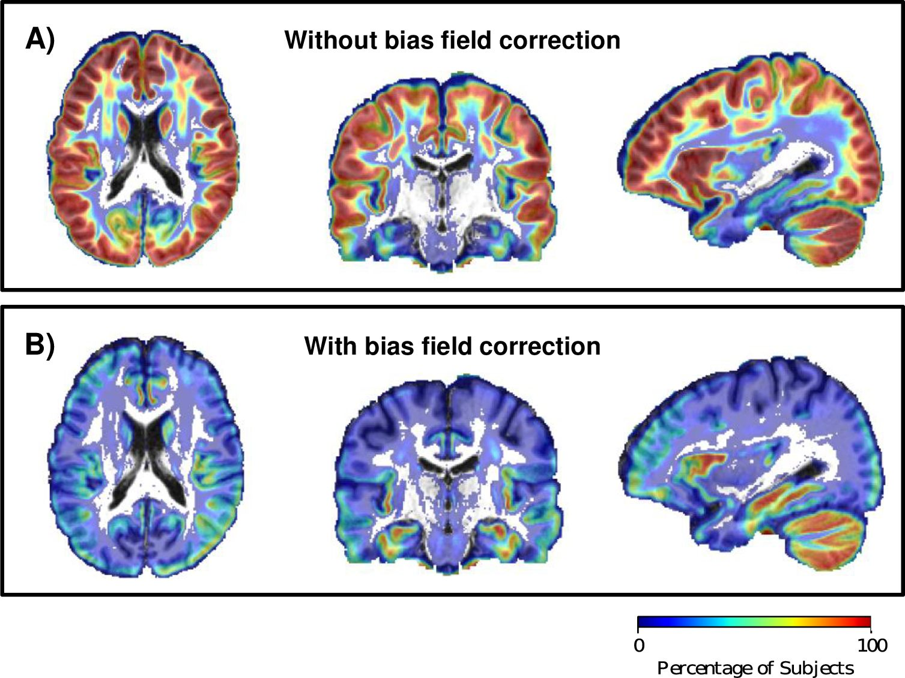
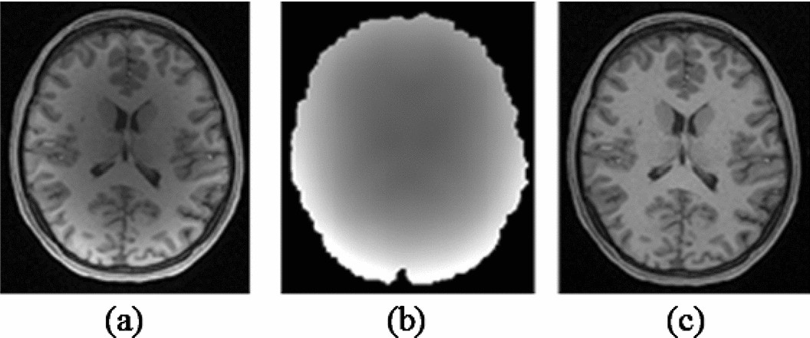
DATA PRE-PROCESSING STEPS FOR NEURO IMAGING DATASETS [ BIAS FIELD CORRECTION ]

Slide 6
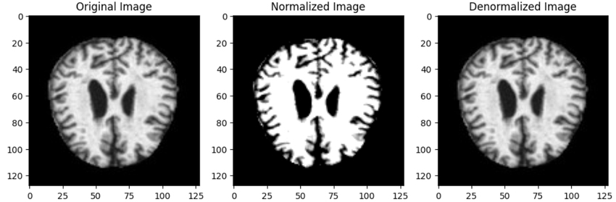
DATA PRE-PROCESSING STEPS FOR NEURO IMAGING DATASETS [ NORMALIZATION ]

Slide 7
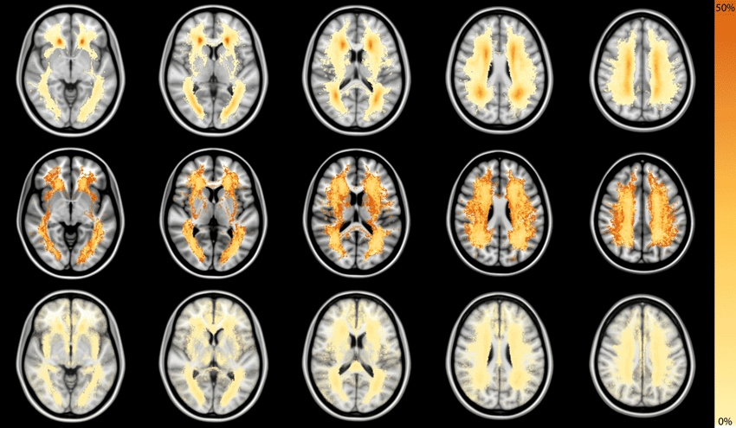
DATA PRE-PROCESSING STEPS FOR NEURO IMAGING DATASETS [ REGISTRATION IN MNI152 TEMPLATE ]

Slide 8
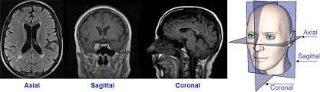
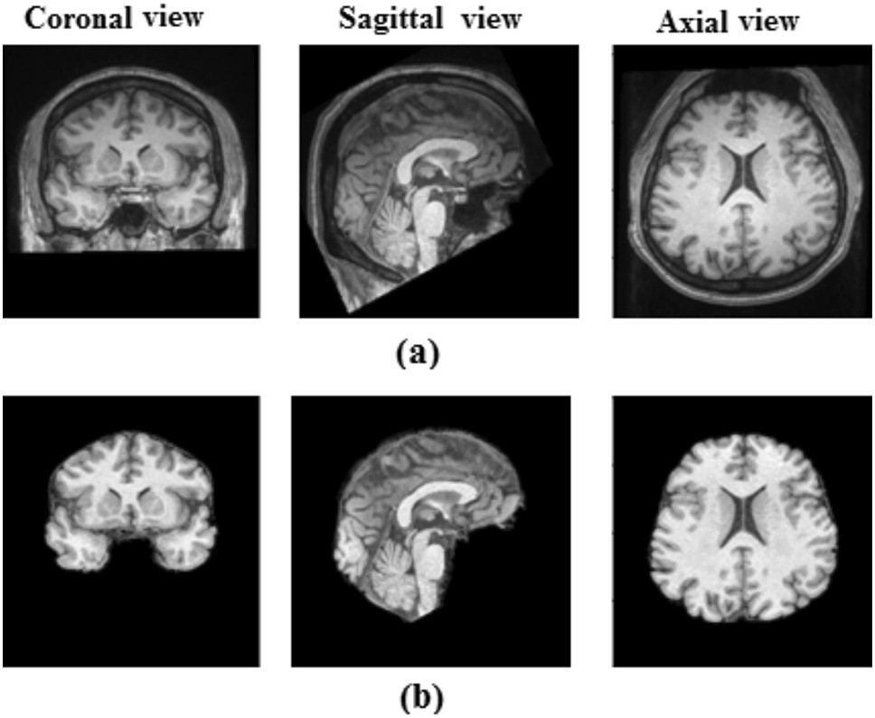
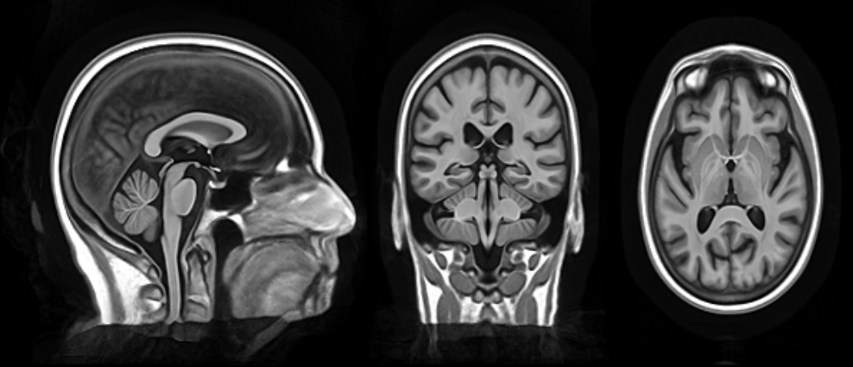
DATA PRE-PROCESSING STEPS FOR NEURO IMAGING DATASETS [ SKULL STRIPPING ]

Slide 9
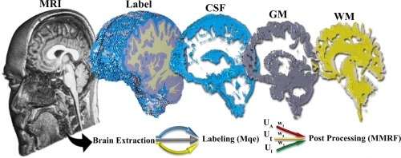
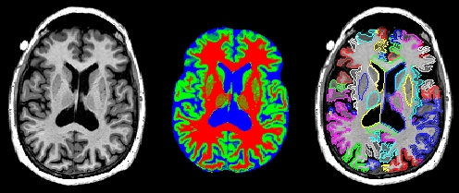
DATA PRE-PROCESSING STEPS FOR NEURO IMAGING DATASETS [ TISSUE SEGMENTATION]

Slide 10

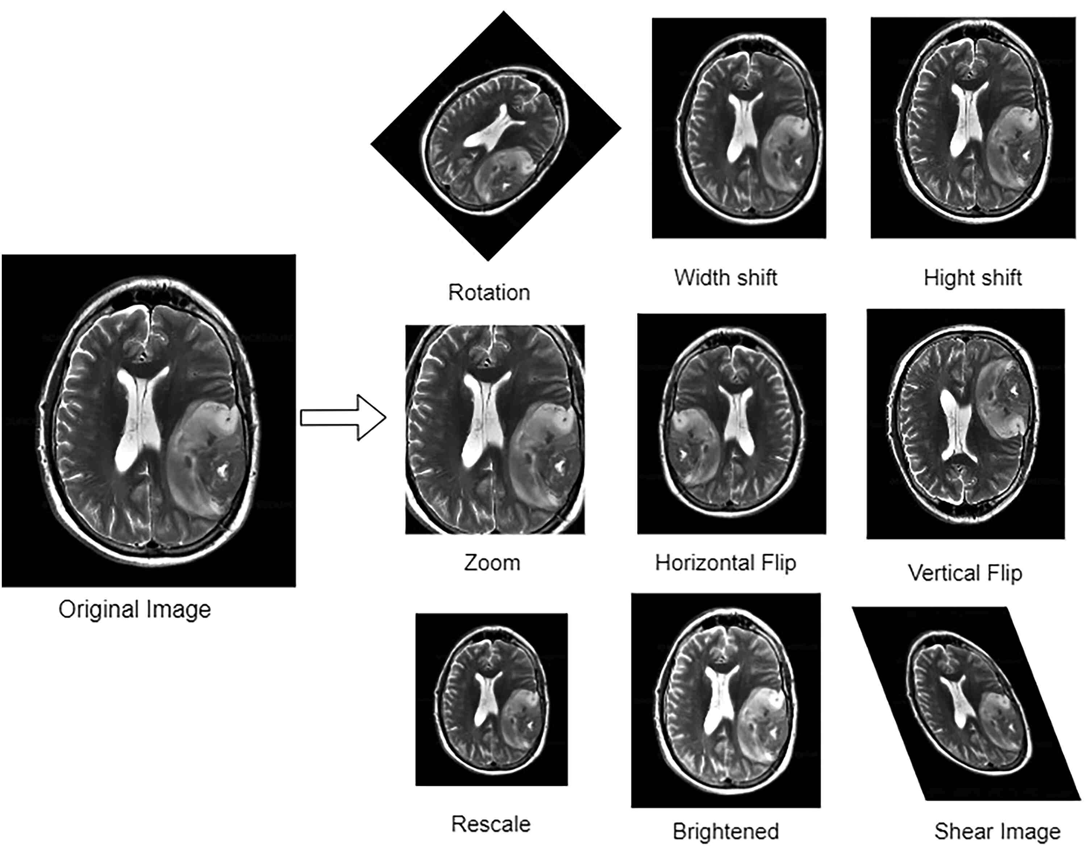
DATA PRE-PROCESSING STEPS FOR NEURO IMAGING DATASETS [ DATA AUGMENTATION ]

