Slide 1

DATA PRE-PROCESSING TECHNIQUES / PIPELINES FOR AI MODELS

Slide 2


NEURO IMAGING DATA PRE-PROCESSING PIPELINES
CONVERTING DICOM / NIFTII DATA STRUCTURE TO

Slide 3
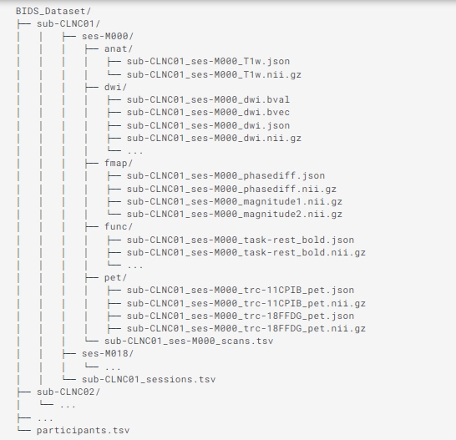
NEURO IMAGING DATA PRE-PROCESSING [BIDS]

Slide 4
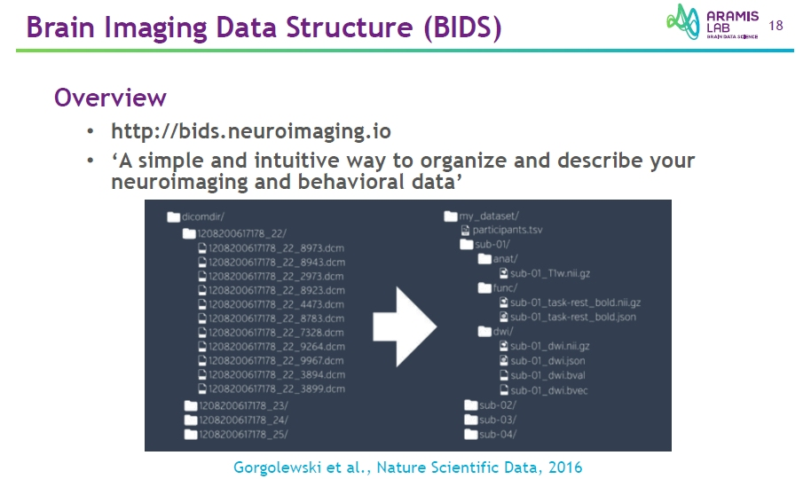

Slide 5
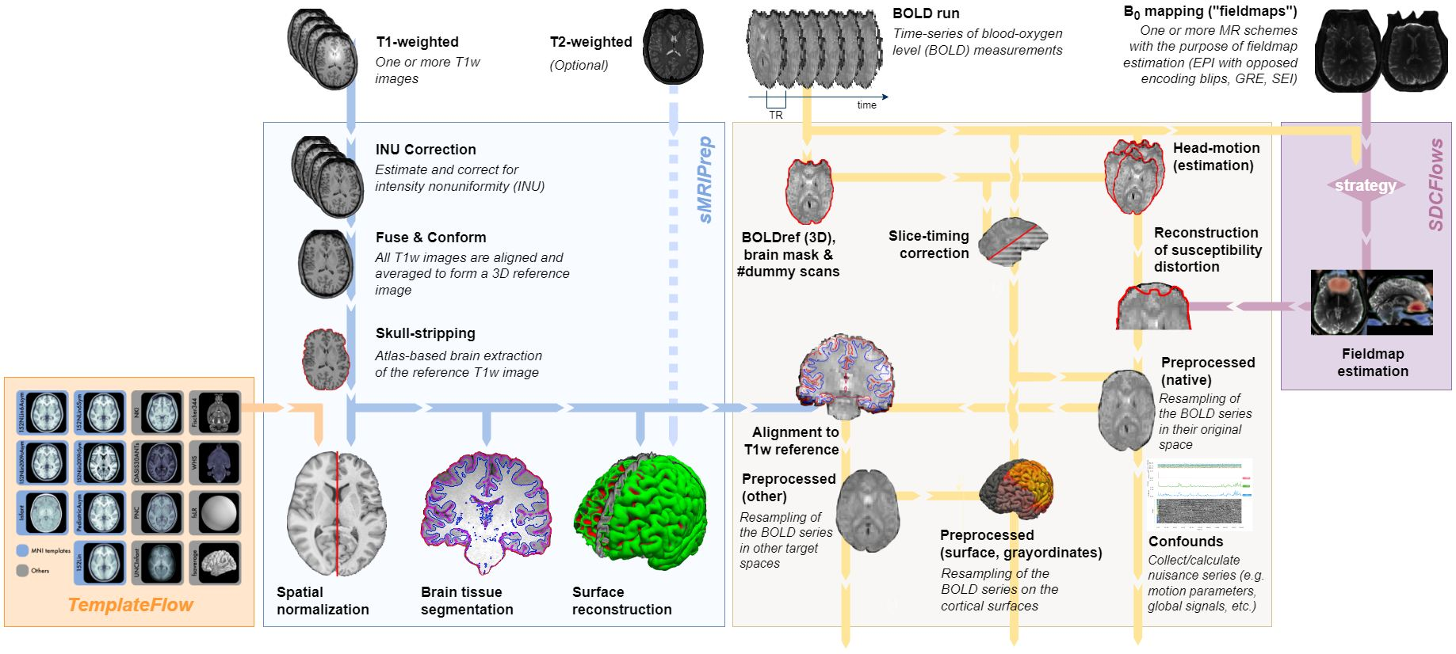
NEURO IMAGING DATA PRE-PROCESSING PIPELINES [ fMRIPrep ]

Slide 6
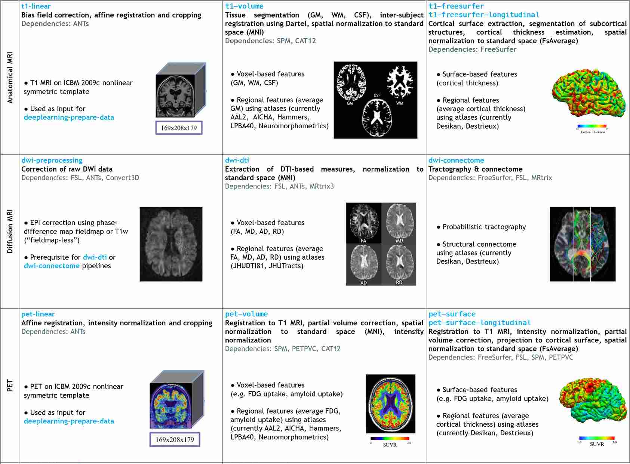
NEURO IMAGING DATA PRE-PROCESSING PIPELINES [ Clinica ]

Slide 7
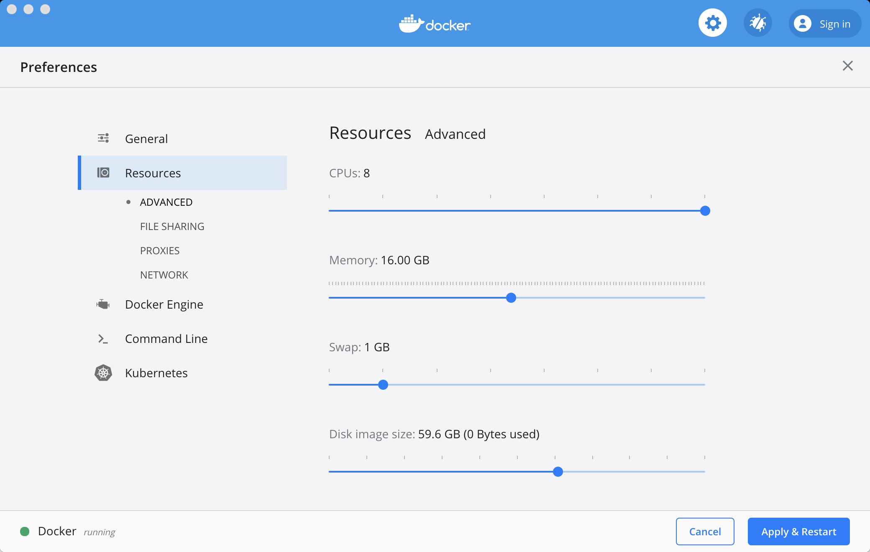
fMRIprep INSTALLATION FOR DATA PRE-PROCESSING PIPELINES
fMRIPrep Installation: Docker Container

Slide 8
fMRIprep INSTALLATION FOR DATA PRE-PROCESSING PIPELINES
fMRIPrep Installation: Docker Container
docker pull nipreps/fmriprep:latest
python -m pip install fmriprep-docker

