Slide 1

DATA PRE-PROCESSING TECHNIQUES / PIPELINES FOR AI MODELS

Slide 2


NEURO IMAGING DATA PRE-PROCESSING PIPELINES
CONVERTING DICOM / NIFTII DATA STRUCTURE TO

Slide 3
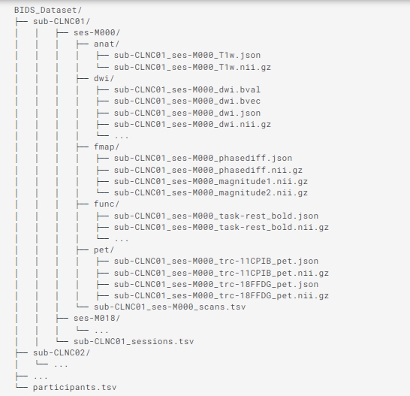
NEURO IMAGING DATA PRE-PROCESSING [BIDS]

Slide 4
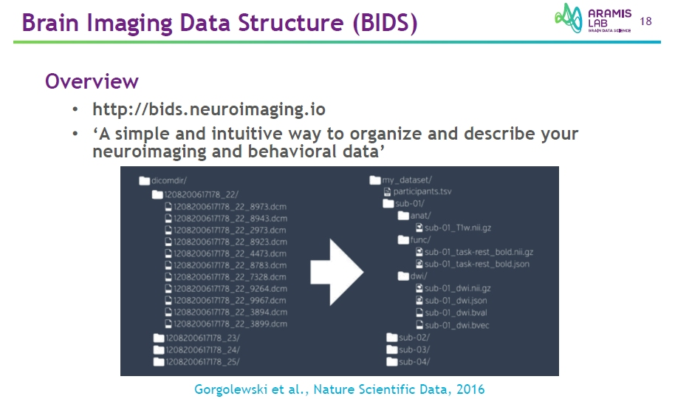

Slide 5
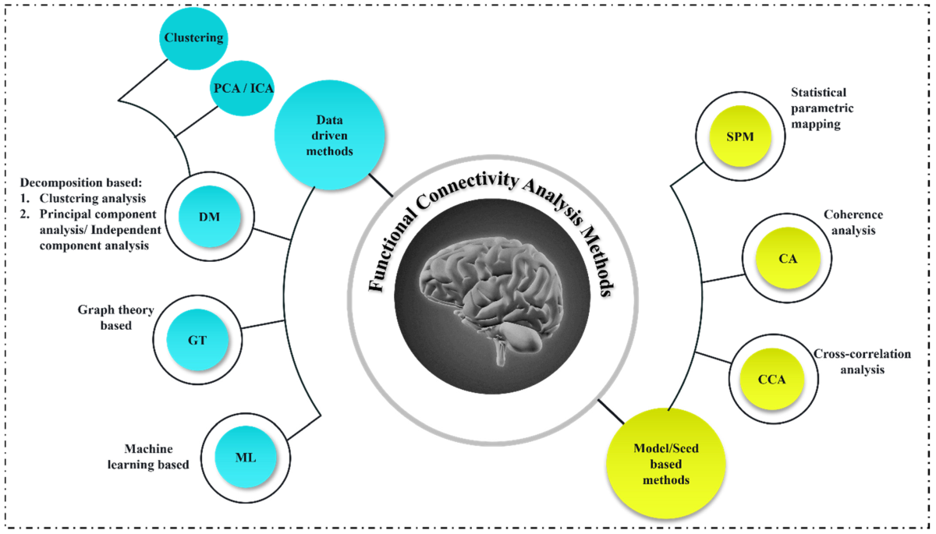
FUNCTIONAL MRI (fMRI) PREPROCESSING
The goal is how to process functional data for successive analyses, including functional region analysis and functional connectivity

Slide 6
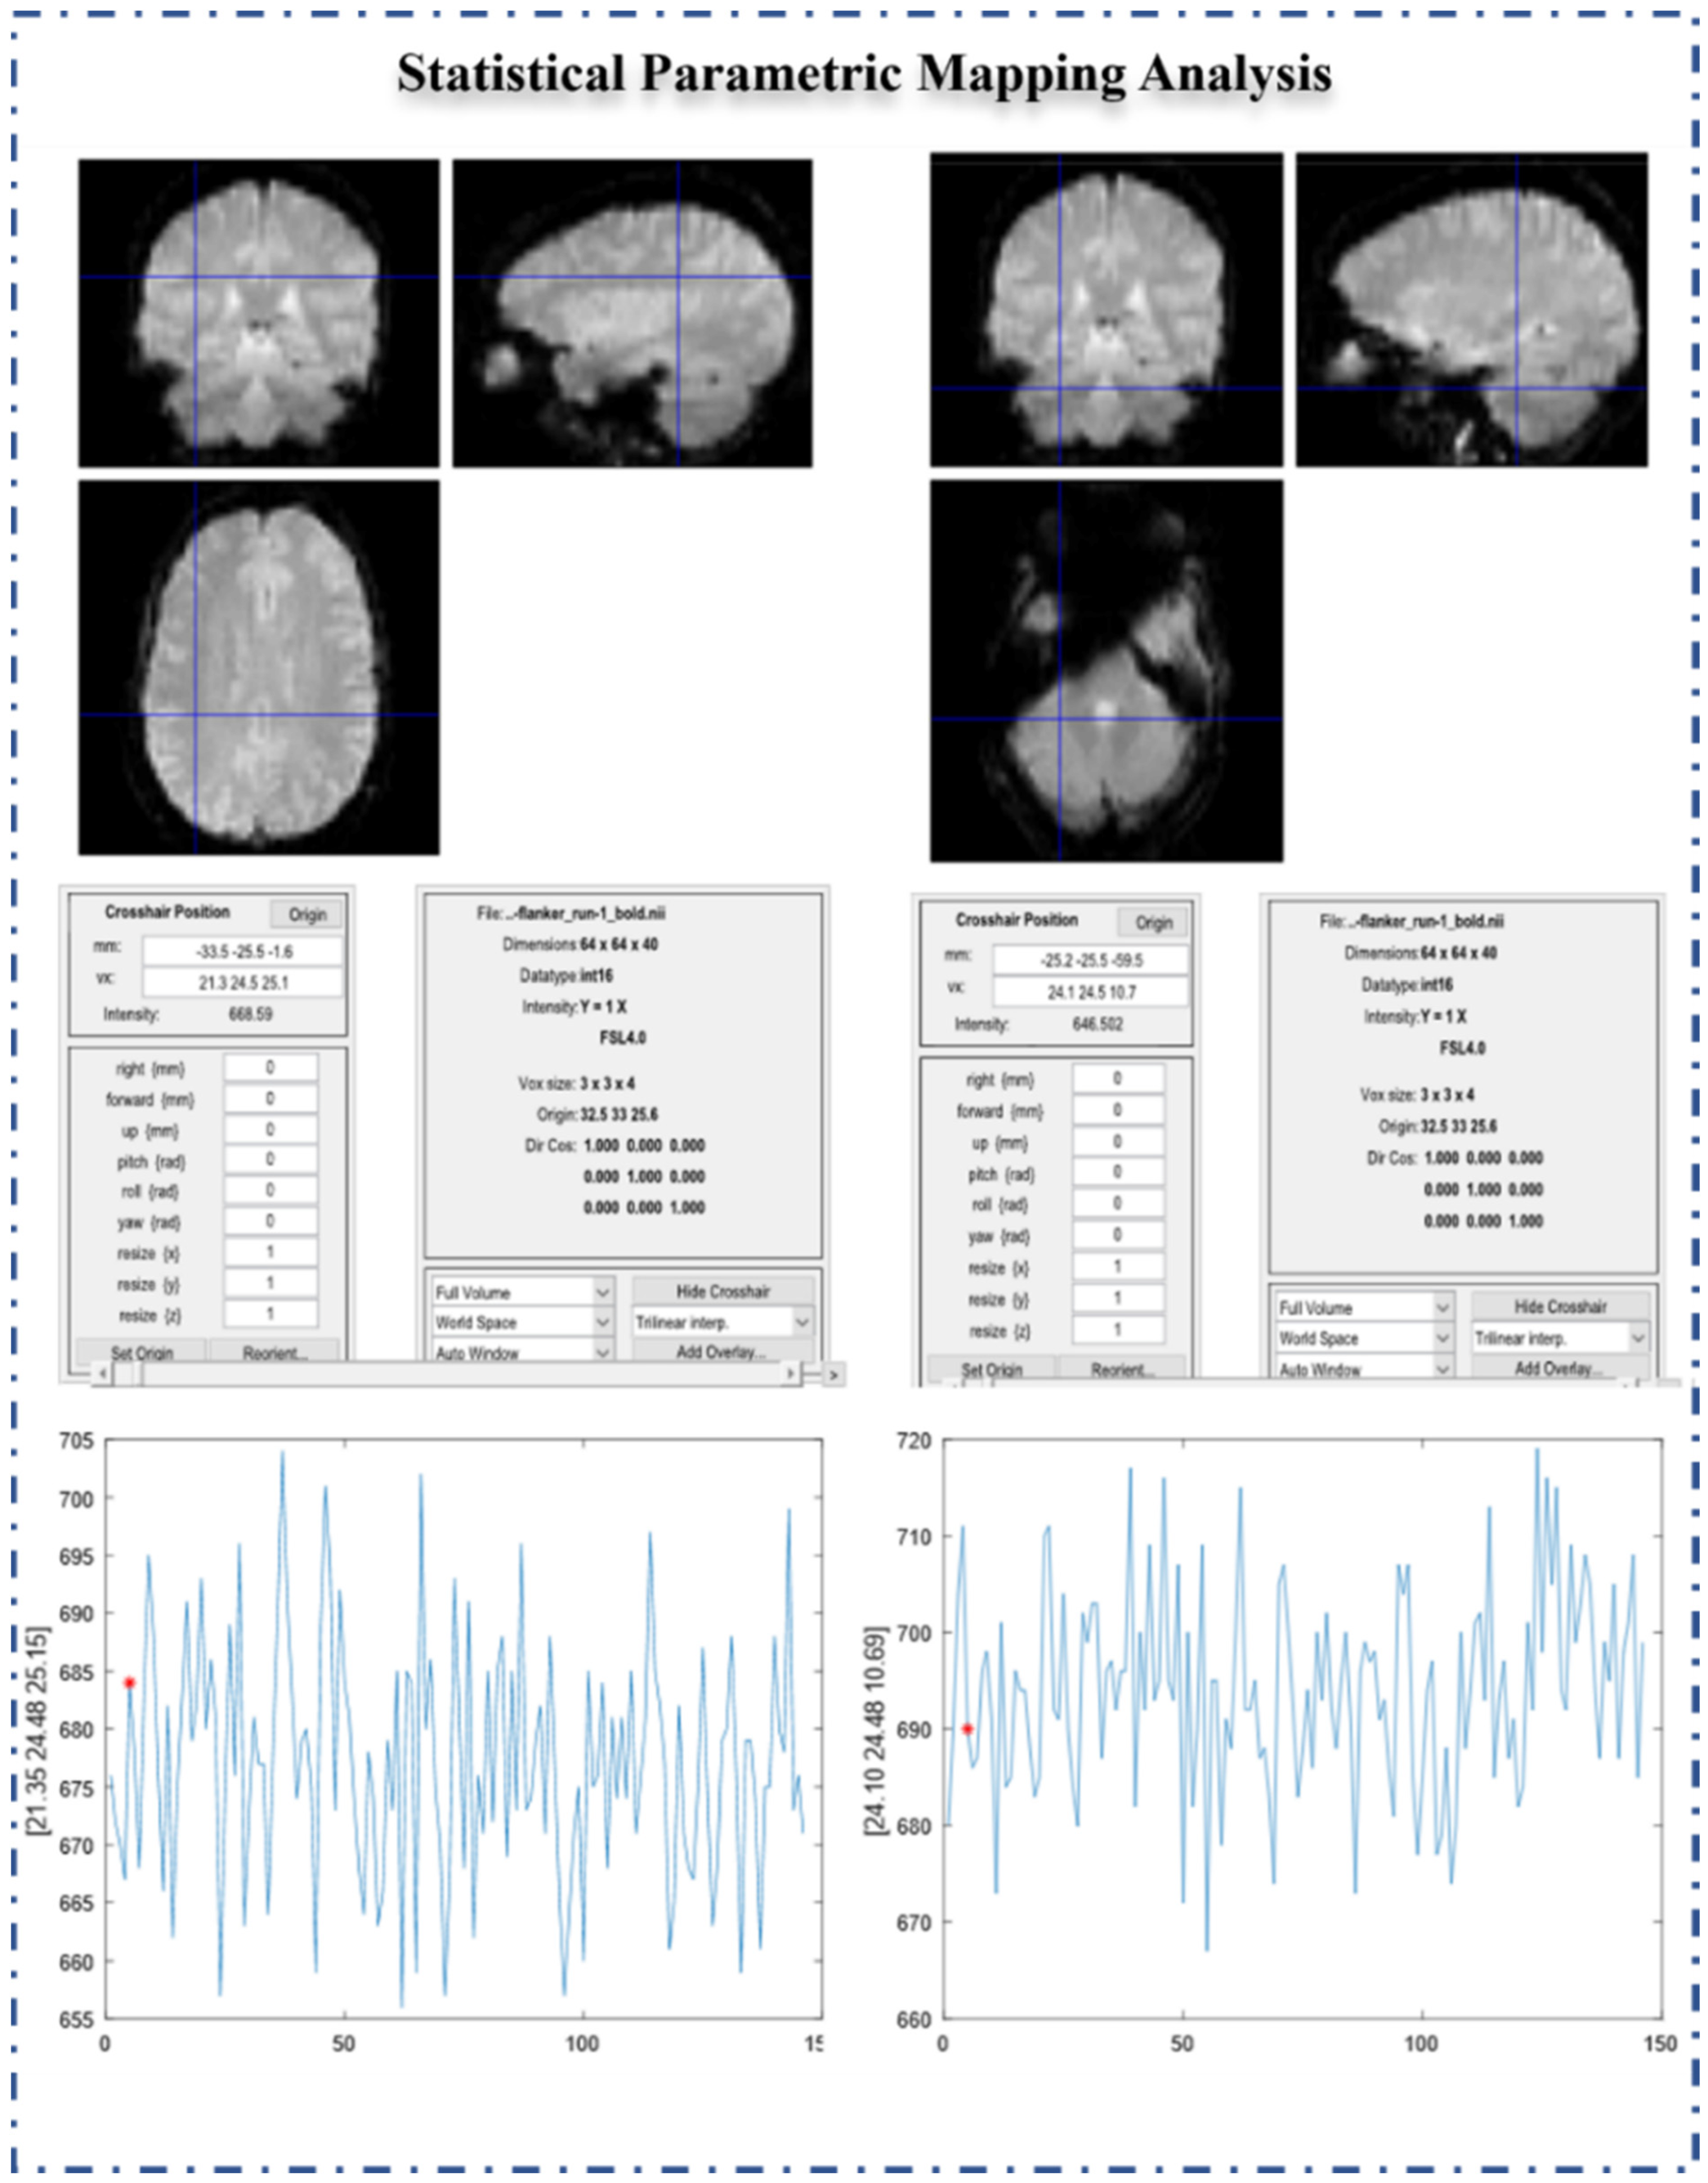

Slide 7
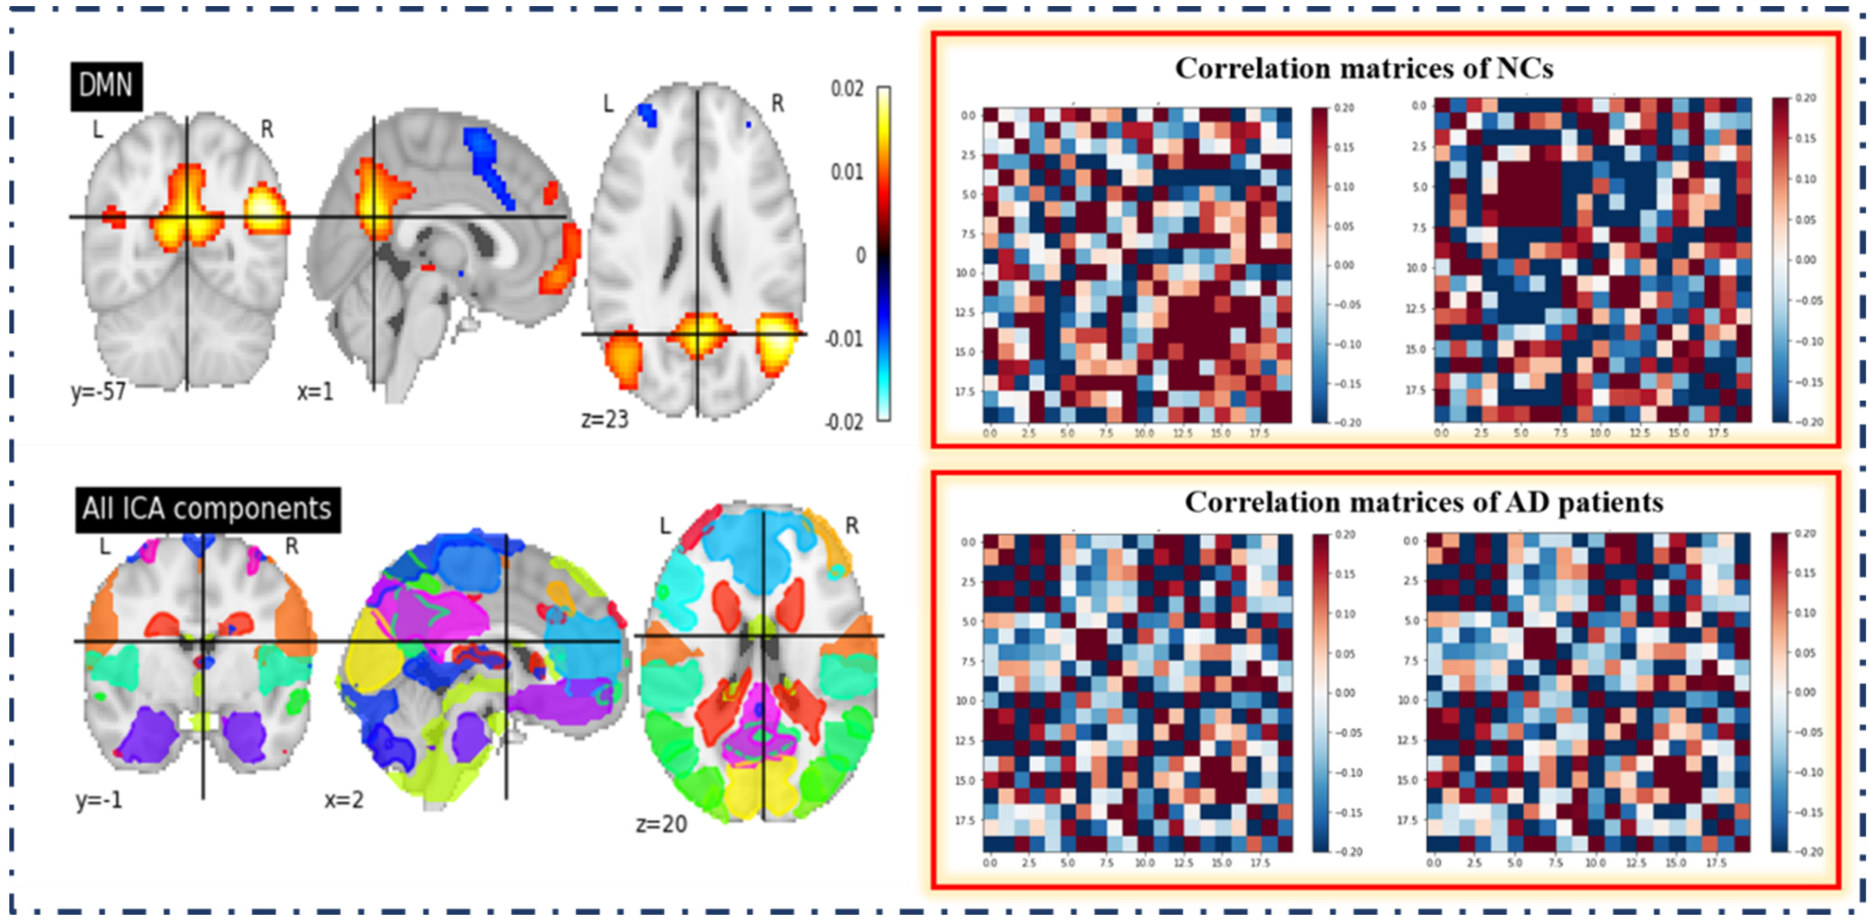

Slide 8
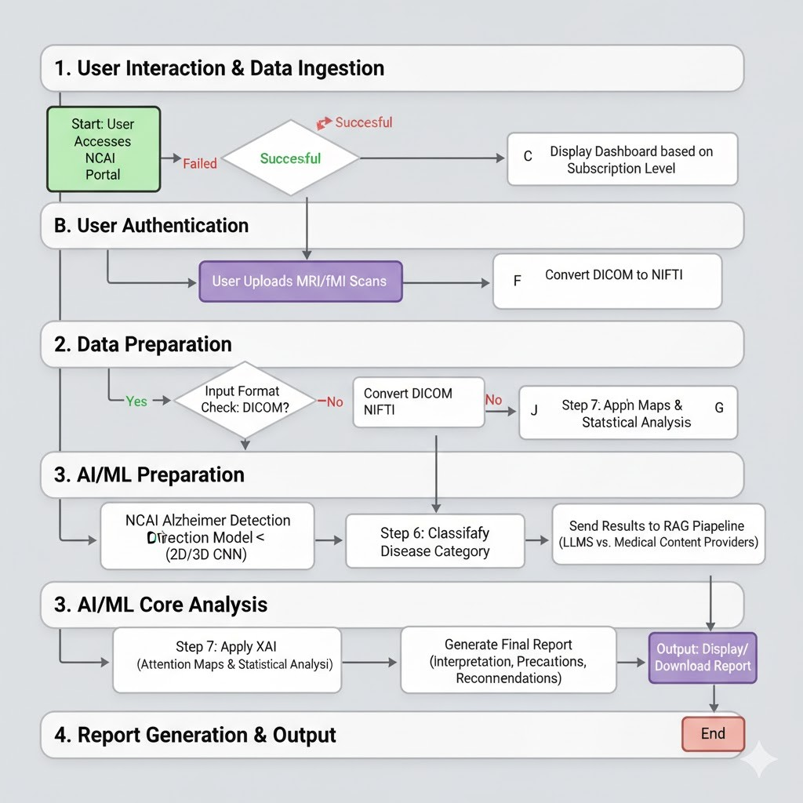
WORK FLOW OF NCAI [SAAS PRODUCT] FOR ALZHEIMER DETECTION

Slide 9
FUNCTIONAL MRI (fMRI) PREPROCESSING
Anatomical preprocessing
The first step of fMRIPrep involves processing the anatomical images.
We must have both of our anatomical (T1w or T2w) images and our diffusion MRI images aligned.
Anatomical preprocessing is typically done with the FSL Anat (T1) app.
Functional preprocessing
The second step of fMRIPrep involves processing the functional (fMRI) images.
fMRIPrep will estimate the motion that occurred across all of the fMRI volumes and correct for it. This will align all of the volumes perfectly to ensure motion is not altering the data.
fMRIPrep can additionally fix the lag in the BOLD signal and the fact that we need to acquire data in non-contiguous slices.
Images from the fMRI scanner might not be perfectly aligned to images collected before it, such as the anatomical images.
Register the functional volumes to the anatomical image and map the fMRI signal onto the surfaces generated in the anatomical preprocessing step.

Slide 10
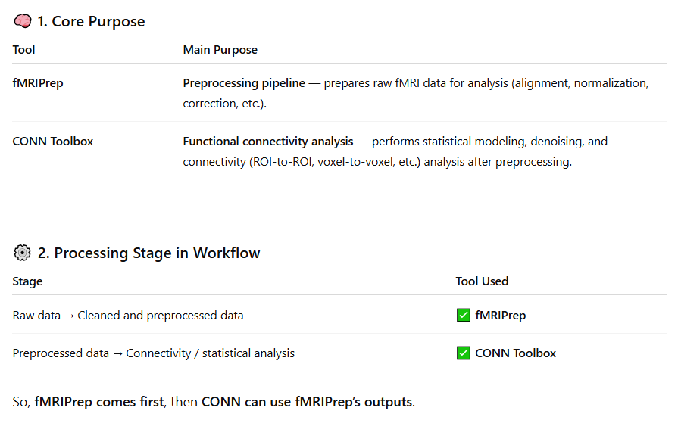
COMPARISON BETWEEN CONN TOOLBOX VS fMRIPrep

Slide 11
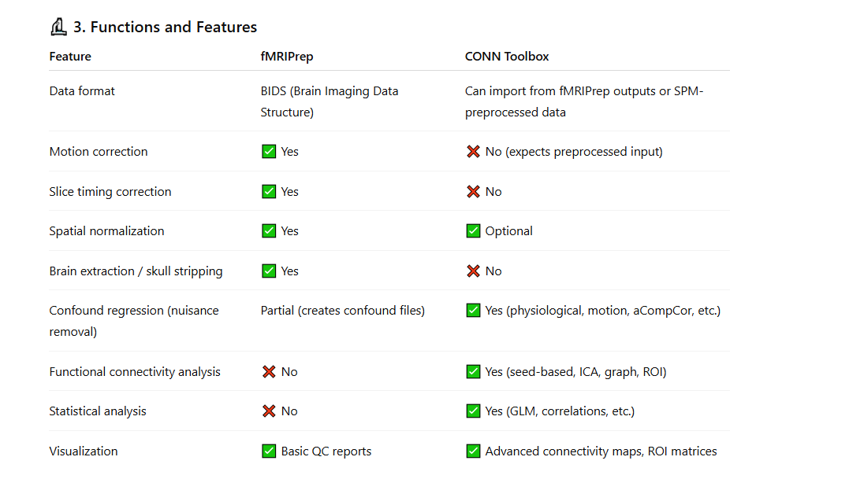
COMPARISON BETWEEN CONN TOOLBOX VS fMRIPrep

Slide 12
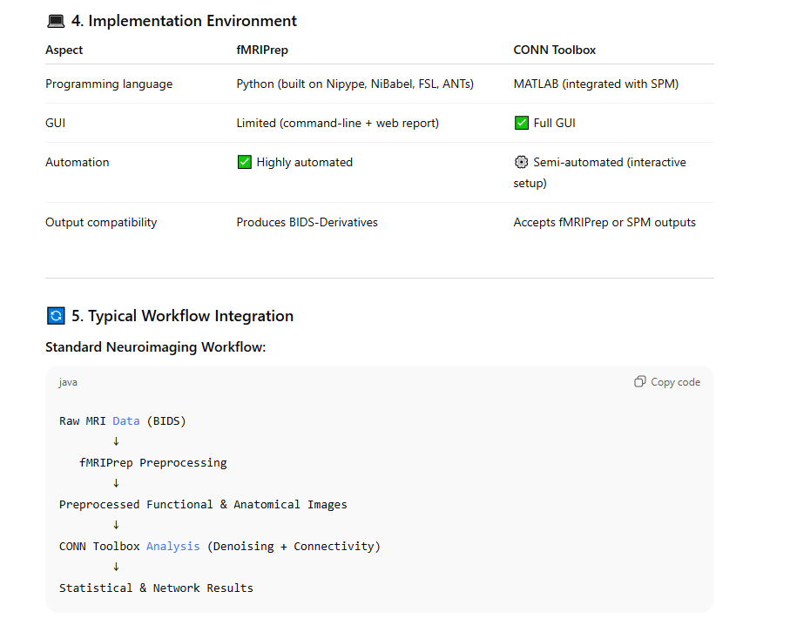
COMPARISON BETWEEN CONN TOOLBOX VS fMRIPrep

Slide 13
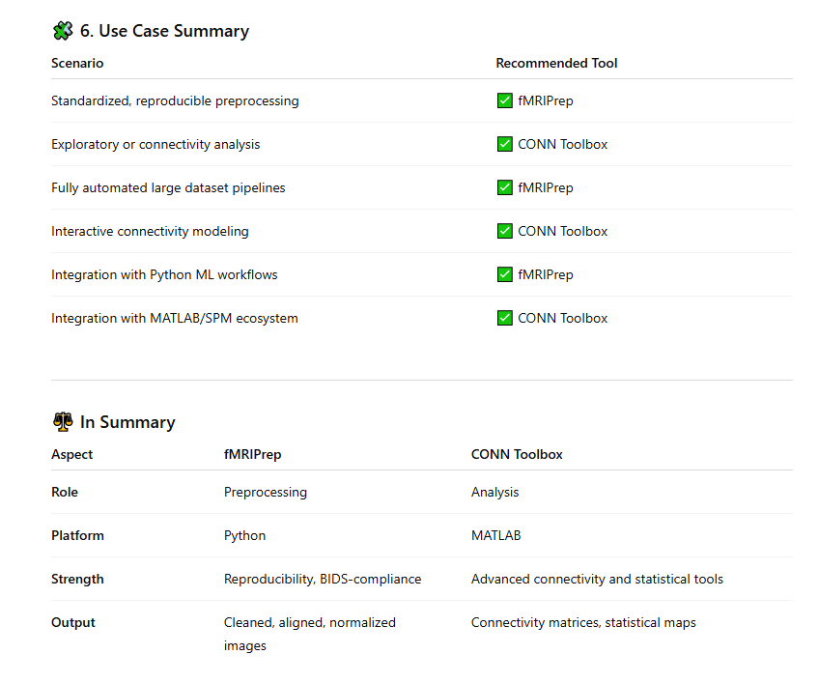
COMPARISON BETWEEN CONN TOOLBOX VS fMRIPrep

Slide 14
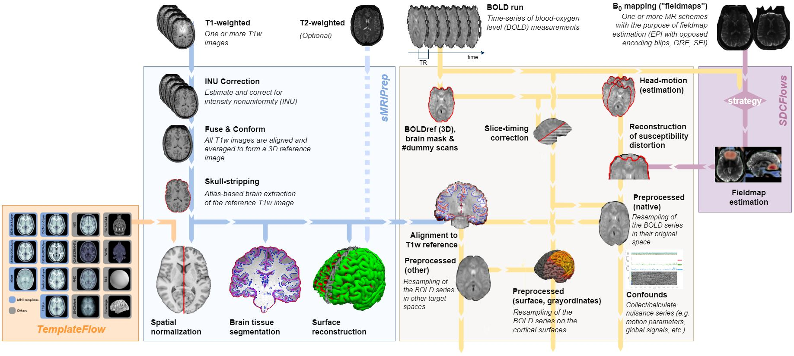
NEURO IMAGING DATA PRE-PROCESSING PIPELINES [ fMRIPrep ]

Slide 15
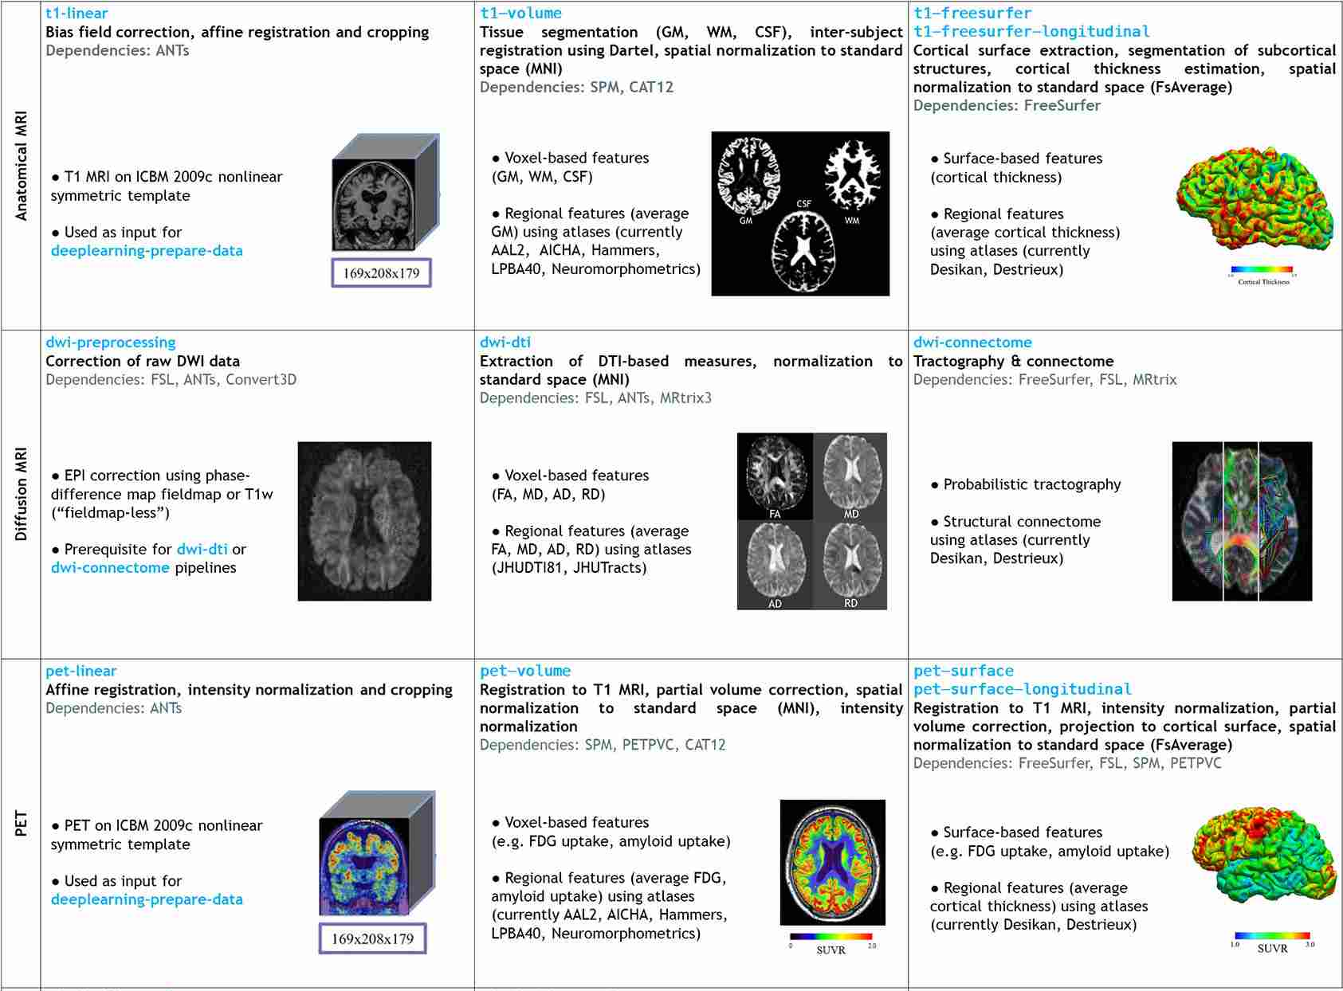
NEURO IMAGING DATA PRE-PROCESSING PIPELINES [ Clinica ]

Slide 16
