Slide 1

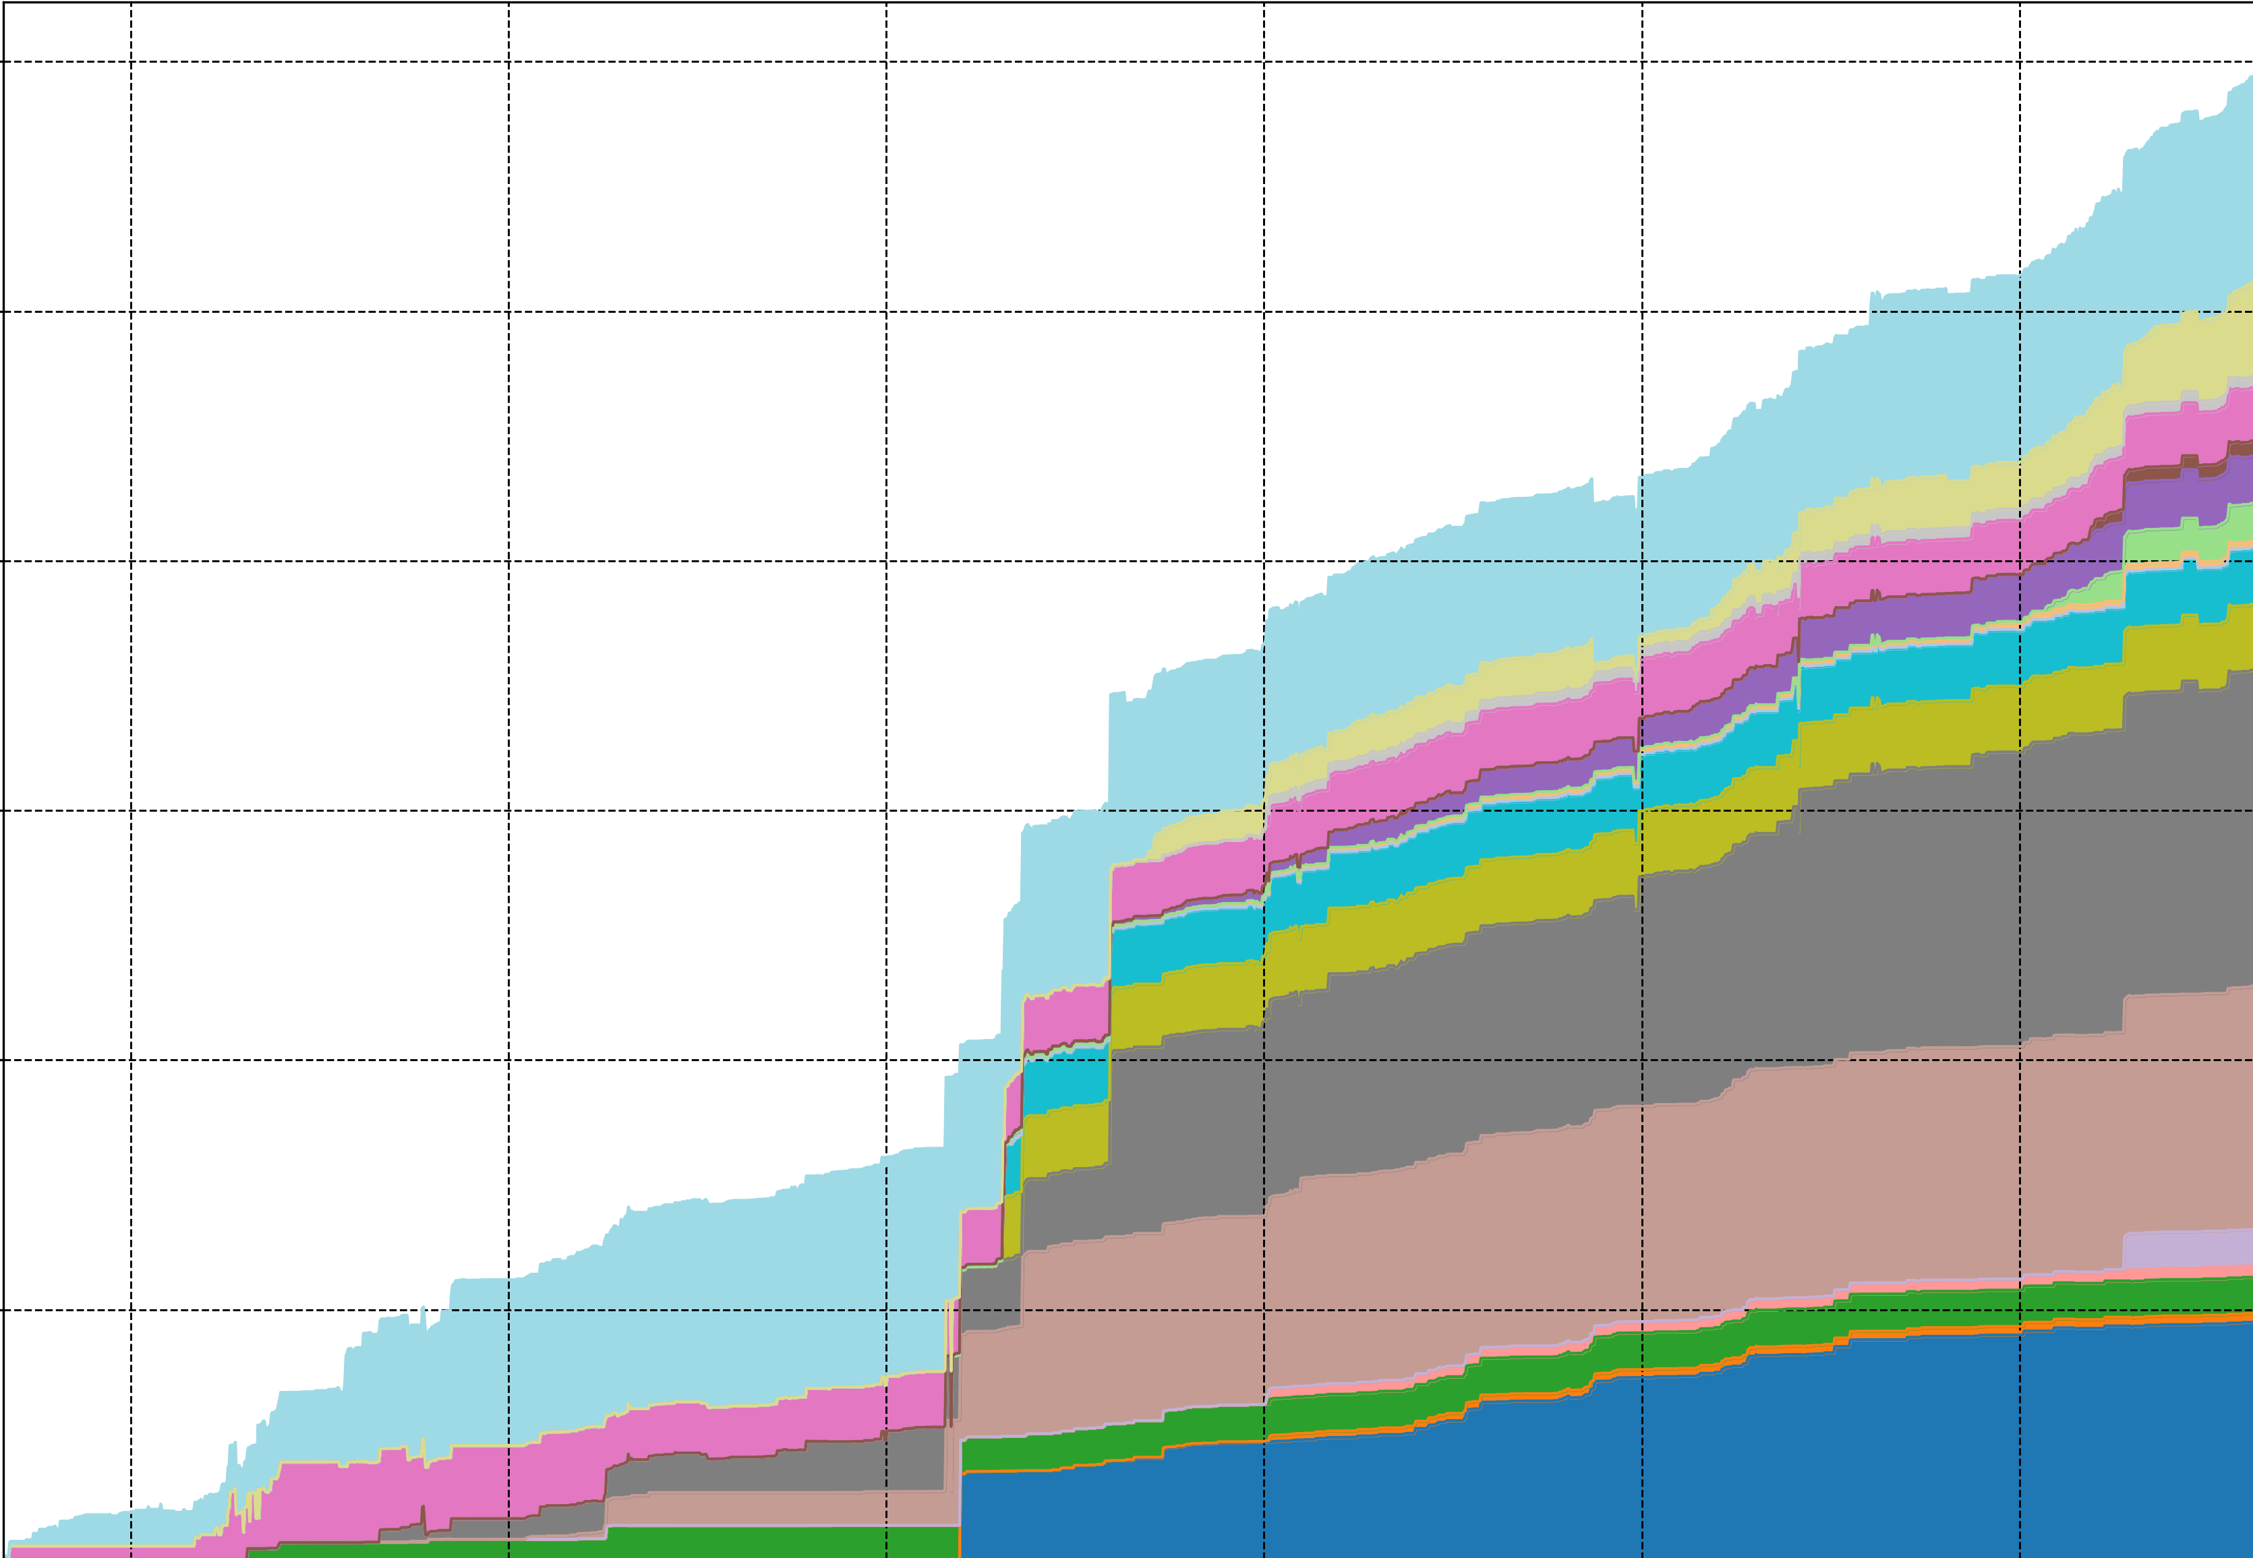
NWB Project Analytics

