Slide 1
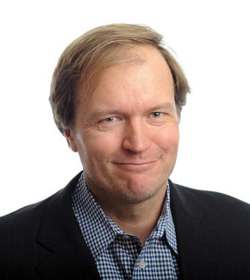
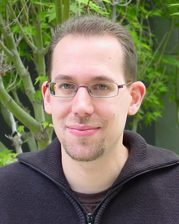
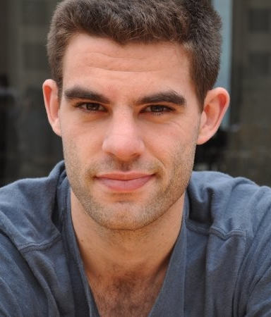
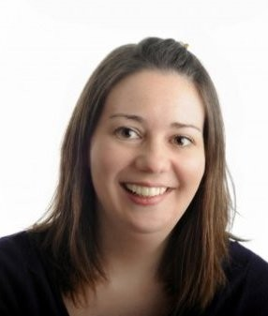
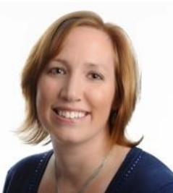
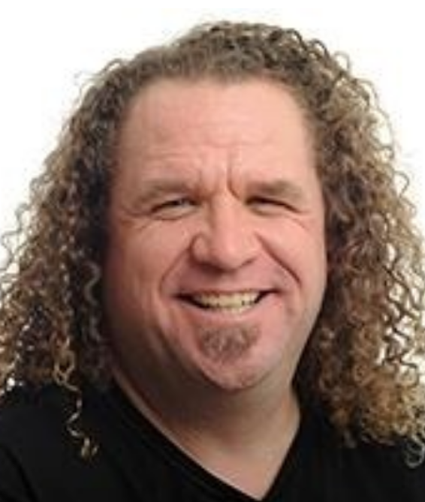




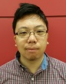
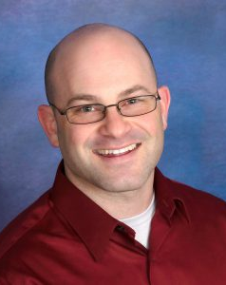
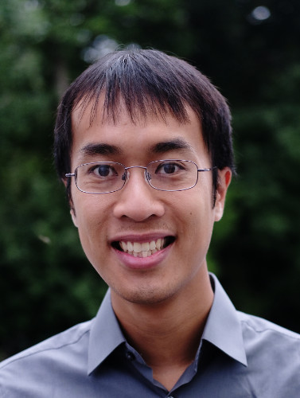
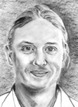
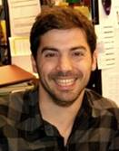
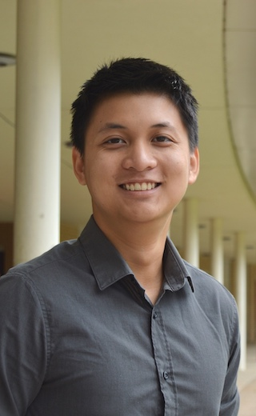
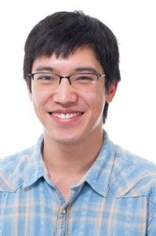
Site Chair
Organizing Committee
Logistics Support
Organizational Support
Karel Svoboda
HHMI Janelia
Oliver Rübel
LBNL
Ben Dichter
Data Science Consultant
Stephanie Albin
Science Program Officer
The Kavli Foundation
Janine Stevens
Director, Scientific Programs
HHMI Janelia
Matt Staley
UC/AV Engineer
HHMI Janelia
Presenters
Andrew Tritt
LBNL
Nathan Clack
Vidrio
Lawrence Niu
Vidrio
Michael Grauer
Ktiware
Ryan Ly
LBNL
Thomas Braun
byte physics
Tom Davidson
UCSF
Thinh Nguyen
Vathes
Vyassa Baratham
UC Berkeley

