Slide 1
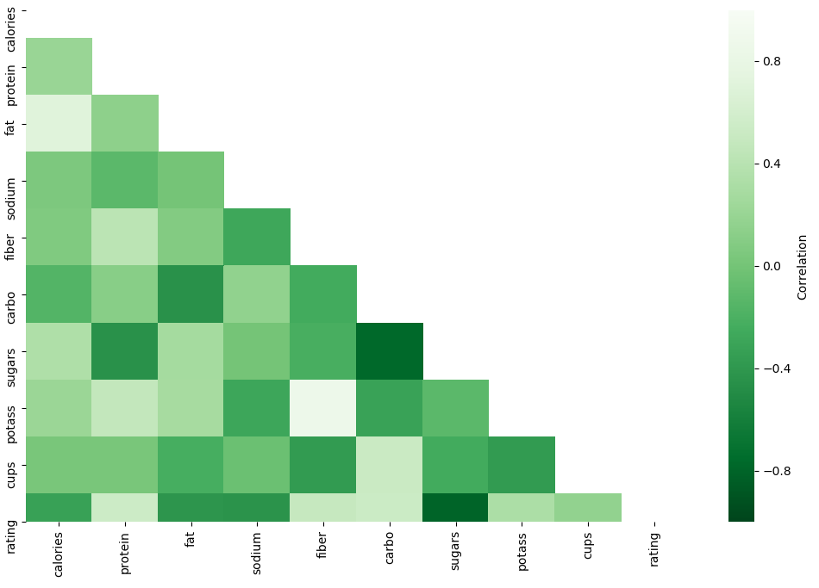






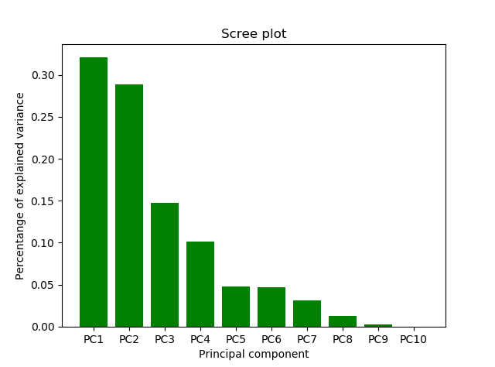
Cereals stuff bla bla
Data Description
Data Source:
Cereal dataset with multiple different cereals with
different ratings based on survey from the consumers.
16 Variables & 80 Entries
Variables:
Methodology:
Data pre-processing
Dimension Reduction
PCA
Factor Analysis
Clustering
K-Means
Linear Regression
Data Pre-Processing:
Rating
Calories
Protein
Standardize everything related to weight to 100 Grams
Sugar
Vitamins
Fiber
Objective:
Analysis the ratings of the cereals
Analysis the similar of the cereals
Predict the ratings of new possible cereals
Dimension Reduction
Clustering
Linear Regression
Conclusion

