Slide 1
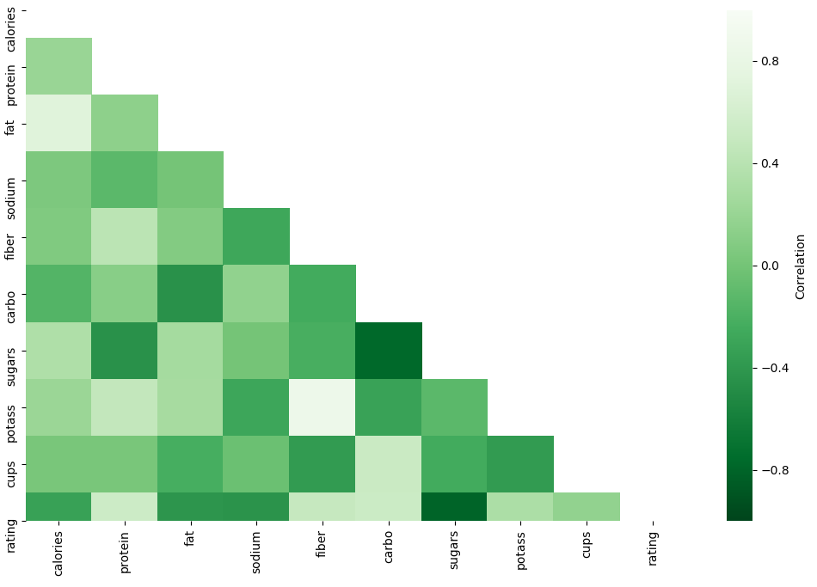






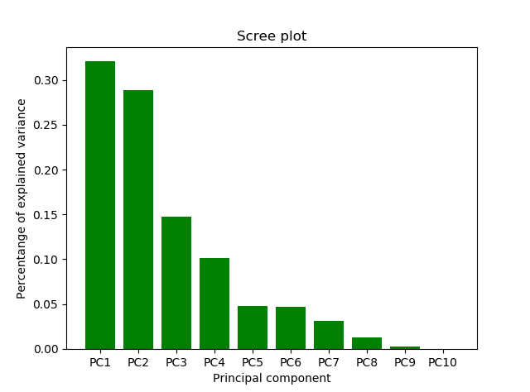
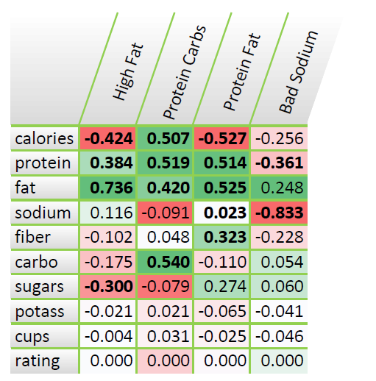
Cereals stuff bla bla
Data Description
Data Source:
Cereal dataset with multiple different cereals with
different ratings based on survey from the consumers.
16 Variables & 80 Entries
Variables:
Methodology:
Data pre-processing
Dimension Reduction
PCA
Factor Analysis
Clustering
K-Means
Linear Regression
Data Pre-Processing:
Rating
Calories
Protein
Standardize everything related to weight to 100 Grams
Sugar
Vitamins
Fiber
Objective:
Analysis the ratings of the cereals
Analysis the similar of the cereals
Predict the ratings of new possible cereals
QQ Plot not normalized
QQ Plot normalized
Short Interpretation QQ Plot
Principal Component Analysis (PCA)
Conclusion PC:
PC 1 (High Fat) is strongly positive correlated to fat, slightly to Protein and slightly negative correlated to calories, therefore the PC1 increases with increasing in fat and protein
PC 2 (Protein Carbs) has no strong correlation to a specific variable, but relatively high correlation to calories, protein, fat and carbo (complex carbohydrates), therefore it increases with increasing in these variables and explains a mix of variables
PC 3 (Protein Fat) behaves like PC 2 but with a negative correlation with calories
PC 4 has a strong negative correlation with sodium and is primarily a measure of sodium. This PC decreases with increasing in sodium
Objectives PCA:
Reduce dimensions
Help visualizing
Interpretation Scree Plot:
PC 1 explains 3X % of the variation
PC1 – PC4 explains 8X % of the variation which can be considered as adequate
Further use of PCA:
Computed PC’s can be used for the following clustering analysis or a linear regression
PCA DIM PLOT?
Clustering
Linear Regression
Conclusion

