Slide 1
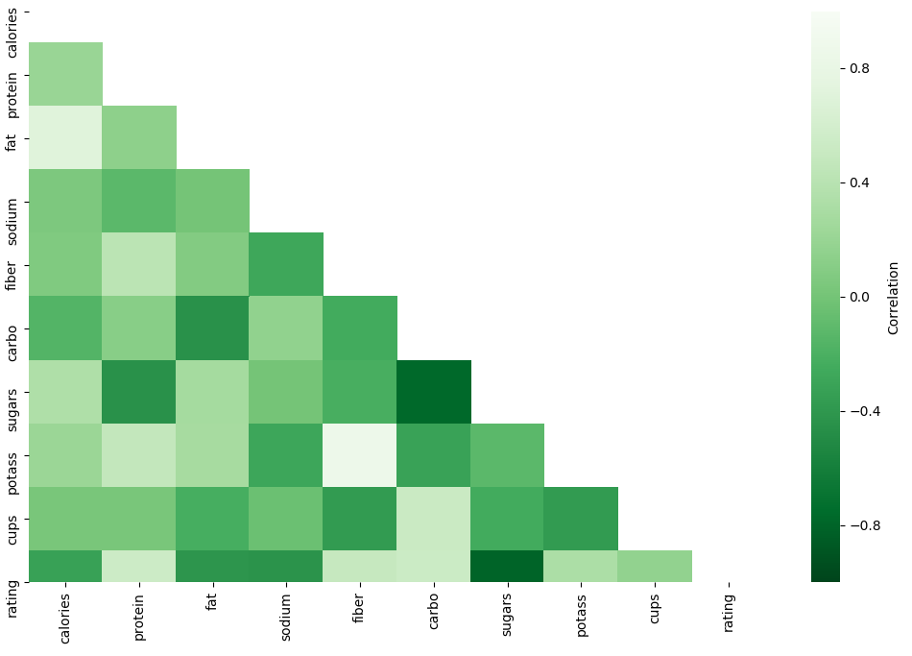






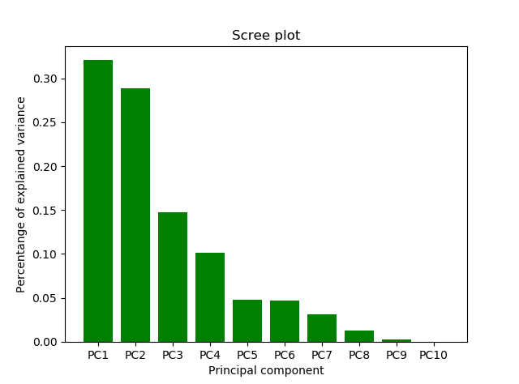
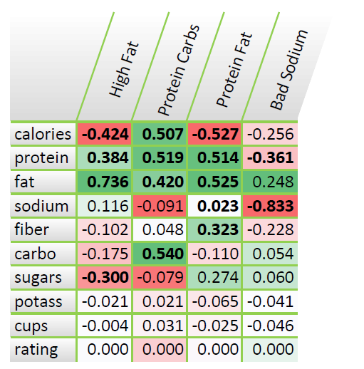
Cereals stuff bla bla
Data Description
Data Source:
Cereal dataset with multiple different cereals with
different ratings based on survey from the consumers.
16 Variables & 80 Entries
Variables:
Methodology:
Data pre-processing
Dimension Reduction
PCA
Factor Analysis
Clustering
K-Means
Linear Regression
Data Pre-Processing:
Rating
Calories
Protein
Standardize everything related to weight to 100 Grams
Sugar
Vitamins
Fiber
Objective:
Analysis the ratings of the cereals
Analysis the similar of the cereals
Predict the ratings of new possible cereals
QQ Plot not normalized
QQ Plot normalized
Short Interpretation QQ Plot
Principal Component Analysis (PCA)
Objectives PCA:
Analysis the ratings of the cereals
Analysis the similar of the cereals
Predict the ratings of new possible cereals
PCA DIM PLOT?
Interpretation Scree Plot:
Analysis the ratings of the cereals
Analysis the similar of the cereals
Predict the ratings of new possible cereals
Conclusion PCA and further use:
Analysis the ratings of the cereals
Clustering
Linear Regression
Conclusion

