Slide 2
Training
Test
F
G
R
H
R
H
E
D
11
10
9
8
13*
12
7
6ª
14*
5^{b}
15*
4
16*
3
C
not to scale
17*
2
Alleys
18*
1
B
Platform
*shorter arms
ªmost direct to R
S
Start
^{b}most direct to H
A
R
Reward
S
H
Light
S

Slide 3
Training
Test
R₂
R₂
R₁
R₁
8
7
6
5^{b}
9
4ª
10
3
not to scale
11
2
Alleys
12
1
Amphitheatre
ªmost direct to R₁
S
Start
^{b}most direct to R₂
R
Reward
S
S

Slide 4
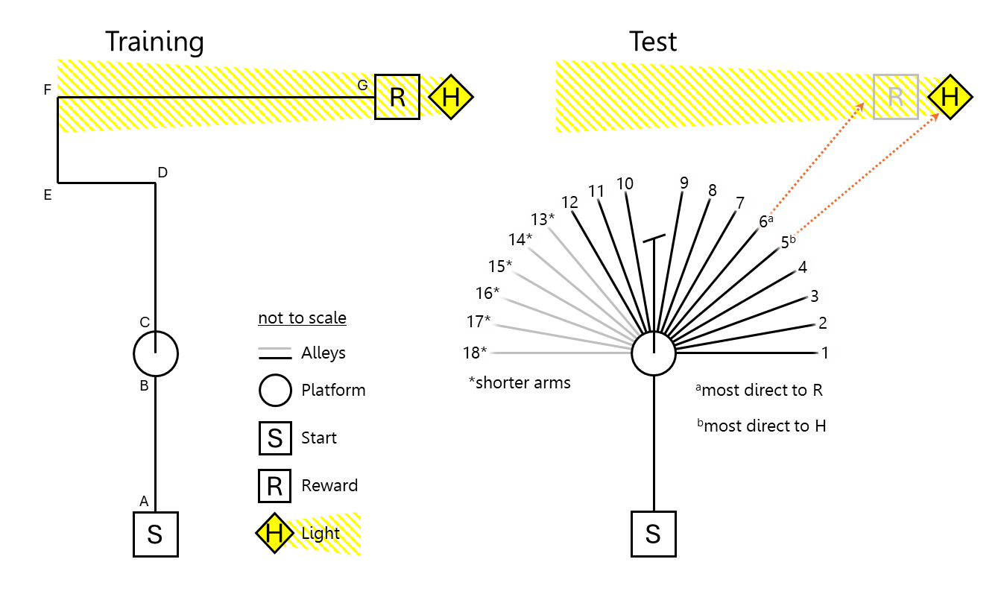
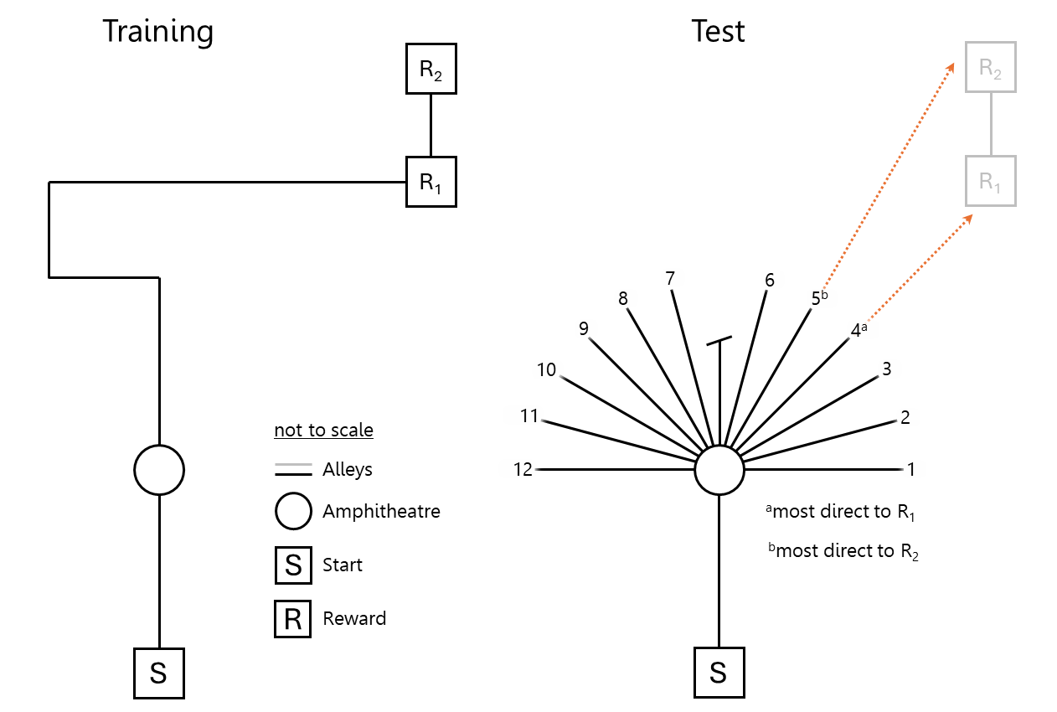
Tolman et al. (1946)
Young et al. (1967)

Slide 5
H
H
H
H
not to scale
Alleys
Dead ends
R
S
H
H
H
H
Light
S
Start
R
Reward
11 right turns

Slide 6
R
S

Slide 7
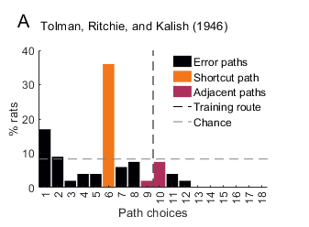
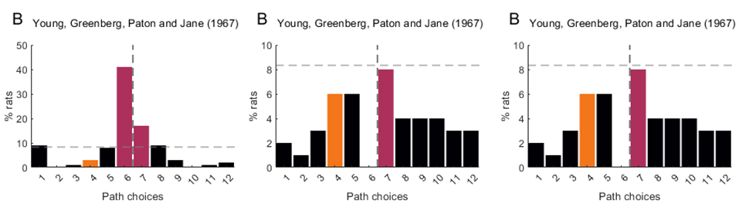

Slide 8
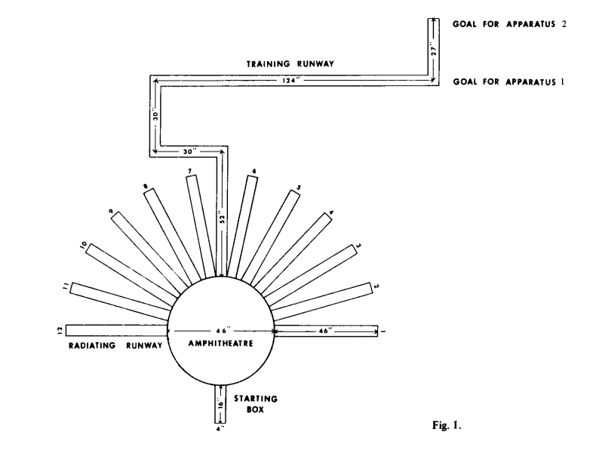

Slide 9
H
H
H
right turns
left turns
H
not to scale
Alleys
Dead ends
R
S
H
H
H
H
Light
S
Start
R
Reward
18 left turns
18 left turns

