Slide 1
Classifying Plankton Species with Computer Vision and Deep Learning
An ANC Seminar Talk by
Scott Lowe
24th March, 2015

Slide 2


Why am I studying plankton?!
Kaggle competition, with 1st prize $100,000
Good way to learn some stuff about Convolutional Neural Networks and Computer Vision
Fun project
The team was
  Matt Graham
  Gavin Gray
  Scott Lowe
  Finlay Maguire
  Alina Selega
  Dragos Stanciu

Slide 3
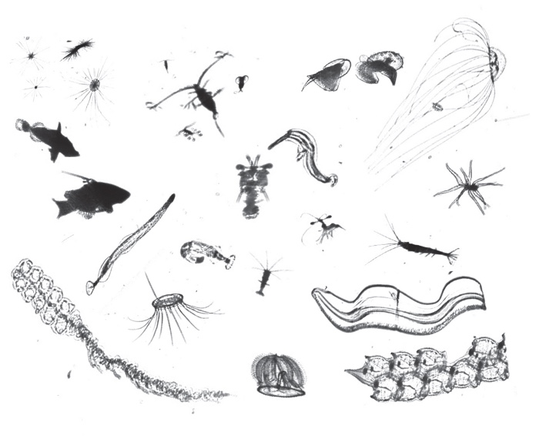
Dataset examples

Slide 4
The Dataset
Plot of example images
Plot histogram of class frequencies
Plot distribution of image sizes
Mention
  Lots of classes (121)
  Class imbalance (show distribution)
  Size variation (show distribution)
  Hierarchical class relationship (show taxonomy)

Slide 5
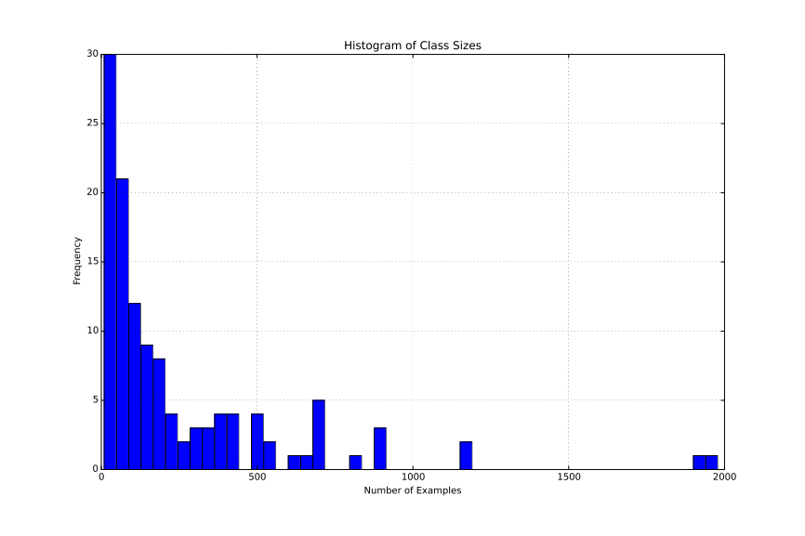
Distribution of class cardinality
Notes:
Lots of classes (121)
Class imbalance

Slide 6
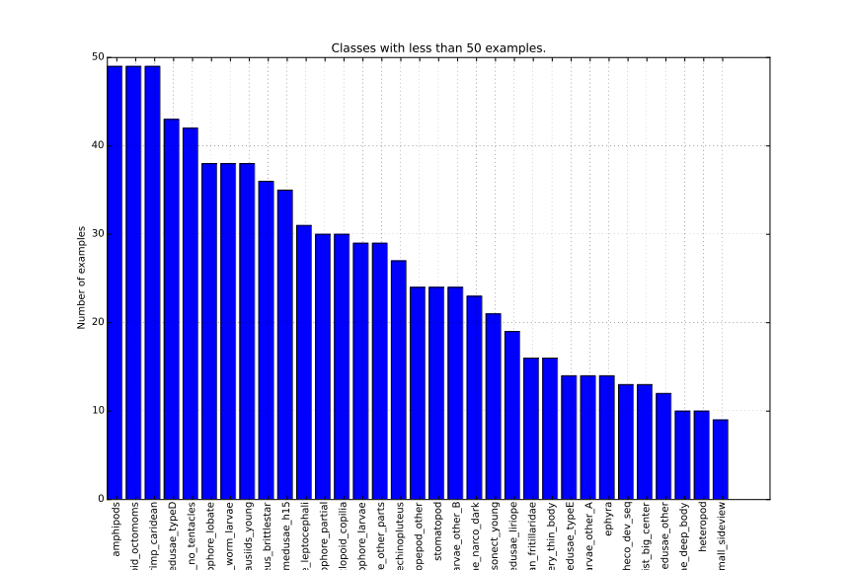
Distribution of class cardinality

Slide 7
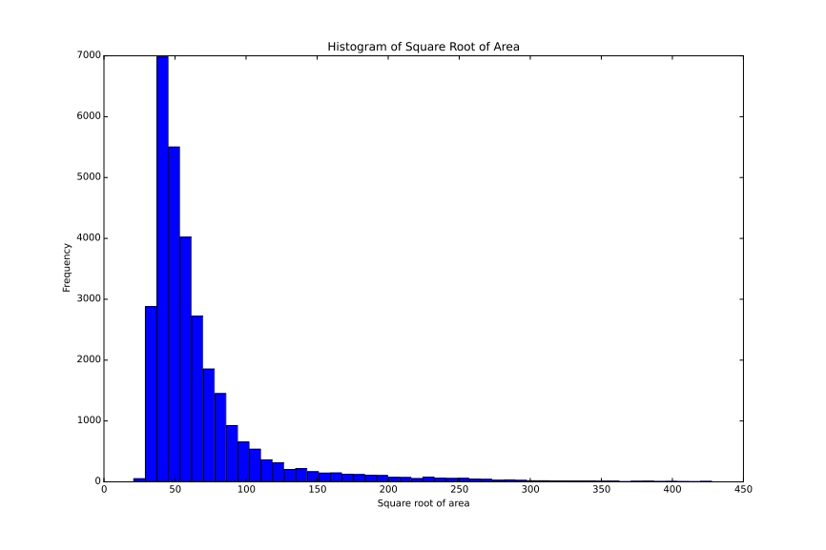
Distribution of image sizes

Slide 8
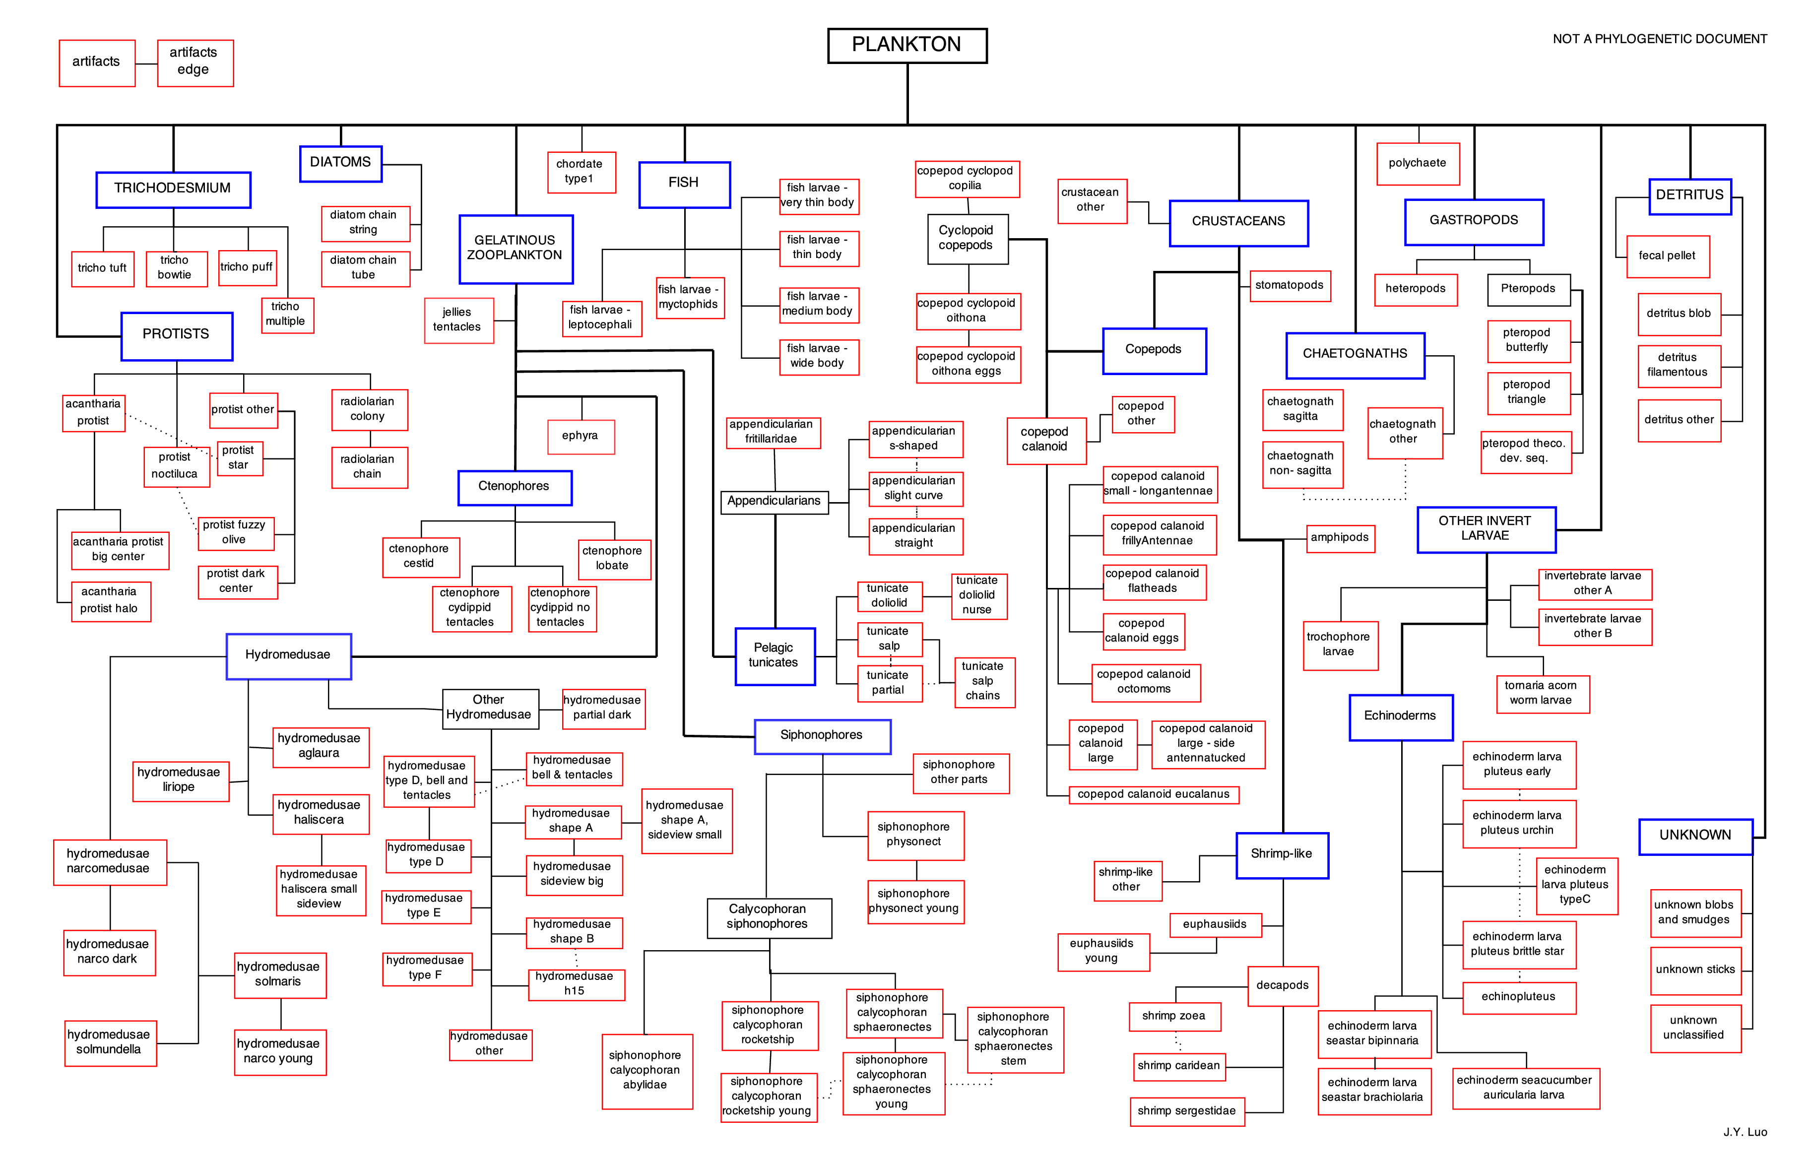

Slide 9
Similarities to other projects
BugID project
Bob Fisher's work

Slide 10
Our approach
Two general routes for solving image classification problem
  Convolutional neural networks (“convnets”)
  Computer vision heuristic techniques
So combine the two techniques and beat though who use only one!

Slide 11
Offline Image Augmentation
Offline augmentations
  Rotation: [0,90,180,270] or [0,45,90,...] degrees, etc
  Reflection: [no, yes]
  Crop: [none, 20% top, 20% left, bottom, right]
  Others implemented but not used
Constrained by lack of CPU RAM

Slide 12
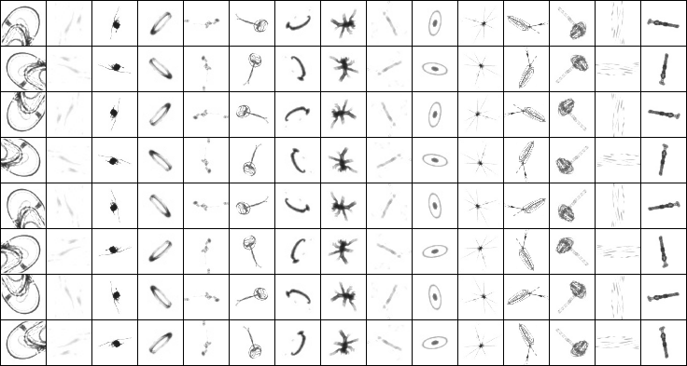
Offline Image Augmentation

Slide 13
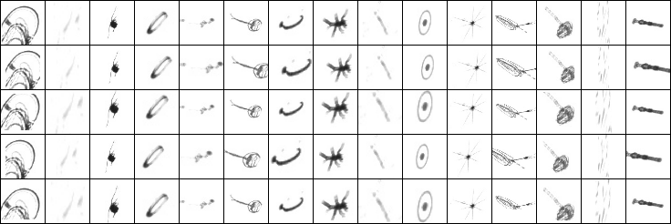
Offline Image Augmentation

Slide 14
Online Image Augmentation
Online augmentations
  Rotation: Uniform across [0,360) degrees
  Reflection: Bernouli distributed
  Translation: Gaussian in x and y, N(0%, 5%)
  Scale: Gaussian N(1.0, 0.1)
  Stretch: Gaussian in x and y individually, N(0, 0.01)
  Shear: Gaussian N(0, 5°)
Augmentations generated for next batch on CPU while training on GPU

Slide 15
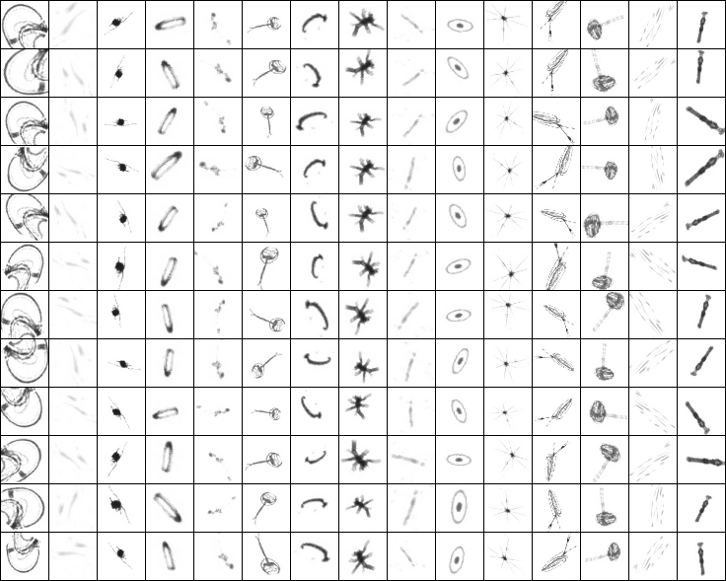
Online Image Augmentation

Slide 16
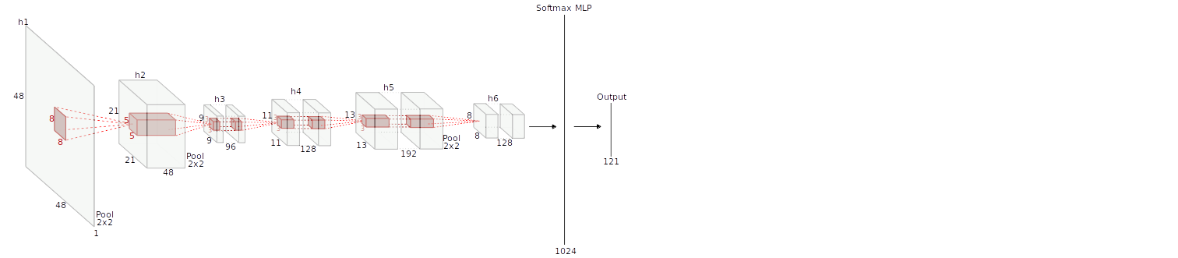
Convnet schema

Slide 17
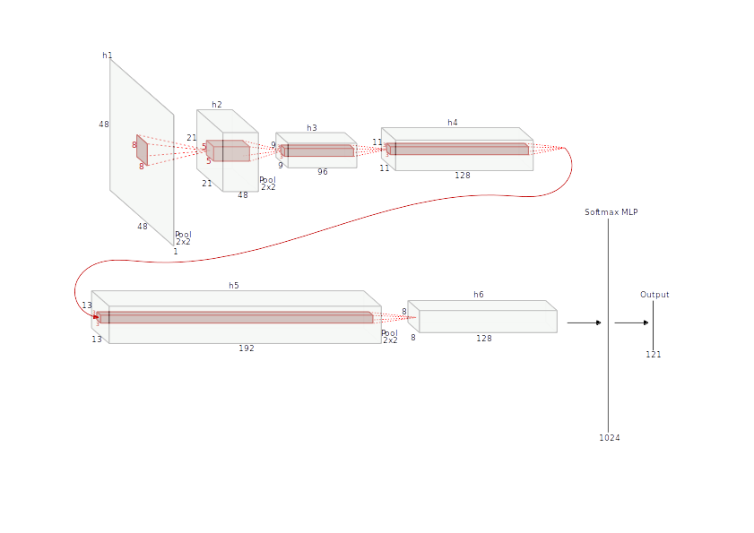
Convnet schema

Slide 18
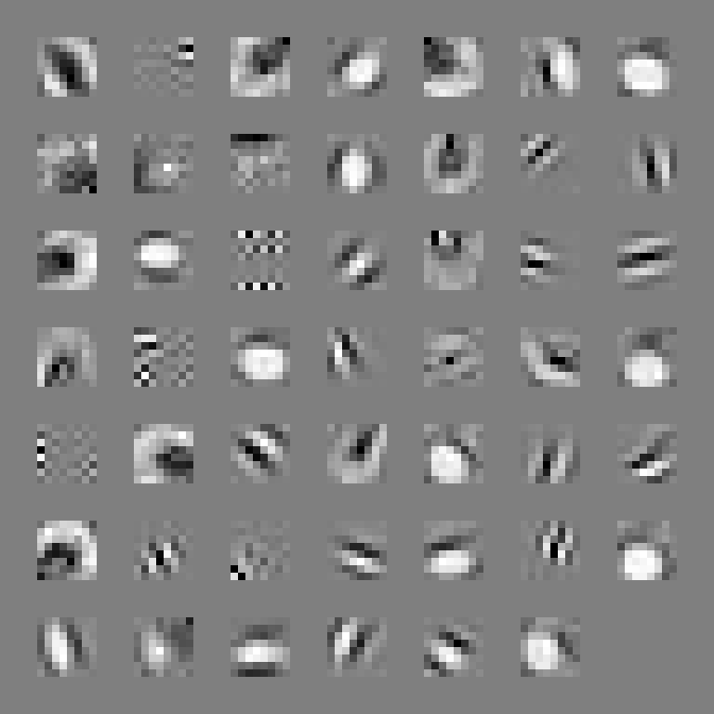
Initial layer kernels

Slide 19
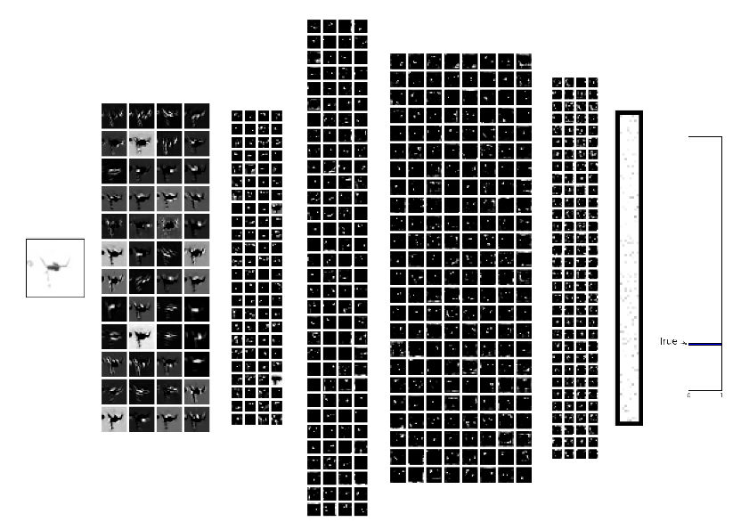
Example stimulus response

Slide 20
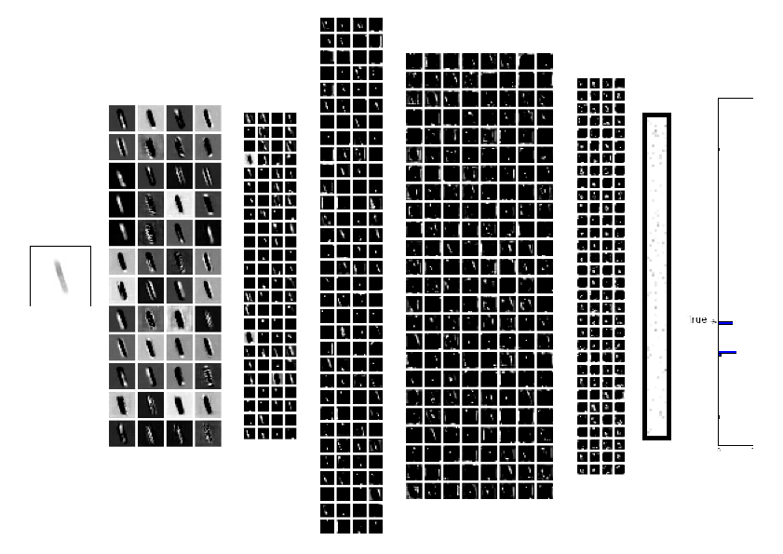
Example stimulus response
Notes:
True: Fecal
Predicted: diatom_chain_tube

Slide 21
Hierarchical Modelling
We can also tell the network about the class structure
Increase performance by adding this information to the output targets?

Slide 22
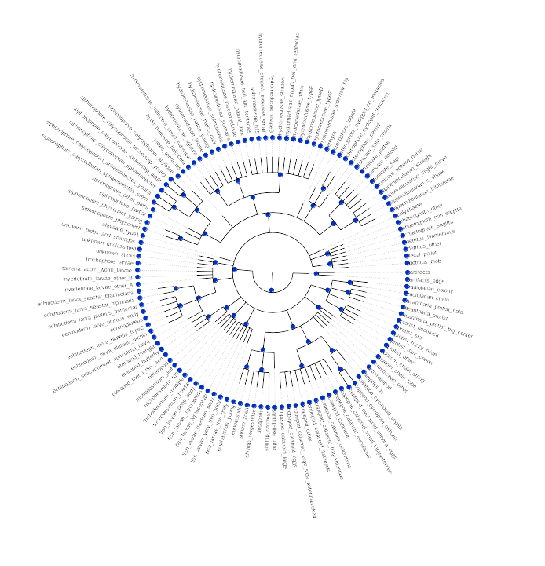

Slide 23
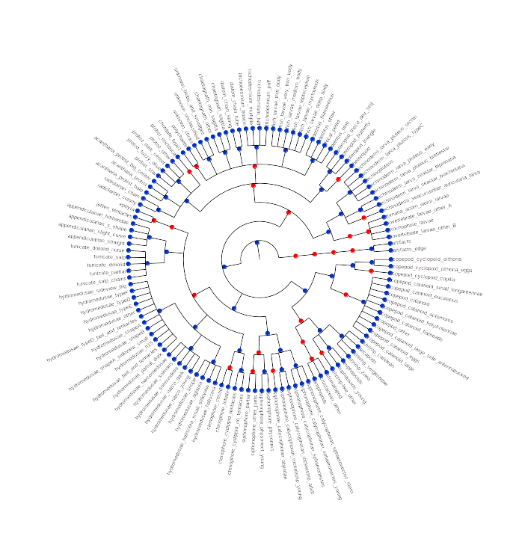

Slide 24
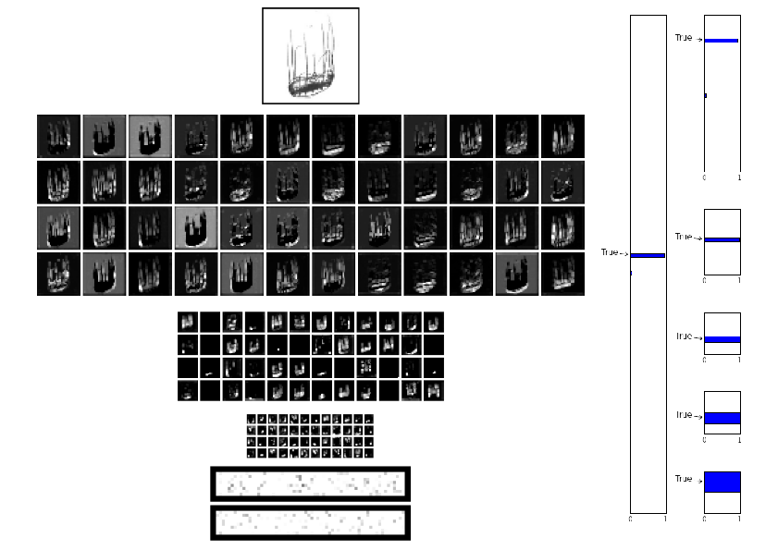
Example stimulus response

Slide 25
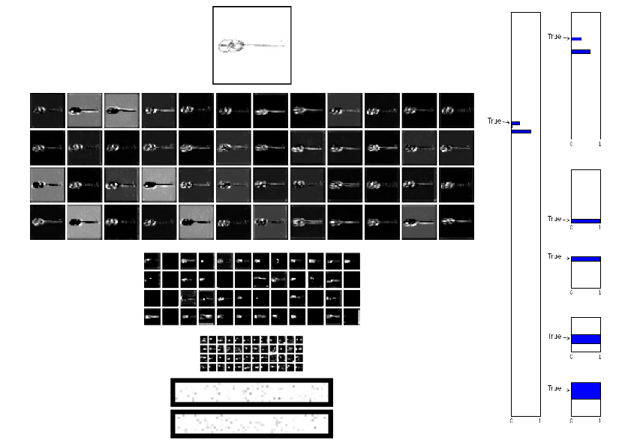
Example stimulus response

Slide 26
Things which didn't work, but should have:
Hierarchical class encoding
Models trained using the hierarchical structure as the output targets
Peak performed was similar to models without hierarchical class encoding

Slide 27
Things which didn't work, but should have:
Siamese networks
Resizing images loses detail in large images, and loses the absolute size of the plankton
Convnets are frequently applied to patches of a larger image
Why not feed the image through with and without resizing and show both to the network?
Did not help - performed worse than single resized input

Slide 28
Things which which really underperformed:
CV feature-based decoder
Detected global texture features
  Haralick features
  Grey-Level Co-ocurrance Matrix properties
  Contour moments and Hu moments
  Grey-level intensity histogram (within contour)
  Parameter Free Threshold Adjacency Statistics
Local feature detection and description
  ORB
  BRISK (but super slow, so not used)
  MSER
Fit classifier with RF, SVM or Logistic Regression (similar performances)
Performance was better with global than local features
Constructed a hierarchical model, but got no benefit (for global features)
All models were worse than the simplest convnets

Slide 29
Things which didn't work, but should have:
CV feature integration
Tried to integrate offline-augmented CV features with convnet
Joined CV features into the network after convolutions
Got worse performance than other models

Slide 30
Final submission
Average probabilities from lots of augmented versions of test stimulus
Weighted average of 3 models

Slide 31
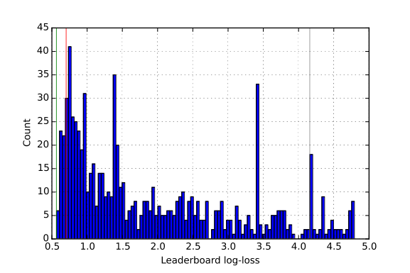
Competition Results
57th out of 1049 teams (top 5.4%)
Log-loss 0.704582
  Winner: 0.565971
  Uniform distribution: 4.795791
  Stratified prior: 4.161789

Slide 32
Toolkit
Git repository for code sharing on Github
waffle.io for issue tracking
Unit tests (but only at the beginning...)
Tests performed on every push using Travis
Python 2.7
  Convnets built with Pylearn2 (Theano under the hood) running CUDA
  skimage, mahotas, OpenCV
  sklearn
  HoloViews for plotting

Slide 33
What did the winning team do?
Everything we did but better
More convolution layers (10), and smaller convolutions
Cyclic pooling & maxing across 4 rotations simultaneously
Leaky rectified linear units

Slide 34
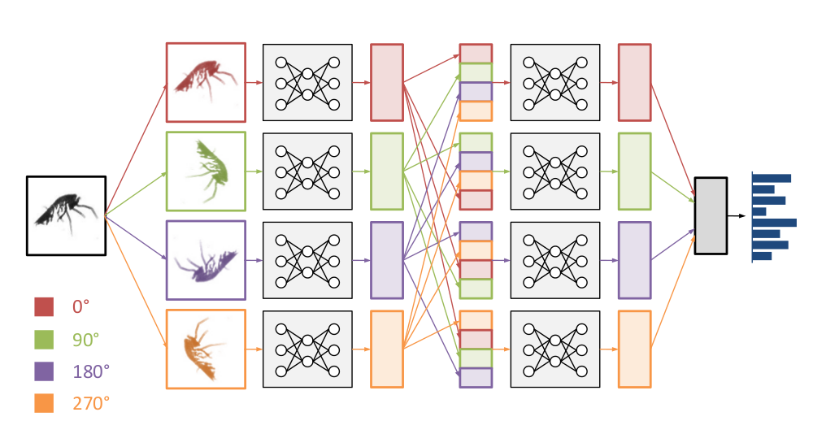
Winning team's
Cyclic pooling
Source: Sander Dieleman et al., http://benanne.github.io/2015/03/17/plankton.html

Slide 35
Conclusions
Unit testing is essential to know your code works the way you think it does
Running experiments testing only one thing at a time is essential
Pylearn2 is poorly documented and probably not work using
Convnets more powerful technique than Computer Vision feature extraction
Hierarchical modelling did not work for us

Slide 36
Acknowledgements
The team was
  Matt Graham
  Gavin Gray
  Scott Lowe
  Finlay Maguire
  Alina Selega
  Dragos Stanciu
Our thanks to Bob Fisher, Amos Storkey and Chris Williams for their helpful advice.

Slide 37
What next?
Diabetic Retinopathy Detection challenge on Kaggle, could be tackled with a similar approach. Prize is $50,000

