Slide 1
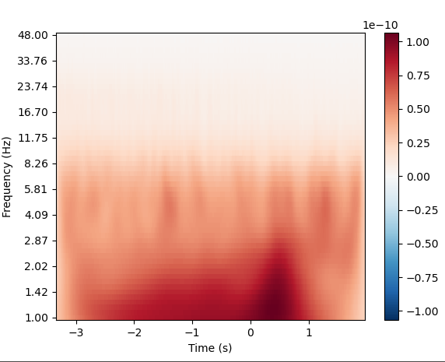
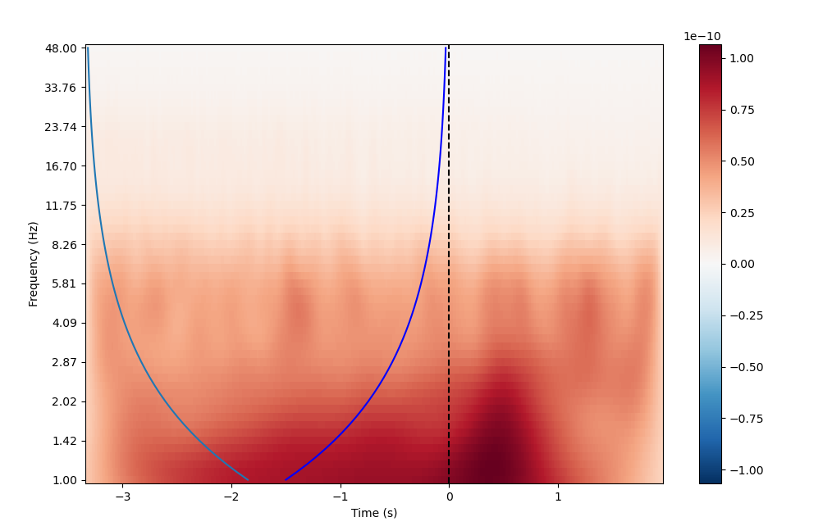
Time frequency
freqs = np.logspace(*np.log10([1, 48]), num=56)
n_cycles = 3
tfr = tfr_morlet(epochs, freqs=freqs, decim= 3, n_cycles=n_cycles, average=False, use_fft=True) tfr.average().plot(2) # example plot channel 2
COI
wavelet_width = n_cycles/freqs
coi = wavelet_width/2
# Add plot
plt.plot(coi-3.35,freqs)
plt.plot(0-coi,freqs,color='blue')
Extract feat for mvpa
X = the mean of this yellow area for each data point covered by it

