Slide 1
Building a Neuromine deck
Neuromine brand skill
The template, the helpers and the checker

Slide 2
1. Start from the template
Every deck opens neuromine-template.pptx and adds slides by layout.

Slide 3
Four steps take a deck from template to send
Open the template and drop its guide slides
Add slides from the eight layouts by name
  Title first, Closing last
Fill text, tables, charts and pictures with the helpers
Run check_deck.py and fix every FAIL

Slide 4
Slide text comes in six sizes
Table 1. Text sizes on a slide. Source: references/brand.md
Text | Font | Size (pt)
Title slide headline | Helvetica Neue bold | 54
Content slide headline | Helvetica Neue bold | 40
Subline and first level text | Helvetica Neue | 22
Second level, tables and chart labels | Helvetica Neue | 16
Eyebrow and captions | Helvetica Neue | 14
Footer and page number | Helvetica Neue | 12

Slide 5
Blue carries the brand on every slide
Title and closing slides are brand blue all over
Content slides are white with a blue strip at left
Headlines are brand blue at 40 pt
The white logo sits only on brand blue, top left, at 0.75 in high.

Slide 6
Title headlines are over twice the subline size
Figure 1. Slide text sizes by role, in points. Source: references/brand.md

Slide 7
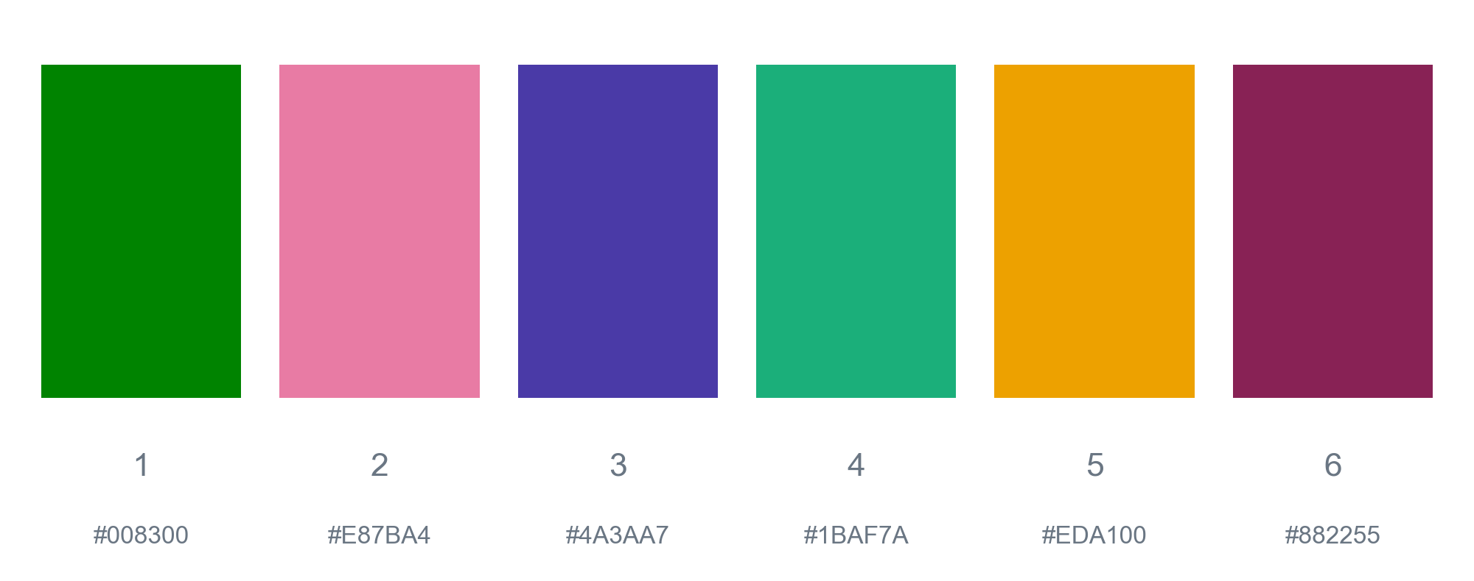
Six chart colors, always in this order
Figure 2. The six categorical chart colors in order. Source: references/brand.md

Slide 8
Run check_deck.py before you send
Neuromine brand skill
Rules: references/powerpoint.md

