Slide 1
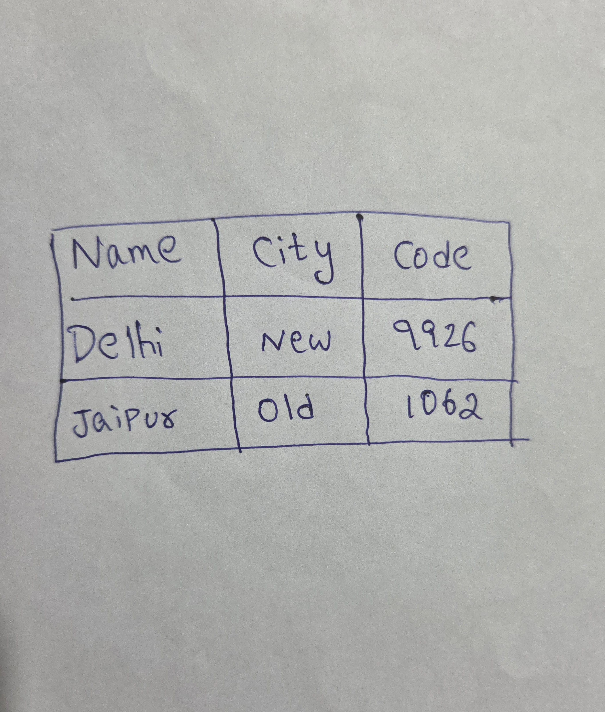

Slide 2
Hello, PowerPoint!
Find the bullet slide layout
Use _TextFrame.text for first bullet
Use _TextFrame.add_paragraph() for subsequent bullets
Notes:
Change the background to the black color.

Slide 3
Hello, PowerPoint!
Find the bullet slide layout
Use _TextFrame.text for first bullet
Use _TextFrame.add_paragraph() for subsequent bullets
Notes:
Change the background to the black color.

Slide 4
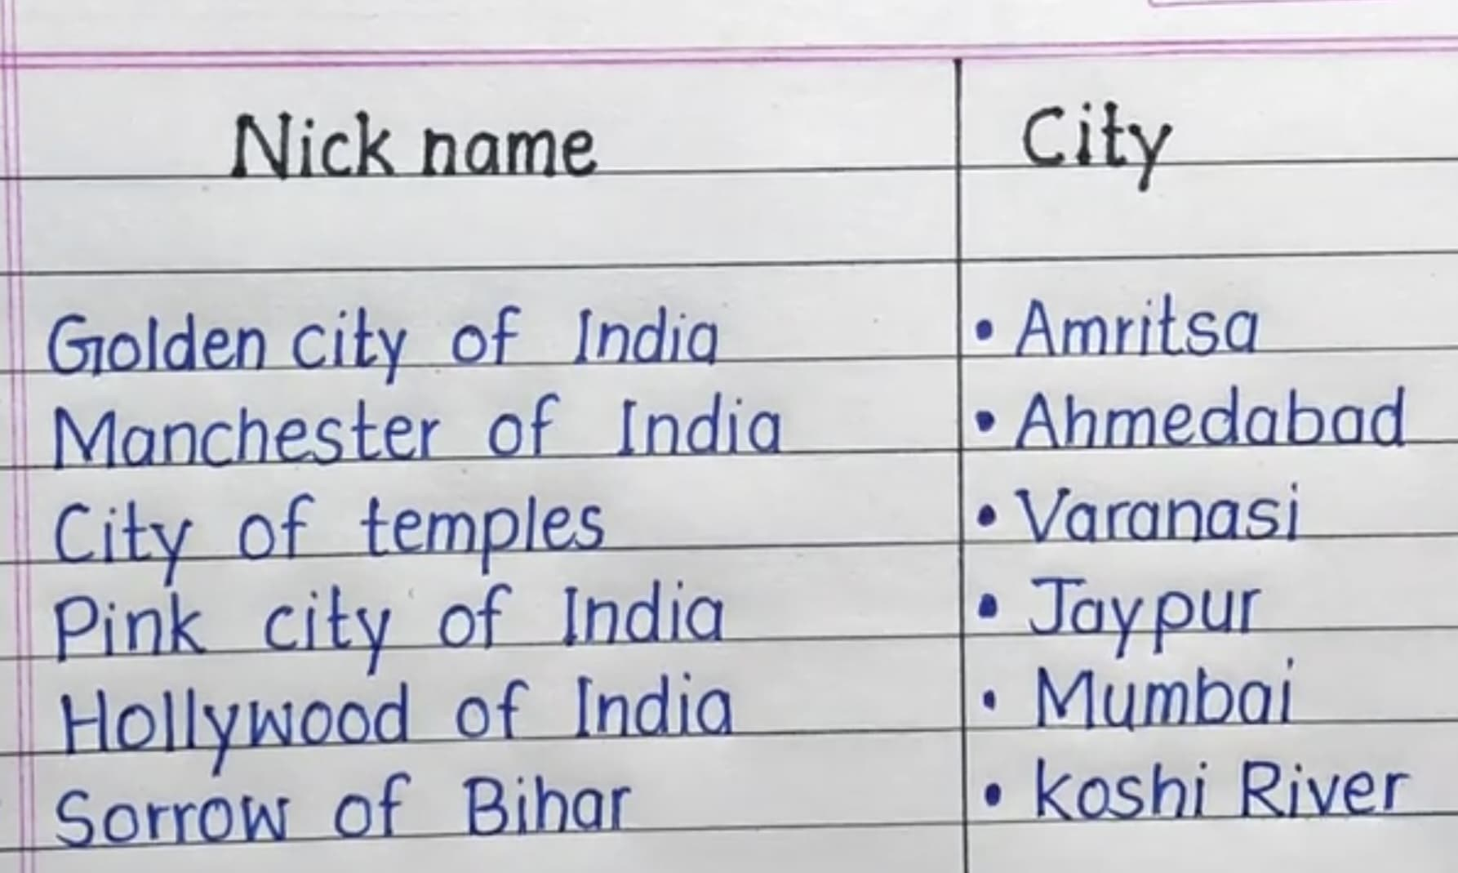

Slide 5
Adding a Bullet Slide
Find the bullet slide layout
Use _TextFrame.text for first bullet
Notes:
Change the text in Slide 2 to Welcome to our presentation.

Slide 6
