Slide 1
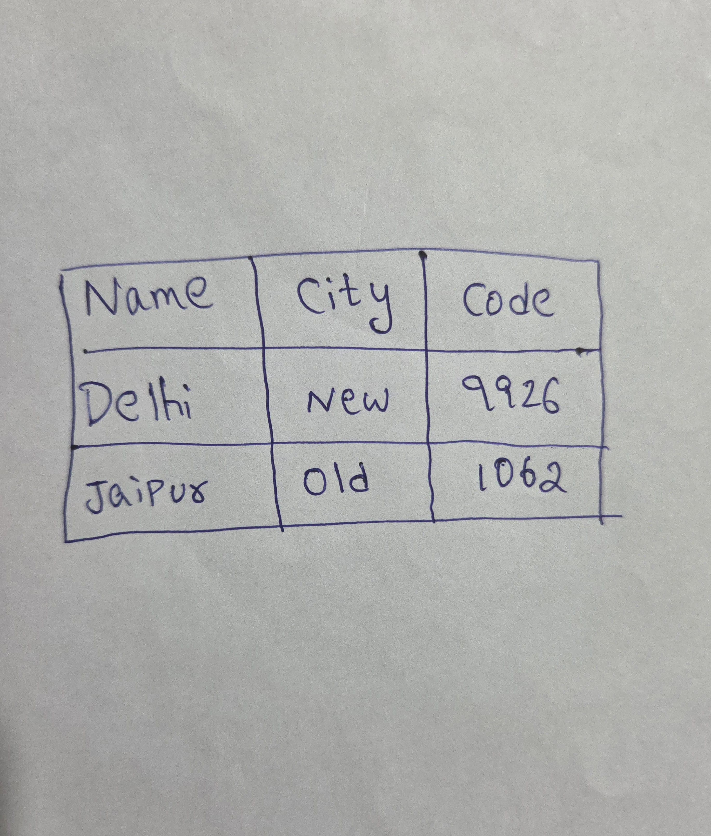

Slide 2
Name | City | Code
Delhi | New | 9926
Jaipur | Old | 1062

Slide 3
Hello, PowerPoint!
Find the bullet slide layout
Use _TextFrame.text for first bullet
Use _TextFrame.add_paragraph() for subsequent bullets
Notes:
Change the background to the black color.

Slide 4
Hello, PowerPoint!
Find the bullet slide layout
Use _TextFrame.text for first bullet
Use _TextFrame.add_paragraph() for subsequent bullets
Notes:
Change the background to the black color.

Slide 5
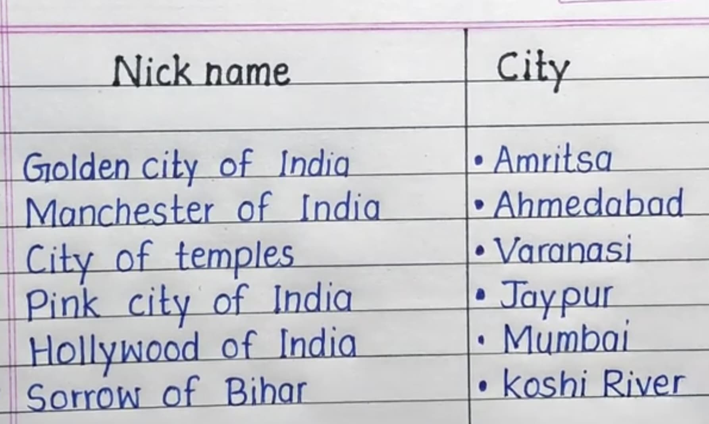

Slide 6
Nick name | City
Golden city of India | • Amritsa
Manchester of India | • Ahmedabad
City of temples | • Varanasi
Pink city of India | • Jaypur
Hollywood of India | • Mumbai
Sorrow of Bihar | • koshi River

Slide 7
Adding a Bullet Slide
Find the bullet slide layout
Use _TextFrame.text for first bullet
Notes:
Change the text in Slide 2 to Welcome to our presentation.

Slide 8
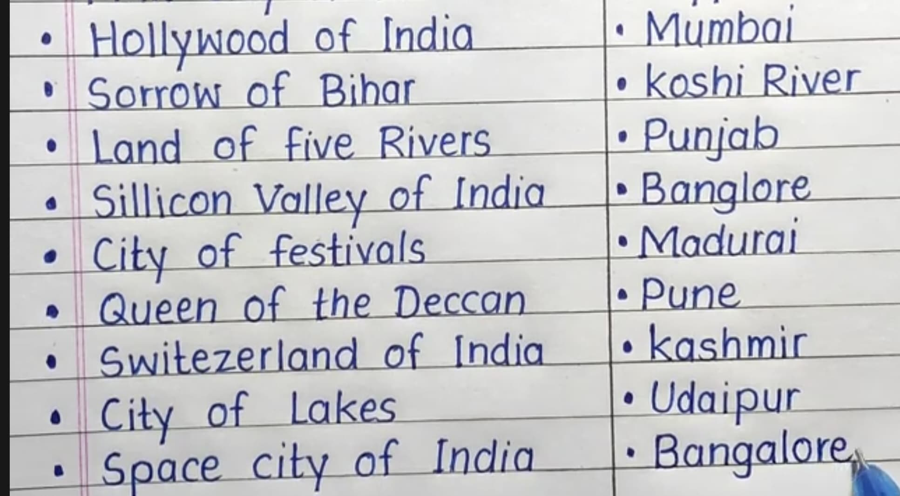

Slide 9
Hollywood of India | Mumbai
Sorrow of Bihar | koshi River
Land of five Rivers | Punjab
Sillicon Valley of India | Banglore
City of festivals | Madurai
Queen of the Deccan | Pune
Switezerland of India | kashmir
City of Lakes | Udaipur
Space city of India | Bangalore

