Slide 1
ACOREL
Tutorial

Slide 2
TABLE OF CONTENTS
1. Image Pre-Processing
2. LABEL GUI
3. Electrodes Post-Processing
4. Plotting

Slide 3
IMAGE PRE-PROCESSING
pre-implant MRI Full-Reconstruction
Alignment of pre-MRI < - > post-CT
post-implant MRI Half-Reconstruction
Alignment of pre-MRI < - > post-MRI
Artifact extraction of post-MRI
Make Smooth Surfaces

Slide 4
SUBJECTS DIRECTORY
Folder with all the subjects
Edit directly in ‘subjects_path.txt’
Or can be changed from the acorel GUI
Top right corner “CHOOSE DIR”

Slide 5
TCSH
The following slides detail the TCSH scripts
Execute script by typing ‘tcsh <script-name>’ in the shell
Must be in same directory as file (aka desktop)
Also can use ‘source’
Ex. tcsh preRecon

Slide 6
FSSetup
Uses the GuestAdditions to create a shared folder with the virtual machine
Password: freesurfer
Sets up the FreeSurfer environment

Slide 7
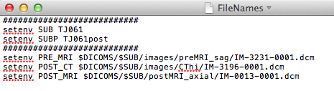
Prepare Files & Enter Names
Separate dicoms into three scan folders
Pre-MRI
Post-MRI
Post-CT
Name the subjects and the write filepaths to image scans
** EDIT THIS PART **

Slide 8
preRecon
This function handles:
Pre-implant full reconstruction (~12 – 24 hrs)
Mutual Information registration postCT - preMR

Slide 9
postRecon
This function handles:
Post-implant partial reconstruction (~12 – 24 hrs)
Mutual Information registration postCT - preMR

Slide 10
postARTS
This function handles:
Extracting the post-implant MRI artifacts

Slide 11
smoothSurf
This function takes in the filled surfaces (created in matlab; see below) and makes a smooth surface that is later used for electrode projection
The filled surfaces can be made in matlab by pushing the button “MakeSmooth” on the gui
DO THIS BEFORE RUNNING “smoothSurf”!!!

Slide 12
MATLAB

Slide 13
LABEL GUI
Remove Erroneous centroids
Add NEW points
LABEL the points
SAVE the coordinates
Features
Use keyboard or buttons on GUI
Rotatable 3D Brain (with transparency)
Re-run the centroid detection algorithm with new parameters (editable on GUI)

Slide 14
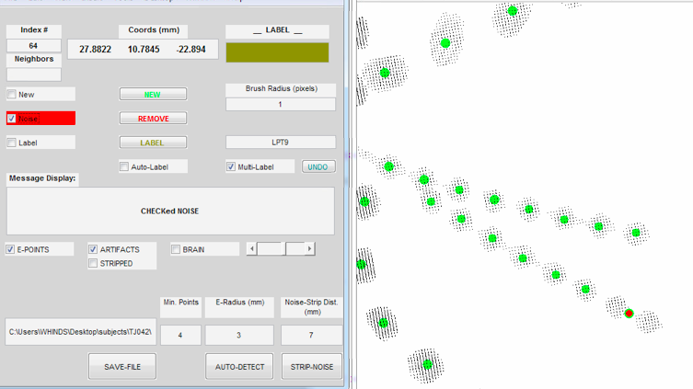
1. Remove the errors
1.
2.
3. Hit Backspace or Delete

Slide 15
Remove errors *Notes
Usually around depth electrodes and overlapping electrodes
Also occurs on wires or other surgically implanted metal

Slide 16
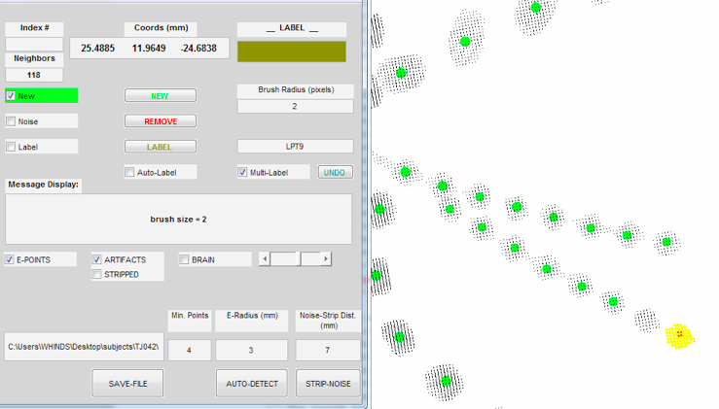
2. NEW Point
1.
2.
3.
4. Hit Enter

Slide 17
NEW Points *Notes
Change the brush radius to the electrode radius
The selected point is highlighted in red and the surrounding points in yellow.
The algorithm picks from this cloud (yellow+red) and calculates the centroid

Slide 18
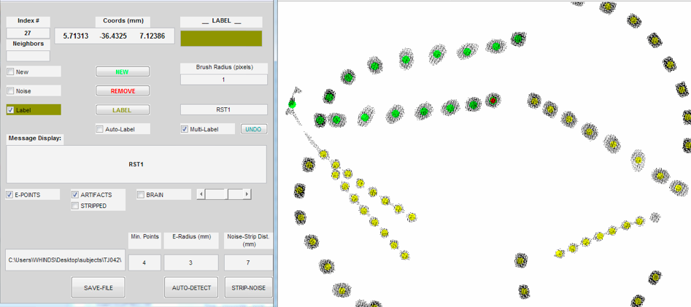
3. LABEL the points
3.
1.
2.
4. Hit Enter

Slide 19
LABEL Points *Notes
Multi-label adds +1 to the edit field with the electrode name after you hit ENTER. This will speed up the process so you don’t have to change the field each time from RST1 to RST2

Slide 20
4. SAVE the points

Slide 21
Electrode Post-Processing
Buttons on MAIN GUI
AUTO-REG
Does the ICP and saves the coords
SURF-PROJ
Projects to surface and saves the coords
Need to Specify the Depth electrodes

