Slide 1
DMT-Harmine & Meditation Retreat Study
Egger et al., 2025 Meditation, Psychedelics, and Brain Connectivity: A Randomised Controlled Resting-State fMRI Study of N,N-Dimethyltryptamine and Harmine in a Meditation Retreat. Imaging Neuroscience (2025). https://doi.org/10.1162/IMAG.a.907
Meling et al., 2024 Meditating on psychedelics. A randomized placebo-controlled study of DMT and harmine in a mindfulness retreat. Journal of Psychopharmacology (2024). https://doi.org/10.1177/02698811241282637

Slide 2
OVERVIEW
Design Overview
Study Type
Intervention
Double-blind, placebo-controlled crossover
DMT-harmine vs. placebo during a 3-day meditation retreat
Sublingual DMT hemisuccinate + harmine glucuronate
120 mg total DMT / session (4 × 30 mg every 30 min)
Setting
Follow-Up
Structured 3-day retreat
Alternating sitting meditation → vitals → walking meditation cycles
Assessments at: baseline, day 1–3 (in-retreat), 1 day after, 1 week after, 1 month after

Slide 3
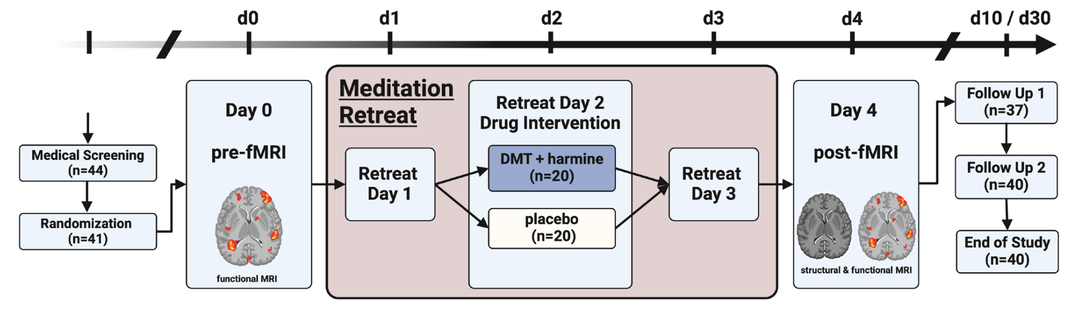
OVERVIEW
Design Overview
Two cohorts started 1 day apart to accommodate scanner availability.
The first cohort began on Day 0 and ended on Day 4
The second cohort began on Day 1 and finished on Day 5.

Slide 4
PROTOCOL — SCHEDULE
Retreat Schedule Overview
Acute Psychometry
1 Day Before
Day 1
Day 2
1 Day After
Post- Retreat
Day 3
18.30
11:00
18.30
12:00
11:30
10:30
14:30
16:30
fMRI scan
DMT + Harmine Administration
fMRI scan
Questionnaires
FMI-13
SOCS-O
SOCS-S
Questionnaires
FMI-13
SOCS-O
SOCS-S
Follow-Up Assessments:
Questionnaires
TMS-13 PIS-6 EBI MEQ30 NADA-S
Questionnaires
TMS-13 PIS-6 EBI MEQ30 NADA-S
Questionnaires
TMS-13 PIS-6 EBI MEQ30 NADA-S
1 Week After: Trait mindfulness (FMI-13) 1 Month After: Meaningfulness, spiritual significance, well-being change, blinding efficacy ratings

Slide 5
PROTOCOL — SCHEDULE
Day-2 (Drug Day) Detailed Schedule
Dose administration began at 10:30. Each cycle repeated:
1
2
3
→
Sitting Meditation
Vital Signs +
Acute Psychometry
Walking Meditation
Drug / Placebo
Administration
30 mg Harmine + 30 mg DMT
Sublingual
20 min
5 min
5 min
This cycle repeated 4 times. Drug/Placebo was administered after walking meditation, before the next sitting meditation.

Slide 6
fMRI — DATA ACQUISITION
fMRI Acquisition Parameters
Scanner: Philips Achieva 3.0T | 32-channel head coil | MultiTransmit parallel RF | University Hospital of Psychiatry Zurich | 10–11 participants/day
Functional MRI — Resting State (eyes closed)
Structural MRI — T1w (Post session only)
Sequence: Gradient echo EPI, whole-brain
TR = 1800 ms | TE = 35 ms | FA = 70°
FoV = 220 × 220 mm² | Matrix = 124 × 121 mm²
Slices = 54 | No interslice gap
Voxel size = 1.7 × 1.7 × 2.0 mm³
Volumes = 240 | Session duration = 7.40 min
Sequence: 3D multishot Turbo Field Echo (TFE)
TR = 8.2 ms | TE = 3.8 ms | FA = 8°
FoV = 240 × 240 mm² | Slices = 160
No interslice gap
Voxel size = 1.0 × 1.0 × 1.0 mm³
Acquisition time = 4.53 min

Slide 7
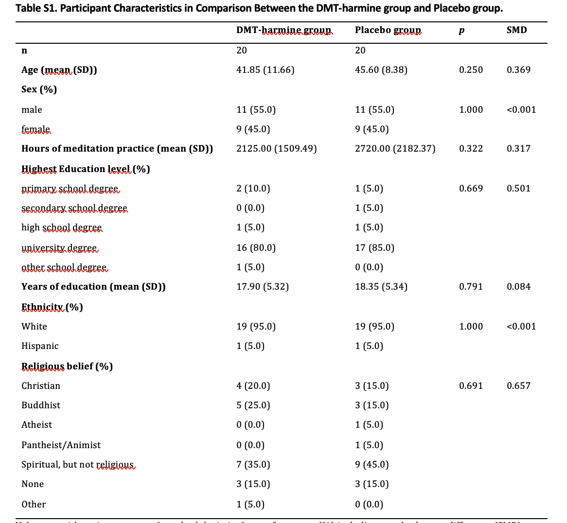
PROTOCOL — SCHEDULE
Participant Overview
Participants reported an average of 2422.5 h of meditation (800–10,000), coming from various traditions, including Zen, Vipassana, and Tibetan Buddhism

Slide 8
PHARMACOLOGY
Pharmacological Intervention: DMT-Harmine Formulation
Formulation
Comparison to Ayahuasca
Standardized sublingual tablets
DMT hemisuccinate + harmine glucuronate
Matched placebo (identical appearance & taste)
Sublingual DMT hemisuccinate + harmine glucuronate
120 mg total DMT / session (4 × 30 mg every 30 min)
Dosing Regimen
Blinding
30 mg DMT + 30 mg harmine per tablet (as freebase weight)
4 increments × every 30 minutes
Total: 120 mg DMT per session
Placebo tablets matched in color and taste
Blinding efficacy tested at the end of day 2: - Did you receive DMT-harmine or placebo? - How satisfied or disappointed are you with your condition? (0–10 each)

Slide 9
PREPROCESSING
Denoising & Motion Quality Control
Post-fMRIPrep pipeline after Goldberg et al. (2024)

Slide 10
PREPROCESSING — OVERVIEW
Denoising Pipeline
The following denoising pipeline was adapted from Goldberg et al. 2024, which is optimized for time analysis:
Nuisance regression of mean WM, mean CSF, and 6 motion parameters with their first derivatives; spike regression for high-motion frames (FD > 0.3 mm); Lomb–Scargle interpolation of censored frames before bandpass filtering (0.01–0.1 Hz). The L-S interpolation is the key step as they show that simply zeroing or removing censored frames disrupts the autocorrelation function (ACW) and systematically biases ACW toward shorter values.
PROCESSING STEPS
fMRIPrep BOLD → nuisance regressors → single GLM (residuals) → Lomb-Scargle interpolation → bandpass 0.01–0.1 Hz → denoised BOLD (±GSR)

Slide 11
PREPROCESSING — OVERVIEW
Denoising Pipeline
Regression + GLM • White matter + CSF (2) — mean tissue signals
• Motion (6) — trans_x/y/z, rot_x/y/z
• Derivatives (6) — first derivatives of the 6 motion params • Spike regressors (n) — one per FD > 0.3 mm frame • GSR (0/1) — global signal, present only in the +GSR version
Censor
High-motion frames (FD > 0.3 mm) removed from the residual time series before filtering.
Lomb-Scargle interpolation
Censored frames reconstructed by Lomb-Scargle interpolation.
Bandpass 0.01–0.1 Hz
Applied via frequency-domain masking (out-of-band coefficients zeroed). No Butterworth filter — band-limiting is built into the LS reconstruction.

Slide 12
STEP 1 — MOTION QC
Subject Exclusion
EXCLUSION RULE
Any run with more than 50% of frames censored → the entire subject is excluded (within-subject design needs both sessions usable).
EXCLUDED (5 SUBJECTS)
sub-06, sub-08, sub-12, sub-26, sub-36

Slide 13
STEP 1 — MOTION QC
Framewise Displacement & Censoring
HOW FD IS COMPUTED
• Power et al. (2012) FD, as produced by fMRIPrep
• 1-TR backward differences of the 6 motion parameters; rotations on a 50 mm sphere
FRAME CENSORING
• Threshold: FD > 0.3 mm (Goldberg 2024)
• Respiratory filter tested via Power (2019) PSD of trans_y — no peaks, so not applied

Slide 14
STEP 2 — DENOISING
Outputs & Batch Processing
TWO VERSIONS PER RUN
• desc-denoisedNoGSR_bold.nii.gz — without global signal regression
• desc-denoisedGSR_bold.nii.gz — with global signal regression
Naming: sub-XX_ses-YY_task-rest_desc-…_bold.nii.gz (float32, zeros outside brain mask).
BATCH RUN
70 runs processed (35 subjects × 2 sessions)
• Shared core logic in denoise_core.py; validated on sub-01 ses-01 test run
• Batch skips existing outputs; per-run log appended to _batch_log.tsv

Slide 15
STEP 3 — QUALITY CONTROL
DVARS Denoising Validation
METHOD
• DVARS computed pre- vs post-denoising, compared across raw, −GSR and +GSR
• FD–DVARS coupling assessed (Pearson r)
• Low-motion (sub-01) and high-motion (sub-21) runs retained as evidence
[ DVARS figure — export sub-01 & sub-21 panels from the server ]

Slide 16
STEP 4 — Parcels
Parcellation
[ DVARS figure — export sub-01 & sub-21 panels from the server ]

Slide 17
RESULTS
Analysis & Findings

Slide 18
RESULTS · PART 1
Intrinsic Neural Timescales

Slide 19
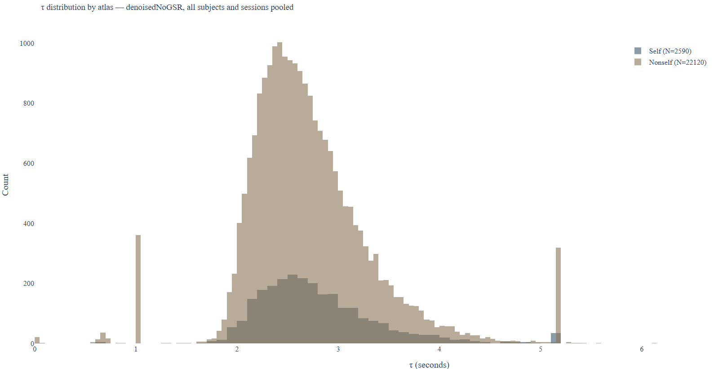
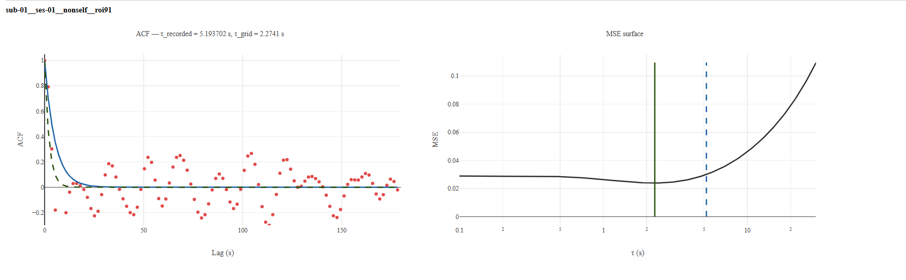
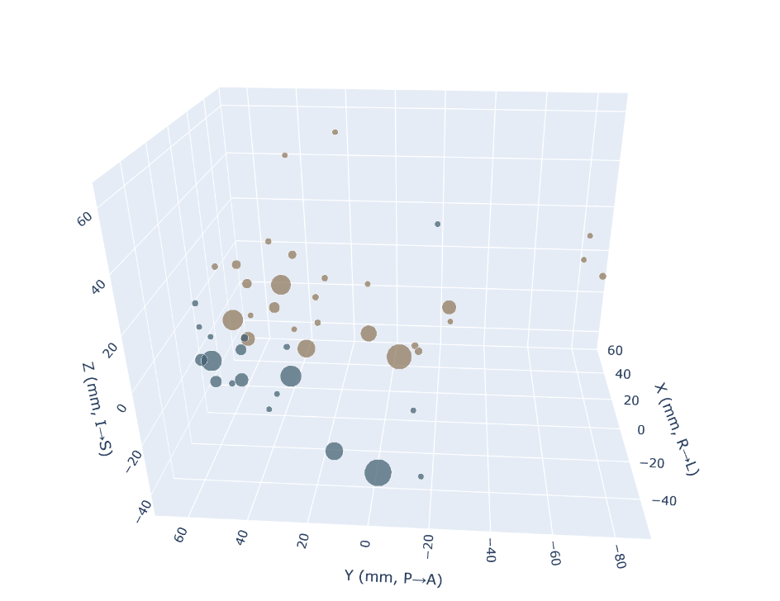
INTRINSIC TIMESCALES — METHODS
ACW Calculation: τ vs AUC
WHY AUC
τ and AUC both computed with IntrinsicTimescales.jl.
τ showed spikes (~1 s, ~5.2 s) in susceptibility-dropout regions — flagged via tSNR and dropped.
A residual spike persisted as an estimator artefact, so AUC is the primary measure.
τ distribution — self vs non-self (spikes at ~1 s and ~5.2 s)
Per-ROI ACF fit and MSE surface (example run)

Slide 20
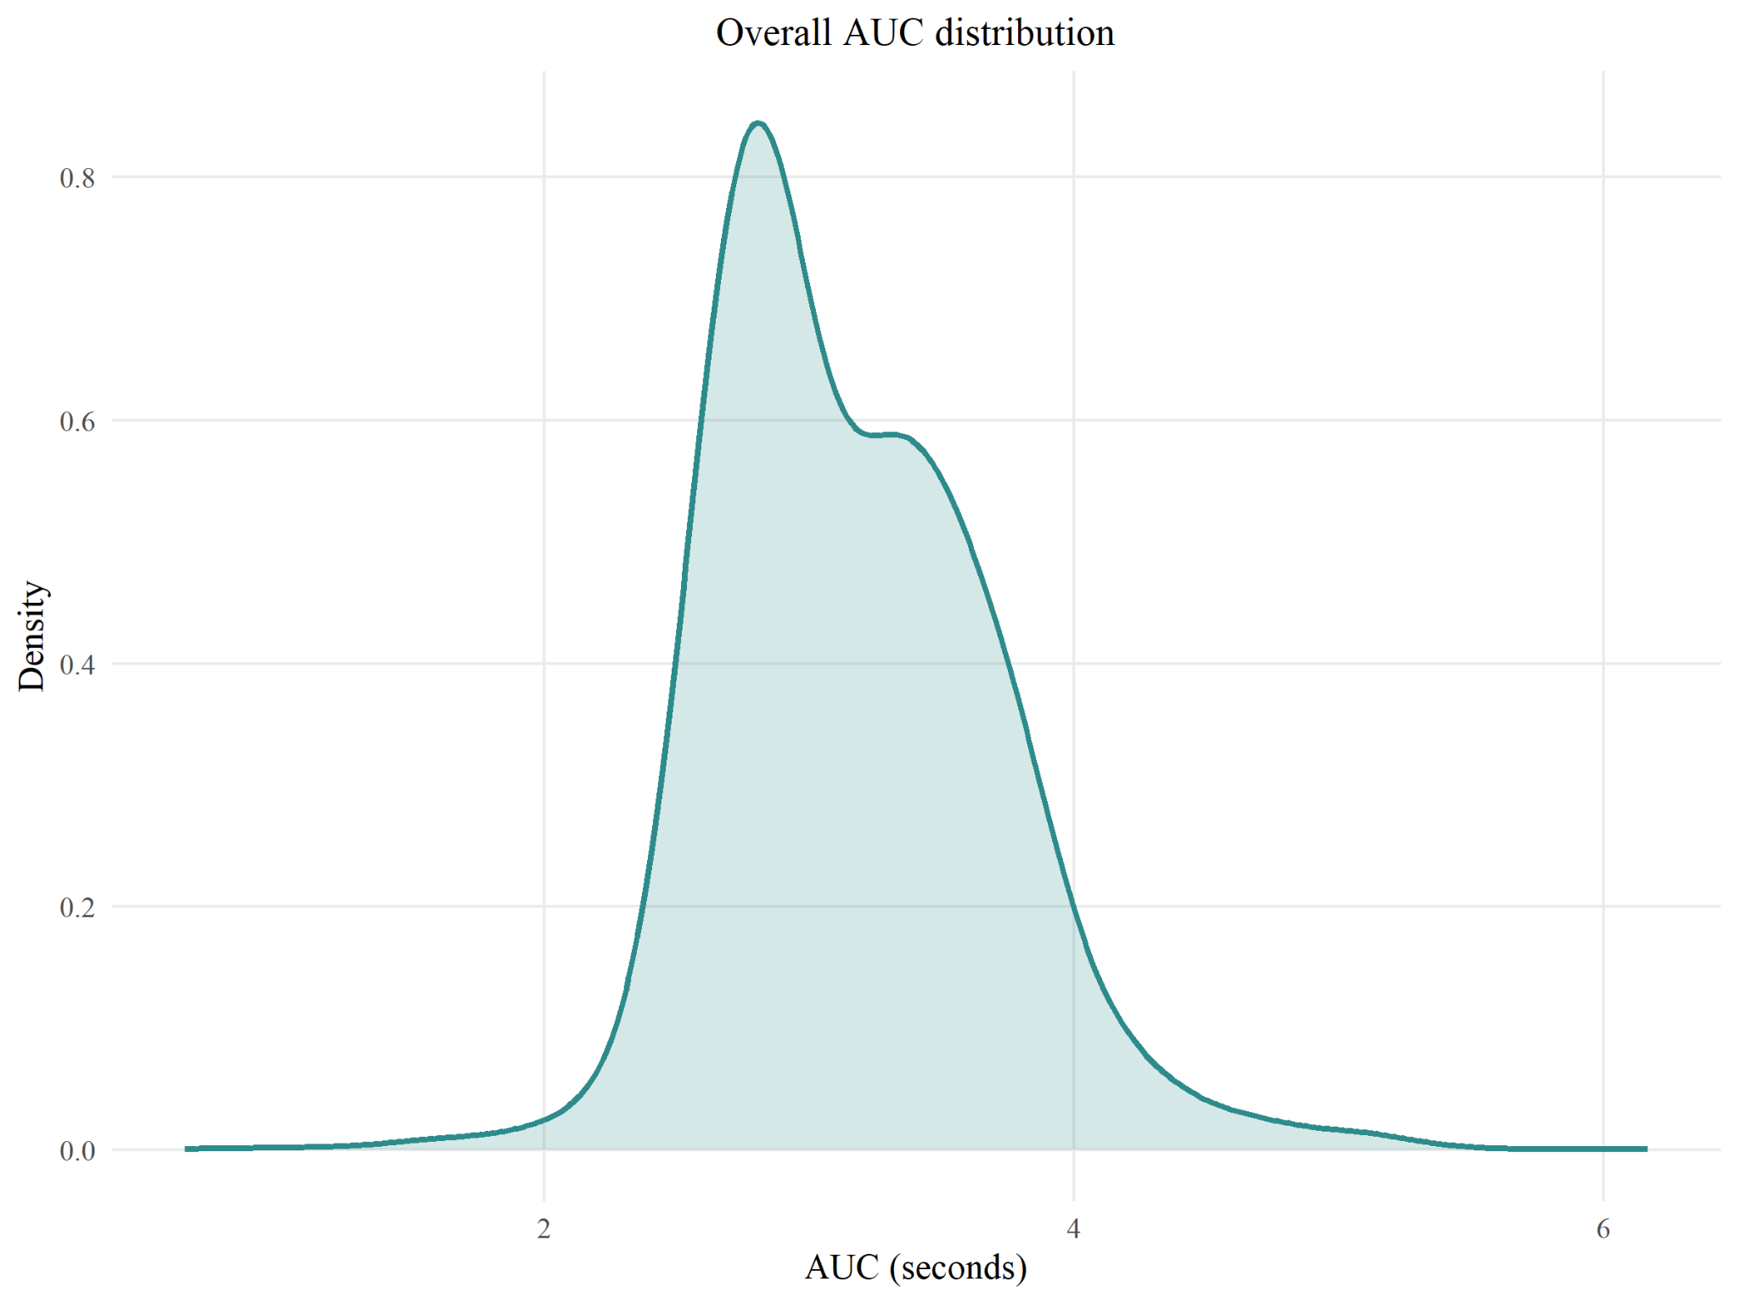
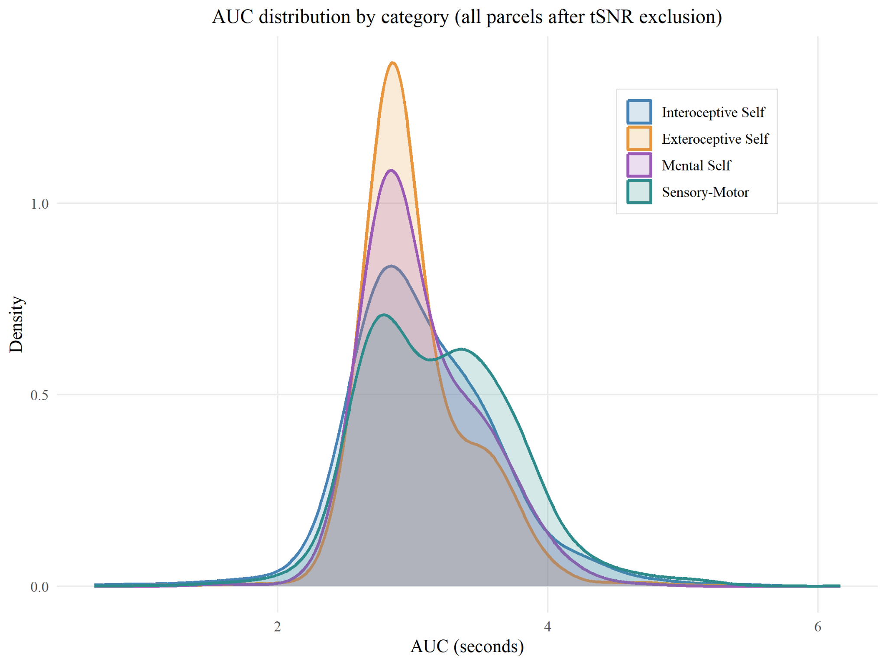
INTRINSIC TIMESCALES — DISTRIBUTION
AUC Distribution
Overall AUC distribution (left) and by self-referential category, all parcels after tSNR exclusion (right)

Slide 21
INTRINSIC TIMESCALES — MODEL
Parcel-level Mixed Model
TWO METRICS, FITTED AT THE PARCEL LEVEL
• Intrinsic timescale (ACW-AUC, s) — how long BOLD stays autocorrelated
MODELS (ONE ROW PER SUBJECT × SESSION × PARCEL)
• ACW: auc ~ group×session×category + (1+session | subject) + (1 | subject:parcel) — Kenward-Roger df
Random effects now partition subject and parcel variance. 58 low-tSNR parcels excluded. Drug effect = (verum pre→post) − (placebo pre→post), FDR across the 4 categories.

Slide 22
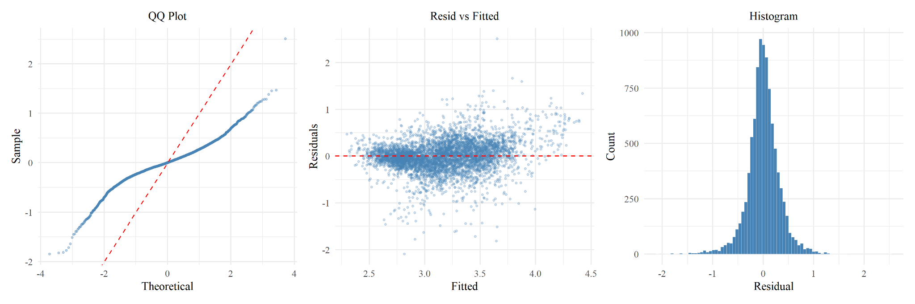
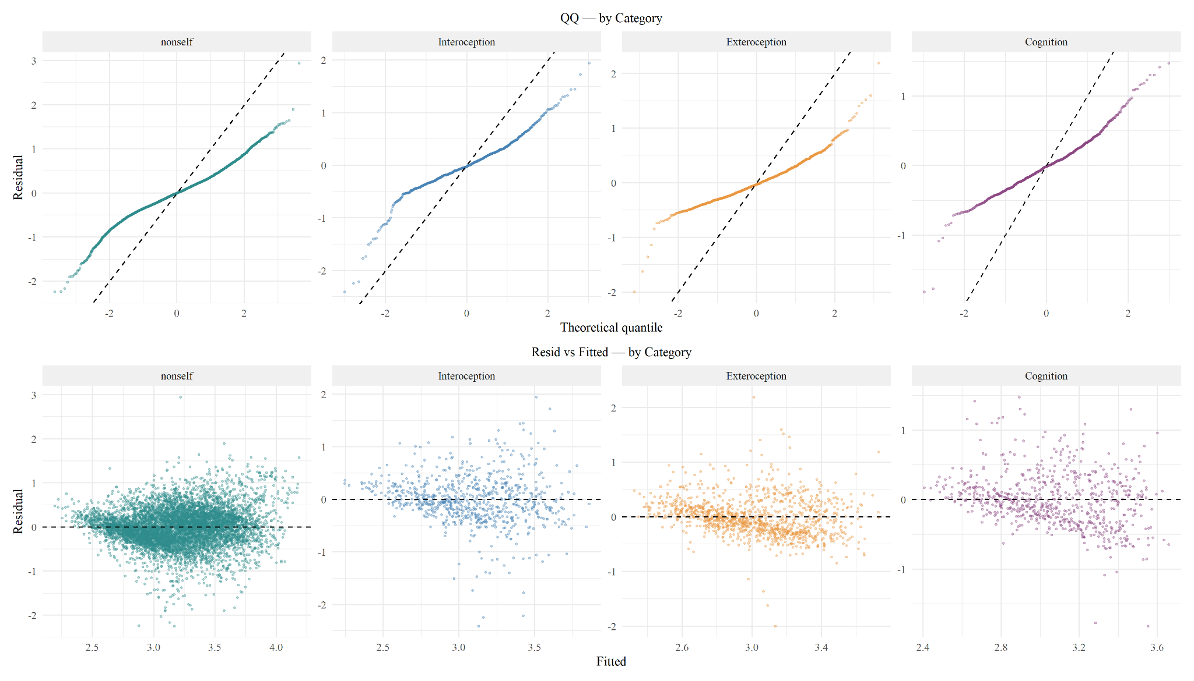
INTRINSIC TIMESCALES — DIAGNOSTICS
Mixed-Model Diagnostics (QC)
QQ / residuals-vs-fitted / histogram (top); QQ by category (bottom)

Slide 23
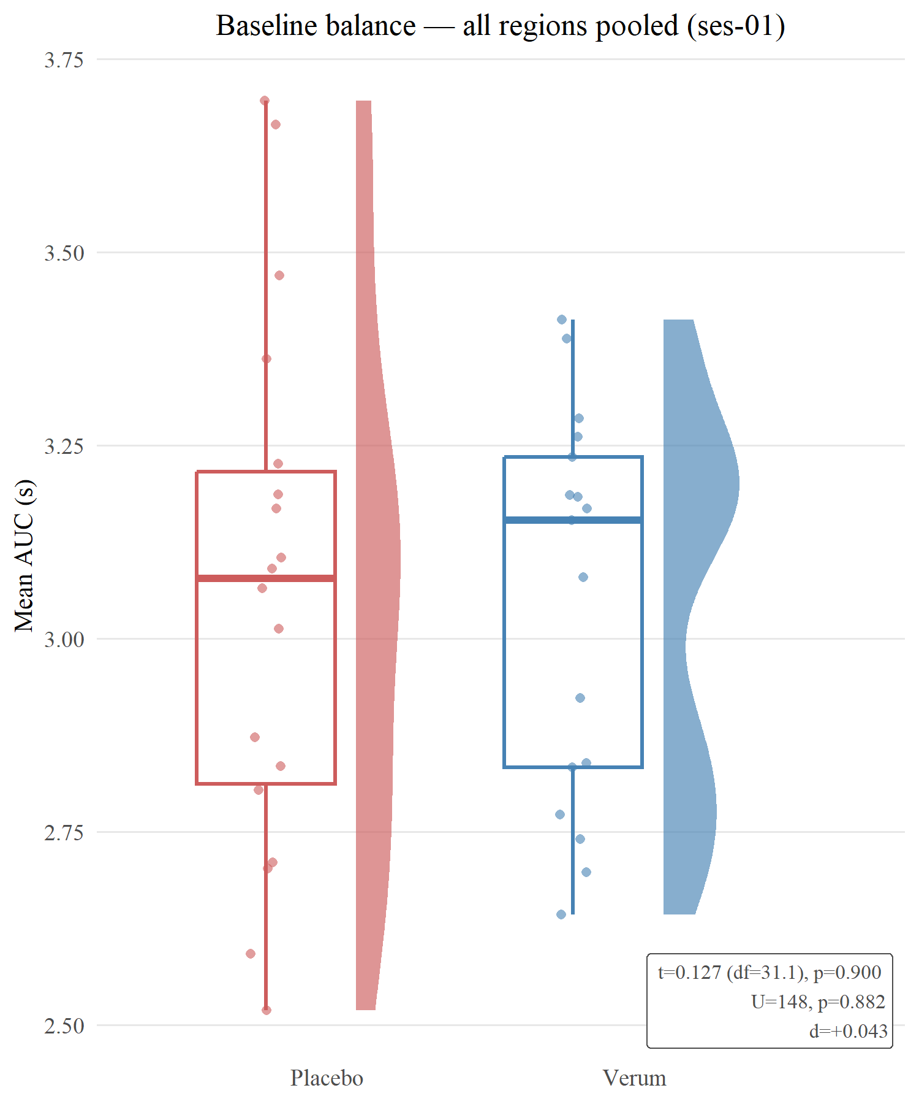
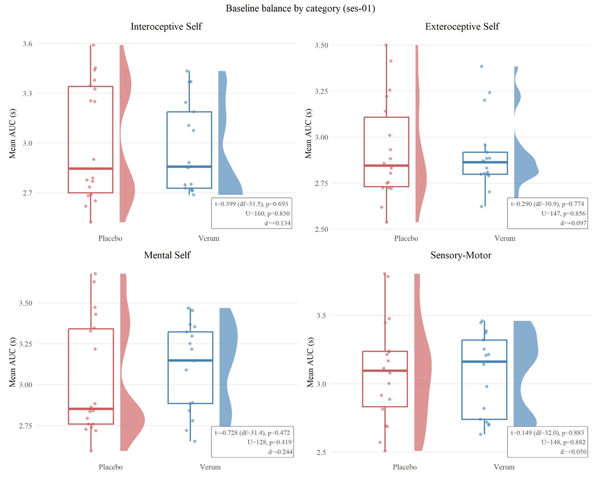
INTRINSIC TIMESCALES — BASELINE
Baseline Balance (Pre-retreat)

Slide 24
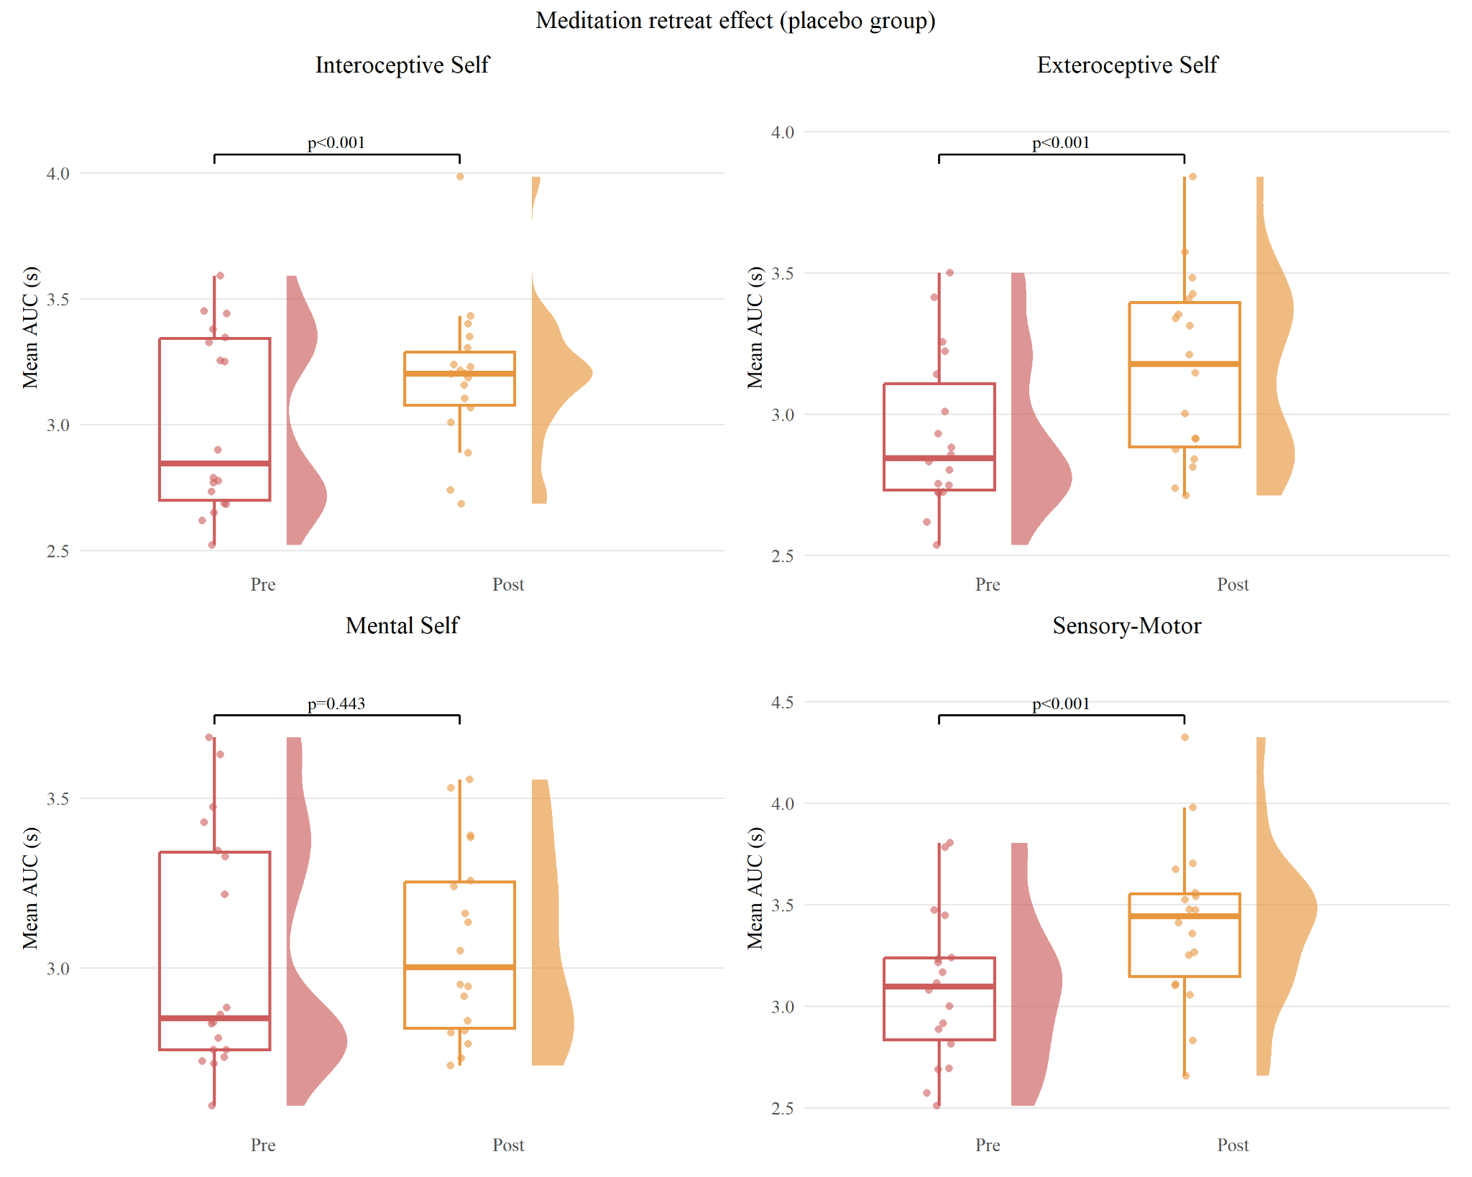
INTRINSIC TIMESCALES — RETREAT
Meditation Retreat Effect (Placebo)

Slide 25
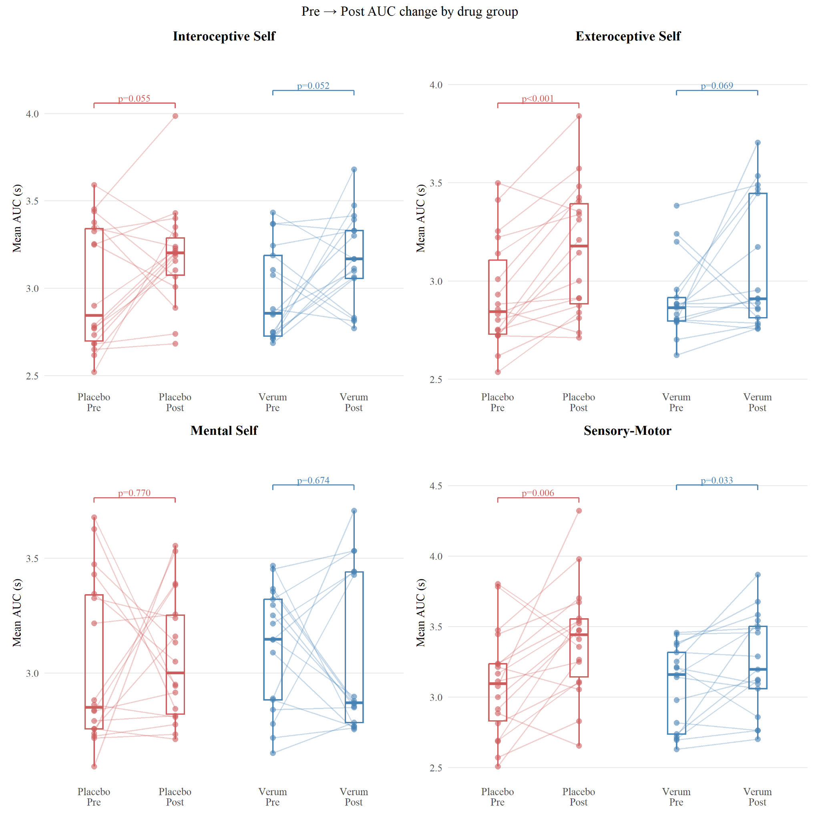
INTRINSIC TIMESCALES — DRUG
Pre → Post AUC by Drug Group

Slide 26
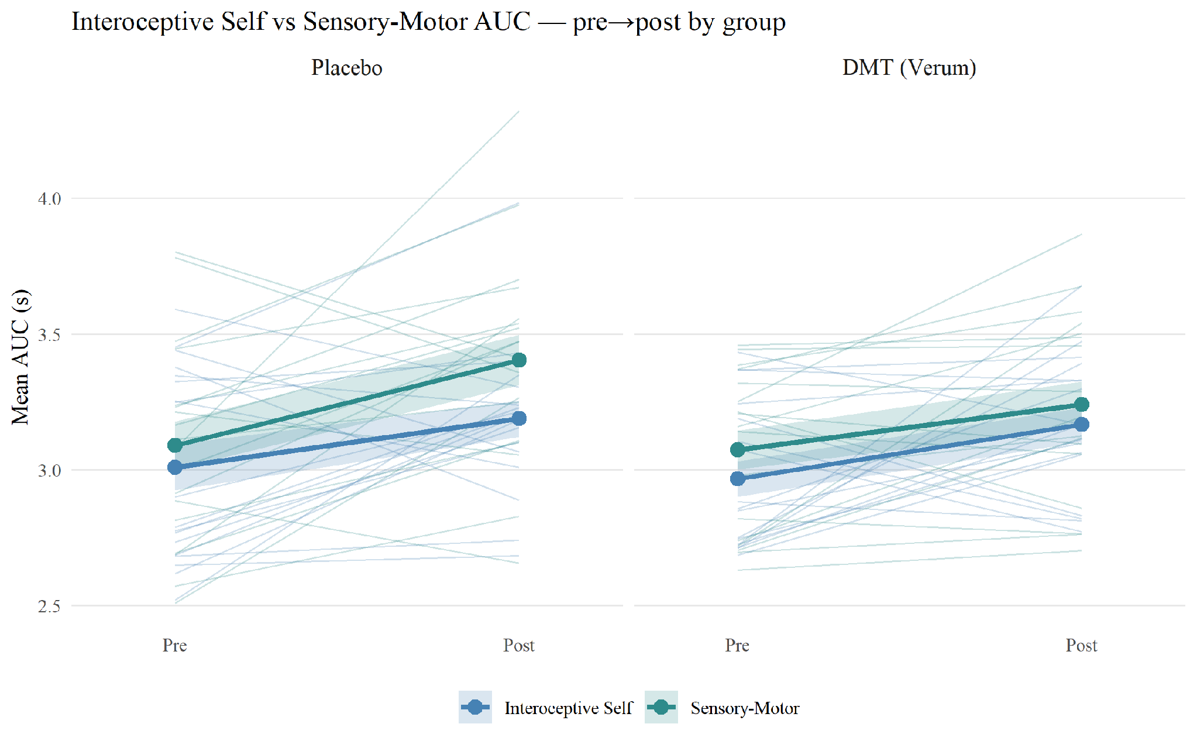
INTRINSIC TIMESCALES — PRIMARY
Interoceptive Self ↔ Sensory-Motor Convergence
Primary finding.
Under placebo the Sensory-Motor–Interoceptive gap widens post-retreat; under DMT it does not.
Gap × time × drug contrast: −0.167, p=0.002.
3-way group×session×category F=3.8, p=0.010.

Slide 27
RESULTS — APPROACH
Parcel-level Mixed Models
TWO METRICS, FITTED AT THE PARCEL LEVEL
• Intrinsic timescale (ACW-AUC, s) — how long BOLD stays autocorrelated
• Sample entropy (SampEn) — signal complexity / irregularity
MODELS (ONE ROW PER SUBJECT × SESSION × PARCEL)
• ACW: auc ~ group×session×category + (1+session | subject) + (1 | subject:parcel) — Kenward-Roger df
• SampEn: sampen ~ session×group×self_layer + (1 | subject) + (1 | parcel) — Satterthwaite df
Random effects now partition subject and parcel variance. 58 low-tSNR parcels excluded. Drug effect = (verum pre→post) − (placebo pre→post), FDR across the 4 categories.

Slide 28
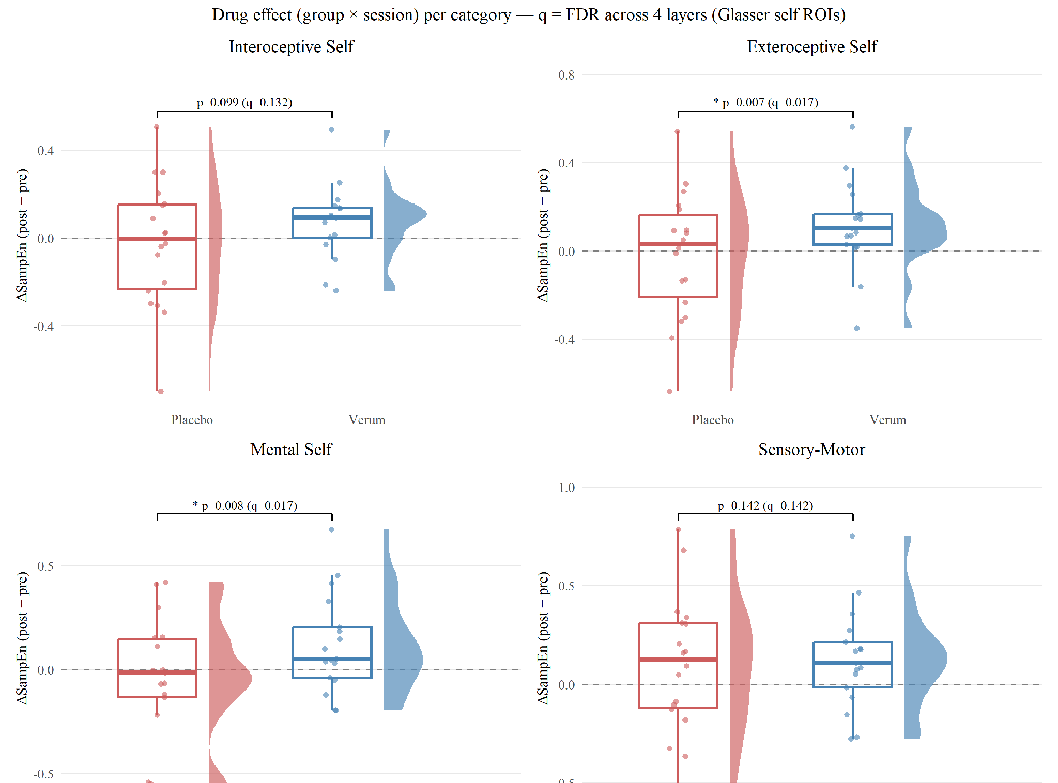
RESULTS — DMT · SAMPLE ENTROPY
DMT Increases Sample Entropy
Strong drug × session interaction:
F(1,9406)=17.7, p=2.6e-5.
Verum > placebo, surviving FDR in:
Exteroceptive Self (q=0.017) and Mental Self (q=0.017).

Slide 29
RESULTS — SUMMARY
What the Two Metrics Show
 | Intrinsic timescale (ACW) | Sample entropy
Self vs non-self | Yes (F=70.8, p<1e-44) | n.s. (parcel-adjusted)
Meditation retreat | Yes — lengthens (p=0.006) | No (placebo flat)
DMT (drug) | Intero–SensoryMotor gap converges (p=0.002) | Increases — Extero & Mental Self (q=0.017)
Both metrics reveal DMT effects: ACW reshapes the interoceptive–sensorimotor timescale hierarchy; sample entropy rises in exteroceptive and mental-self regions.

Slide 30
Extras
Data Not Available Publicly- Questionnaires

Slide 31
4 Psychological Clusters Examined With Questionnaires
Mindfulness
2. Insight
State mindfulness (during retreat)
Trait mindfulness (before, after, 1-week follow-up)
Instruments: TMS-13, FMI-13
Psychological insight specific to psychedelic experience
Emotional breakthrough quality
Instruments: PIS-6, EBI (6 items each)
3. Compassion
4. Transcendence
Compassion for others & for self
Five dimensions: recognizing, acknowledging universality,
feeling for, tolerating, acting
Instrument: SOCS-O (20 items) + SOCS-S (20 items)
Mystical-type experiences
Non-dual awareness (state measure, immediate effect of meditation)
Instruments: MEQ30 (30 items), NADA-S (3 items)

Slide 32
SUMMARY
All Questionnaires at a Glance
Instrument | Cluster | Items | Timing | Type
TMS-13 | Mindfulness | 13 | Each retreat day | State
FMI-13 | Mindfulness | 13 | Before / After / 1-week | Trait
SOCS-O + SOCS-S | Compassion | 20+20 | Retreat period | State/Trait
PIS-6 | Insight | 6 | Post-session | State
EBI | Insight | 6 | Post-session | State
MEQ30 | Transcendence | 30 | Post-session (Day 2) | State
NADA-S | Transcendence | 3 | Immediately post-meditation | State
Meaningfulness Scale | Secondary | 3 | 1-month follow-up | State
Blinding Efficacy | Secondary | ~4 | End of Day 2 | State
Expectations | Secondary | 5×2 | Day 2 morning (pre-drug) | State

Slide 33
Questionnaires Measuring Mindfulness
Mindfulness as a Temporary State
TMS-13 — Toronto Mindfulness Scale Items: 13
Two factors:
Curiosity — orientation toward learning about one's own subjective experiences
Decentering — the extent to which a person identifies with experiences vs. seeing them as mere thoughts and emotions passing through
Mindfulness as a Trait
FMI-13 – Freiburg Mindfulness Inventory Items: 13
One-dimensional — a single construct of mindfulness derived from Buddhist psychology
Captures mindfulness as a stable disposition rather than a momentary state

Slide 34
Questionnaires Measuring Compassion
Sussex-Oxford Compassion Scales (SOCS; Gu et al., 2020)
Two 20-item scales: SOCS-O (compassion for Others) + SOCS-S (compassion for Self)
Five Dimensions of Compassion Captured by Both Scales:
1
Recognizing suffering
4
Tolerating unpleasant experiences
2
Acknowledging the universality of suffering
5
Motivation & determination to act toward alleviating suffering
3
Feeling for the person suffering

Slide 35
Questionnaires Measuring Insight
PIS-6 — Psychological Insight Scale (Peill et al., 2022)
EBI — Emotional Breakthrough Inventory (Roseman et al., 2019)
Items: 6
Captures level of psychological insight specifically after a psychedelic experience
Designed to be used in psychedelic research contexts
Items: 6
Captures emotional insight quality — a type of insight typical for psychedelic experiences
Often accompanies personal & transpersonal insights
Complementary to PIS-6 (cognitive vs. emotional insight)
Note:
PIS-6 and EBI assess acute/post-session insight quality
Both are 6-item self-report scales with validated use in psychedelic-assisted research
Psychedelic experiences can produce both cognitive insight (PIS-6) AND emotional breakthroughs (EBI)

Slide 36
Questionnaires Measuring Transcendence
MEQ30 — Mystical Experience Questionnaire (Barrett et al., 2015)
Items: 30
Captures individual mystical-type experiences
Predicts sustainable changes in attitudes, behavior & well-being associated with psilocybin-occasioned experiences (Barrett et al., 2015)
Typically administered post-session
NADA-S — Nondual Awareness Dimensional Assessment – State (Hanley et al., 2018)
Items: 3
Measures fluctuations in non-dual states of awareness evoked by contemplative practice
State measure: captures immediate effect of meditation practice on nondual awareness
Distinct from mystical experiences — focuses specifically on the nondual dimension
Nondual awareness ≠ mystical experience: NADA-S is contemplative-practice-specific; MEQ30 is psychedelic-experience-specific.

Slide 37
Secondary & Contextual Measures
Meaningfulness & Spiritual Significance (1-Month Follow-Up, Griffiths et al., 2006)
Item 1 — Personal meaningfulness: 0 (routine experience) → 6 (top 5 most meaningful) → 7 (most meaningful ever)
Item 2 — Spiritual significance: 0 (not at all) → 4 (top 5 most spiritually significant) → 5 (most significant ever)
Item 3 — Well-being/life satisfaction change: 0 (decreased very much) → 3 (no change) → 6 (increased very much)
Blinding Efficacy (End of Day 2)
Expectations (Day 2 Morning, pre-drug)
Did they guess correctly? (DMT-harmine or placebo?)
Confidence in their guess: 0–10 Likert
Satisfaction about their condition: 0–10 Likert
Disappointment about their condition: 0–10 Likert
Rated separately for the scenario of receiving DMT-harmine AND placebo:
• Positive experience
• Challenging experience
• Transformative experience
• Meditative experience
• Insightful experience

