Slide 1

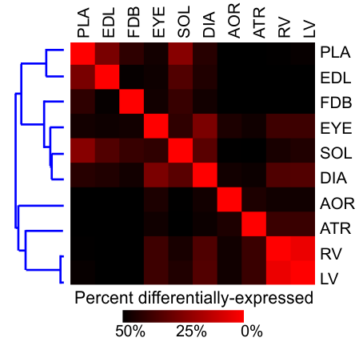
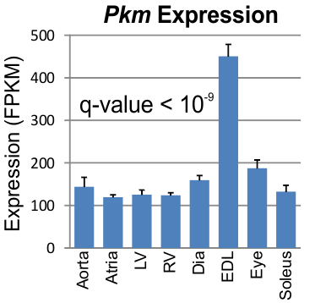
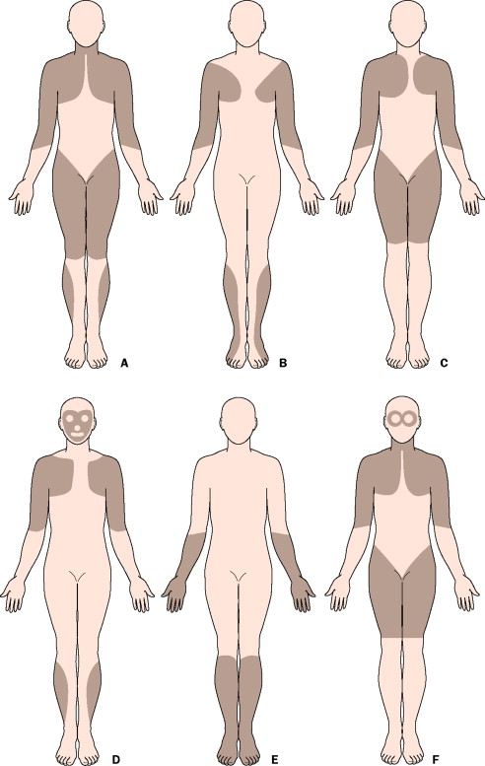
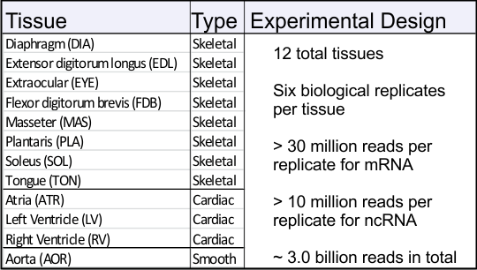
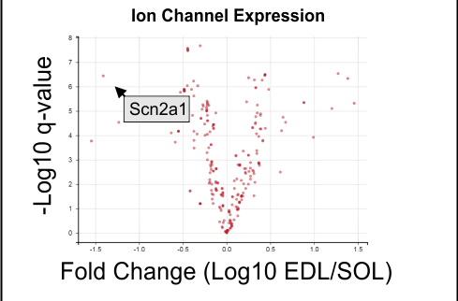
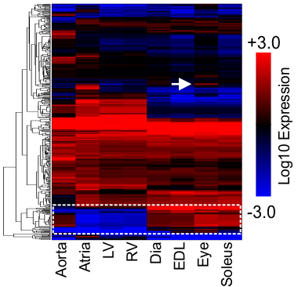
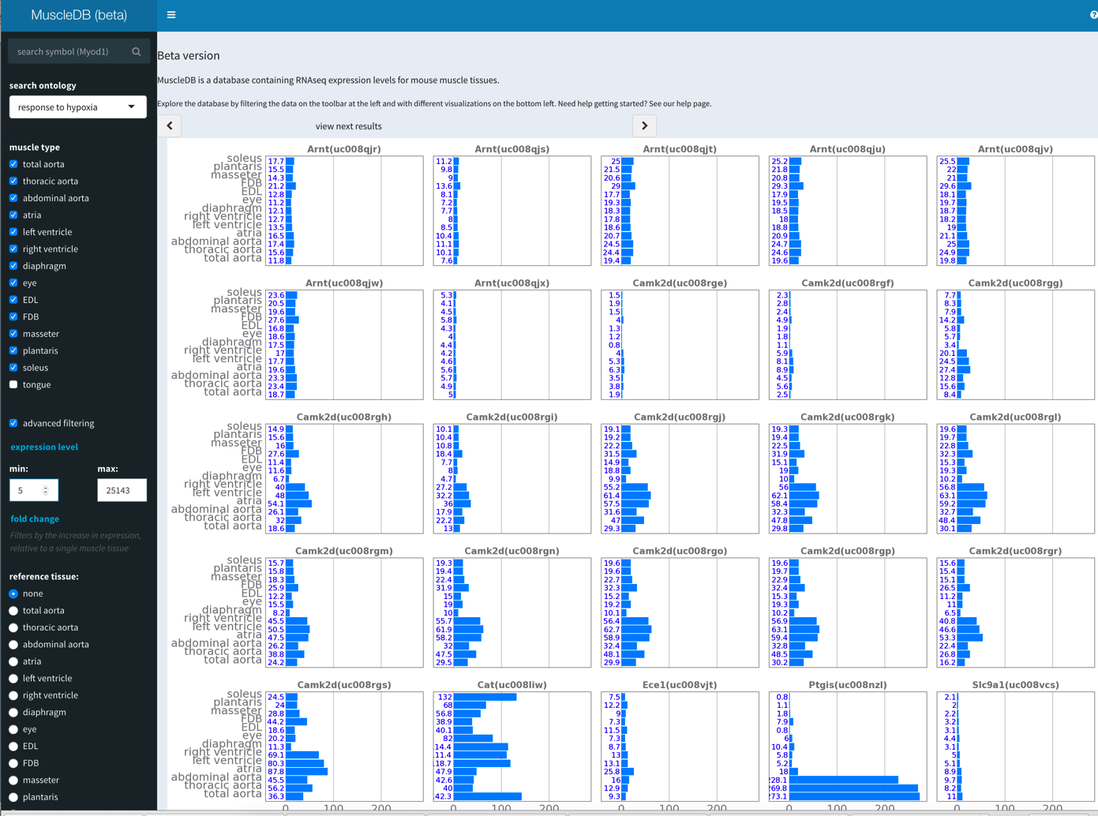
MuscleDB: An open source cloud based platform for visualizing RNA-seq data
Scott A. Lewis¹, Erin E. Terry¹, Jiajia Li¹, Laura D. Hughes¹, Xiping Zhang², Jon England³, Elizabeth Schroder³, Ming Gong³, Francisco Andrade³, Karyn A. Esser², and Michael E. Hughes^{1,4}
1. Department of Biology, University of Missouri-St. Louis, St. Louis, Missouri, USA
2, Department of Physiology and Functional Genomics, University of Florida, Gainesville, Florida, USA
3. College of Medicine, University of Kentucky, Lexington, Kentucky, USA
4. To whom correspondence should be addressed: hughesmi@umsl.edu
Abstract
Transcriptional Profiling of Muscle Tissue
Visualizing the Data in MuscleDB
In order to address the challenges involved in managing a broad range of RNA sequencing data we have developed an online, open source RNA-seq database – MuscleDB – which systematically profiles transcriptional diversity between different skeletal muscle tissues. Thousands of genes are differentially expressed between different skeletal muscles, underscoring the remarkable specialization of these tissues and providing an opportunity to understand the genetic pathways underlying muscle specialization and susceptibility to different pathologies.
Alan Emory (2002) Lancet
MuscleDB query showing the expression levels of a skeletal muscle-specific transcription factor.
Thousands of transcripts are differentially expressed in muscle. The percent of all transcripts differentially expressed between pairs of tissues are shown as a heat map. The blue dendrogram represents overall similarity of tissues based on their transcriptional profile.
MuscleDB query displaying an interactive volcano plot of ion channel genes. The arrow shows a voltage-gated sodium channel. Scn2a1, expression 20X higher in soleus versus EDL.
Global expression pattern of ion channel transcripts. Heat map representation of ion channel transcripts in muscle tissues. The dendrogram at the left represents clustering based on expression similarity. The white, dashed box indicates ion channel transcripts specifically expressed in skeletal muscle. The white arrow indicates an ion channel specifically expressed in eye muscle.
Acknowledgements: We thank members of the Hughes, Esser, and Hogenesch labs, as well as the support staff at Shiny-apps for helpful comments and technical advice during the course of this project. Work in the Hughes Lab is supported by awards from the University of Missouri Research Board, UMSL's College of Arts and Sciences, and the NIH (NIAMS 1 R21 AR069266-01A1
YouTube link for a tutorial video: https://youtu.be/wq7uGnkN4C8
URL for MuscleDB: http://muscledb.org/MuscleDB/

