Slide 1


Web Application for the study of the relationship between Obesity and intestinal microbiome based on PubMed text mining
Neus Torrent Ample
Master’s degree in Bioinformatics and Biostatistics UOC-UB
Supervisors: Romina Astrid Rebrij
Lecturer responsible of the subject: : Antoni Pérez Navarro
June – 2022
Notes:
Good evening,
My name is Nabil Mehaba, and I am going to present the master's thesis in Bioinformatics and Biostatistics, which is entitled: Integrative metabolomics methods for analyzing data in precision biological research and application in animal production investigations.
Therefore, I will follow the following index (introduction to the next slide)

Slide 2

Thesis Index
1
Introduction
2
Objectives
3
Methodology
4
Results and Discussion
5
Conclusions
Notes:
I Will start with an introduction to subject studied, followed by the objectives, then a case study is presented in which I will analyze the outcomes of an experiment investigating the Effects of heat stress on blood metabolomics, physiological indicators and lactation performance of dairy goats. The materials and methods, results and discussion used in the case study. Finally, the conclusions drawn out from this work.

Slide 3
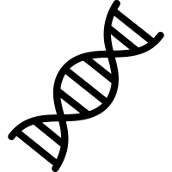

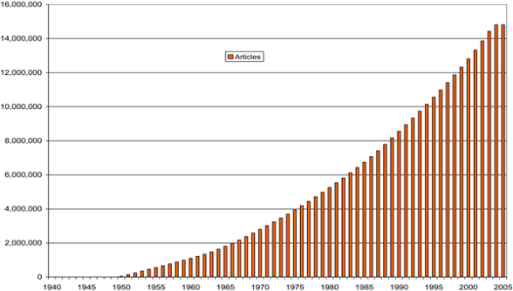
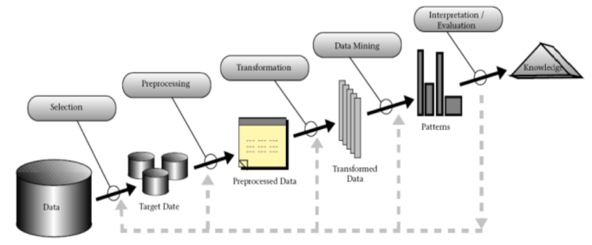

Introduction
The prevalence of obesity has reached epidemic proportions. The global obesity epidemic continues its advance, currently affecting >2 billion people.
Exponential growth of biomedical literature has supposed a challenge for professionals to keep up with the lasts findings. Moreover, to find connections between different disciplines has become even more difficult.
The use of the data mining has been proposed to glean useful insights, discovering novel patterns, relationships and trends contained within the documents → Applications difficult to be adaptable by end users.
Data mining techniques have been applied to predict the diagnoses of metabolic diseases, their severity or their risk factors → There isn’t any text mining applications that relates genes and microbiota in this area.
Source: Rebholz-Schumann et al., 2005; Tomar and Argarwal, 2013.
Notes:
Worldwide, the prevalence of obesity has reached epidemic proportions. The global obesity epidemic continues its relentless advance, currently affecting >2 billion people.
Over the last decade, 227 genetic variants involved in different biological pathways and distortion of the normal microbial balance have been associated with obesity and other metabolic diseases.
Exponential growth of biomedical literature has supposed a challenge for professionals to keep up with the lasts findings. Moreover, to find connections between different topics or disciplines has become even more difficult for the scientific community. In recent decades, the use of the data mining has been proposed to glean useful insights, discovering novel patterns, relationships and trends contained within the documents.
This figure shows the exploding number of articles available from Medline over 1940-2005 (data retrieved from the SRS server at the European Bioinformatics Institute; www.ebi.ac.uk/). In 2003, about 560,000 articles were added to Medline, and from 2000 to 2003, 2 million articles [13].
Because of its potential power for solving complex problems, data mining has been successfully applied to diverse areas such as business, engineering, social media, and biological science.
The biomedical domain is one of the most interesting application areas for text mining, given both the potential impact of the information that can be discovered and the specific characteristics and volume of information available [12].
In general, data mining and Knowledge Discovery in Databases (KDD) are related terms and are used interchangeably but many researchers assume that both terms are different as data mining is one of the most important stages of the KDD process. The knowledge discovery process are structured in various stages: Whereas the first stage is data selection where data is collected from various sources; the second stage is pre-processing of the selected data; the third stage is the transformation of the data into appropriate format for further processing; the fourth stage is data mining where suitable data mining technique is applied on the data for extracting valuable information; and evaluation is the last stage as shown in Figure 4 [14].

Slide 4

Objectives
General objective:
Develop an interactive web application that allows discovering information contained in the summaries of PubMed publications from data mining.
Notes:
The general objectives of this were:

Slide 5
Objectives
Specific objectives:
Obtain a list of genes potentially related to different metabolic diseases.
Explore the relationship between the intestinal bacterial populations in patients with obesity and other metabolic diseases.
Indentify relationships between genes, obesity and other metabolic diseases.
Notes:
Moreover, the specific objectives of this work are:

Slide 6



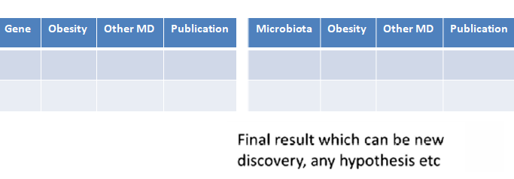
Methodology: Text mining
Abstracts from PubMed
R v4.1.2
Filtered abstracts
Corpus
Extracted features
Terms election
New knowledge & hypothesis
LSA & cosine similarity
Association patters

Slide 7

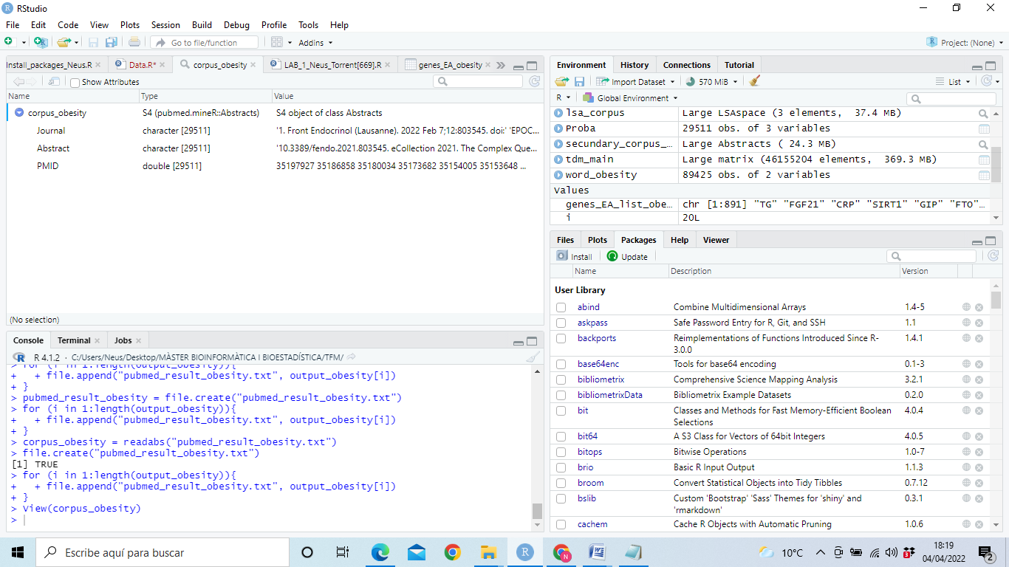
Methodology: Create the corpus
easyPubMed()
pubmed.minerR ()
Download the abstracts from PubMed using batch_pubmed_download(), the tag [MH] and [DP], and saved locally.
Read and transform de abstracts to S4 class object using readabs().
Create secondary corpus searching the abstracts containing “microbiota | microbiome” terms of the corpus using SearchabsL().
Notes:
To download the abstracts from PubMed, the function batch_pubmed_download() of the package easyPubMed was used. That function allows download the information from PubMed to R, restricting the search by keywords and years of publication. Abstracts of articles were saved locally in form of text files and it formed the starting point, the primary corpus. In our case, it was selected the abstracts from PubMed, which contains the MesH term “Obesity” and date publication.
The package pubmed.minerR contains the function readabs(), which read the abstracts downloaded and saved locally and transform them into a S4 class object.
The function SearchabsL() from the pubmed.minerR package searched the abstracts for the given term or combinations of several terms. In this method the argument "include" uses the boolean operator 'OR' and is liberal. The abstracts containing the term “microbiome” or “microbiota” are selected from primary corpus to perform the secondary corpus. It is composed by 28 abstracts.

Slide 8
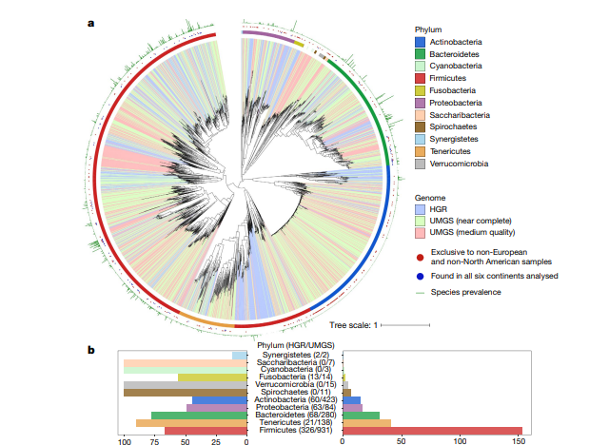
Methodology: Extract features
stringr()
pubmed.minerR ()
Extract genes using gene_atomization() automatically fetch the genes (HGNC approved Symbol) from the text and report their frequencies.
Extract terms using word_atomizations()
tokenizes text into words and reports them in
descending order of their occurrence frequencies.
Common English words, 23 extra white space,
and punctuation marks are automatically removed.
Extract microbiota using the str_subset()
and str_extract() the terms of microbiota were
extracted from the abstracts of the secondary corpus.
Source: modified from Almeida et al., 2019.
Notes:
word_atomizations() and gene_atomizations()
The function word_atomizations() tokenizes text into words and reports them in descending order of their occurrence frequencies. Common English words, 23 extra white space, and punctuation marks are automatically removed. That’s why an extra document preparation is not carried out. The top ranking words are high-occurrence frequency terms.
Microbiota: Using the str_subset() and str_extract() from the package stringr() the terms of the “Microbiota_one_word” vector were extracted from the abstracts of the secundary corpus.
*The HUGO Gene Nomenclature Committee (HGNC) maintains the HUGO Gene Nomenclature. The HGNC is a committee of the Human Genome Organisation (HUGO). Purpose. The HGNC approves a gene name and symbol (short-form abbreviation) for each known human gene. The approved symbols are maintained and stored in the HGNC database.

Slide 9



Methodology: Terms election for LSA
List of genes extracted from the corpus (>10).
Intestinal microbiome population extracted from the corpus.
Metabolic diseases extracted from bibliography.
List of words extracted from the corpus.
… and the term “Obesity”
Notes:
These come from the list of genes (extracted from the corpus), intestinal microbiome population (detailed previously), the names of metabolic diseases (according to [25]) and other terms in the abstracts, such as the keywords of the study topic.
Els gens seleccionats son els que tenen una frequència superior a 10.
En la relació de gens es tria la llista de gens I en la relació de microbiota es tria la llista de Intestinal microbiome population.
terms_obesity = c("bmi", "metabolic", "diabetes", "glucose", "liver", "adipose")

Slide 10
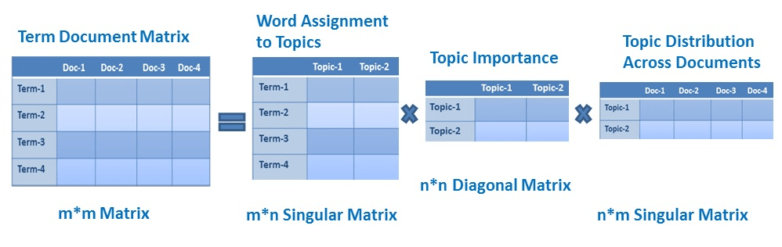
Methodology: LSA and cosine similarity
lsa ()
High-dimensional sparsity each word in the lexicon = an attribute; document word frequency = attribute value → most attribute values are 0.
Latent semantic analysis to transform the text collection to a non-sparse representation with lower dimensionality.
LSA uses bag of word model, which results in a term-document matrix.
LSA performs a singular matrix decomposition on the document-term matrix using singular value decomposition.
Contains the number of times any term of interest appears in any of the documents.
Source: modified from Datacamp [on line] [consult: 16th of May of 2022].
Notes:
Non-negativity: The frequencies of words take on nonnegative values. When combined with high-dimensional sparsity, the non-negativity property enables the use of specialized methods for document analysis.
Although the vector-space representation of text can be considered a sparse numeric data set with very high dimensionality, this special numeric representation is not very amenable to conventional data mining algorithms.
Rather, traditional text mining algorithms are directly applied to the reduced representation obtained from LSA [9].

Slide 11
Methodology: LSA and cosine similarity
lsa ()
SVD is a two mode data reduction analysis that transforms the TDM into three matrices: 1, terms; 2, documents; and 3, a matrix that multiplied by the other two reconstruct the original TDM matrix.
→ A portion of the Σ matrix is retained and the remaining singular values are replaced with zeroes. If the matrices were multiplied back together, it would create an approximation of the original matrix where the number of singular values used determines how close the approximation is (rank k approximation).
→ SVD combines vectors that are closest to each another, thus preserving as much of the original information as possible in fewer dimensions.
M = U x ∑ x V^{T}
Notes:
At the philosophical core underlying LSA is that text embeds knowledge not only by conveying information explicitly through sentences but also implicitly through how words co-occur with each other. Sometimes, the co-occurrence of words may also reveal ideas, because ideas are embedded into language through word co-occurrences. Terms can be related to one another in LSA even if they do not co-occur in the same document as long as both terms cooccur with shared other terms [18].
Mathematically, this is done by running a singular value decomposition (SVD) on the term-document (frequency) matrix (TDM). This matrix contains the number of times any term of interest (or to be exact, any term not excluded) appears in any of the documents being analyzed. SVD is a two mode data reduction analysis that transforms the TDM into three matrices: 1, terms; 2, documents; and 3, a matrix that multiplied by the other two reconstruct the original TDM matrix. Running SVD on the TDM is what defines LSA and makes it more than mere word co-occurrences analysis [18].
Por lo tanto, la matriz M original podría reconstruirse multiplicando las matrices U, Σ y V. Sin embargo, en LSA, se usa un SVD truncado en el que solo se calcula o retiene una parte de la matriz Σ y los valores singulares restantes se reemplazan con ceros. Si las matrices se volvieran a multiplicar juntas, se crearía una aproximación de la matriz original donde el número de valores singulares utilizados determina qué tan cerca está la aproximación. La matriz reconstruida se conoce como aproximación de rango k, donde k es el número de valores singulares utilizados. Que multiplicar las matrices de rango reducido solo crea una aproximación de la matriz original puede parecer un problema, pero en realidad es una de las características más poderosas de LSA. Debido a que SVD busca minimizar el error, combina los vectores más cercanos entre sí, preservando así la mayor cantidad de información original posible en menos dimensiones. Como resultado, seleccionar un rango apropiado es de vital importancia en LSA. k a menudo se establece en 100, 200 o 300. No existe una regla sobre la mejor manera de seleccionar k a priori. La transformación SVD crea un espacio semántico a partir del TDM [18].

Slide 12
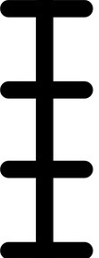
Methodology: LSA and cosine similarity
lsa ()
Cosine similarity Once the semantic space has been created, calculating the cosine similarity between vectors in the Σ×U matrix was applied to find which terms are related to one another.
Results
1
→ The closer the cosine of two vectors is to 1, the more similar they are.
A similarity near 0 may indicate:
Terms have opposite meanings.
They are unrelated.
0
Notes:
Once the semantic space has been created, much can be done with the term and document matrices created within that space. One common analysis is 27 to compare vectors of terms by applying cosine similarity. This kind of analysis can be applied to find which terms are related to one another by calculating the cosine similarity between vectors in the Σ×U matrix.

Slide 13
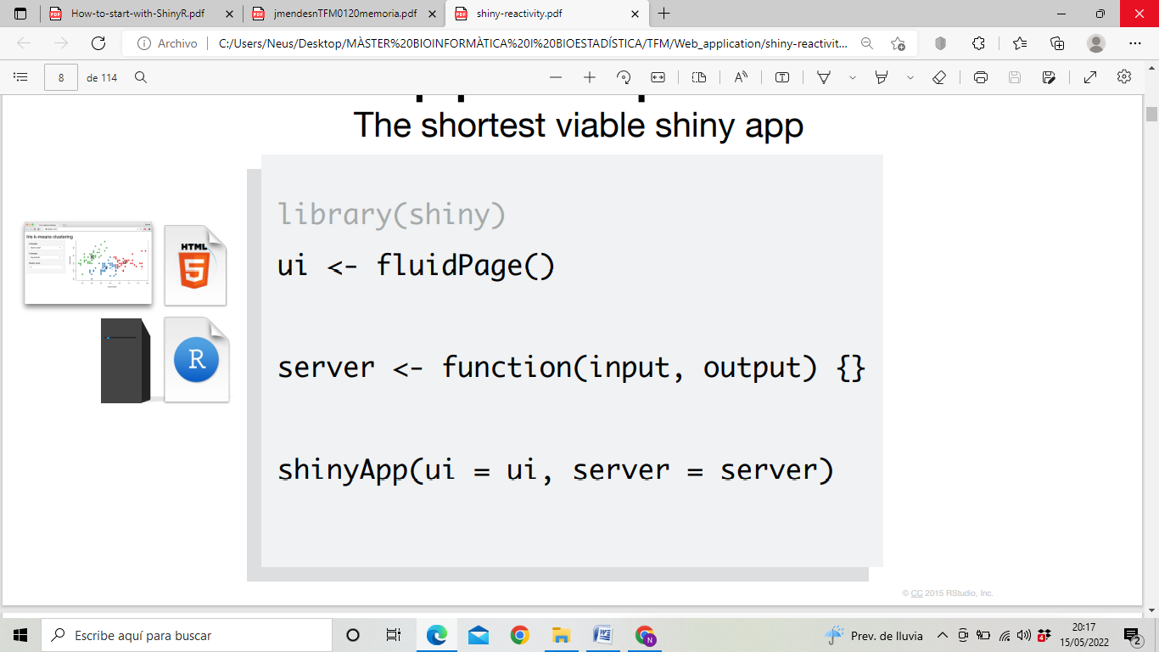

Metodology: Development of web application
Shiny ()
Shinydashboard()
Shinyjs()
shinyBS()
wordcloud()
rgl()
Shinyapps.io
UI which defines how your app looks.
Server function which defines how your app works.
Reactive programming to automatically update outputs when inputs change.
Source: Shiny from R Studio [on line] [consult: 15th of May of 2022]
Notes:
Shiny is an open source R package that provides an elegant and powerful web framework for building web applications using R. Shiny helps you turn your analyses into interactive web applications without requiring HTML, CSS, or JavaScript knowledge.
Shiny allows you to take your work in R and expose it via a web browser so that anyone can use it.
As we introduced before, the two key components of every Shiny app are: the UI (short for user interface) which defines how your app looks, and the server function which defines how your app works. Moreover, Shiny uses reactive programming to automatically update outputs when inputs change [20].

Slide 14
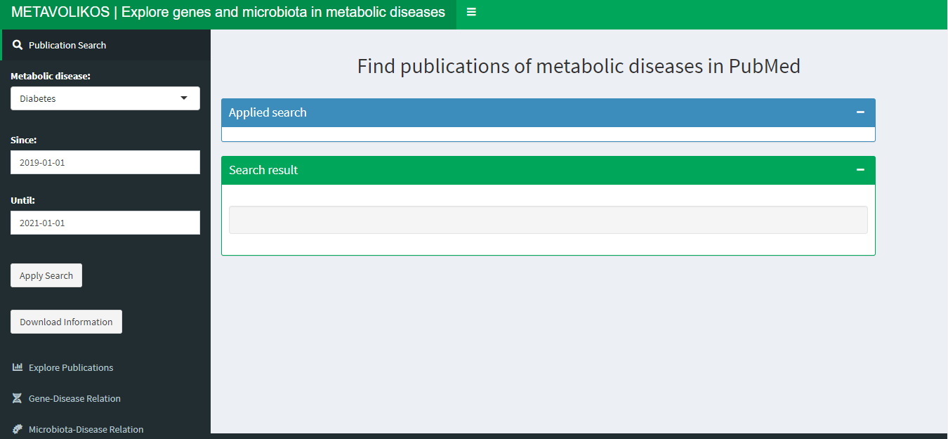
Results and Discussion: METABOLIKOS web application
Home page
https://neustorrentample.shinyapps.io/METAVOLIKOS/

Slide 15
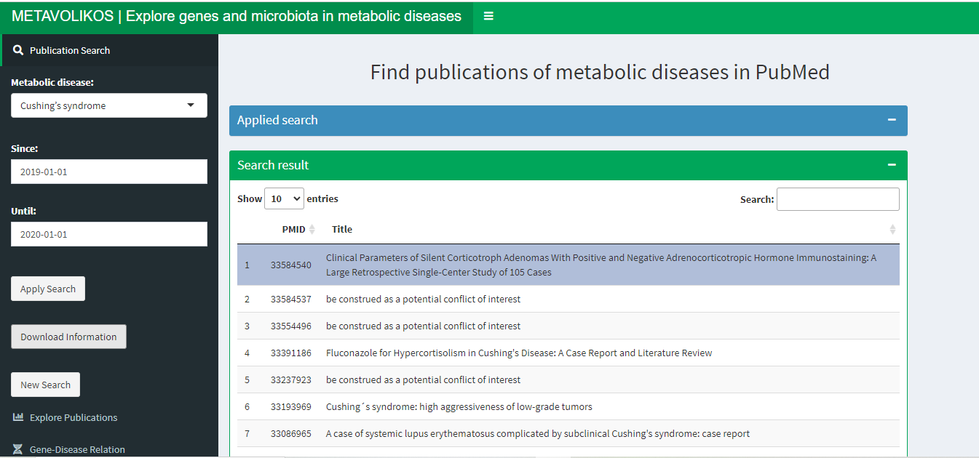
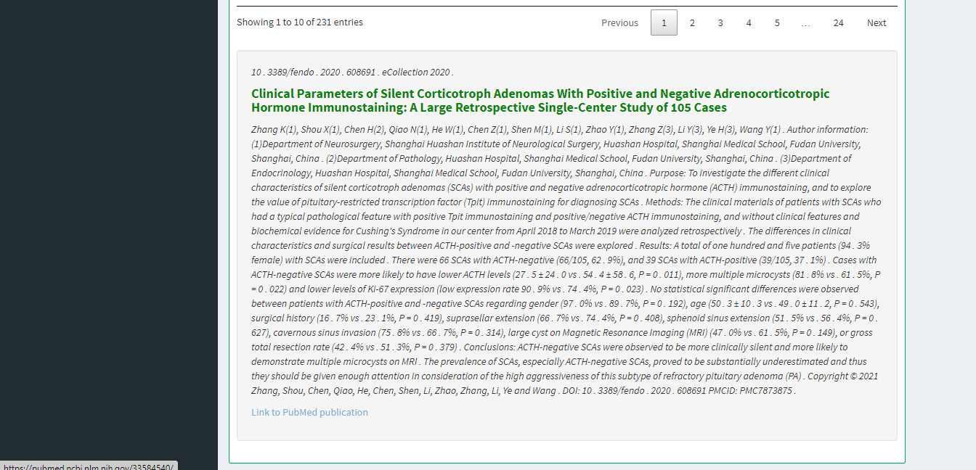
Results and Discussion: METABOLIKOS web application
Publication Search tab
Notes:
This tab allows to search articles from PubMed, which contain the MeSH tag associated with one of the diseases in a range of dates chosen by the user.
The table shows the PMID number and the title of each downloaded article.
At the bottom of the table, the title and abstract of the selected publication is displayed, allowing a quickly reading of the content of the article.
In addition, a link that leads to the article in PubMed is facilitated.

Slide 16
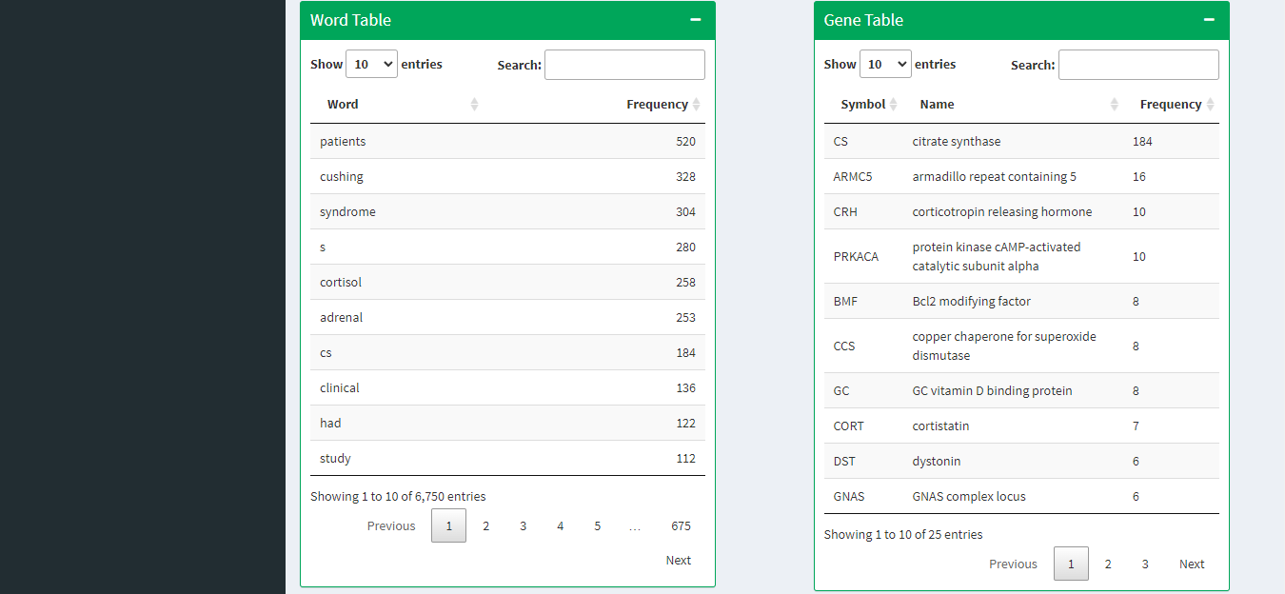
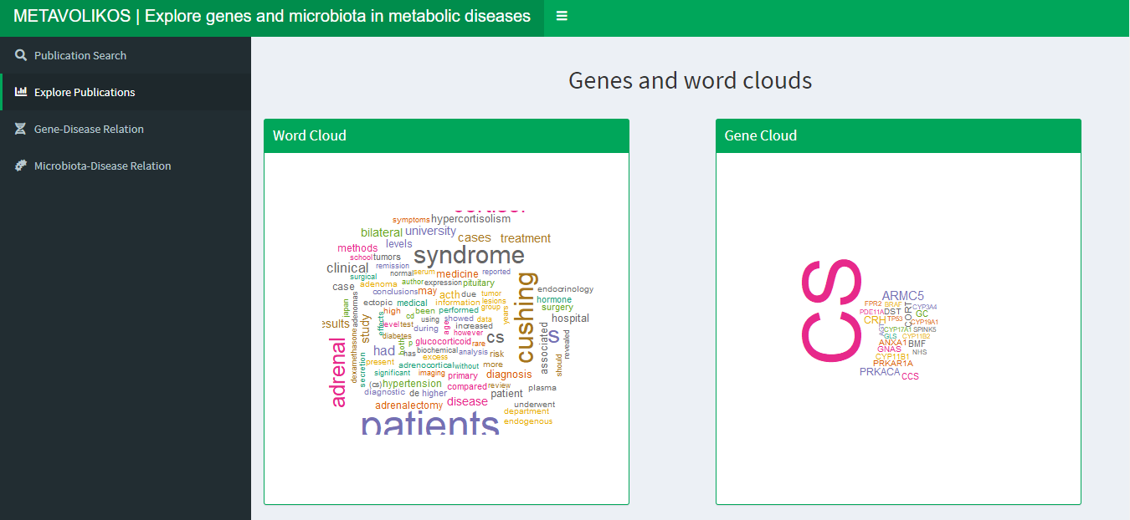

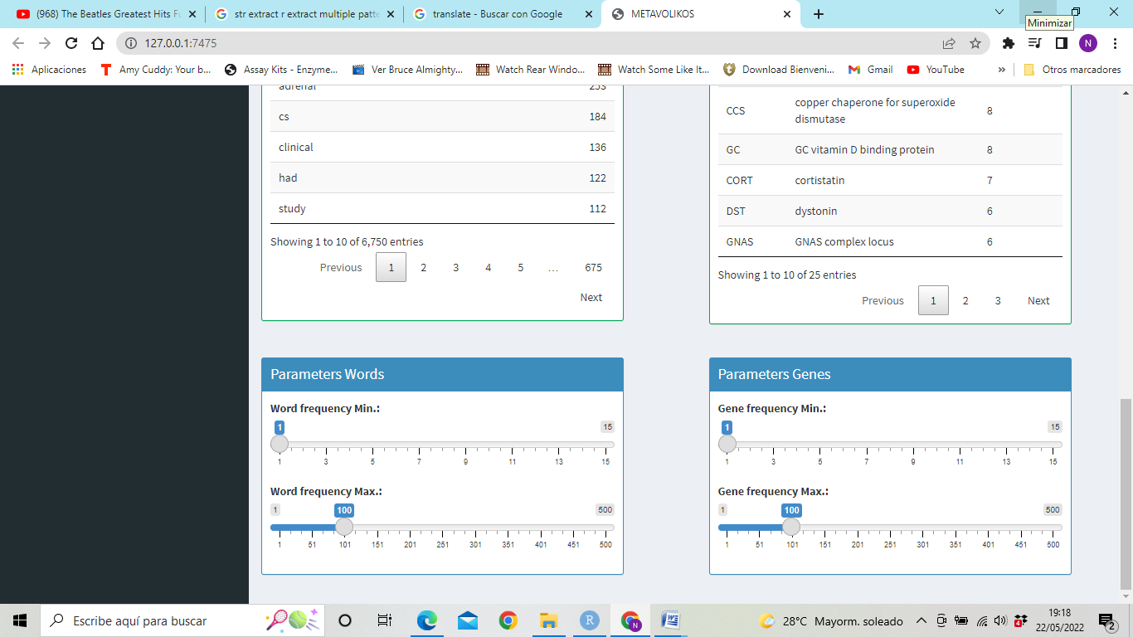
Results and Discussion: METABOLIKOS web application
Explore Publications tab
Notes:
Genes and words are extracted from them and are displayed in cloud graph and table format.
Maximum and minimum frequency of words and genes can be selected. When this selection is modified, the cloud graphs and the tables are updated automatically.

Slide 17
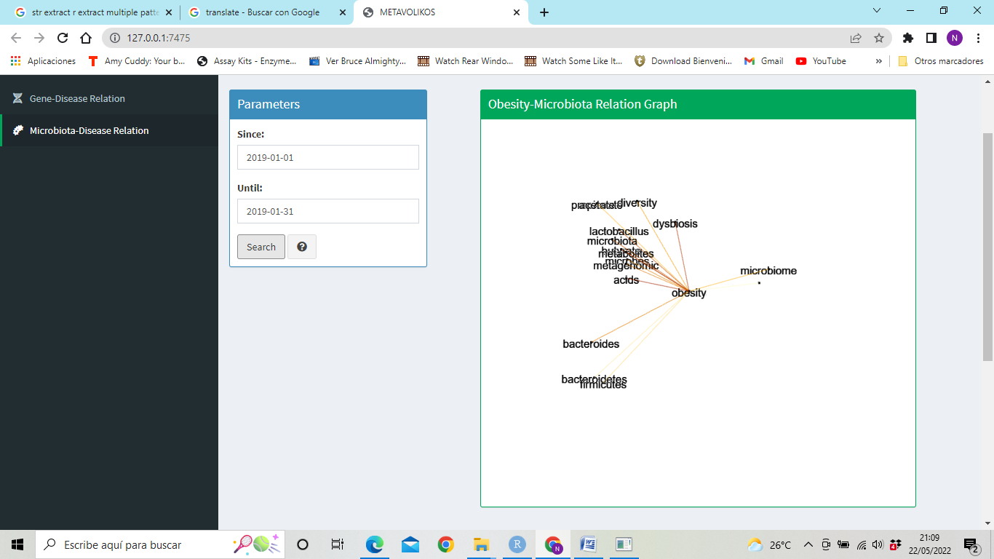
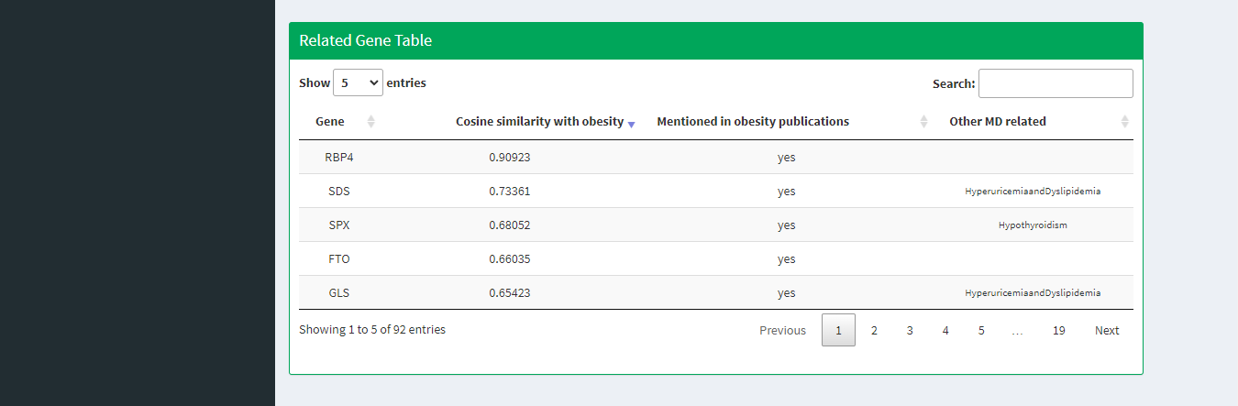
Results and Discussion: METABOLIKOS web application
Gene & Microbiota Disease Relation tab
Relation established based on genes/microbiota mentioned in publications on metabolic diseases to infer their relation with the term “Obesity” through latent semantic analysis.
From document terms matrix → the terms terms matrix: Genes/Microbiota related to obesity with which other metabolic diseases have high similarity (cosine).
Notes:
In this tab the relation between genes, obesity and other metabolic diseases is carried out. That relation is established based on the genes mentioned in publications on metabolic diseases to infer their relation with the term “Obesity” through latent semantic analysis. The result is a table indicating if the gene was already found in MeSH searchbased obesity publications. 40 By obtaining the document terms matrix, and consequently, the terms terms matrix, it is possible to find for those genes related to obesity with which other metabolic diseases have high similarity (measured by cosine). Results are displayed in table and graph form. Moreover, it is possible to select a range of dates between which to search the publications. The instructions for the user and showed when the question sign button is clicked.

Slide 18
Results and Discussion: Genes related to different metabolic diseases
Obesity | Diabetes | Hypercholesterolemia | Metabolic Syndrome
TG¹ | CAD | PCSK9 | TG¹
FTO | HR² | FH | CAD
CRP | TG¹ | TG¹ | HR²
HR² | SIRT1 | CAD | CRP
FGF21 | CP | NPC1L1 | DBP
SSB | NHS | ABCG5 | FGF21
NHS | ADA | APOE | SHBG
CS | CRP | CRP | HGS
MC4R | NLRP3 | CETP | LBP
SIRT1 | CS | ABCG8 | FADS1
¹Thyroglobulin. ²Lysine demethylase and nuclear receptor corepressor.
Notes:
It is possible to observe that several top 10 most cited genes in to the corpus are common between the different metabolic diseases. Concretely, the TG is expressed in all diseases and the HR in three of them (all except 39 hypercholesterolemia). It supports the theory that all theses metabolic imbalances are related between them.
Thyroglobulin: Thyroid hormone synthesis...crete in this lumen the specialized protein thyroglobulin (TG) which serves as a store for the hormo...
Lysine demethylase (also known as LSD1): Activation of these adipocytes leads to an increase in calorie consumption and is expected to improve overweight conditions, providing a potential strategy for treating obesity and its related metabolic disorders.

Slide 19

Results and Discussion: Relationship genes in patients with obesity and other metabolic diseases.
Gene | Cosine similarity whit obesity | Mentioned in obesity publications | Other MD related
RBP4 | 0.91 | yes
SDS | 0.73 | yes | Hyperuricemia, and dyslipidemia.
SPX | 0.68 | yes | Hypothyroidism.
FTO | 0.66 | yes
GLS | 0.65 | yes | Hyperuricemia, and dyslipidemia.
CA1 | 0.56
TF | 0.50 |  | Hyperlipidemia and dyslipidemia.
PTX3 | 0.46 | yes | Hyperuricemia, dyslipidemia, hyperlipidemia, and hypothyroidism.
NLRP3 | 0.35 | yes
ANGPTL8 | 0.33 | yes | Hyperuricemia, dyslipidemia, and hyperlipidemia.
Notes:
In the Table 6, it is possible to see that the gene RBP4 has high relation with the term “Obesity” (0.91 cosine similarity). Due to that, this gene is already present into the abstracts of publications with the MeSH term “Obesity” associated. It doesn’t have any other metabolic disease related.
In the second tab of the related gene table (also exposed in Table 6), appears the gene TF, which has a medium cosine similarity (0.50) with the term 42 “Obesity” and it doesn’t appear into the publications about obesity of the selected period of publications. Moreover, this gene has relation with other metabolic diseases like hyperlipidemia and dyslipidemia. This case represents how latent semantic analysis, and specifically METAVOLIKOS tool, can shed light to create new research hypotheses. A relationship has been inferred from publications on metabolic diseases where articles that include the term “Obesity” or explicitly this gene are not necessarily included. It is not unreasonable to think that the gene TF is related with the obesity and it is not related directly in scientific publications. It opens a new research line.

Slide 20
Results and Discussion: Relationship intestinal bacterial populations in patients with obesity and other metabolic diseases.
Microbiota related concepts | Cosine similarity whit obesity | Mentioned in obesity publications | Other MD related
dysbiosis | 0.92 | yes | Metabolic, diabetes, and dyslipidemia.
acids | 0.82 | yes | Hyperlipidemia, metabolic, and diabetes.
metabolites | 0.82 | yes | Hyperlipidemia, dyslipidemia, metabolic, and diabetes.
butyrate | 0.77 | yes | Hyperlipidemia, dyslipidemia, metabolic, and diabetes.
metagenomic | 0.75 | yes | Hyperlipidemia, dyslipidemia, and diabetes.
Microbiota | Cosine similarity whit obesity | Mentioned in obesity publications | Other MD related
lactobacillus | 0.58 | yes | Hyperlipidemia, and diabetes.
bacterioides | 0.57 | yes | Dyslipidemia, and hyperlipidemia.
firmicutes | 0.23 | yes | Dyslipidemia, and hyperlipidemia.
Notes:
In the Table 7, it is possible to see that the concept “dysbiosis” has high relation with the term “Obesity” (0.92 cosine similarity). Due to that, this concept is already present into the abstracts of publications with the MeSH term “Obesity” associated. Moreover, this concept is also related with metabolic diseases, diabetes and dyslipidemia.
Is in the second tab of the related microbiota table (also exposed in Table 7) is possible to find the first bacterial population related to the term “Obesity” (cosine of 0.58). The most related concepts to term “Obesity” are concepts related to intestinal microbiome (like dysbiosis or acids), but not bacterial population. This bacteria is lactobacillus, which is already present into the obesity publications and also is related with other metabolic diseases like diabetes and hyperlipidemia.

Slide 21
Conclusions
The development of METAVOLIKOS, a web application that allows discovering information contained in the abstracts of scientific publications on metabolic diseases, has been achieved.
LSA predicted a relationship between terms, evidencing the power of the LSA and its potential to infer relationships between two terms in a context. It shed light to the biomedical literature and facilitate the creation of new research hypotheses.
The main two genes already related with different metabolic diseases were TG and HR. Moreover, genes RBP4 and TF were presented as potentially related with obesity and are good candidates to study their relation in patients with obesity.
Most related bacteria population with obesity and others related metabolic diseases are lactobacillus, bacterioides and firmicutes.
It would be interesting to optimize the functions already used to optimize the computation time.
Notes:
Just read the conclusions.

Slide 22
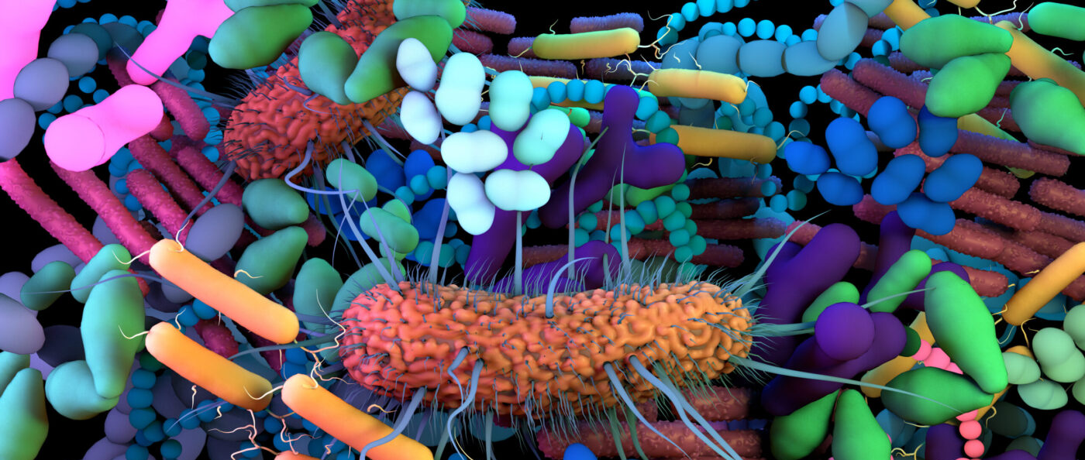
Thank you for the attention
Notes:
Thank you for your attention

