Slide 1

$$\frac{1}{19}$$

Slide 2

$$\frac{1}{7}$$

Slide 3

$$\frac{1}{4}$$

Slide 4

$$\frac{3}{8}$$

Slide 5

$$\frac{1}{2}$$

Slide 6

$$\frac{4}{7}$$

Slide 7

$$\frac{2}{3}$$

Slide 8

$$\frac{7}{9}$$

Slide 9

$$\frac{5}{6}$$

Slide 10
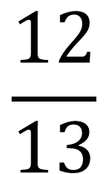
$$\frac{12}{13}$$

