Slide 1
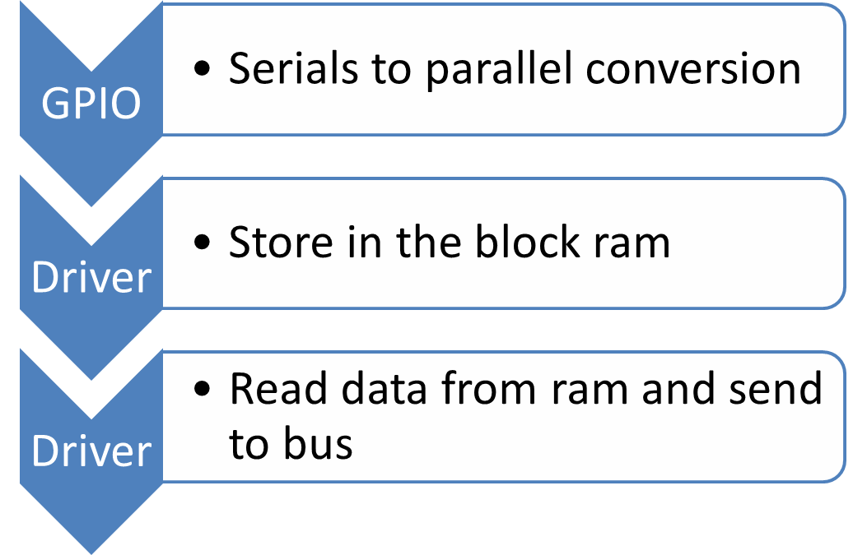
Memory Design

Slide 2
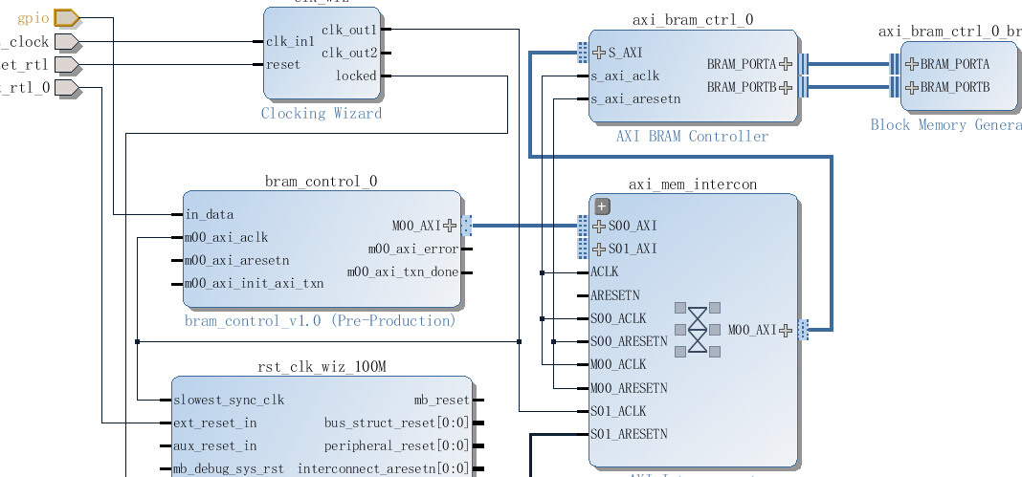
Draft Functional block

Slide 3
Considerations
In order to save IO port, using serials transmission for trace port.
Considering how much space is really needed
Considering how to separate data from different signals.
Considering ways to work coordinate with JTAG
Considering proper structure to leave space for data compression after finishing basic function

