Slide 2
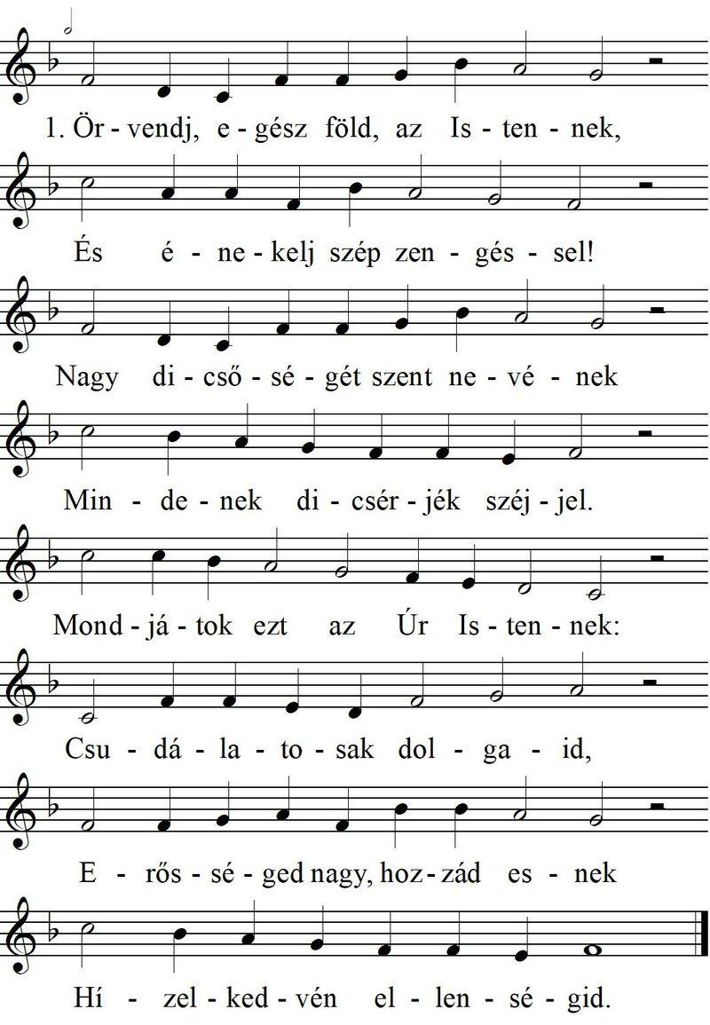
BAD

Slide 3
BAD

Slide 4
