Slide 1


Oleg Gorin
20.08.2026

Slide 2

Outline
Executive Summary
Introduction
Methodology
Results
Conclusion
Appendix

Slide 3
Introduction
Rocket launch costs:
Purpose of research:
SpaceX Falcon 9:
62 million dollars
other providers:
upward of 165 million dollars
Determine if first stage will land
Why is it important?:
Predict the cost of launch
Give opportunity to other companies to compete with SpaceX
Reason of difference:
SpaceX can reuse the first stage.

Slide 4

Section 1

Slide 5
Methodology
Executive Summary:
Built a complete Falcon 9 landing-success analysis pipeline.
Collected launch data from SpaceX REST API and Wikipedia scraping.
Cleaned landing outcomes into a binary target: Success / Failure.
Explored patterns with visualization, SQL, and Folium maps.
Trained classification models and compared accuracy/confusion matrices.

Slide 6
Data Collection
Data were collected from following sources:
api.spacexdata.com
https://en.wikipedia.org/wiki/List_of_Falcon_9_and_Falcon_Heavy_launches
Key tools/libraries used for data collection:
Web scraping:
Beautifulsoup4
Requests
SpaceX REST API:
Requests

Slide 7
Data Collection – SpaceX API
Data collection with SpaceX REST:
spacex_url = https://api.spacexdata.com/v4/launches/past
response = requests.get(spacex_url)
data = pd.json_normalize(response.json())

Slide 8
Data Collection - Scraping
Web scraping process using key phrases and flowcharts
response = requests.get(static_url, headers = headers)
soup = BeautifulSoup(response.text)
html_tables = []
for table in soup.find_all('table'):
html_tables.append(table)
External reference:
https://github.com/Neuvox512/Data-Science-Capstone-Project

Slide 9
Data Wrangling
To determine if landing of first stage was successful ‘Outcome’ column was processed
From different types of landing were extracted only values 1 and 0, indicating Success and Failure respectively
These values formed new column and served as target values
External reference:
https://github.com/Neuvox512/Data-Science-Capstone-Project

Slide 10
EDA with Data Visualization
Charts used in Data Visualization Analysis:
Relationship between Flight Number and Launch Site (scatter plot)
Relationship between Payload Mass and Launch Site (scatter plot)
Relationship between success rate of each orbit type (bar plot)
Relationship between FlightNumber and Orbit type (scatter plot)
Relationship between Payload Mass and Orbit type (scatter plot)
Launch success yearly trend (line chart)
External reference:
https://github.com/Neuvox512/Data-Science-Capstone-Project

Slide 11
EDA with SQL
SPACEXTABLE was created in sqlite database
Unique names of launch site were displayed
Total Payload mass carried by boosters launched by NASA (CRS) was found
average payload mass carried by booster version F9 v1.1 was found
date when the first successful landing outcome in ground pad was achieved has been found
Names of the boosters which have success in drone ship and have payload mass greater than 4000 but less than 6000 were explored
total number of successful and failure mission outcomes was found
All the booster versions that have carried the maximum payload mass were explored
All records which display the month, failure landing in drone ship ,booster versions and launch site for the months in year 2015 were extracted
All landing cases between the date 2010-06-04 and 2017-03-20 were extracted in descending order.
External reference:
https://github.com/Neuvox512/Data-Science-Capstone-Project

Slide 12
Build an Interactive Map with Folium
First folium.Map object was created with coordinates related to NASA Johnson Space Center at Houston, Texas
Then folium.Circle and folium.Marker object were used to highlight and label NASA Space Center
Then all Launch Site and their coordinates were extracted from data set
Launch sites were highlighted the same way with folium.Circle
MarkerCluster object was used to present successful and unsuccessful landing of rocket’s first stage launched from respective launch site
Then PolyLine object was created to represent the distance between launch site and their proximities
External reference:
https://github.com/Neuvox512/Data-Science-Capstone-Project

Slide 13
Predictive Analysis (Classification)
Model workflow
Split the dataset into features (X) and target (Y).
Standardized numeric features with StandardScaler.
Used an 80:20 train/test split.
Tuned Logistic Regression, SVM, Decision Tree, and KNN with GridSearchCV.
Compared accuracy and confusion matrices to select the best model.
External reference:
https://github.com/Neuvox512/Data-Science-Capstone-Project
External reference:
https://github.com/Neuvox512/Data-Science-Capstone-Project

Slide 14
Results
Exploratory data analysis results
Interactive analytics demo in screenshots
Predictive analysis results

Slide 15

Section 2

Slide 16
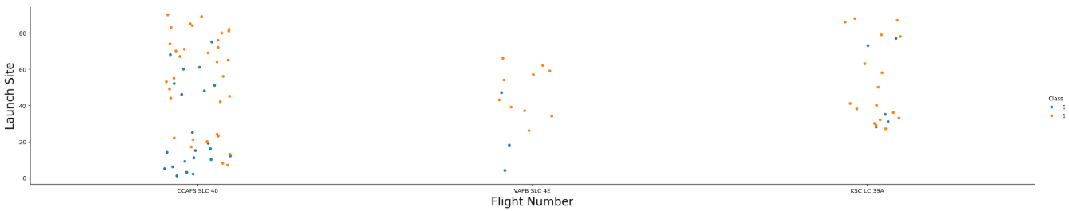
Flight Number vs. Launch Site
• The chart is now taken from the uploaded notebook output.
• Successful first-stage landings become more common at higher flight numbers.
• CCAFS SLC-40 has the highest number of launches in this visual.
External reference: https://github.com/Neuvox512/Data-Science-Capstone-Project

Slide 17
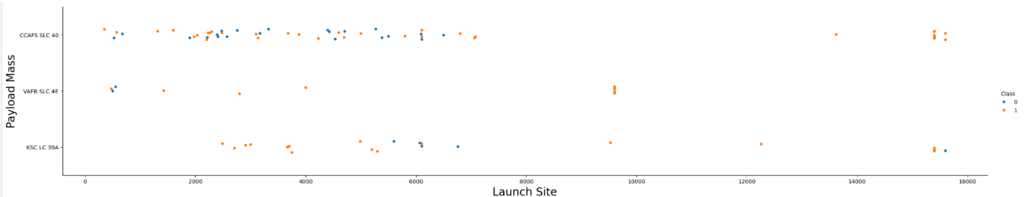
Payload Mass vs. Launch Site
• The chart is now taken from the uploaded notebook output.
• Payload distributions vary by launch site.
• The notebook notes that VAFB SLC-4E does not include very heavy payloads above 10,000 kg.
External reference: https://github.com/Neuvox512/Data-Science-Capstone-Project

Slide 18
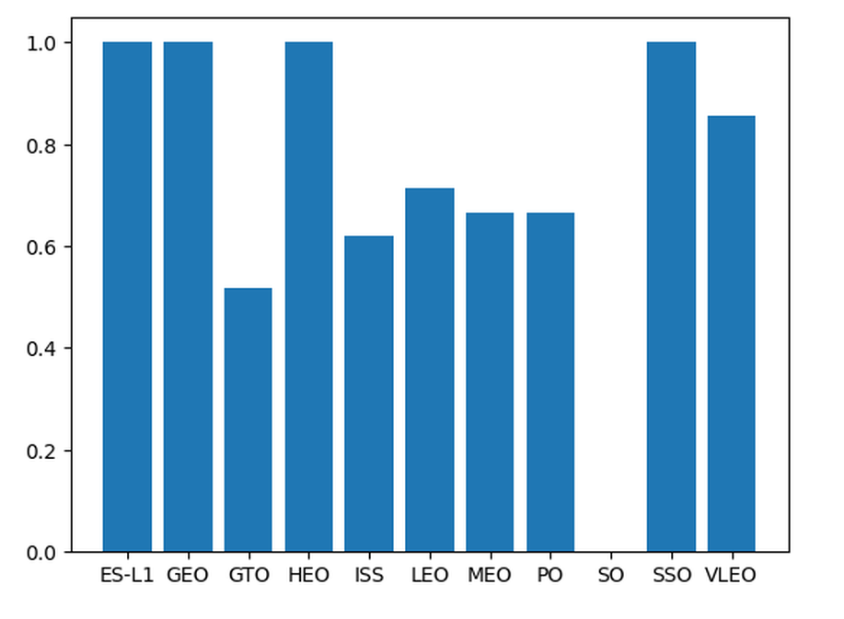
Success Rate by Orbit Type
• Orbit type has a strong relationship with landing success.
• GTO shows a visibly lower success rate than several other orbit classes.
• ES-L1, GEO, HEO, and SSO appear near 100% successful in this sample.
Show a bar chart for the success rate of each orbit type
Show the screenshot of the scatter plot with explanations
External reference: https://github.com/Neuvox512/Data-Science-Capstone-Project

Slide 19
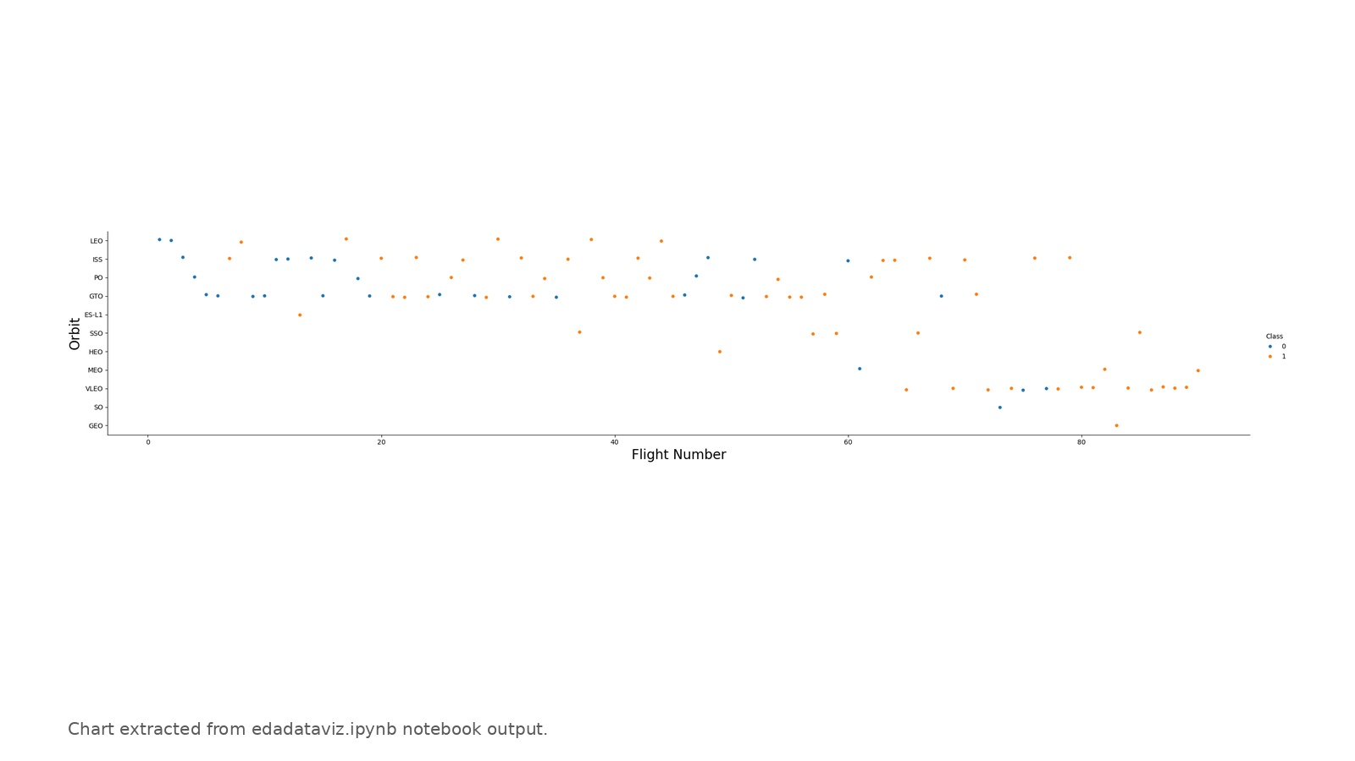
Flight Number vs. Orbit Type
• The plot compares flight number and orbit type against landing outcome.
• More later-flight missions are successful across several orbit categories.
• This supports including Flight Number and Orbit as model features.
External reference: https://github.com/Neuvox512/Data-Science-Capstone-Project

Slide 20
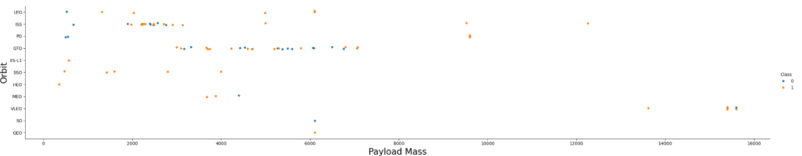
Payload Mass vs. Orbit Type
• Payload mass and orbit type together describe mission difficulty.
• GTO covers a broad middle-to-high payload range.
• Several successful high-payload launches are visible in VLEO.
External reference: https://github.com/Neuvox512/Data-Science-Capstone-Project

Slide 21
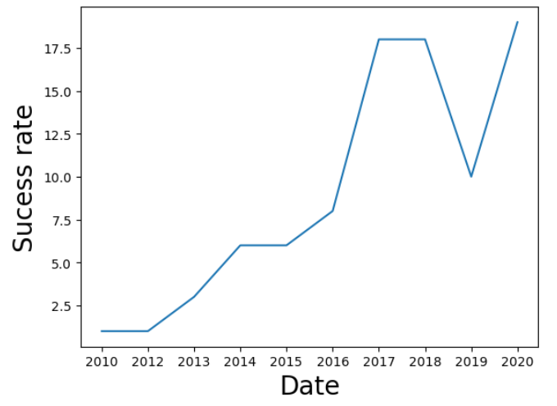
Launch Success Yearly Trend
• This slide now uses the notebook output directly.
• The trend rises strongly after 2013, with much higher activity in 2017–2020.
• Note: the uploaded notebook plot reflects yearly launch counts, not a cleaned yearly success-rate chart.
External reference: https://github.com/Neuvox512/Data-Science-Capstone-Project | Visual source: edadataviz.ipynb

Slide 22
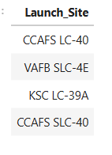
All Launch Site Names
Unique names of Launch sites were extracted from database SPACEXTABLE
SQL query using DISTINCT was implemented for that purpose

Slide 23
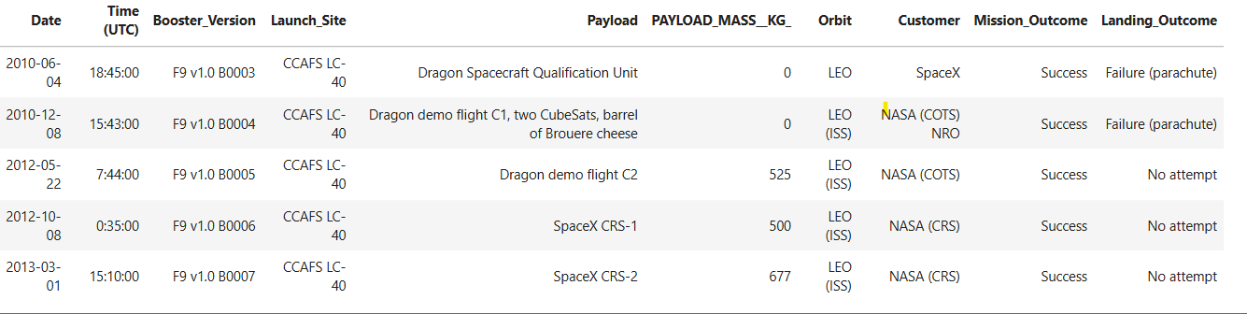
Launch Site Names Begin with 'CCA'
5 records where launch sites begin with the string 'CCA’ were extracted from database SPACEXTABLE
SQL query using like ‘CCA%’ LIMIT 5 was implemented for that purpose

Slide 24
Total Payload Mass
SQL query using SUM() method was implemented for that purpose
SQL query also contained condition where customer was chosen as ‘NASA (CRS)’
SQL result: 45596 kg

Slide 25
Average Payload Mass by F9 v1.1
SQL query using AVG() method was implemented for that purpose
SQL query also contained condition where Booster Version was chosen as ‘F9 v1.1’
SQL result: 2928,4 kg

Slide 26
First Successful Ground Landing Date
SQL query using MIN() method for date column was implemented for that purpose
SQL query also contained condition where Landing Outcome was chosen as ‘Success (ground pad)’
Result date: 2015-12-22

Slide 27
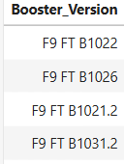
Successful Drone Ship Landing with Payload between 4000 and 6000
SQL query was used for extraction Booster Version from table
SQL query also contained 2 conditions:
Landing Outcome was chosen as ‘Success (drone ship)’
Payload mass was chosen in range between 4000 and 6000 kg

Slide 28
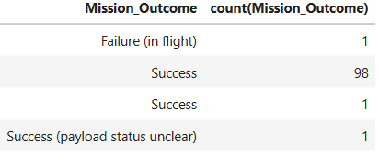
Total Number of Successful and Failure Mission Outcomes
SQL query was used for extraction Mission Outcome and their count using method COUNT() from table
GROUP BY method was further implemented in SQL query to get number of Missions to related outcome

Slide 29
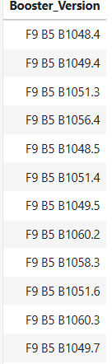
Boosters Carried Maximum Payload
SQL query was used for extraction Booster Version from table
Subquery with aggregate function was further implemented in SQL query
Aggregate function included MAX() method to extract maximum payload mass

Slide 30
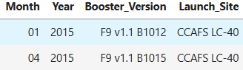
2015 Launch Records
SQL query was used for extraction Booster Version, Launch Site, Year and Month from table
SQL query also contained 2 conditions:
Landing Outcome was chosen as ‘Success (drone ship)’
2015 year was selected

Slide 31
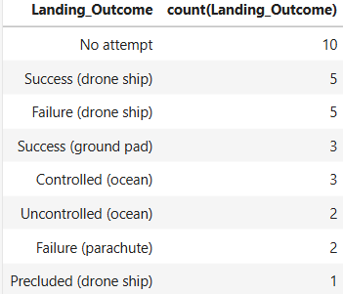
Rank Landing Outcomes Between 2010-06-04 and 2017-03-20
SQL query was used for extraction Mission Outcome and their count using method COUNT() from table
GROUP BY method was further implemented in SQL query to get number of Missions to related outcome
SQL query also included condition where date was selected between 2010-06-04 and 2017-03-20
The query was further presented by number of successful landings in descending order

Slide 32

Section 3

Slide 33
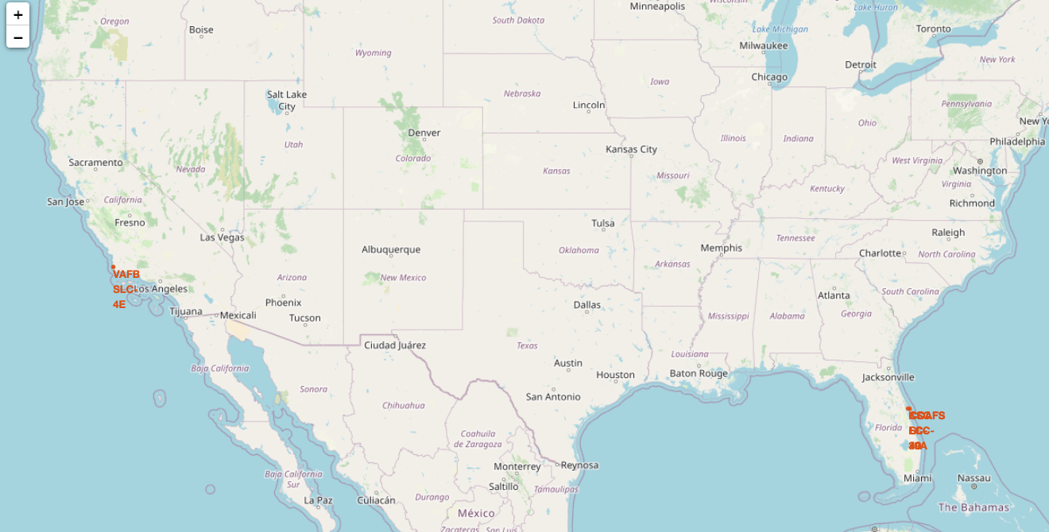
Launch Site Markers
On global map location markers related to launch site coordinates were placed
2 of 3 launch site are settled down very close to each other on east coast

Slide 34
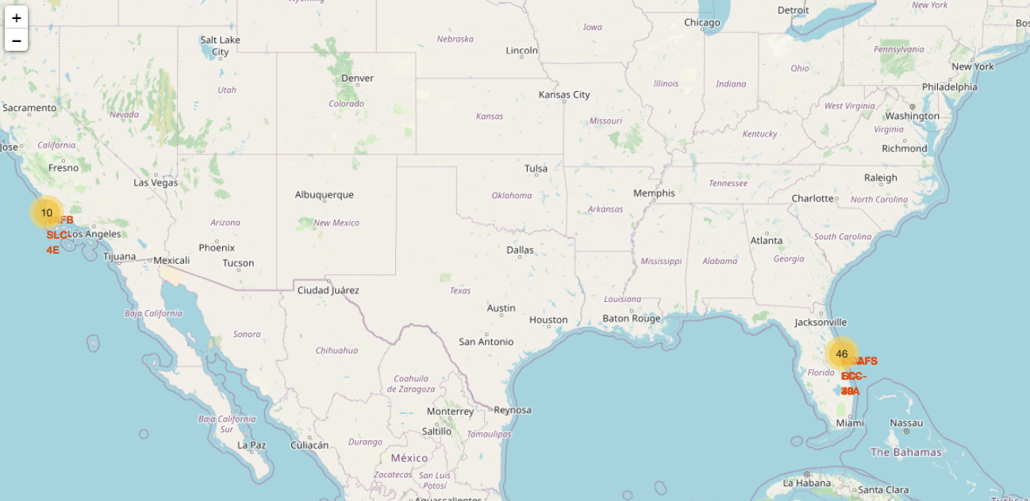
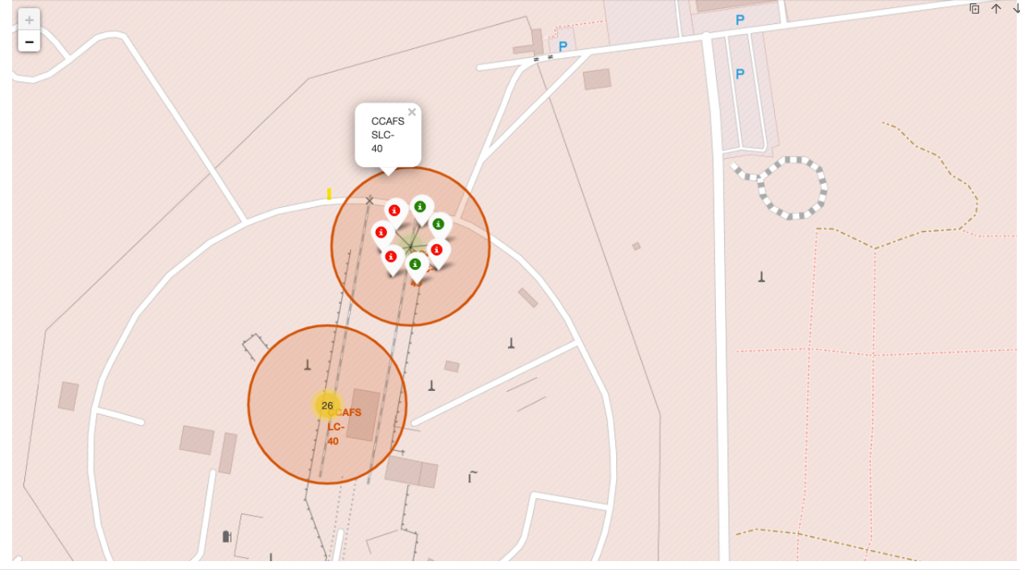
Markers for all launch records
MarkerCluster object was used to create markers having the same coordinate
Then we used a green markers for successful launches and red marker for unsuccessful

Slide 35
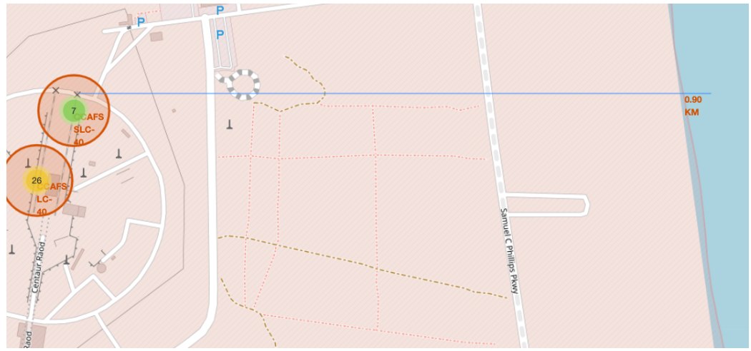
Launch site proximities
PolyLine method was
Point on the closest coastline using MousePosition was marked down and the distance between the coastline point and the launch site was calculated
Then coastline corresponding Marker was added to the map
PolyLine method was used to draw the line between launch site and coastline

Slide 36

Section 5

Slide 37
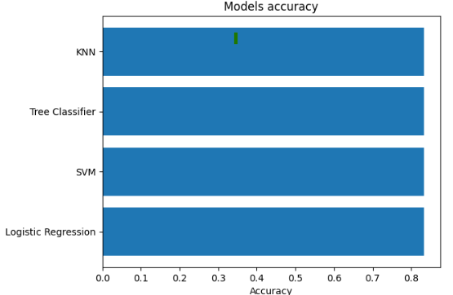
Classification Accuracy
All models performed well in terms of accuracy
Every model has the same accuracy equal to 83,33 %

Slide 38
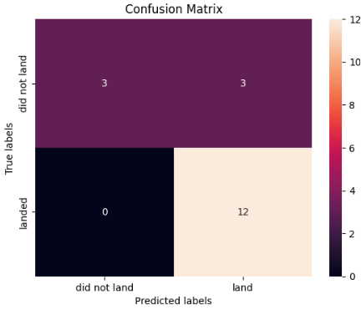
Confusion Matrix
Confusion matrices for all models are the same
All models have the same False Positive and False Negative rates

Slide 39
Conclusions
1. SpaceX launch cost advantage is tied to first-stage reuse; predicting landing success is therefore commercially important.
2. EDA shows that launch site, orbit type, payload mass, flight number, and year are meaningful predictors of landing outcome.
3. SQL and Folium analysis confirm that launch records are concentrated in a small number of coastal sites with clear operational patterns.
4. Classification models reached comparable accuracy (83.33%); the final recommendation is to use the simplest high-performing model and validate it on new launches.

Slide 40


Slide 41
Appendix: Project Assets
• REST API extraction notebook/code
• Wikipedia scraping notebook/code
• Data wrangling and EDA notebooks
• SQL queries and outputs
• Folium map screenshots
• Predictive analysis notebook and model comparison
Repository: https://github.com/Neuvox512/Data-Science-Capstone-Project

