Slide 1
Inventarium
A project to manage Inventory

Slide 2
Why did I chose to do this App?

Slide 3
Features
Creating Lists
Adding Items to each List
Editing list titles
Editing list items
Deleting list items
Deleting Lists

Slide 4
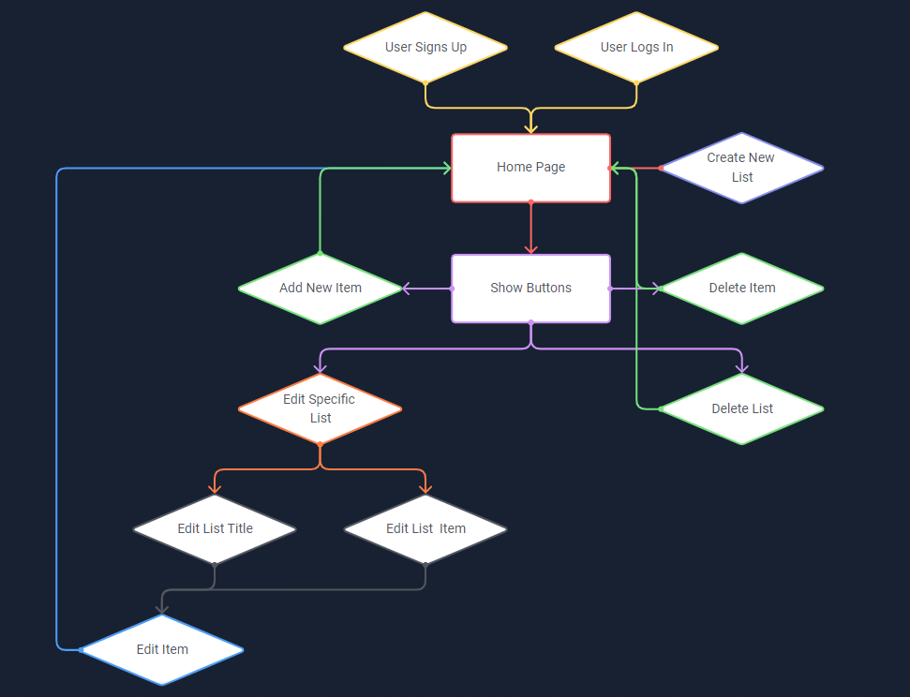
Flow chart

Slide 5




Technologies Used

Slide 6
Process

Slide 7
Future Features
(Add Back-End)
Add Light/Dark Mode
Share List (Inside App and on Social Media)
Add Collaborators
Group Items
Change Items From One List to The Other

Slide 8
What was most challenging
Definitely the <EditList> View

Slide 9
What I am Most Proud of
Map
Toggle Buttons

Slide 10
The End

