Slide 1
Microbiome (16S rRNA) Analysis Pipeline : The Basics
Nevada Center for Bioinformatics

Slide 2
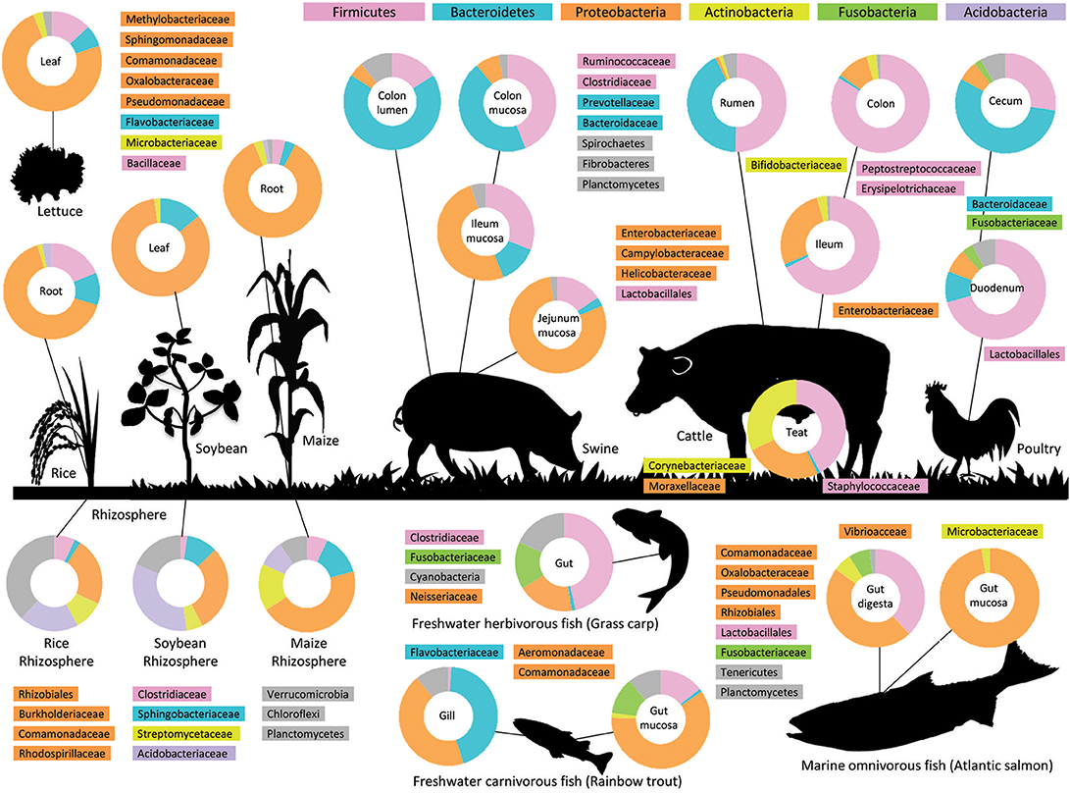
Microbiome analysis gives insights into microbial populations in many different ecosystems
Pieterse et al. 2018

Slide 3
Benefits of microbiome studies
Microbes impact on human health by causing disease, regulating our immune system, and producing vitamins
They also are major contributors to geochemical cycling in bodies of water and nutrient cycling in agricultural fields
Microbiome studies can help identify populations trends or new uncultured bacteria

Slide 4
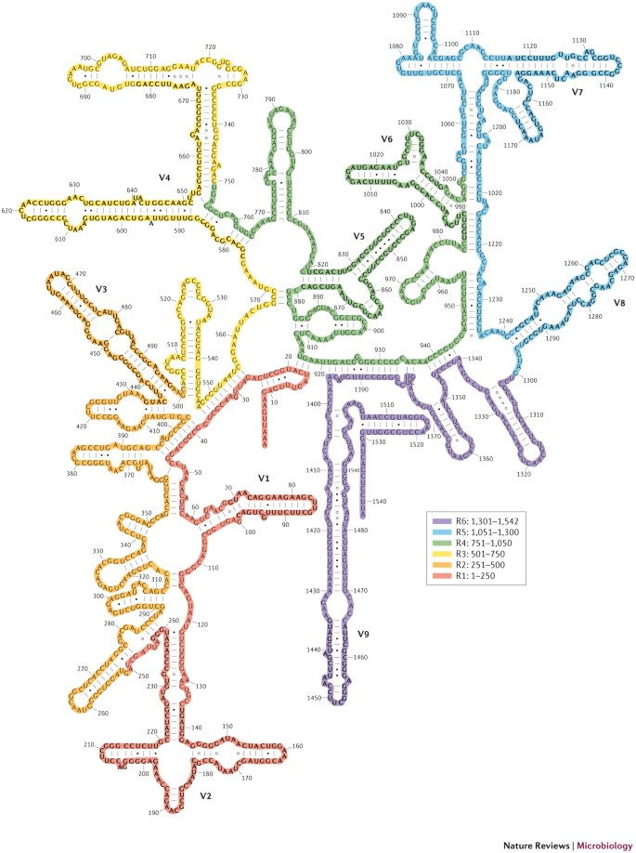
16S rRNA Gene
The 16S rRNA gene encodes the small subunit in prokaryotic ribosomes
It is used to understand microbial (Bacteria and Archaea) populations
Some regions are conserved while others are variable making a good marker gene to explore evolutionary relationships
16S rRNA analysis is a relatively cheap and quick way to gain insights into microbial populations
Yarza, et al., 2014

Slide 5





Typical 16S rRNA analysis pipeline
DNA is extracted from samples and the 16S rRNA gene is amplified through PCR
Amplicons are sequenced using an Illumina MiSeq Sequencer
Sequences, stored fastq files, are separated into Amplicon Sequence Variants (ASVs) using the DADA2 algorithm
Data Analysis of ASVs provides insights into sample diversity, populations, and correlations with environmental

Slide 6
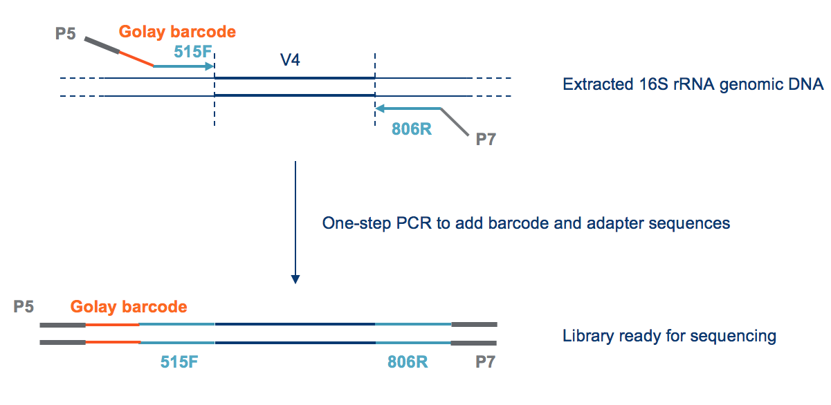
DNA extraction and PCR
DNA can be extracted using commercial kits or phenol-chloroform. How you extract is usually dependent on the sample
Note: extraction method and PCR primers cause some biases
Generally, microbiome studies will use primers that amplify the V4 region of the 16S rRNA which produces ~300bp product
Water studies may want to use V4V5 primers as they remove biases against the SAR11 clade but this requires more expensive sequencing
PCR products will need to be barcoded so multiple samples can be analyzed in one sequencing run

Slide 7
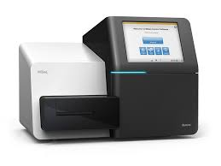
Illumina MiSeq Sequencer
Illumina MiSeq platform is capable of generating 8.5 Gbp of 250bp reads.
Each read is sequenced twice because of the nature of the paired end primers
Reads are demultiplexed (separated into samples) and returned in fastq files
Fastq files contained the generated sequence with a quality score assigned to each base pair
Illumina.com

Slide 8



Sequence Analysis: DADA2
3 main ways to analyze the sequence data:
DADA2: Divisive Amplicon Denoising Algorithm- R package
QIIME2: End-to-end sequencing analysis pipeline- Python wrapper
Mothur: Microbiome analysis into Operational Taxonomic Units- R package
Which one to use is personal preference, QIIME2 uses the DADA2 algorithm to separate sequences but downstream analysis is less customizable
We use DADA2 because it is well documented, report issues (https://github.com/benjjneb/dada2), and uses error rates rather than phylogeny to assign separate taxonomic units

Slide 9
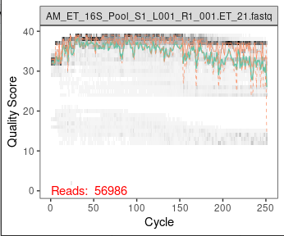
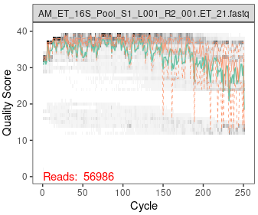
DADA2 pipeline: Filter and Trim
Fastq files contain quality scores and the sequence generated
First step is to filter out low-quality reads and trim off the primers and ends of the reads which are usually low quality
You want the length of your forward and reverse reads to at least be [expected product + 20bp] in length so the reads can be merged later
out <- filterAndTrim(forward_reads, path/to/placeFfilteredreads, reverse_reads, path/to/placeRfilteredreads, truncLen=c(180,120), maxN=0, maxEE=c(2,2), trimLeft = c(19,20), truncQ=2, rm.phix=TRUE, compress=TRUE)
Forward read
Reverse read
*Note: Reverse reads have a sharper decline in quality at the ends of the cycle

Slide 10
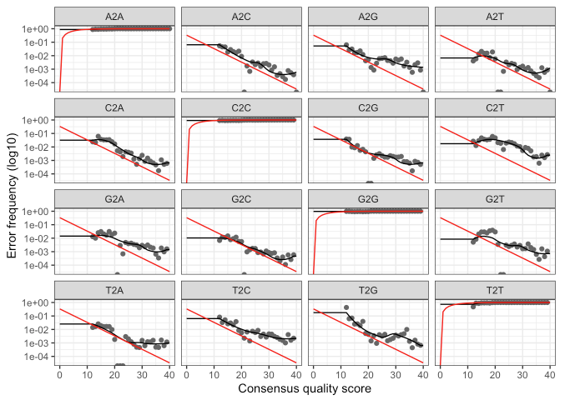
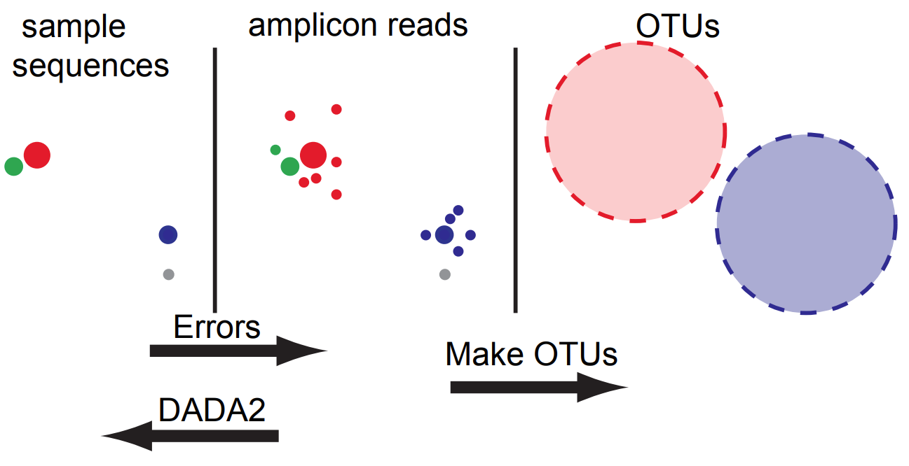
DADA2 pipeline: Learn error rates and separation into amplicons
The error rate algorithm is what separates DADA2 from previous methodologies
Instead of focusing on phylogeny similarities to known species, DADA2 samples from the sequences to calculate error rates
Errors depend on nucleotide substitutions, quality scores, and batch runs
Error rates are then used to separate reads into Amplicon Sequence Variants (ASVs)
Callahan, et al., Nature Methods (2016)

Slide 11

DADA2 pipeline: Merge reads and remove chimeras
Forward and reverse reads are merged following separation into amplicons
After merging, chimeric sequences can be removed
Quality check: Compare input reads with filtered, merged, non-chimeric reads to make sure one step didn't cause too large of a loss

Slide 12
DADA2 pipeline: Assign Taxonomy
DADA2 maintains training fastas for three databases: SILVA, RDP, and Greengenes. Many others have contributed databases that can be used.
We typically use SILVA as it is common among microbiome analyses and is regularly updated.
Two options for Taxonomy assignment
Native Bayesian assignment using the DADA2 assignTaxonomy() function
ML assignment using DECIPHER Package
Taxonomy is assigned down to the genus level with the option to go down to the sequence/variant level if it is needed for the analysis

Slide 13
Preparing for analysis: Controls
Decontam is a package that statistically finds ASVs that are likely to be contaminants
Uses either negative controls or DNA quantification
For water controls; check number of reads in each sample. For a full MiSeq run, <1000 reads in water samples is usually ok.
For mock communities, if included; calculate error rate derived from PCR, sequencing. How ‘noisy’ is our data?
Any control groups are removed from downstream analysis

Slide 14



Diversity Metrics
Alpha diversity tells you how much variance there is among one sample
Beta diversity tell you how similar or dissimilar one sample is from another
Beta diversity is the higher between
A and B
than
A and C
There is high beta diversity
between
B and C
Group A has the highest alpha diversity since there are 3 species
Group B has medium alpha diversity since there are 2 species
Group C has the lowest alpha diversity since there is 1 species

Slide 15
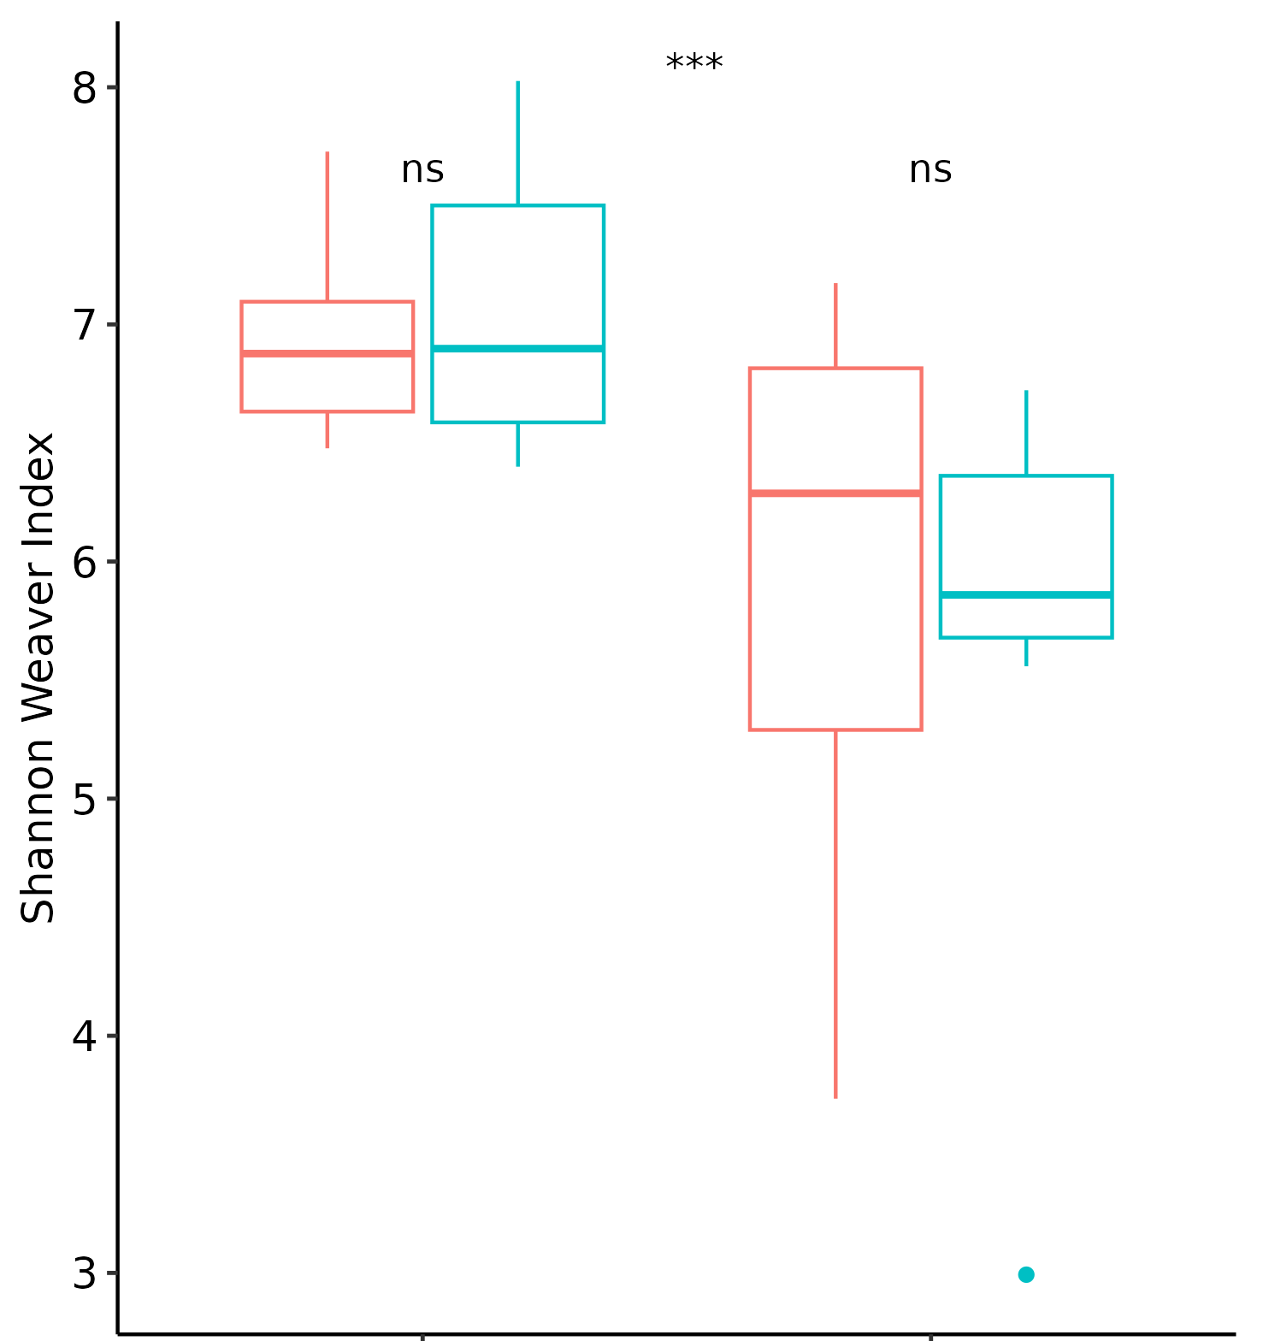
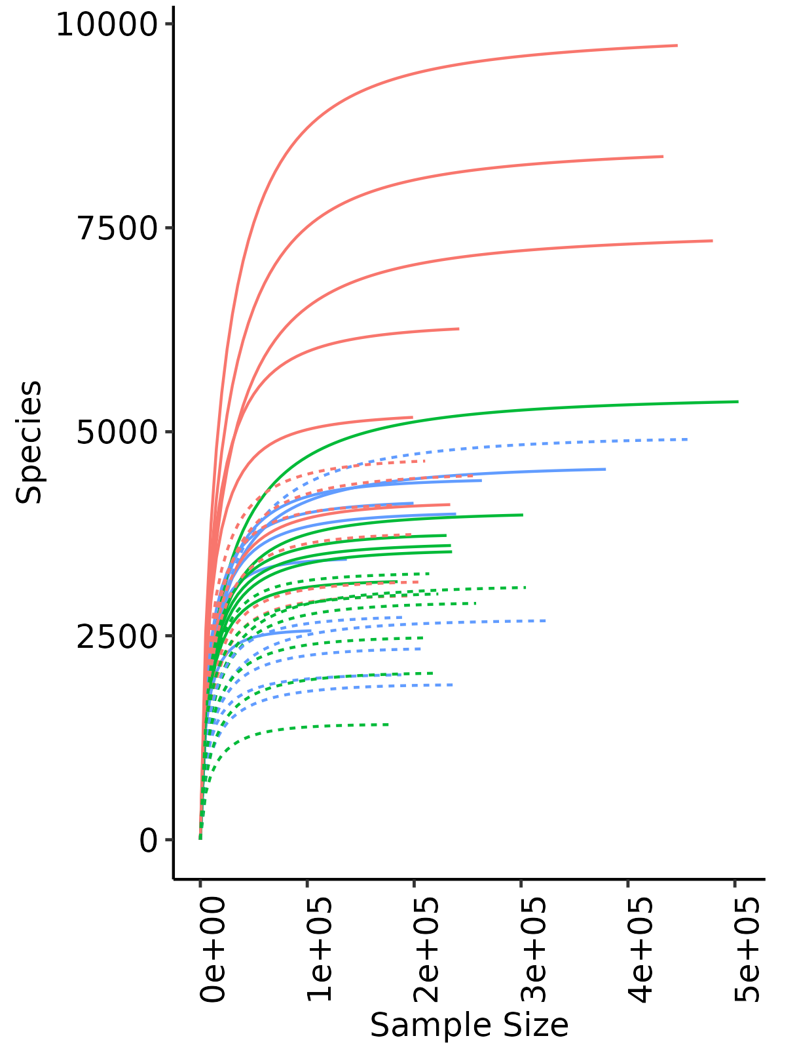
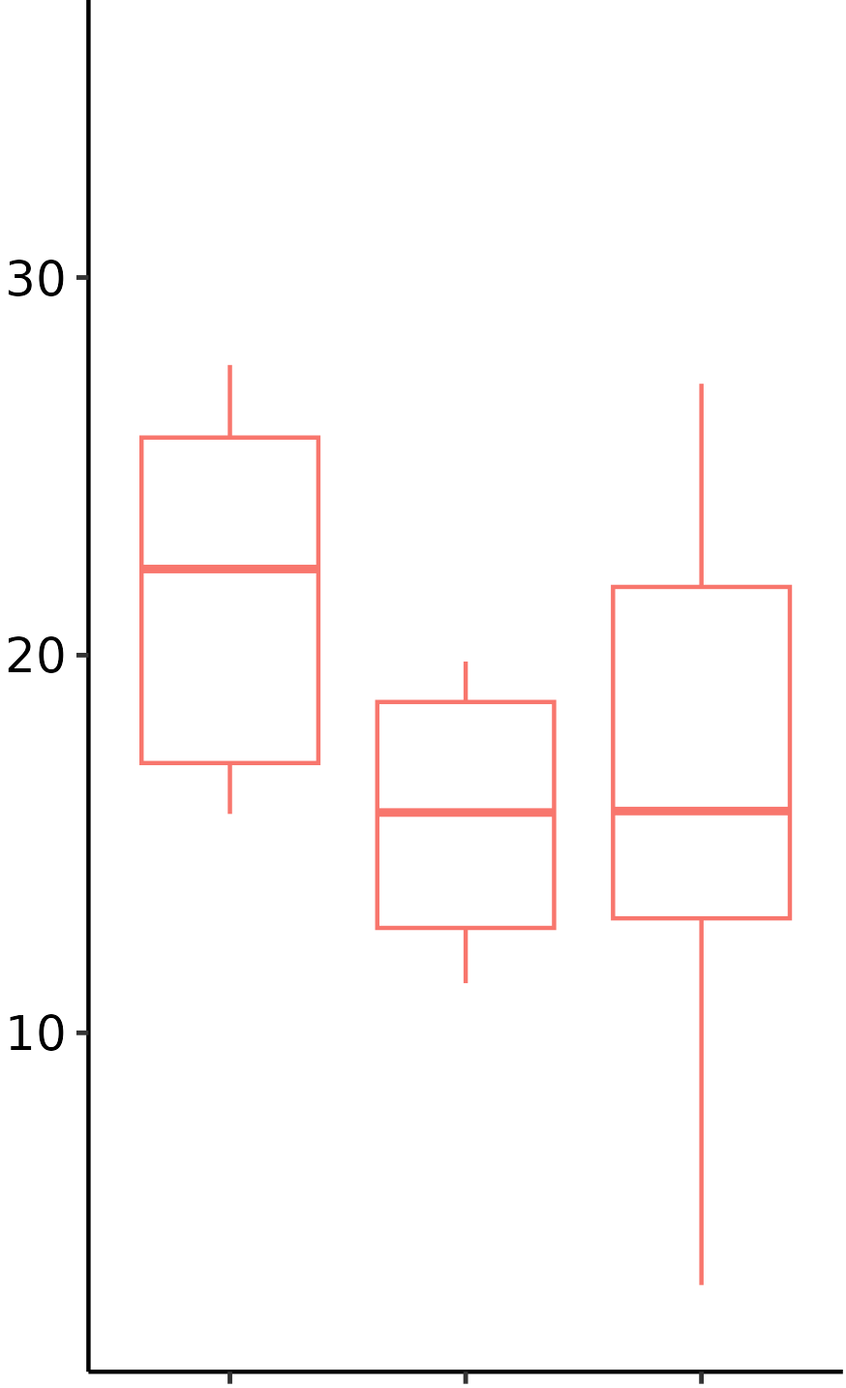
Alpha Diversity Analysis
Richness: Total number of species in a sample
Evenness: Similar abundance of species in a sample
Typical Measures of Alpha Diversity
Rarefaction curves: show richness of the samples
Shannon-Weaver Index: Σ(abundance)*ln(abundance)
This gives an index of the richness in a sample while attempting to account for evenness
Inverse Simpson Index: 1/Σ(abundance)²
This gives an index of the richness of a sample with a higher focus on evenness.

Slide 16
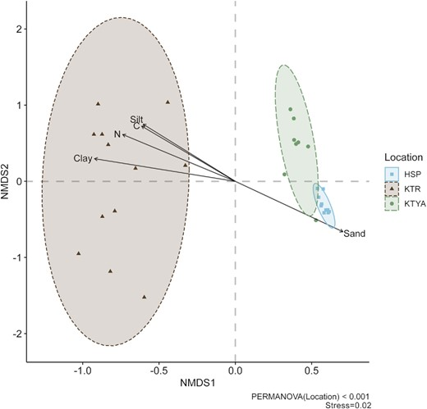
Beta Diversity Analysis
Beta diversity is usually visualized using a distance calculation
Bray-Curtis
Euclidean
Hellinger
PCoA and/or NMDS is used to visualize the dissimilarity
PERMANOVA can be ran to see if sample cluster by a certain identifier (sample site, treatment, etc.) within each ordination are statistically significant.
Correspondence of relative abundance of each OTU or environment gradients can be measured along the two axes and plotted as a biplot

Slide 17
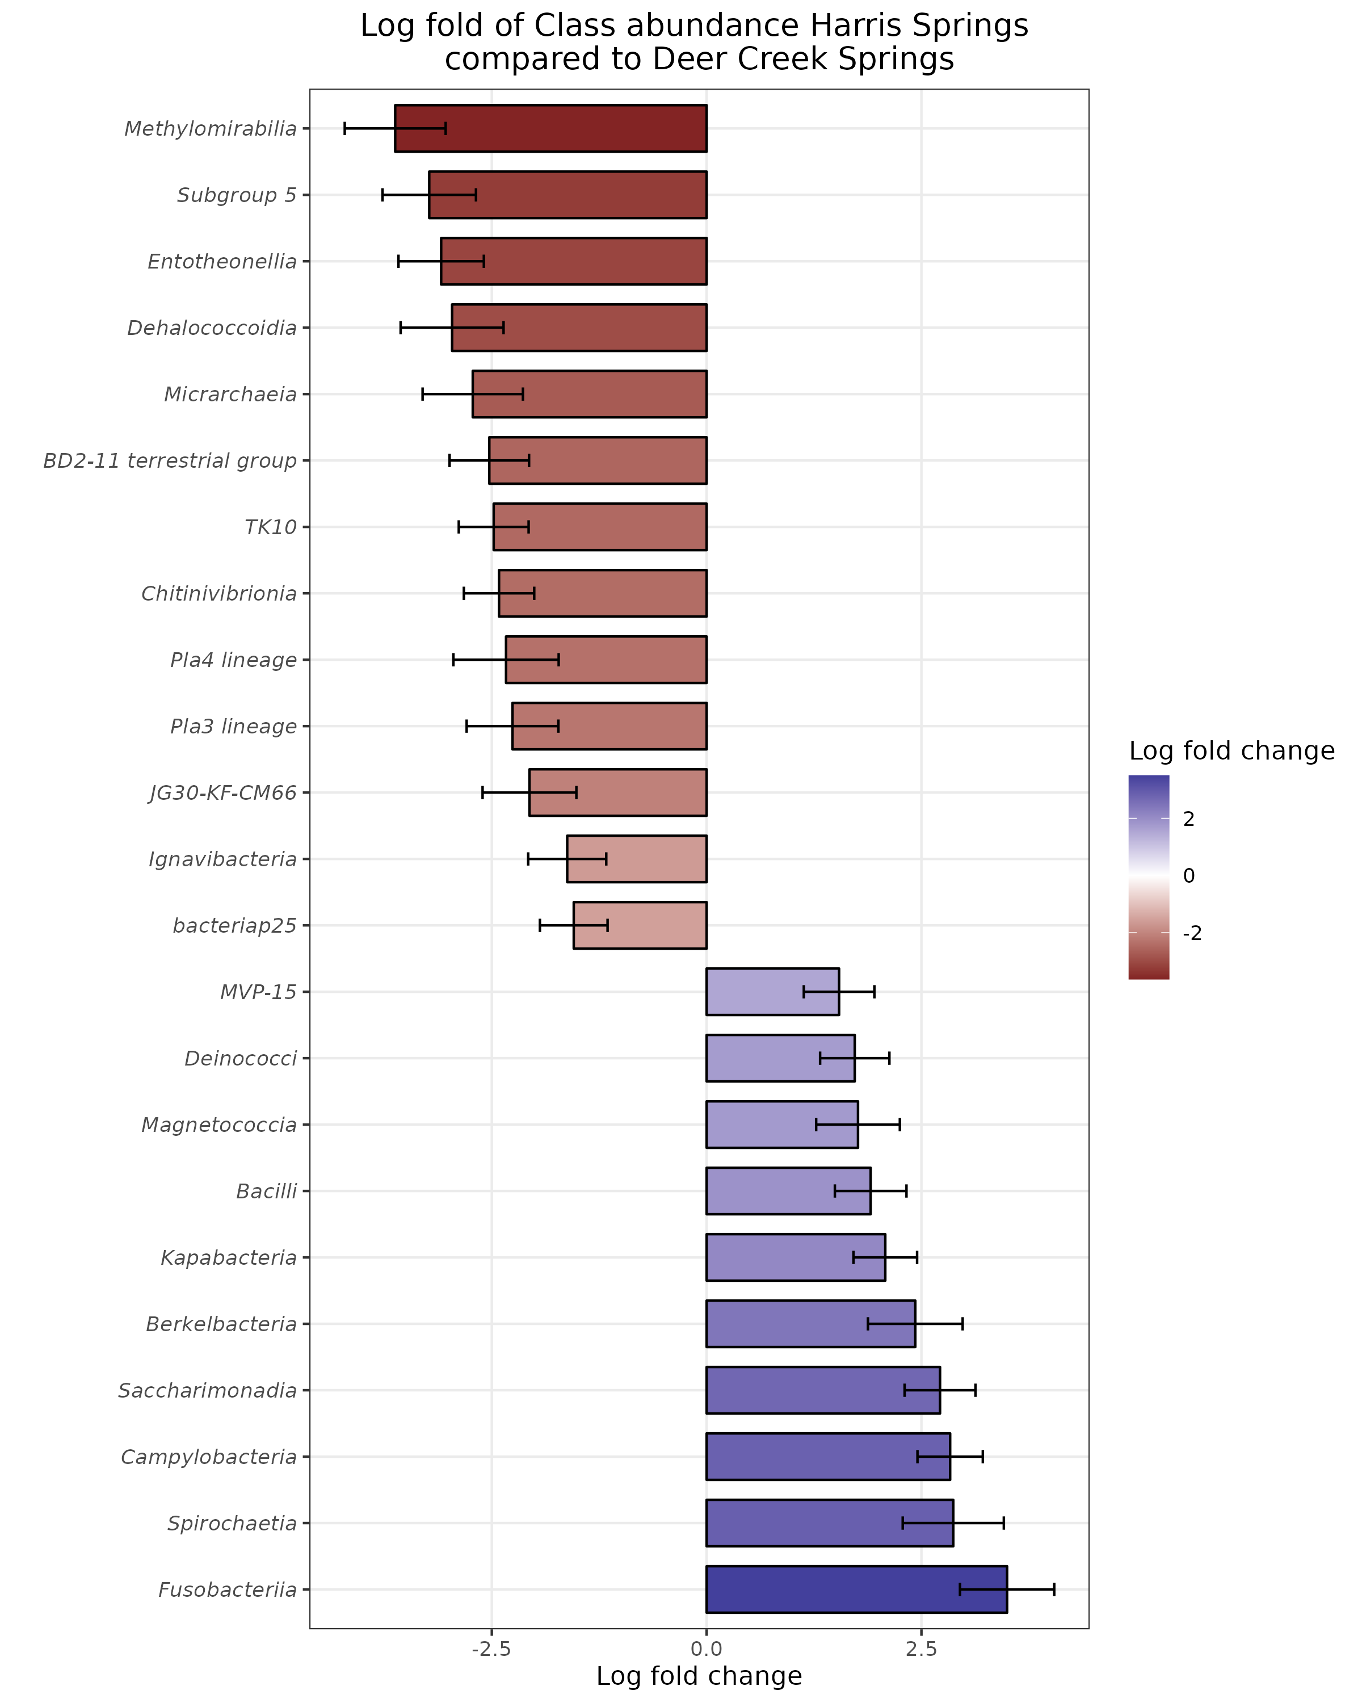
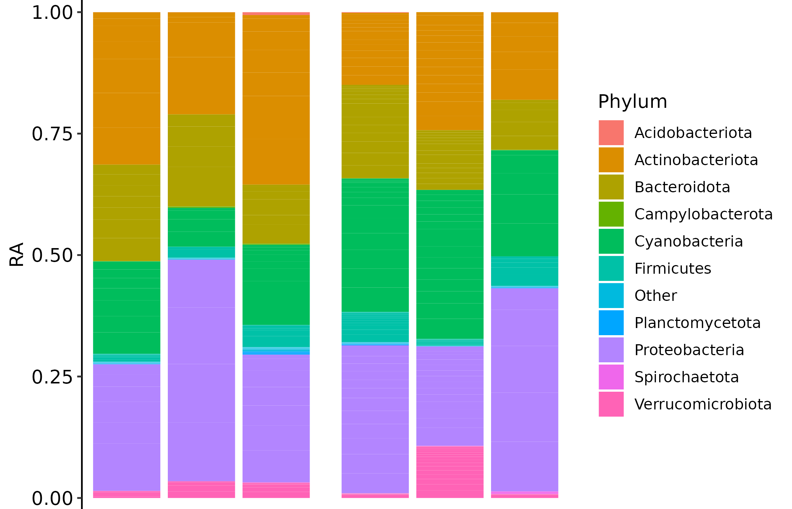
Compositional Analyses
Stacked bar plots give insights into the relative abundance of each taxa group
These can be used to form testable hypothesis about specific taxa that are playing a role in the environment being studied
Abundance of certain taxa can also be compared across treatment groups, sampling location, etc.
Differential abundance analysis finds ASVs that are significantly changed in abundance across a certain factors without rarefying the data

Slide 18
Further Biological Analyses
Potential Analyses include:
Constrained Correspondence Analysis: explaining community variance using environmental gradients
Tracking particular genera capable of a specific metabolism (i.e. Manganese reducers)
Review of most abundant genera to help develop new hypotheses
Analyses are dependent on the client's needs and the amount of collected data

