Slide 1

Introduction to RNA-Seq: Overview
Wandrille Duchemin

Slide 2

General Information
Course page: https://sib-swiss.github.io/RNAseq-introduction-training/
Slides, Data sets, Exercises, Solutions
Optional exam, 0.5 ECTS value
Course from 09:00 to 17:00
Lunch break 12:00 to 13:00
15min breaks around 10:30 and 15:00

Slide 3



Asking questions - Communication
Raise your hand anytime
Done with an exercise?

Slide 4
Course Outline
Day 1
Overview of RNAseq
Getting started with the cluster
Quality Control of the raw data
Sequence trimming
Day 2
Reas mapping
Differential Expression Inference
Enrichment Analysis

Slide 5
slides Outline
RNA and molecular biology
Main challenges for RNAseq
Major Sequencing technologies
Planning your sequencing : choices, number of samples, …
Bioinformatics analysis overview

Slide 6
Introducing Ourselves

Slide 7
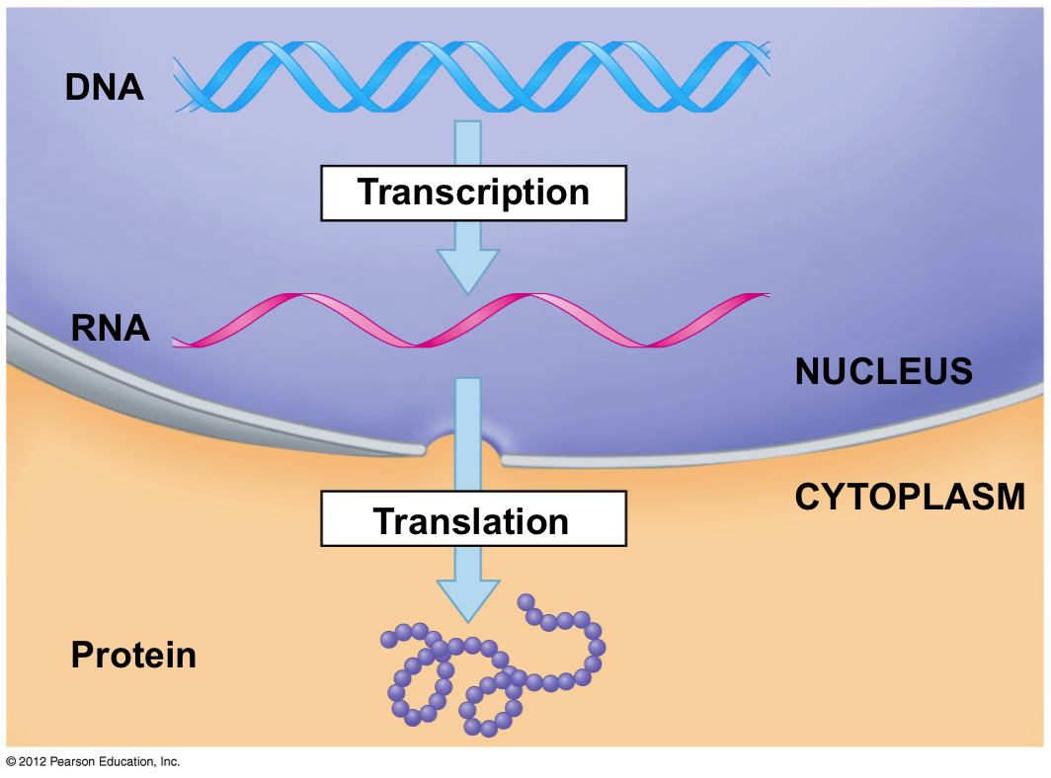
Nucleic acids everywhere
Notes:
7

Slide 8
Nucleic acids everywhere
Notes:
8

Slide 9
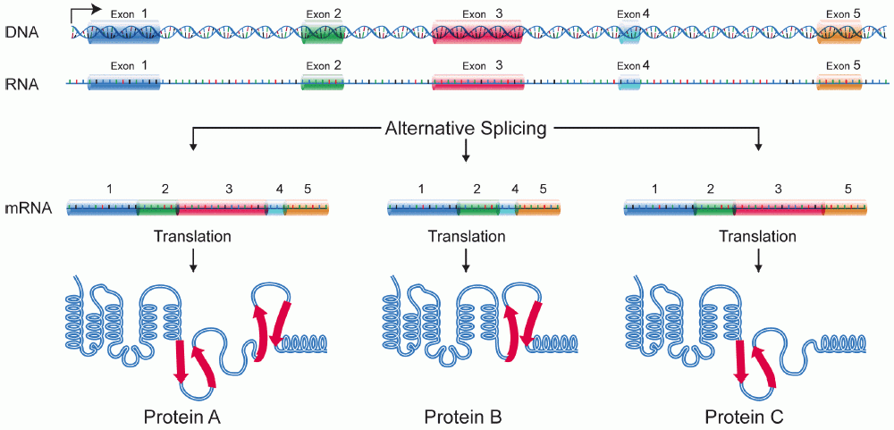
alternative splicing adds a layer of complexity
~20'000 mammalian genes
>>100'000 (?) transcripts
>>1'000'000 (?) proteins
Image credit: National Human Genome Research Institute – public domain

Slide 10
Nucleic acids everywhere
mRNA levels :​
a proxy of a proxy​
of cell physiology​
Notes:
10

Slide 11
What (and why) are we sequencing
Genomics
Whole genome/exome sequencing (WGS/WES)
Variant calling (SNPs, CNVs, structural variations)
Epigenomics
Bisulphite sequencing : DNA methylation
ATAC-Seq : chromatine opening
ChIP-seq : TF binding sites
Transcriptomics
Total RNA
Poly-A tail selection : focus on mRNA
Ribo depletion: mRNA + ncRNA
5'/3' RACE seq : isoform characterization for one gene
scRNAseq
Long read RNA sequencing
…

Slide 12
What (and why) are we sequencing
Genomics
Whole genome/exome sequencing (WGS/WES)
Variant calling (SNPs, CNVs, structural variations)
Epigenomics
Bisulphite sequencing : DNA methylation
ATAC-Seq : chromatine opening
ChIP-seq : TF binding sites
Transcriptomics
Total RNA
Poly-A tail selection : focus on mRNA
Ribo depletion: mRNA + ncRNA
5'/3' RACE seq : isoform characterization for one gene
scRNAseq
Long read RNA sequencing
…
Imagination is the limit
See : https://liorpachter.wordpress.com/seq/

Slide 13
slides Outline
RNA and molecular biology
Main challenges for RNAseq
Major Sequencing technologies
Planning your sequencing : choices, number of samples, …
Bioinformatics analysis overview

Slide 14
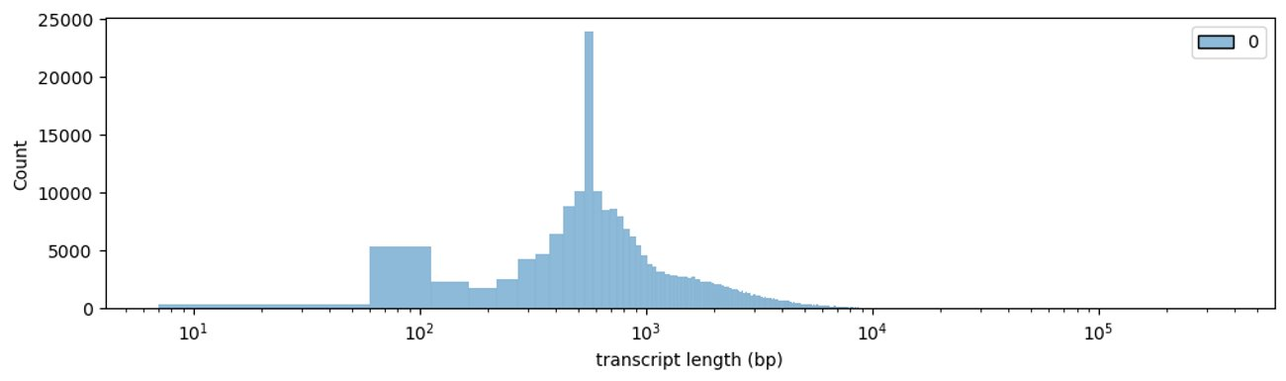

Main challenges of RNAseq
Transcripts are diverse in size
Human annotated transcripts

Slide 15
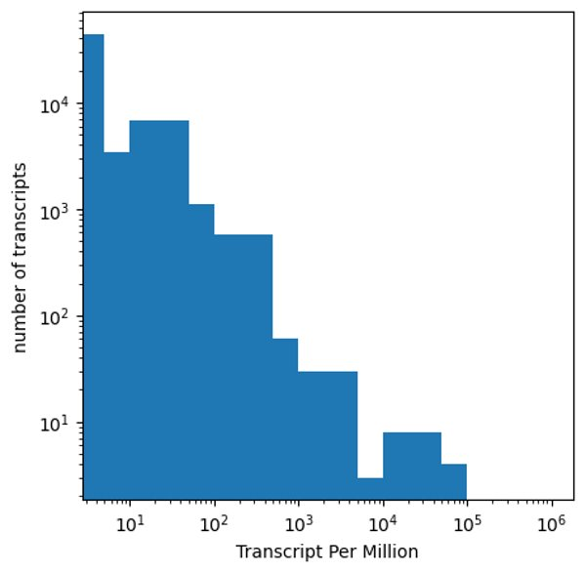
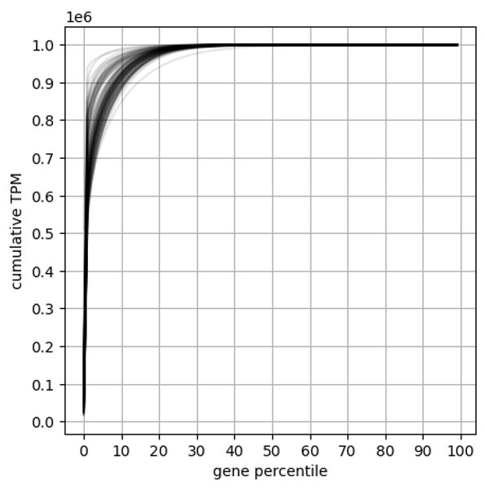
Main challenges of RNAseq
Transcripts are diverse in size
Expression levels have a high dynamic range
From Gtex V8 – human tissue samples
Data source : https://gtexportal.org/home/downloads/adult-gtex/bulk_tissue_expression

Slide 16
Main challenges of RNAseq
Transcripts are diverse in size
Expression levels have a high dynamic range
RNA molecules are exposed to degradation enzyme:
RNA integrity affects results
Is there a reference genome.
If yes,
How good is it?
How good is the gene annotation ?

Slide 17
slides Outline
RNA and molecular biology
Main challenges for RNAseq
Major Sequencing technologies
Planning your sequencing : choices, number of samples, …
Bioinformatics analysis overview

Slide 18
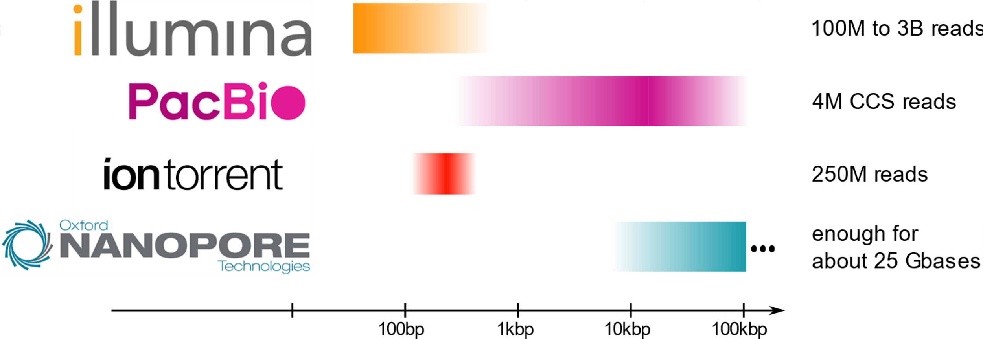
Main sequencing technologies

Slide 19
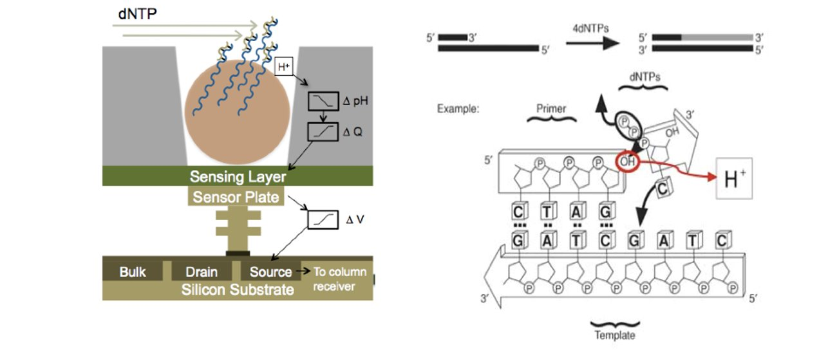
Ion torrent - reading pH changes

Slide 20
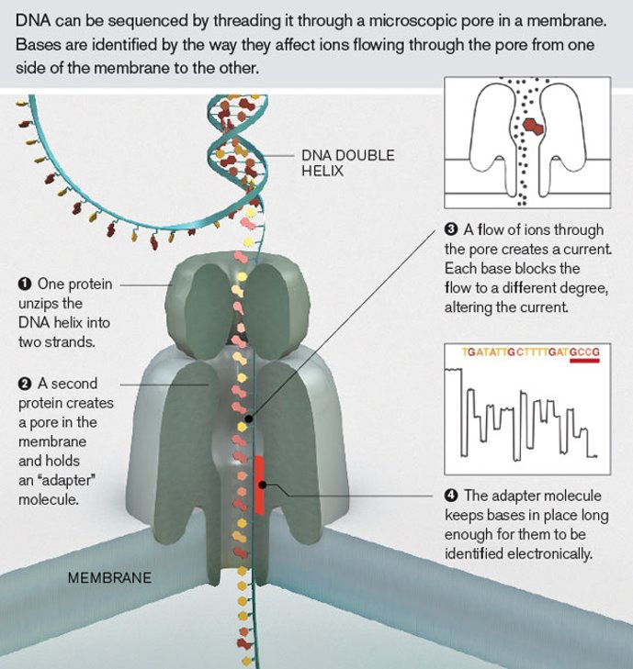
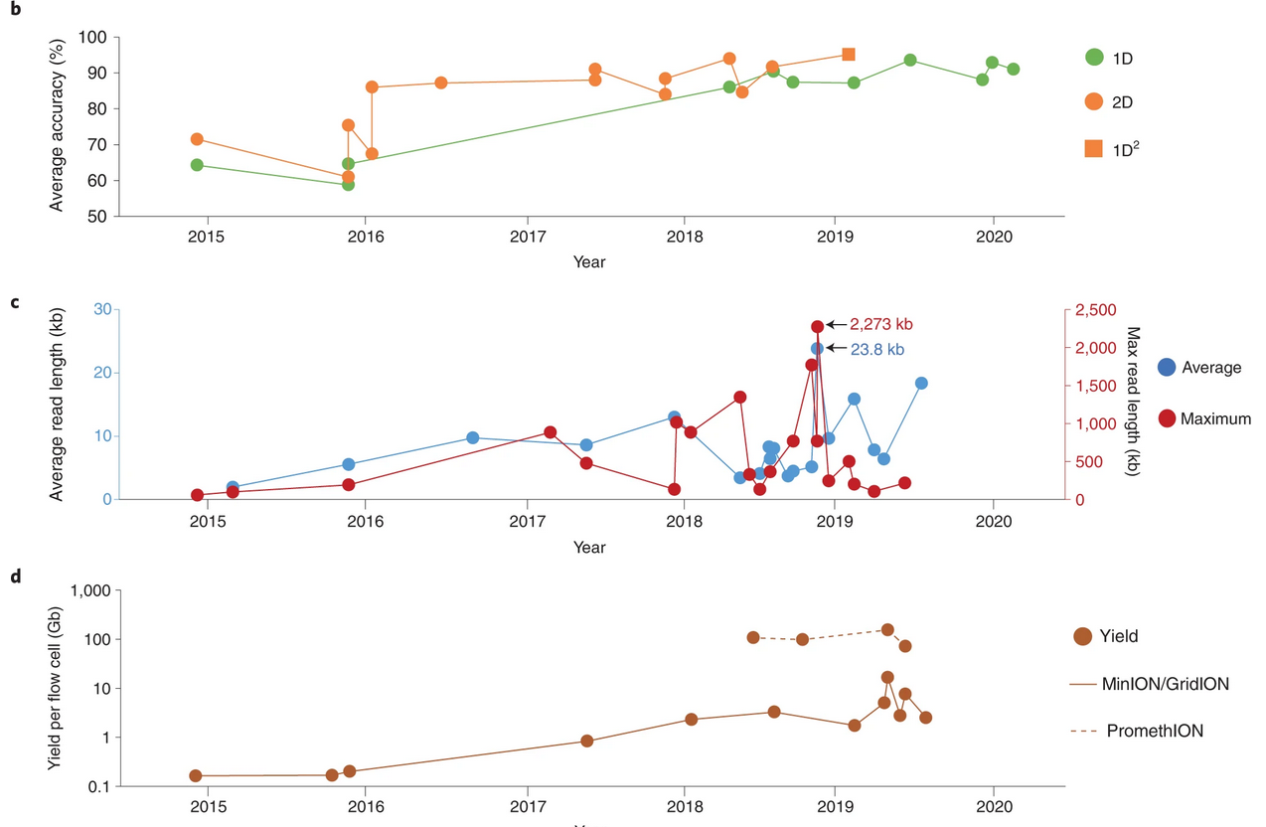
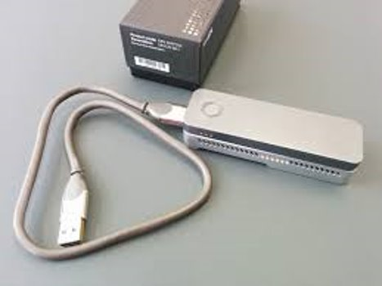
Oxford Nanopore - direct sequencing
From Wang, Y., et al. Nanopore sequencing technology, bioinformatics and applications. Nat Biotechnol 39, 1348–1365 (2021). https://doi.org/10.1038/s41587-021-01108-x

Slide 21
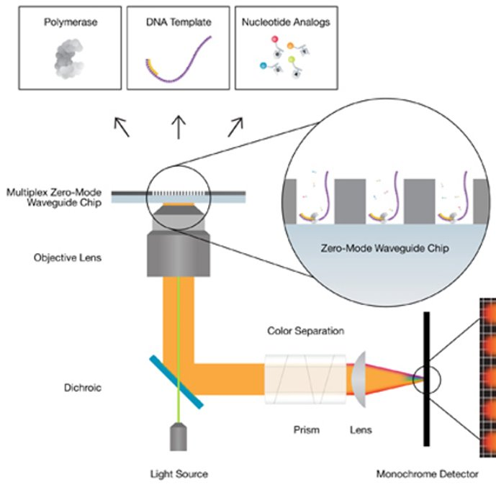
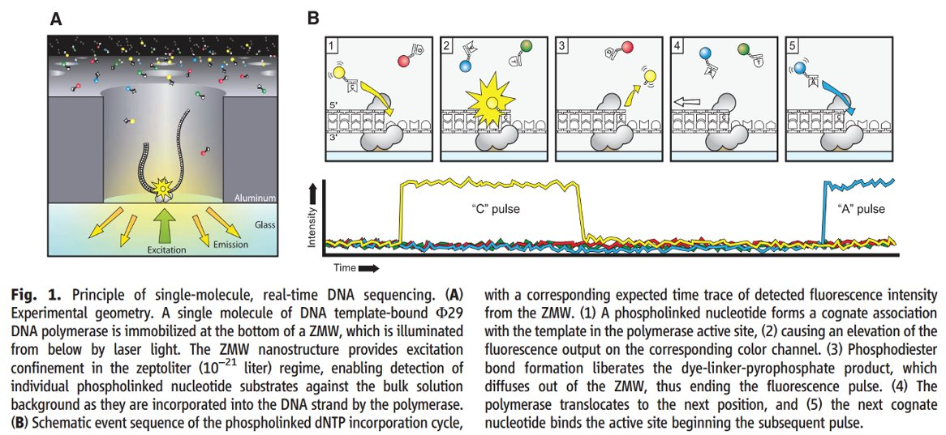
Pacific Biosciences - Single Molecule Real Time
From Rhoads & Au. Genomics Proteomics Bioinformatics 2015

Slide 22
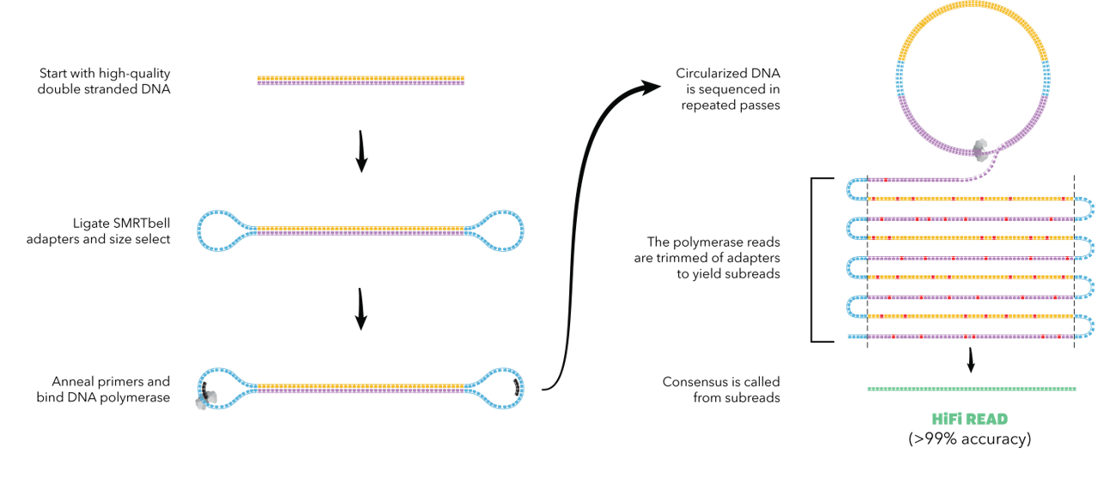
Pacific Biosciences - Circular Consensus Sequencing
Raw reads
~15% random errors
Typical in isoseq

Slide 23
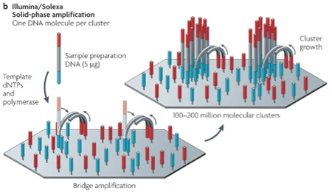
Illumina sequencing - cluster formation
Source: Fig1b of Metzker, M. Sequencing technologies — the next generation. Nat Rev Genet 11, 31–46 (2010). https://doi.org/10.1038/nrg2626

Slide 24
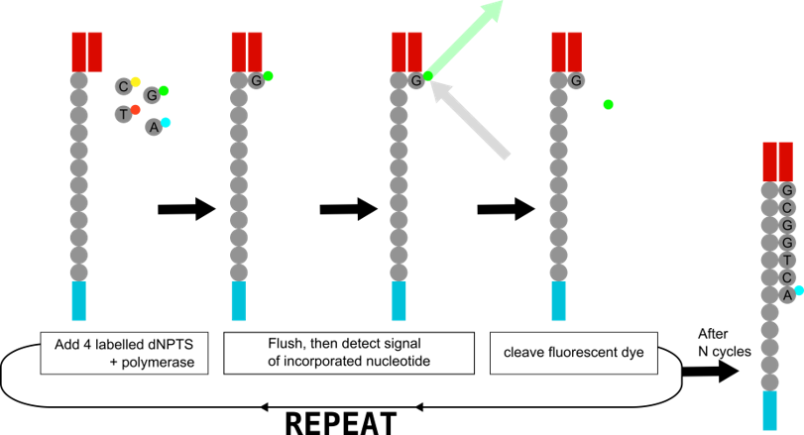
Illumina sequencing - sequencing by synthesis

Slide 25
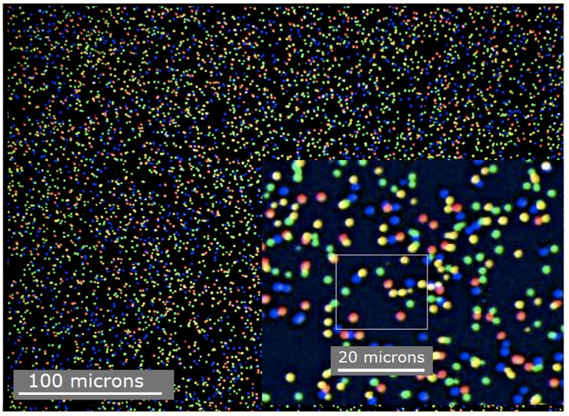
Illumina sequencing - image analysis
On the fly, instrument-associated software

Slide 26
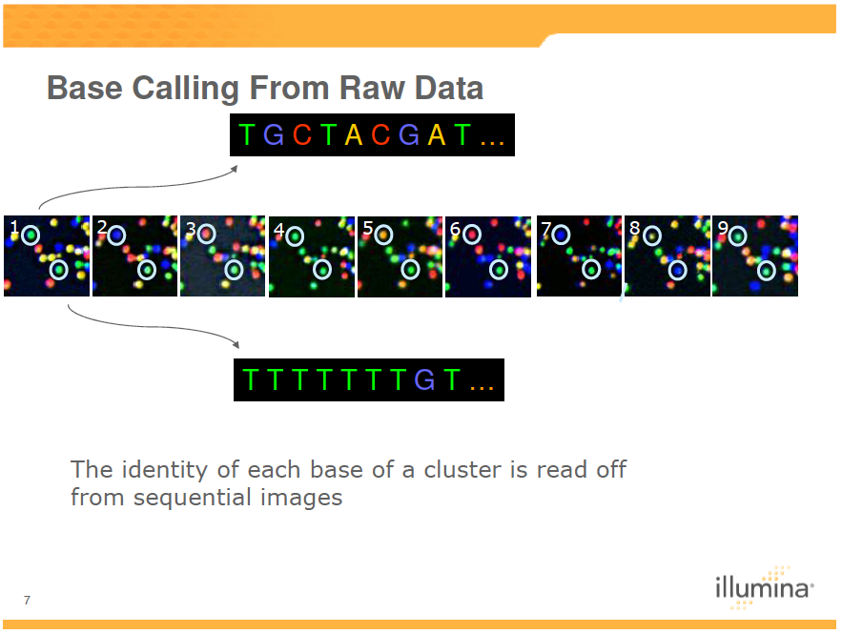
Illumina sequencing - from image to sequence

Slide 27
slides Outline
RNA and molecular biology
Main challenges for RNAseq
Major Sequencing technologies
Planning your sequencing : choices, number of samples, …
Bioinformatics analysis overview

Slide 28
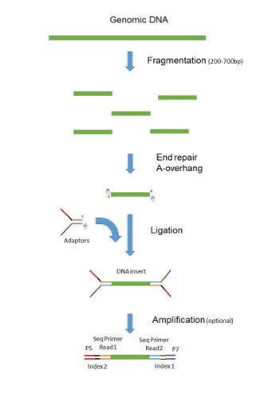
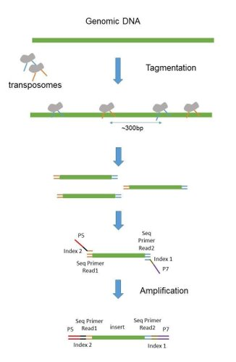
Paired-end sequencing
“Classical” paired end library (illumina)
“Nextera” paired end library
Source : France Genomique

Slide 29
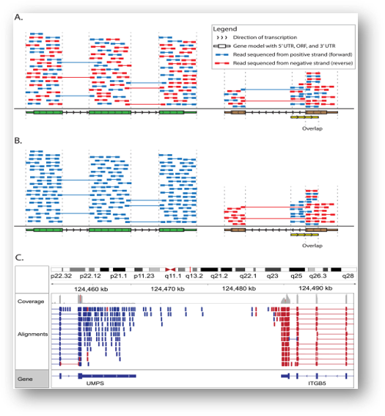
Stranded vs Unstranded Sequencing
Overlapping genes regions are substantial (~8% in Homo sapiens)
Stranded sequencing allows us to quantify expression in these overlapping regions
Achieved by ligating different adapters to 5' and 3' ends
M.Griffith et al.
PLoS Comp Biol 2015
doi:10.1371/journal.pcbi.1004393

Slide 30
RNA purification
PolyA selection
Commonly used and inexpensive
3' end bias when RNA is degraded
Loses almost all non-polyA transcripts
Gets rid of vast majority of ribosomal RNAs, but ncRNA too
Ribosomal RNA depletion
Less popular, ~2x more expensive
Higher proportion of rRNA than in polyA selection
Bacterial data
Allows identification of lncRNAs without polyA tails
Retains more immature mRNAs ( bad for gene expression quantification )

Slide 31
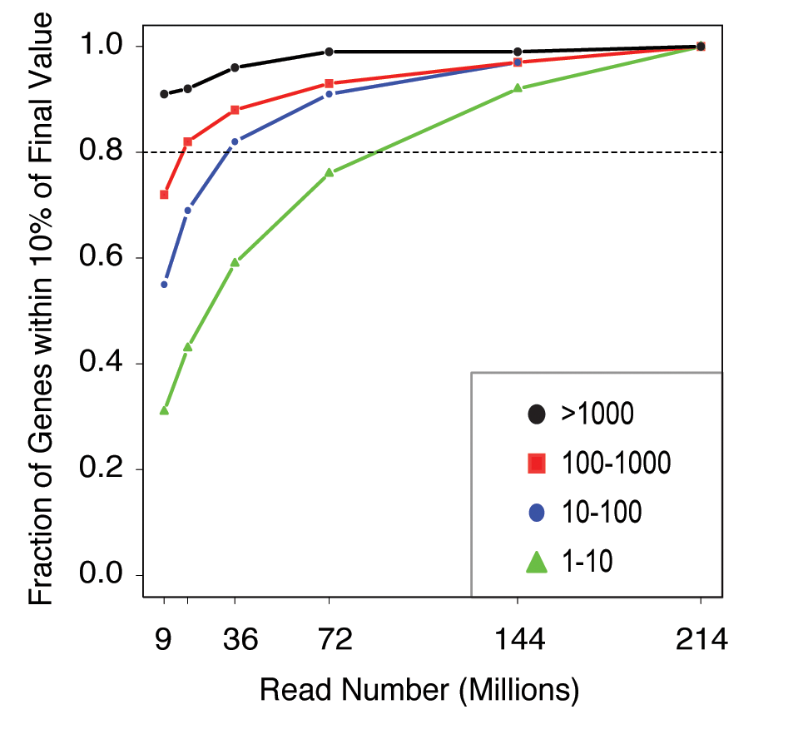
Sequencing depth
DE : usually aim for ~30-40 million reads
For rare events (isoforms, somatic mutations) much more depth is required
Not easy to know in advance
RPKM class
A User's Guide to the Encyclopedia of DNA Elements
(ENCODE) PLoS 2011

Slide 32
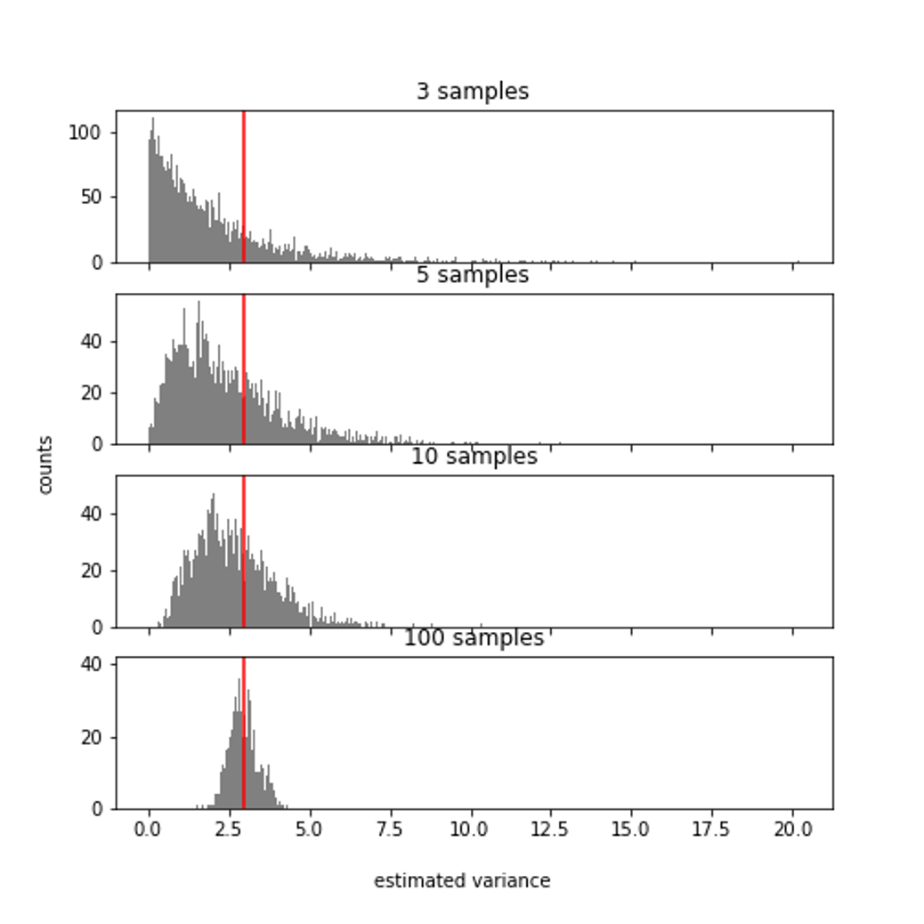
Replicates - estimating a biological variance
What does this tell you about the number of
replicates needed ?

Slide 33
Replicates - estimating a biological variance
What does this tell you about the number of
replicates needed ?
2 types of replicates:
Technical: same RNA extract
Biological: same biological condition

Slide 34
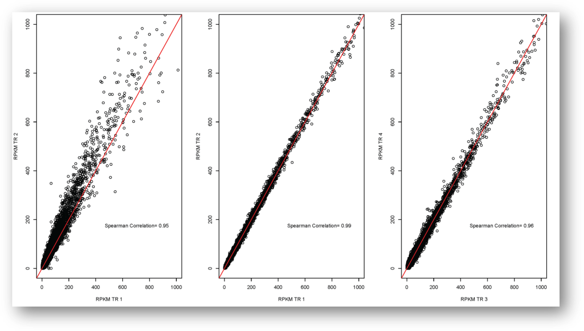
Technical replicates
D. simulans
Male heads
D. melanogaster
Female heads
C167 cell line
Lauren M Mclntyre et al., BMC Genomics 2011

Slide 35
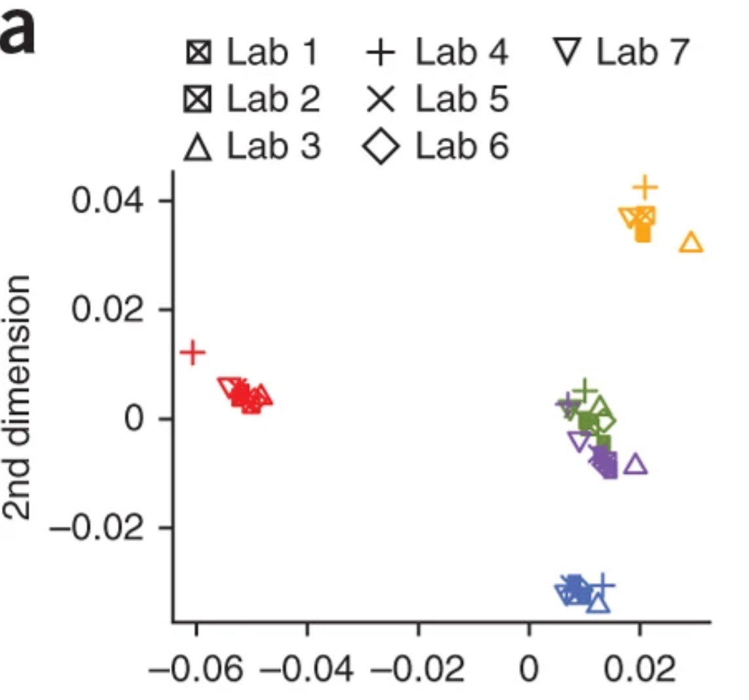
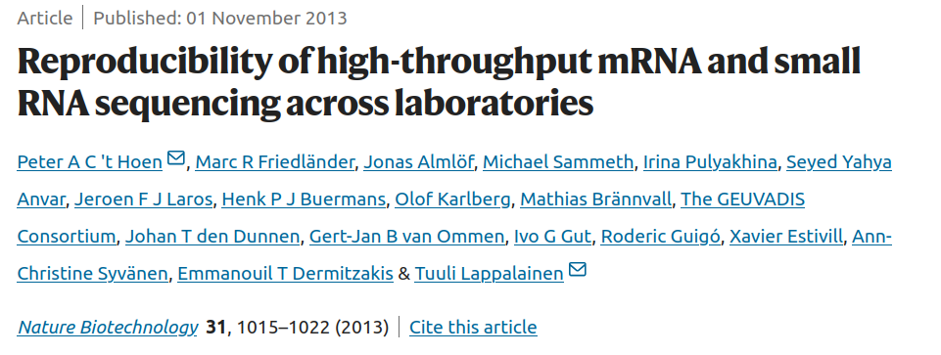
Technical replicates
Exon level: reproducible

Slide 36
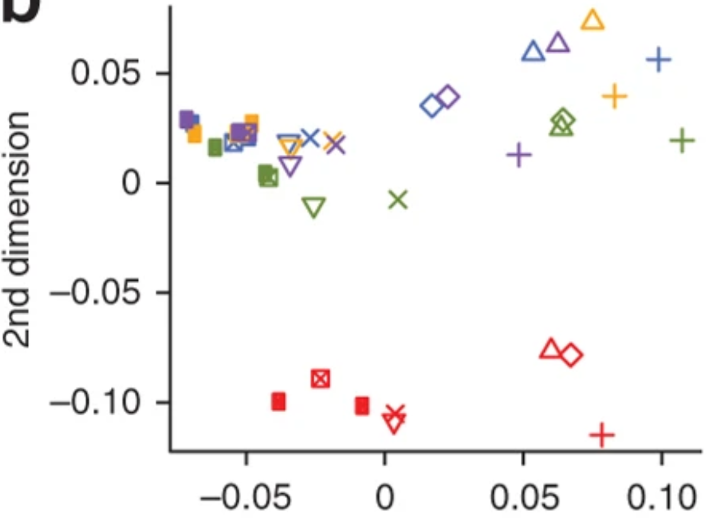
Technical replicates
Transcript level: not reproducible

Slide 37
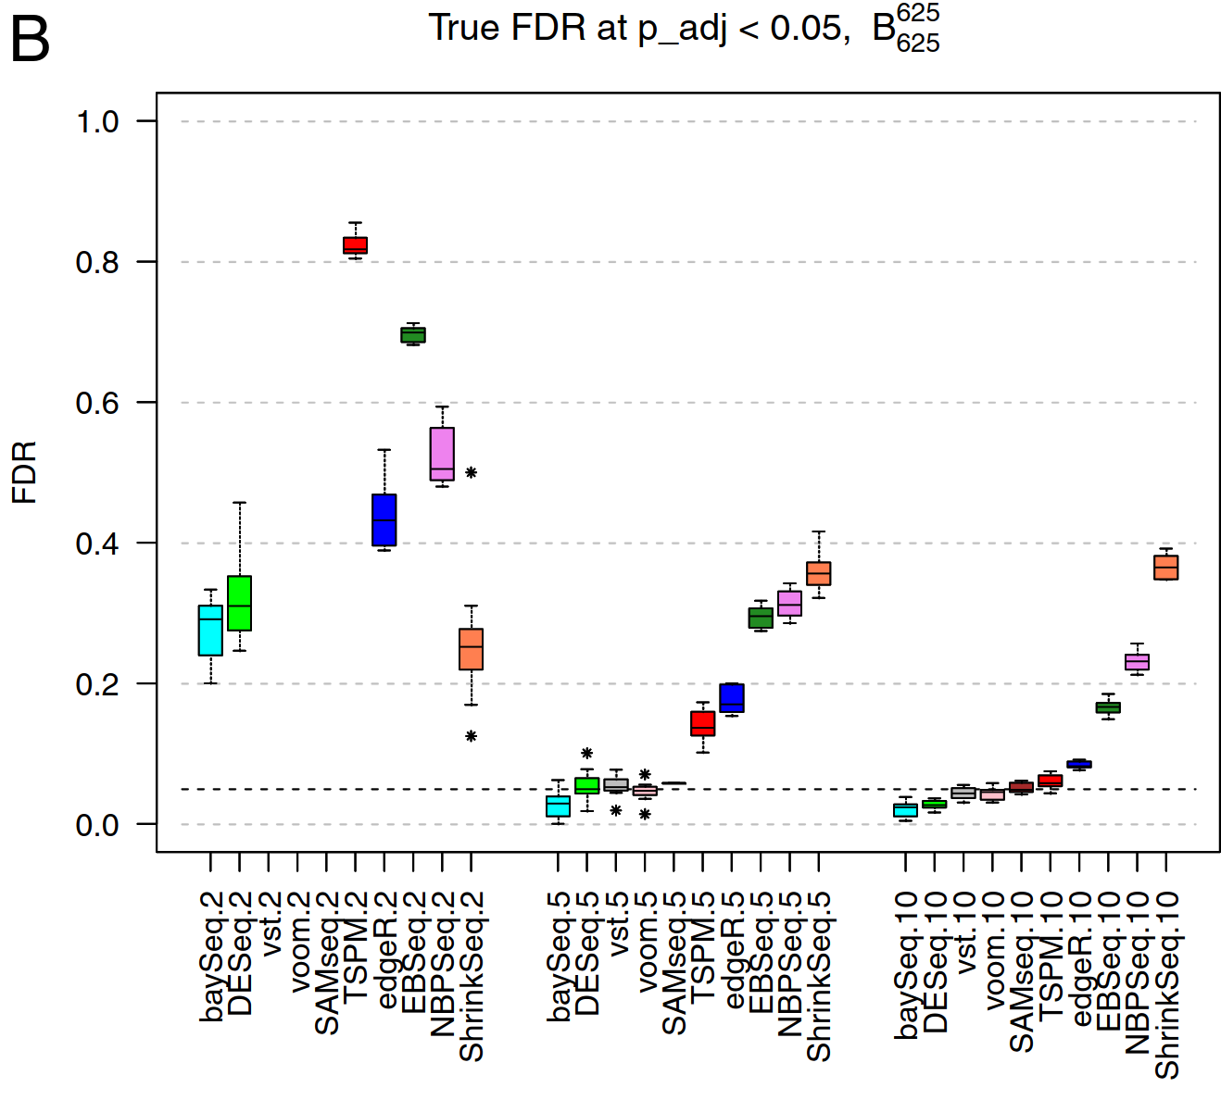
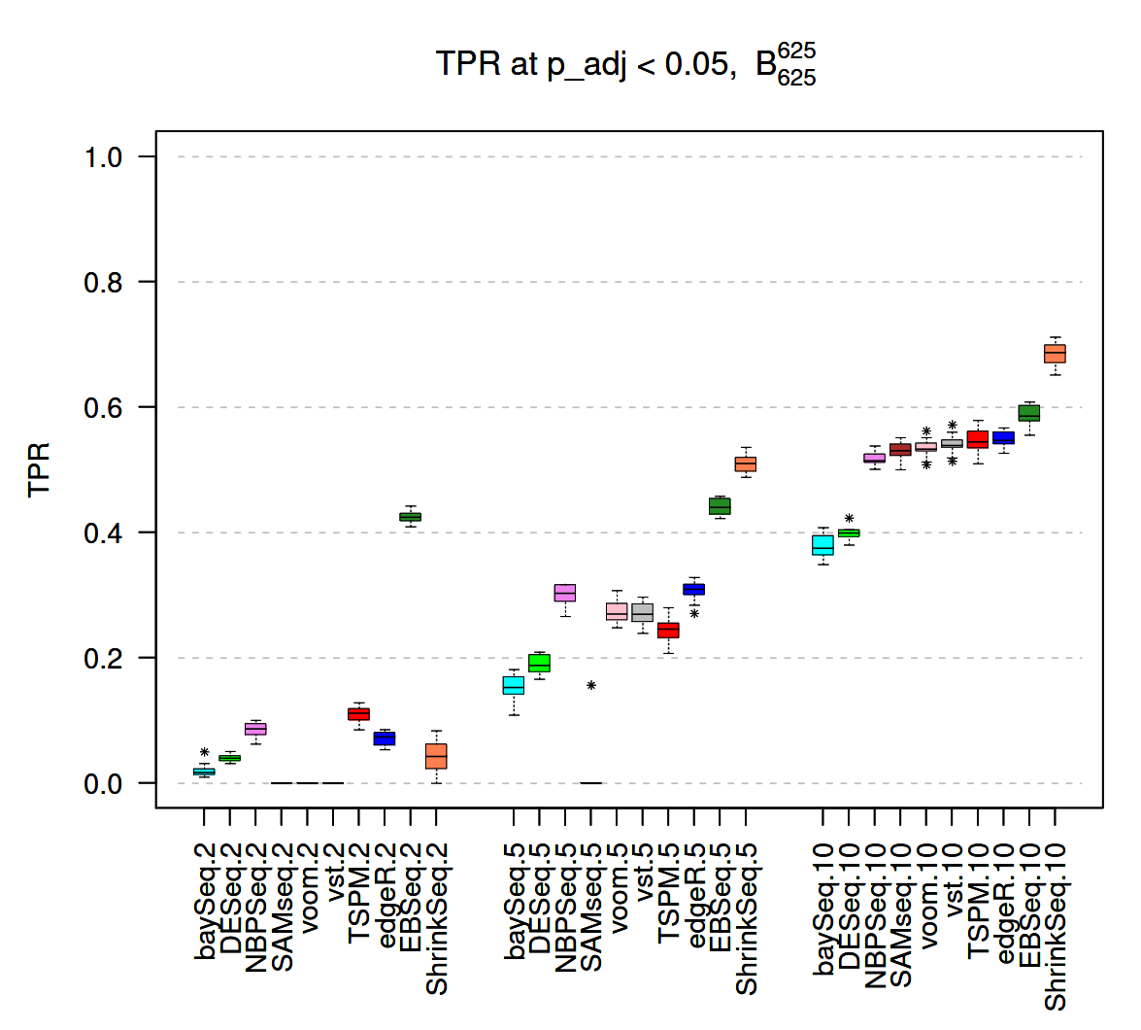
Biological replicates
2
5
10
2
5
10
Samples per condition
Soneson, C., Delorenzi, M. A comparison of methods for differential expression analysis of RNA-seq data.
BMC Bioinformatics 14, 91 (2013).

Slide 38
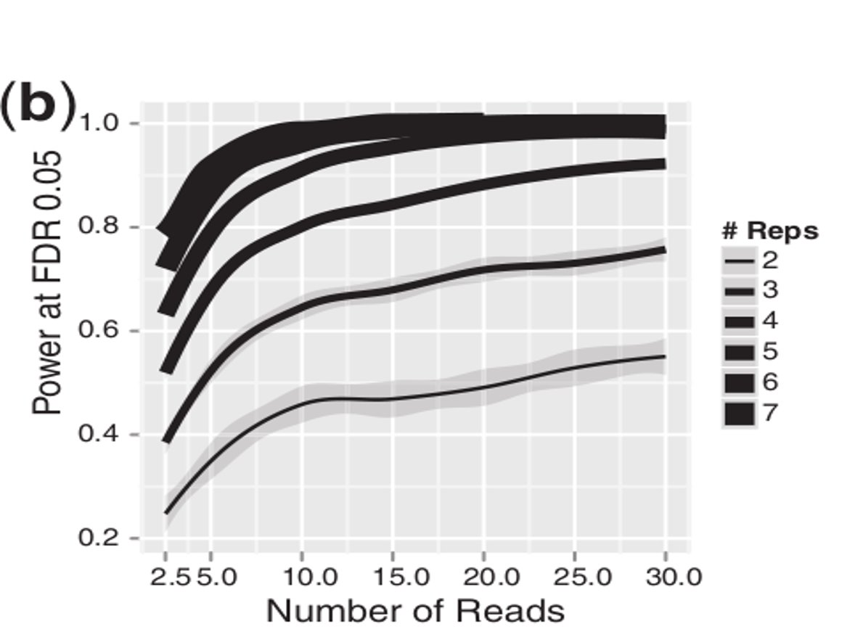
More reads or more replicates?
From Liu et al. 2014. RNA-seq differential expression studies: more sequence or more replication?

Slide 39
More reads or more replicates?
6 reps - 10M
4 reps - 15M
2 reps - 30M
From Liu et al. 2014. RNA-seq differential expression studies: more sequence or more replication?

Slide 40
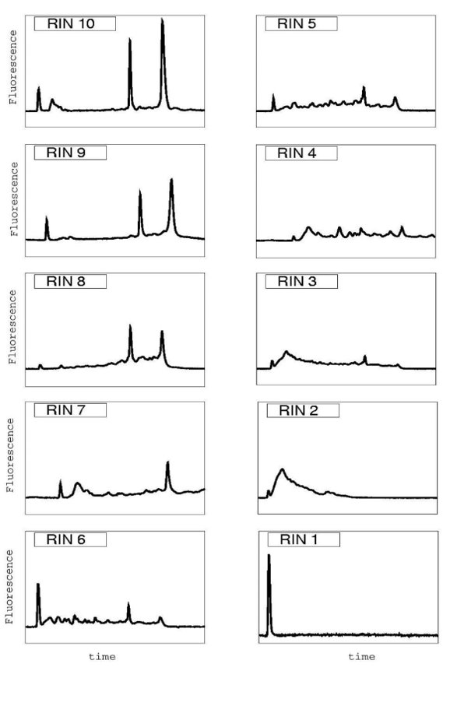
RNA sample preparation - RIN
Sample quality is critically important: we cannot make up for poor data
RNA Integrity Number (RIN)
Minimums:
7-8 : eukaryot mRNA
9 : bacterial
Schroeder et al BMC Mol Biol 2006

Slide 41
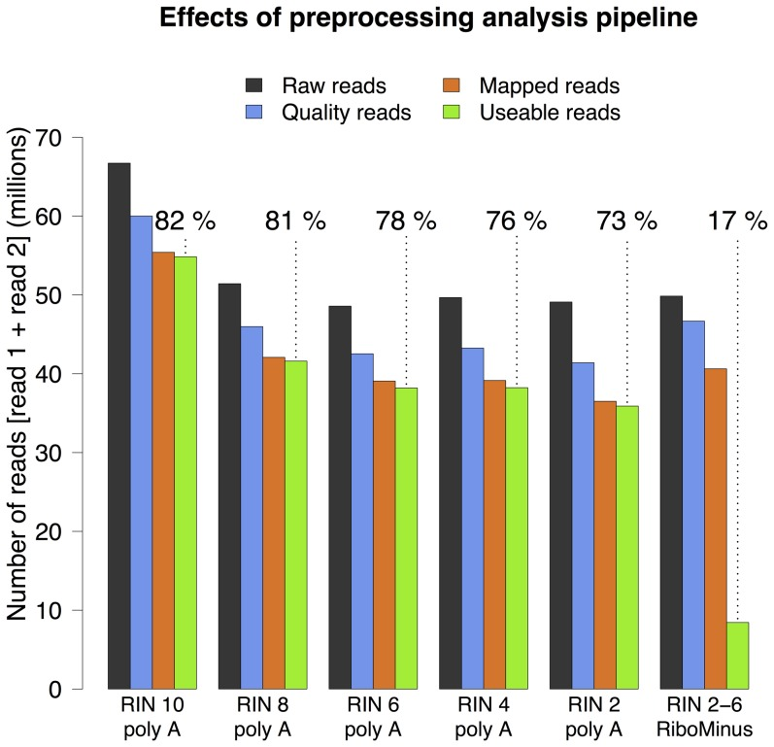
RNA sample preparation - RIN
Schroeder et al BMC Mol Biol 2006
Sigurgeirsson B, Emanuelsson O, Lundeberg J. Sequencing degraded RNA addressed by 3' tag counting.
PLoS One. 2014 Mar 14;9(3):e91851.

Slide 42
slides Outline
RNA and molecular biology
Main challenges for RNAseq
Major Sequencing technologies
Planning your sequencing : choices, number of samples, …
Bioinformatics analysis overview

Slide 43
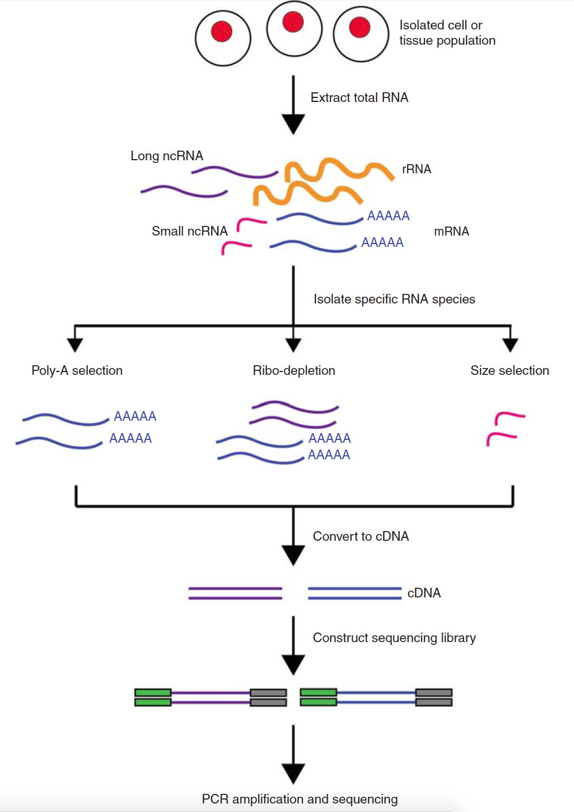
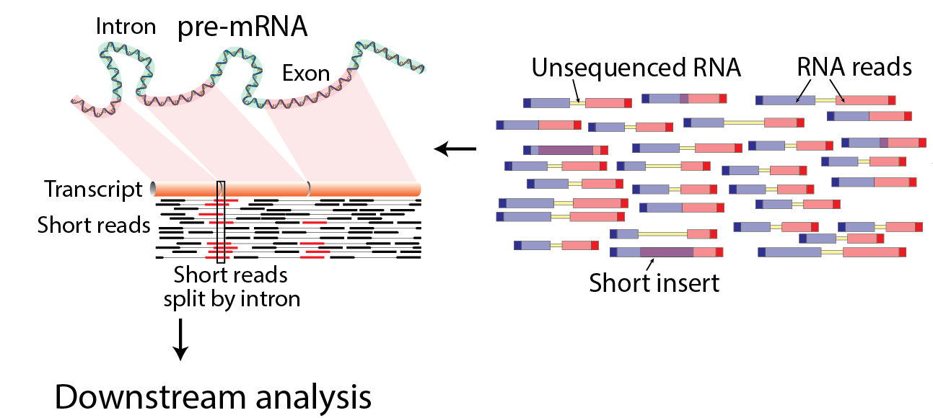
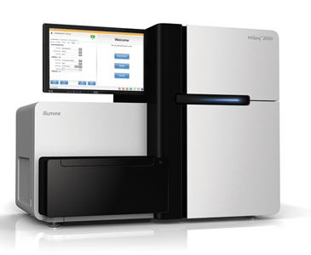
Basic RNAseq protocol overview

Slide 44

RNAseq data analysis - basic pipeline
Raw reads
Sequencing
facility
mapping
Mapped reads
normalization
across libraries
Expression
matrix
expression
quantification
Normalized
counts
...
Pathway enrichment
analysis
Differential
Expression analysis
Table of DE genes/transcript
...

Slide 45
RNAseq data analysis - basic pipeline
trimming/filtering
Trimmed/filtered
reads
Raw reads
Sequencing
facility
mapping
Mapped reads
normalization
across libraries
Expression
matrix
expression
quantification
Normalized
counts
...
Pathway enrichment
analysis
Differential
Expression analysis
Table of DE genes/transcript
...

Slide 46
RNAseq data analysis - basic pipeline
trimming/filtering
Trimmed/filtered
reads
Raw reads
Sequencing
facility
mapping
Mapped reads
normalization
across libraries
Expression
matrix
expression
quantification
variant
calling
Normalized
counts
isoform
description
...
Pathway enrichment
analysis
...
Differential
Expression analysis
Table of DE genes/transcript
...

Slide 47
RNAseq data analysis - basic pipeline
trimming/filtering
Trimmed/filtered
reads
Raw reads
Sequencing
facility
assembly
Assembled
transcriptome
normalization
across libraries
Expression
matrix
expression
quantification
variant
calling
Normalized
counts
isoform
description
...
Pathway enrichment
analysis
...
Differential
Expression analysis
Table of DE genes/transcript
...

Slide 48
RNAseq data analysis - basic pipeline
trimming/filtering
Trimmed/filtered
reads
Raw reads
QC
QC
Sequencing
facility
mapping
Mapped reads
QC
normalization
across libraries
Expression
matrix
expression
quantification
QC
Normalized
counts
...
Pathway enrichment
analysis
Differential
Expression analysis
Table of DE genes/transcript
...

Slide 49
Thank you

