Slide 1

Introduction to RNA-Seq: Sequence trimming
Wandrille Duchemin

Slide 2
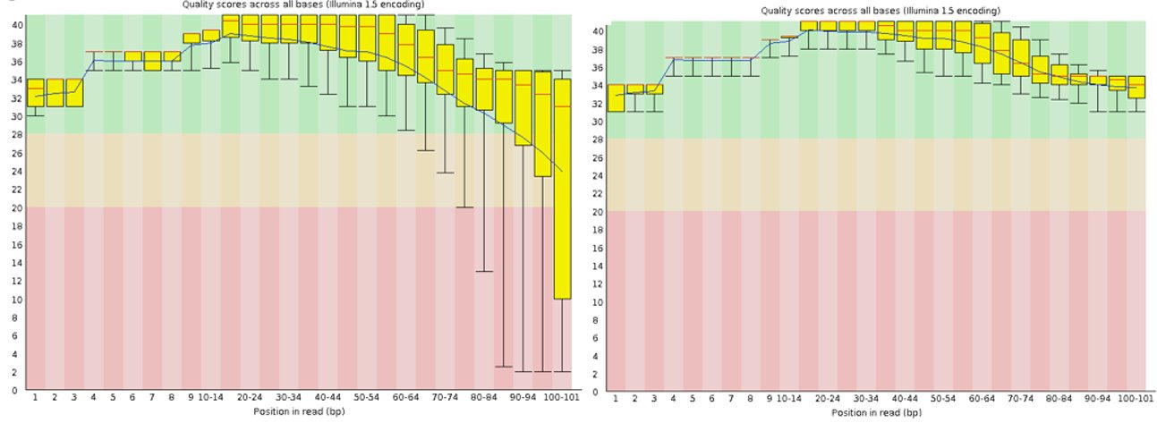
Par base sequence quality

Slide 3
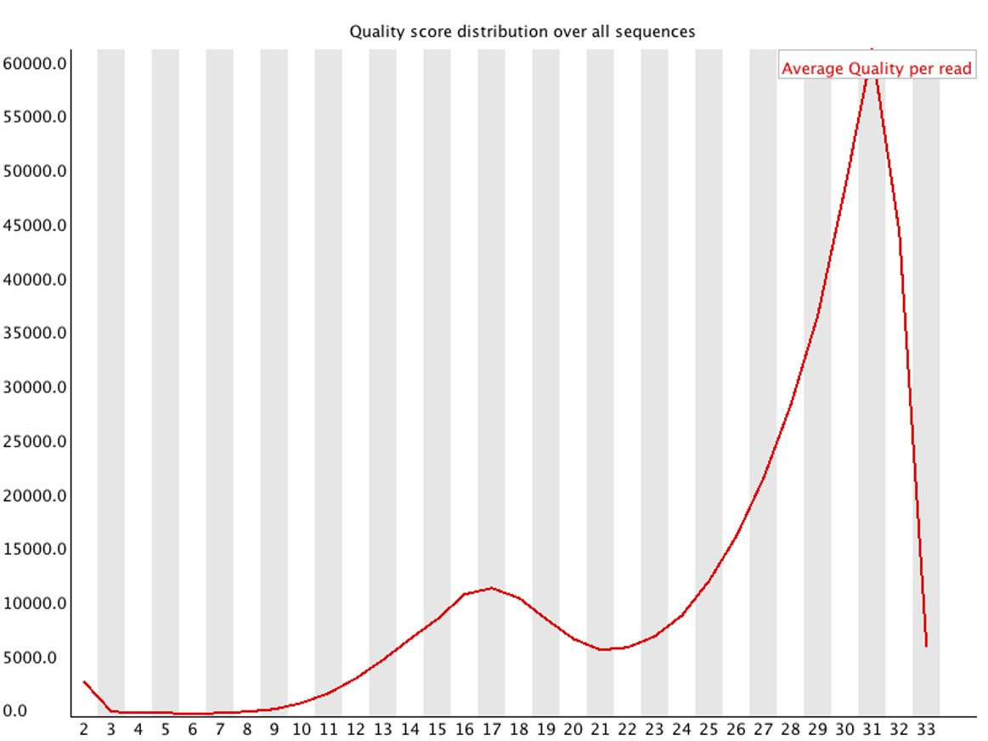
Par sequence quality score

Slide 4
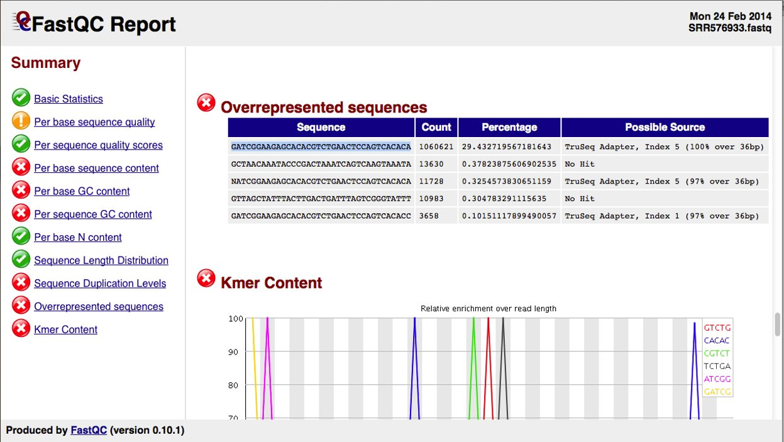
Over-represented sequences

Slide 5
Trimming: doing it or not?

Slide 6

Trimming: doing it or not?
Raw reads
trimming/filtering
Trimmed/filtered
reads
QC
QC
Sequencing
facility
mapping
assembly
QC
Mapped reads
Assembled
transcriptome
QC
normalization
across libraries
Expression
matrix
expression
quantification
variant
calling
QC
isoform
description
Normalized
counts
...
Pathway enrichment
analysis
...
Differential
Expression analysis
Table of DE genes/transcript
...

Slide 7
Trimming: doing it or not?
Raw reads
trimming/filtering
Trimmed/filtered
reads
Sequencing
facility
assembly
Assembled
transcriptome
Transcriptome assembly:
Trimming is highly recommended
(at least light)
expression
quantification
variant
calling
isoform
description
...

Slide 8
Trimming: doing it or not?
Raw reads
trimming/filtering
Trimmed/filtered
reads
Sequencing
facility
mapping
Mapped reads
Variant analysis:
Trimming is highly recommended
(at least light)
variant
calling
…

Slide 9
Trimming: doing it or not?
Raw reads
trimming/filtering
Trimmed/filtered
reads
Sequencing
facility
mapping
Mapped reads
Counting, expression quantification:
No trimming or light trim
expression
quantification

Slide 10
Trimming: doing it or not?
Raw reads
trimming/filtering
Trimmed/filtered
reads
Sequencing
facility
mapping
Mapped reads
Counting, expression quantification:
No trimming or light trim
expression
quantification
Aggressive trimming (high quality threshold, low length filtering) can have negative impacts on expression quantification
see: William et al. (2016) Trimming of sequence reads alters RNA-Seq gene expression estimates. BMC bioinfo.

Slide 11
Trimming: doing it or not?
Raw reads
trimming/filtering
Trimmed/filtered
reads
Sequencing
facility
mapping
Mapped reads
% mapped reads
Counting, expression quantification:
No trimming or light trim
# mapped reads
QC
expression
quantification
Aggressive trimming (high quality threshold, low length filtering) can have negative impacts on expression quantification
see: William et al. (2016) Trimming of sequence reads alters RNA-Seq gene expression estimates. BMC bioinfo.

Slide 12
Trimmomatic
http://www.usadellab.org/cms/?page=trimmomatic
ILLUMINACLIP: Cut adapter and other illumina-specific sequences from the read.
SLIDINGWINDOW: Performs a sliding window trimming approach. It starts scanning at the 5‟ end and clips the read once the average quality within the window falls below a threshold.
LEADING: Cut bases off the start of a read, if below a threshold quality
TRAILING: Cut bases off the end of a read, if below a threshold quality
CROP: Cut the read to a specified length by removing bases from the end
HEADCROP: Cut the specified number of bases from the start of the read
MINLEN: Drop the read if it is below a specified length
AVGQUAL: Drop the read if the average quality is below the specified level

Slide 13
Practical

Slide 14
Thank you

