Slide 1


Introduction to RNA-Seq – Read Counting
Wandrille Duchemin
Notes:
<number>

Slide 2

Is RNA-Seq expression inference reliable?
It’s been known for many years that most Illumina-type RNA-Seq workflows are highly concordant with estimates from quantitative PCR methods
Griffith et al (2010) Nature Methods
Validation rates of ~85% for junction discovery and 88% for expression validation
Everaert et al (2017) Scientific Reports
~85% concordance between RNA-Seq and RT-qPCR
reproducibly inconsistent genes are typically small, with fewer exons, and lower overall expression

Slide 3
Read Counting – Initial Considerations
RNA-Seq comprises many technologies which are rapidly evolving
The appropriate choice of methods highly depends on the question(s) you’re asking
Parameter space is important!
Proper gene/transcript model annotations are crucial

Slide 4
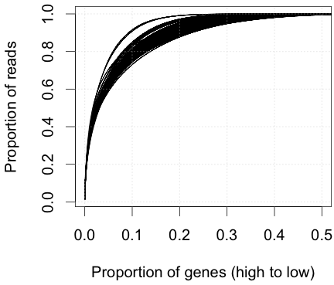
How much sequencing goes to highly expressed genes?
Pr. Mark Robinson UZH

Slide 5
Basics of RNA-Seq Quantification
Remember - stochastic models underlie all methods for relative transcript abundance estimates
First align reads against reference
Count number of reads aligning to features
“fragment assignment”
decide how to treat multi-mapping reads
Convert read counts to relative abundance
“density deconvolution”
Account for differences in:
library size
feature lengths
sequence-based biases

Slide 6
Read Counting – Fundamental Problems
Aligners map reads to genomic coordinates and/or to all features associated to the mapped coordinates
How to treat multi-mapping reads?
eg gene families, repetitive sequences, alternative splice forms

Slide 7
Read Counting – Fundamental Problems
Gene 1
Gene 2
Transcript A
Transcript B

Slide 8
Solutions to multi-mapping reads
Discard all multi-reads, estimate abundance based on uniquely mapping reads only
Loss of information
Potentially biased abundance estimates
Appropriate for edgeR/DESeq2, expected that samples being compared have same distribution of multi-reads
“Rescue” multireads by fractional allocation
Estimate abundances based on uniquely mapping reads
Divide multireads between features based on abundance estimates from uniquely mapped reads
Recompute abundances based on updated counts
Used by tools like Cufflinks

Slide 9
Counting/Quantification
union counters -> simple sum of all reads
transcript counters -> sum of length-normalized reads
(often unknown which reads map to which transcript )
Pr. Mark Robinson UZH
adapted from Trapnell et al 2013 Nat Biotech

Slide 10
Define the differential problem
Differential transcript
expression (DTE)
Differential gene
expression (DGE)
condition A condition B
condition A condition B
Pr. Mark Robinson UZH
Slide adapted from Mar Gonzàlez-Porta’s talk at ECCB 2014
http://radiant-project.eu/ECCB/gonzalez-porta-140907065638-phpapp01.pdf

Slide 11
Define the differential problem
Differential transcript
usage (DTU)
Differential gene
expression (DGE)
condition A condition B
condition A condition B
Pr. Mark Robinson UZH
Slide adapted from Mar Gonzàlez-Porta’s talk at ECCB 2014
http://radiant-project.eu/ECCB/gonzalez-porta-140907065638-phpapp01.pdf

Slide 12
Define the differential problem
Differential transcript
expression (DTE)
Differential exon
usage (DEU)
Differential transcript
usage (DTU)
See also Soneson, Matthes et al., 2016, Genome Biology (comparison of DTU methods)
Pr. Mark Robinson UZH
Slide adapted from Mar Gonzàlez-Porta’s talk at ECCB 2014
http://radiant-project.eu/ECCB/gonzalez-porta-140907065638-phpapp01.pdf

Slide 13
What do you want to know?
whether individual transcripts have changed? (DTE)
whether any transcripts in gene have changed? (DTE-> G)
whether the overall output has changed? (DGE)
whether transcript proportions have changed? (DTU/DEU)
Blue/red transcript changed? Yes, Yes
Any transcripts changed? Yes
Overall expression change? No
Transcript proportions changed? Yes
Pr. Mark Robinson UZH

Slide 14
Transcript-Level Counting
More informative to understand regulation of alternative transcript usage
Enables novel transcript discovery
Primary drawbacks:
requires complex statistical modeling, often difficult to interpret. see Pachter’s 2013 keynote address describing how Cufflinks was (not) reviewed
highly dependent on the quality of feature annotation
Many more transcripts than genes, thus higher multiple testing penalty and potentially lower sensitivity
Generally introduces extra noise
Long-read sequencing is a solution here

Slide 15
Transcript-Level Counting & Alternative splicing
splice junction counting as a proxy for differential isoform expression
JunctionSeq , Hartley & Mullikin (2016) Nucleic Acids Research
WHIPPET , Blencowe et al (2018) Molecular Cell

Slide 16
Gene-Level Counting
Collapsing reads from all alternative spliced transcripts to one gene feature simplifies counting
Recent insights indicate gene-level counting is preferred due to performance and interpretability
However, differential isoform usage can lead to inflated false discovery rates when gene-level counting
this effect is relatively minor in most real datasets
can be addressed by incorporating offsets from transcript-level abundance estimates
→ see the tximport Bioconductor package
Soneson et al (2016) F1000Research 4:152

Slide 17
Approaches to RNA-Seq Abundance Estimation
RPKM/FPKM/TPM
Normalization for feature length and library size
Cufflinks combines FPKM counts with complex models for density deconvolution
“Raw counts” used for subsequent abundance estimates by fitting to negative binomial distribution
Technical and biological noise is estimated from data
Employed by edgeR, DESeq2

Slide 18
RPKM/FPKM and TPM
Reads Per Kilobase per Million mapped reads
Fragments Per Kilobase per Million mapped reads
Same as RPKM but accounts for paired-end reads
sum of all RPKM is not the same between samples
Transcripts Per Million :
idem but operation order differs
proportionality constants are comparable between experiments
Li & Dewey 2011, Wagner et al 2012, Dillies et al 2012
https://rna-seqblog.com/rpkm-fpkm-and-tpm-clearly-explained/

Slide 19
Read Counting with STAR
Use --quantMode GeneCounts
“A gene is counted if it overlaps one and only one gene”
“Both ends of the paired-end are checked for overlaps”
This coincides with the counts produced by htseq-count with default parameters :
https://htseq.readthedocs.io/en/master/count.html

Slide 20
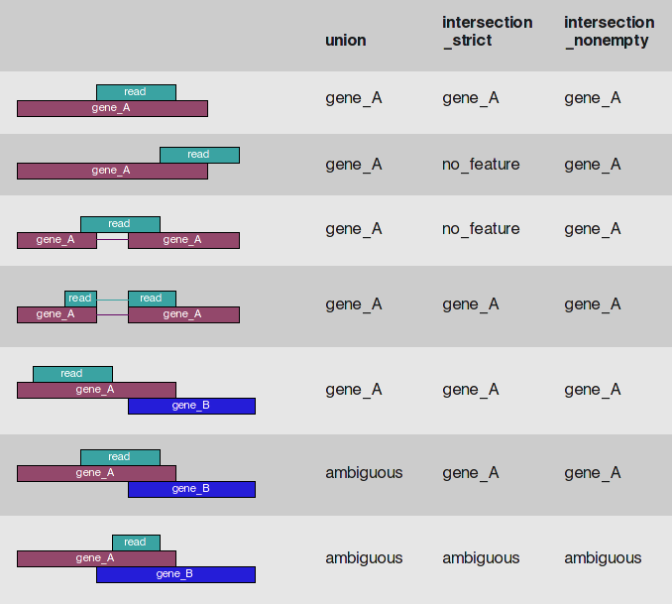
Read Counting with STAR
Use --quantMode GeneCounts
“A gene is counted if it overlaps one and only one gene”
“Both ends of the paired-end are checked for overlaps”
This coincides with the counts produced by htseq-count with default parameters :
https://htseq.readthedocs.io/en/master/count.html

Slide 21
Read Counting with HTSeq
HTSeq is actually a large Python library providing easily modified tools for a broad range of analyses
The function htseq-count pre-processes RNA-Seq alignment files into read count matrices which can be used for differential expression analysis
Requirements:
an annotation file
a decision about how to treat multi-reads
generally, ambiguous reads are discarded and paired reads are treated as one fragment

Slide 22
HTSeq – Overlap Resolution Models
http://www-huber.embl.de/users/anders/HTSeq/doc/count.html

Slide 23
Read Counting with FeatureCount
http://subread.sourceforge.net/featureCounts.html
FeatureCount is actually a part of the larger Subread package
It summarizes the counts in one or several .bam/.sam files at a given level:
feature (eg. exon)
meta-feature (eg. gene)
Requirements:
an annotation file (gtf/gff)
Paired-end or single-end ?
Stranding information
a decision about how to treat multi-mapping/overlapping reads (generally discarded)

Slide 24
Read Counting with FeatureCount
http://subread.sourceforge.net/SubreadUsersGuide.pdf
Reads are counted if any overlap are found between read and feature.
change with –minOverlap
Multi-mapping reads : not counted
change with -M and –fraction
Multi-overlapping genes : not counted
change with -O and --fraction

Slide 25
Practical 5
Go to the website and do the featureCount practical

Slide 26
REFERENCES
Griffith et al (2010) “Alternative expression analysis by RNA sequencing” Nature Methods 7:843-847.
Everaert et al (2017) “Benchmarking of RNA-sequencing analysis workflows using whole-transcriptome RT-qPCR expression data” Scientific Reports 7:1559.
Soneson et al (2016) “Differential analyses for RNA-seq: transcript-level estimates improve gene-level inferences” F1000 Research 4:1521.
Li & Dewey (2011) BMC Bioinformatics 12:323.
Wagner et al (2012) Theory Biosciences 131(4):281-285.
Dillies et al (2012) “A comprehensive evaluation of normalization methods for Illumina high-throughput RNA sequencing data analysis” Briefings Bioinformatics 14(6):671-683.
Liao Y, Smyth GK and Shi W (2014). “featureCounts: an efficient general purpose program for assigning sequence reads to genomic features.” Bioinformatics, 30(7):923-30.

Slide 27
Contributors: Wandrille Duchemin Geoffrey Fucile Walid Gharib Pablo Escobar Lopez Mark Robinson

