Slide 1

Introduction to RNA-Seq: Differential Expression
Wandrille Duchemin

Slide 2
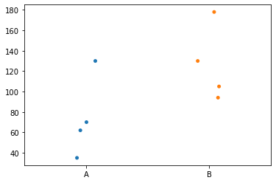
Differential Expression : the goal
Expression of GeneX
?

Slide 3
Differential Expression : challenges for RNAseq
Sequencing depth varies across libraries
High dynamic range of expression
Limited number of samples
Large number of genes

Slide 4
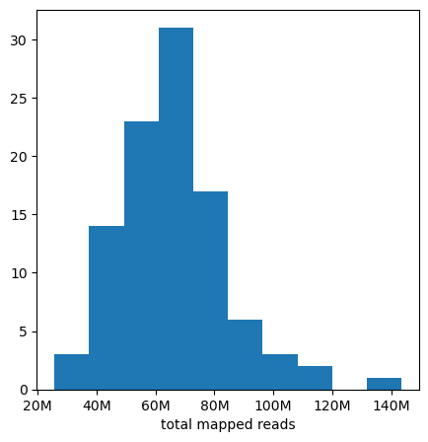
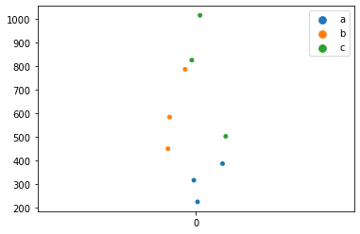
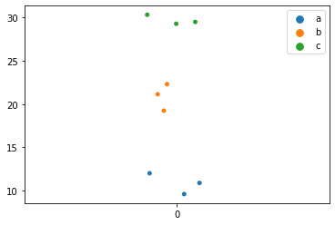
Differential Expression : challenges for RNAseq
Sequencing depth varies across libraries
Normalization

Slide 5
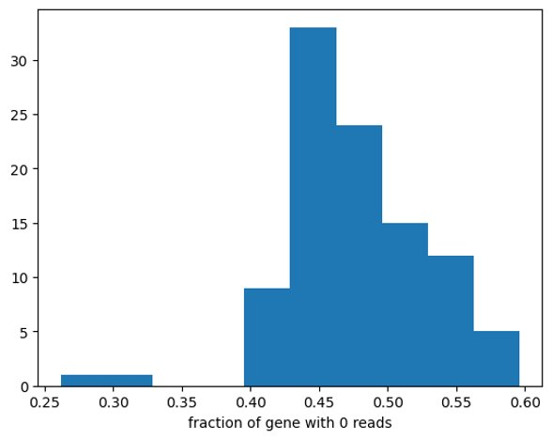
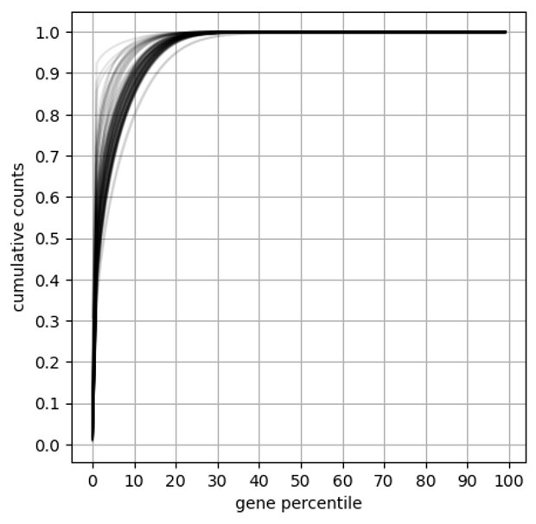
Differential Expression : challenges for RNAseq
High dynamic range of expression

Slide 6
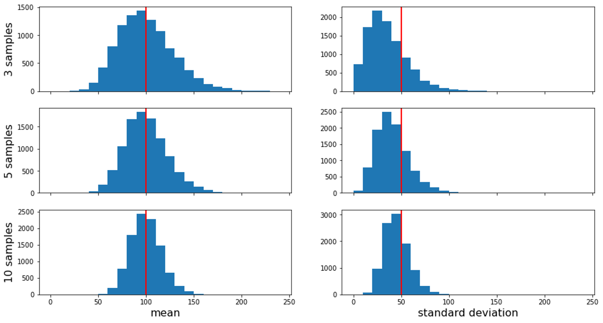
Differential Expression : challenges for RNAseq
Limited number of samples

Slide 7
Differential Expression : challenges for RNAseq
Large number of genes

Slide 8
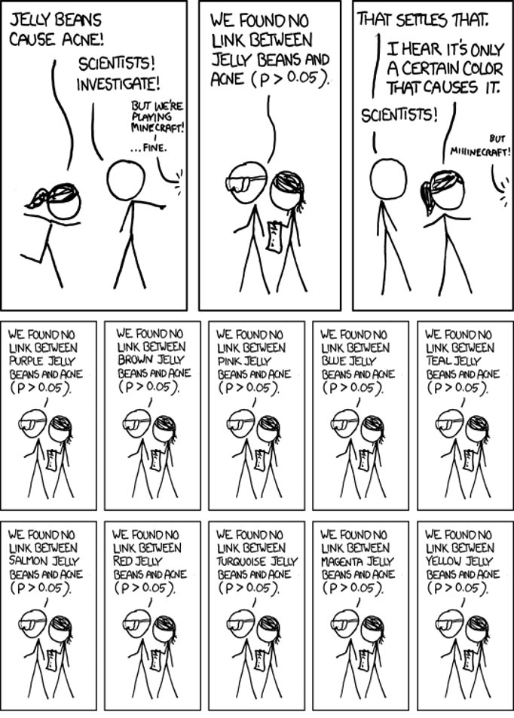
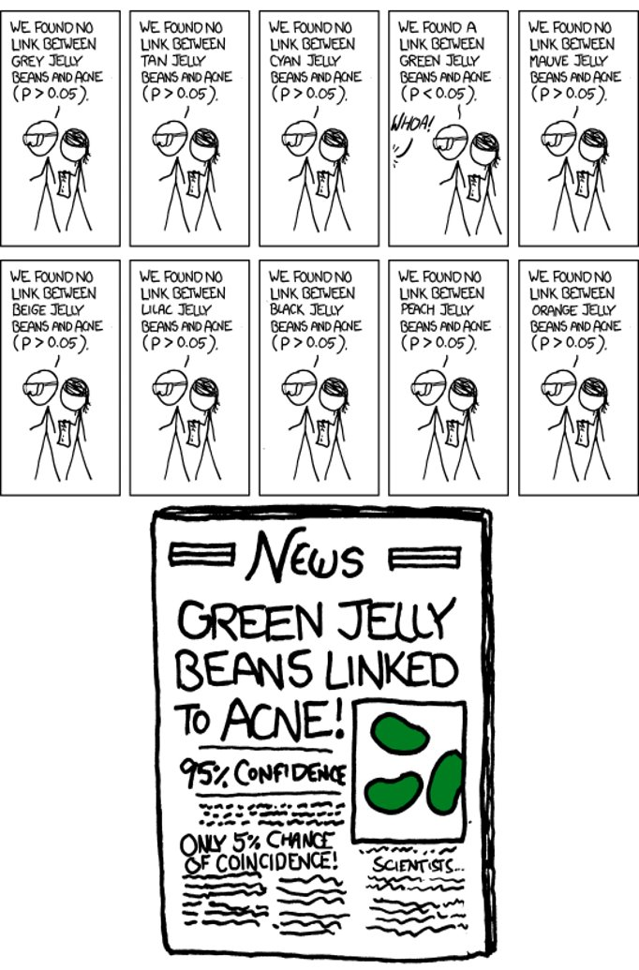
Differential Expression : challenges for RNAseq
xkcd.com/882

Slide 9
Differential Expression : challenges for RNAseq
Apply p-value correction for multiple testing
xkcd.com/882

Slide 10
Input for Differential Expression
Counts from mapping
Affected by library size
TPM from pseudo-aligners
The R library tximport aggregates counts at the gene-level

Slide 11
Input for Differential Expression
Counts from mapping
Affected by library size
TPM from pseudo-aligners
The R library tximport aggregates counts at the gene-level
EdgeR and DESeq2 expect raw counts

Slide 12
Digression : "naïve" normalization
CPM (Count Per Million): count / library size * 10⁶
RPKM (Read Per Kilobase per Million): CPM / gene length (kb)
TPM (Transcript Per Million):
RPK : count / gene length (kb)
TPM : RPK / sum(RPK) * 10⁶

Slide 13
Digression : "naïve" normalization
CPM (Count Per Million): count / library size * 10⁶
RPKM (Read Per Kilobase per Million): CPM / gene length (kb)
TPM (Transcript Per Million):
RPK : count / gene length (kb)
TPM : RPK / sum(RPK) * 10⁶
The sum of RPKM is different between samples
The sum of TPM is
constant between samples

Slide 14
Digression : "naïve" normalization
CPM (Count Per Million): count / library size * 10⁶
RPKM (Read Per Kilobase per Million): CPM / gene length (kb)
TPM (Transcript Per Million):
RPK : count / gene length (kb)
TPM : RPK / sum(RPK) * 10⁶
How do you compute
"gene length" ?

Slide 15
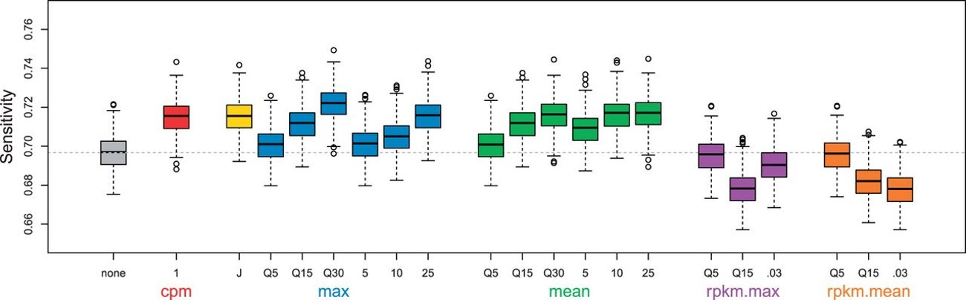
Differential Expression : filtering low count genes
Very low counts genes:
Very little information. No chance of DE
Filtering them out = less test = less p-value correction
Andrea Rau et al., 2009 https://doi.org/10.1093/bioinformatics/btt350
EdgeR: CPM > 10/(min lib size) in at least N samples
DESeq2: mean normalized count optimizing # of DEG

Slide 16
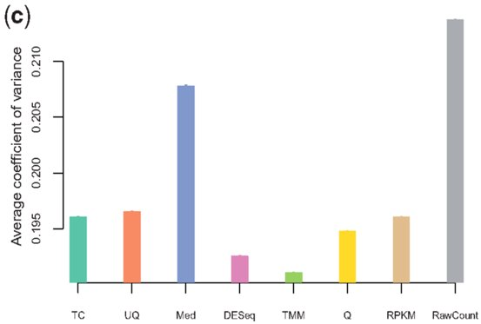
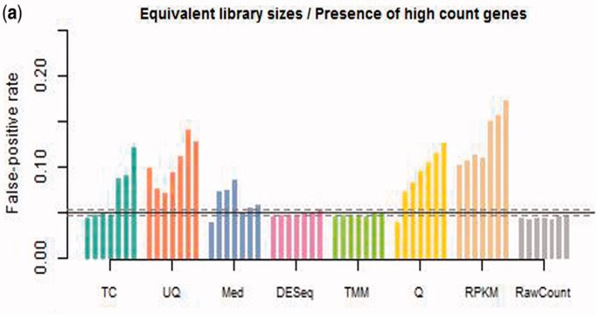
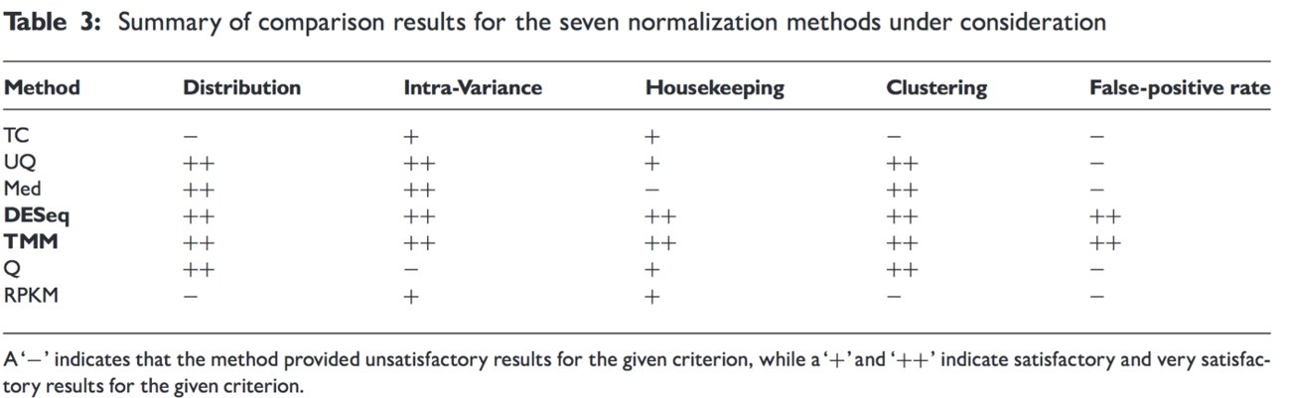
Differential Expression : normalization
Dillies et al 2013 https://doi.org/10.1093/bib/bbs046

Slide 17
Differential Expression : normalization
EdgeR: "Trimmed Mean of M-Values" (TMM)
Set one sample as reference
For each sample, the TMM is computed as the weighted mean of log ratios between this test and the reference, after exclusion of the most expressed genes and the genes with the largest log ratios.
Compute the correction factor to get all TMMs to 1
DESeq2: "Relative Log Expression" (RLE)
For each sample: compute the median of the ratio of each gene read count over its geometric mean across all lanes.
This provides the correction factor that should be applied to all read counts
Both presume that most gene are not DE

Slide 18
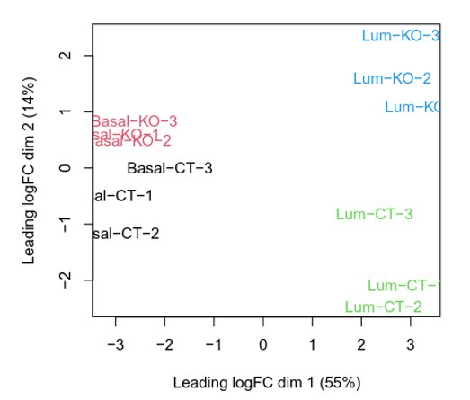
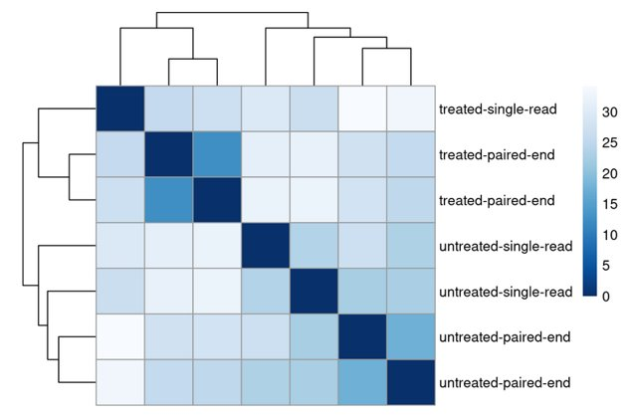
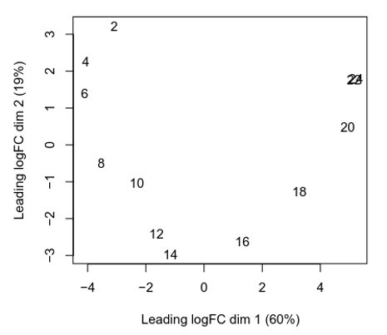
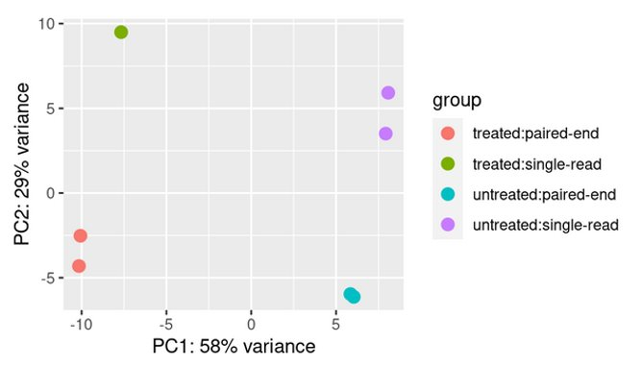
Quality Control: PDS or PCA of the samples

Slide 19
Quality Control: PDS or PCA of the samples
This is often when we decide to exclude outliers / come back to previous steps

Slide 20
Differential Expression : statistical model
To conduct statistical testing, we need an adapted statistical model.
Idea: expression corresponds to a number of transcripts, captured and sequenced independently from a given "space" (the sample) --> Poisson model

Slide 21
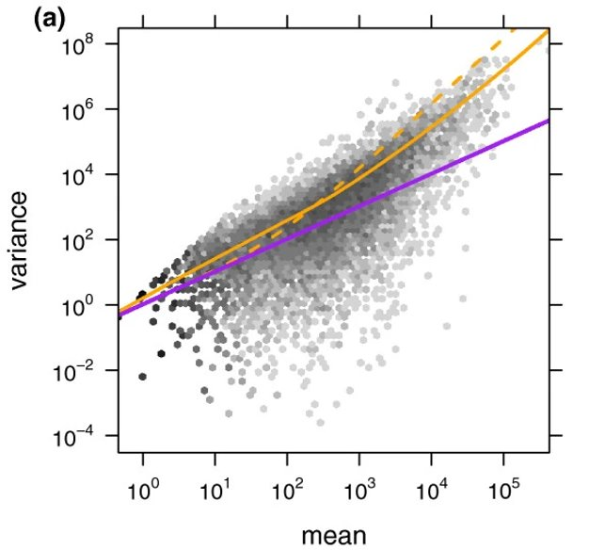
Differential Expression : statistical model
To conduct statistical testing, we need an adapted statistical model.
Idea: expression corresponds to a number of transcripts, captured and sequenced independently from a given "space" (the sample) --> Poisson model
There is an over-dispersion!
Anders, S., Huber, W. 2010 https://doi.org/10.1186/gb-2010-11-10-r106

Slide 22
Differential Expression : statistical model
To conduct statistical testing, we need an adapted statistical model.
Idea: expression corresponds to a number of transcripts, captured and sequenced independently from a given "space" (the sample) --> Poisson model
There is an over-dispersion
--> Negative Binomial model
Variance = μ + θμ²
θ: dispersion parameter
μ: (expected) expression
Anders, S., Huber, W. 2010 https://doi.org/10.1186/gb-2010-11-10-r106

Slide 23
Differential Expression : statistical model
To conduct statistical testing, we need an adapted statistical model.
Idea: expression corresponds to a number of transcripts, captured and sequenced independently from a given "space" (the sample) --> Poisson model
There is an over-dispersion
--> Negative Binomial model
Variance = μ + θμ²
θ: dispersion parameter
μ: (expected) expression
Often modelled with a linear model:
μ = base level + genotype effect + batch effect + treatment effect ….
Anders, S., Huber, W. 2010 https://doi.org/10.1186/gb-2010-11-10-r106

Slide 24
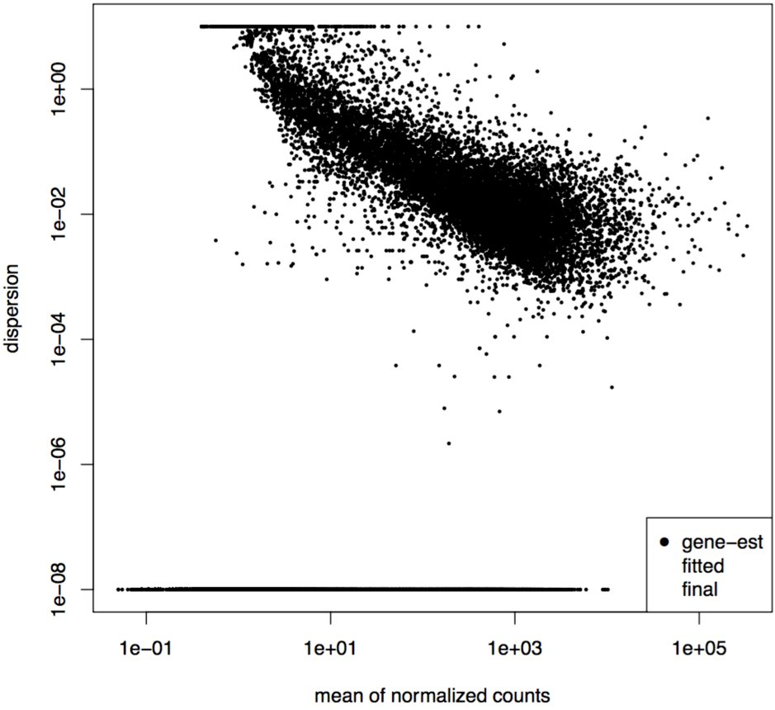
Estimating dispersion
Problem:
we often have very few replicates

Slide 25
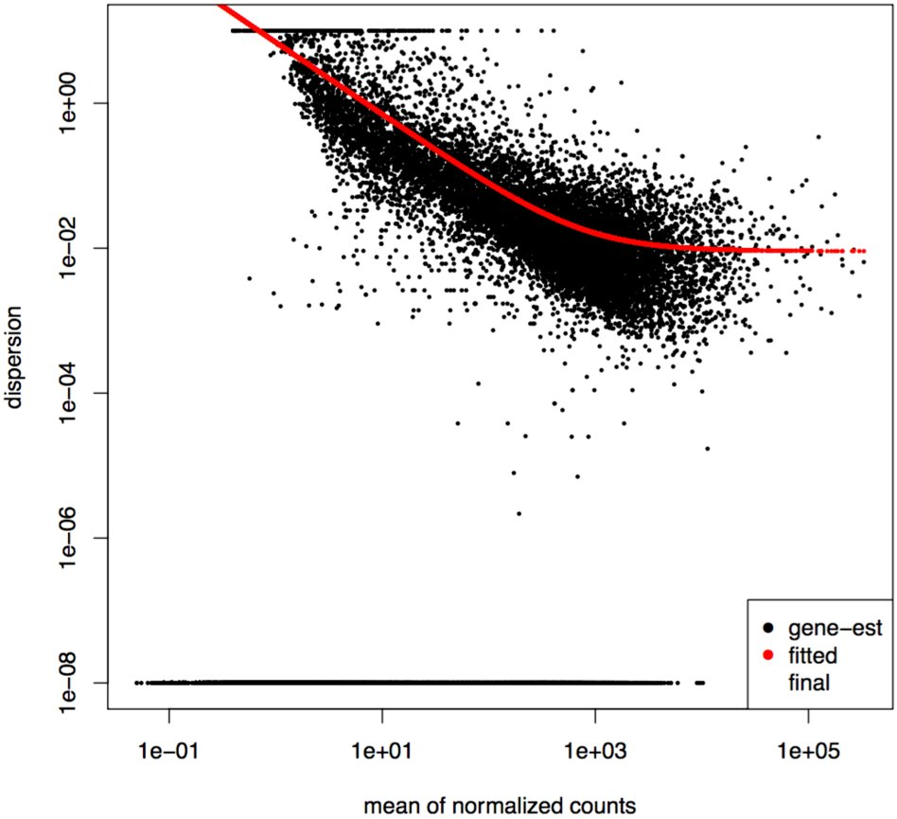
Estimating dispersion
Problem:
we often have very few replicates
Solution:
take advantage of the large number of genes
Shrink gene-wise estimates toward the center value observed of dispersion across genes with similar expression.

Slide 26
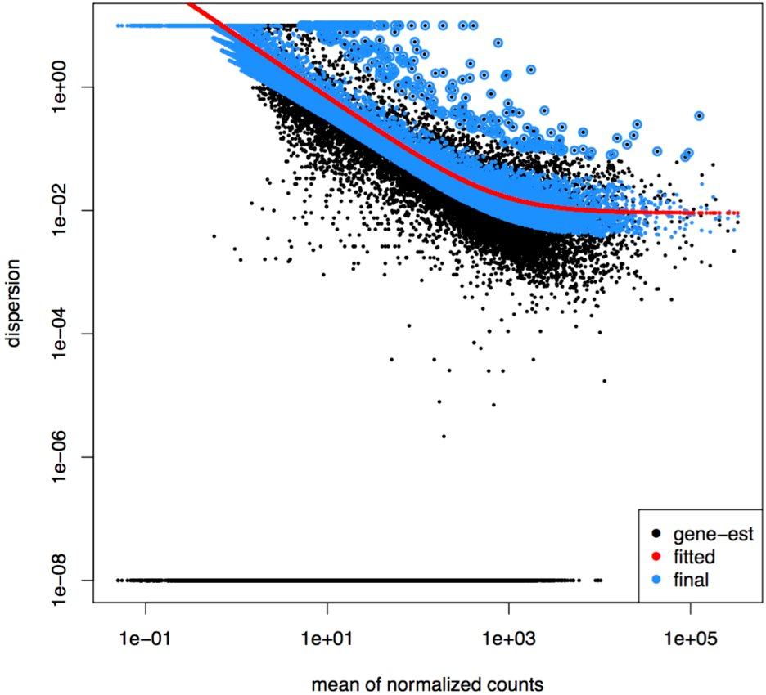
Estimating dispersion
Problem:
we often have very few replicates
Solution:
take advantage of the large number of genes
Shrink gene-wise estimates toward the center value observed of dispersion across genes with similar expression.

Slide 27
Testing for differential expression: DESeq2
For each gene:
Z-score = shrunken LFC / estimated standard error
Wald test:
Compare Z-score to a standard normal distribution to compute a p-value
Benjamini-Hochberg procedure to adjust p-values

Slide 28
Testing for differential expression: edgeR
"simple": 1 factor : exactTest()
using the computed conditional distribution for the sum of counts in a group
Otherwise: GLM framework
Quasi-likelihood F-test : generally preferred
Likelihood Ratio Test : when "the dispersions are very large and the counts are very small, whereby some of the approximations in the QL framework seem to fail"
https://support.bioconductor.org/p/84291/

Slide 29
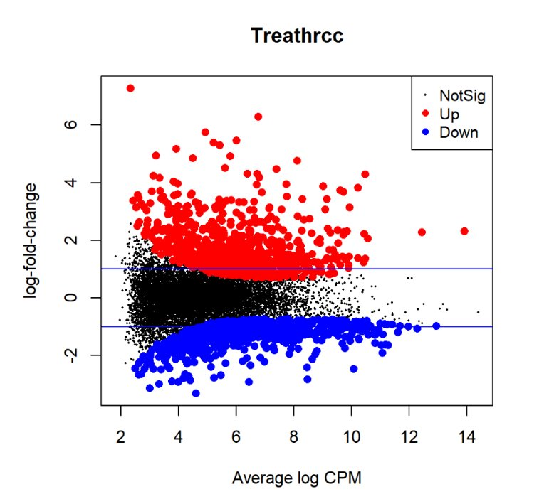
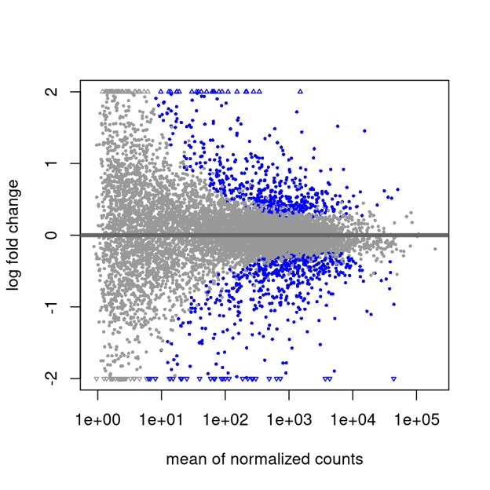
DE results: MA plot

Slide 30
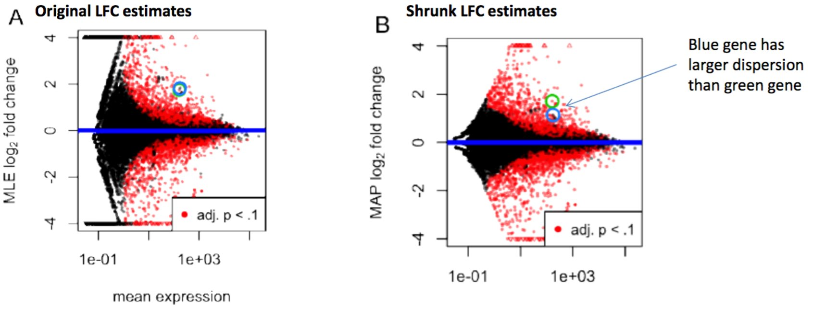
DESeq2 : shrinkage of log-fold change
Love et al. 2014

Slide 31
DESeq2 : shrinkage of log-fold change
Makes log-fold change values more useful for down-stream analysis
Love et al. 2014

Slide 32
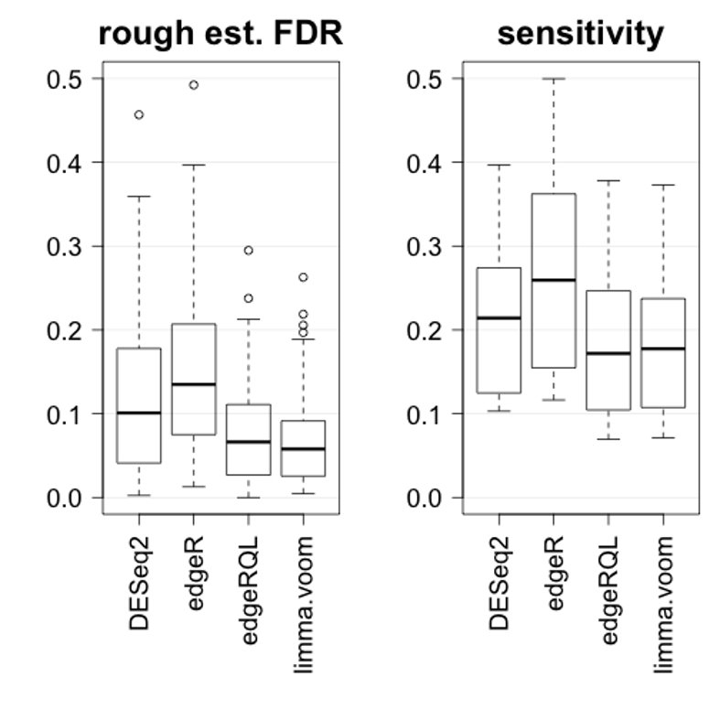
edgeR vs DESeq2
edgeR exact test : more sensitive
edgeR QL : more conservative
DESeq2 : thight FDR control
Love et al. 2014
https://mikelove.wordpress.com/2016/09/28/deseq2-or-edger/

Slide 33
Practical

Slide 34
Thank you

