Slide 1
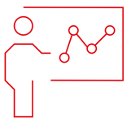
Introduction to RNA-Seq: Enrichment analysis
Wandrille Duchemin

Slide 2
Enrichment analysis
What to do with your list of differentially expressed gene?
Interpretation can be difficult, especially if many genes are DE

Slide 3
Enrichment analysis
What to do with your list of differentially expressed gene?
Interpretation can be difficult, especially if many genes are DE
ENRICHED
Biological function
Pathway
TF
...
DE
genes

Slide 4
Enrichment analysis
What to do with your list of differentially expressed gene?
Interpretation can be difficult, especially if many genes are DE
ENRICHED
Biological function
Pathway
TF
...
DE
genes
mapping

Slide 5
Enrichment analysis
What to do with your list of differentially expressed gene?
Interpretation can be difficult, especially if many genes are DE
testing
ENRICHED
Biological function
Pathway
TF
...
DE
genes

Slide 6
Enrichment analysis : mapping
Regrouping genes together in meaningful sets
Same pathway
Same location in the cell
Same molecular function
…

Slide 7
Enrichment analysis : mapping
Gene Ontologies
Reactome
KEGG
MSigDB
Custom set
...

Slide 8
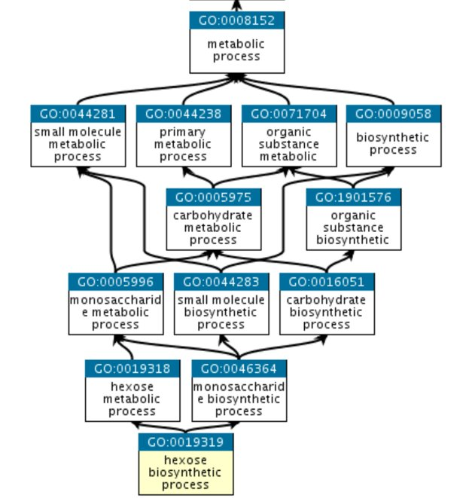
Enrichment analysis : mapping
Gene Ontologies geneontology.org
3 domains of nested terms:
Molecular Function
Cellular Component
Biological Process

Slide 9
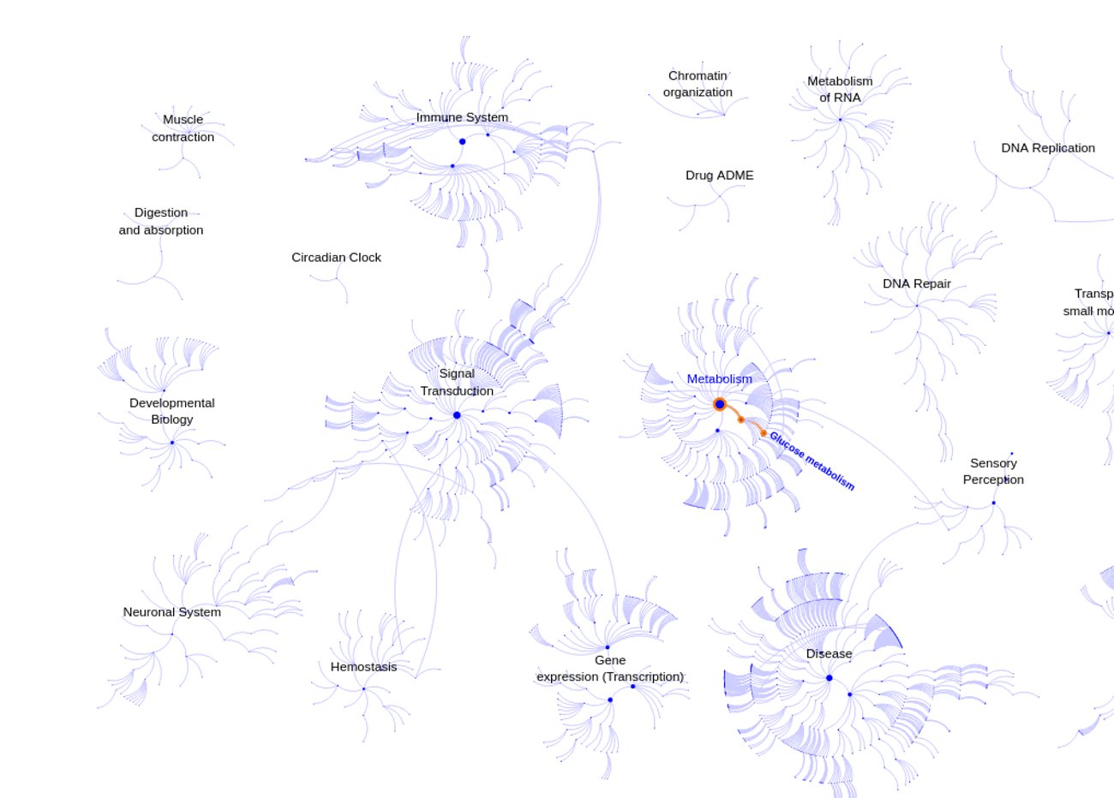
Enrichment analysis : mapping
reactome.org

Slide 10
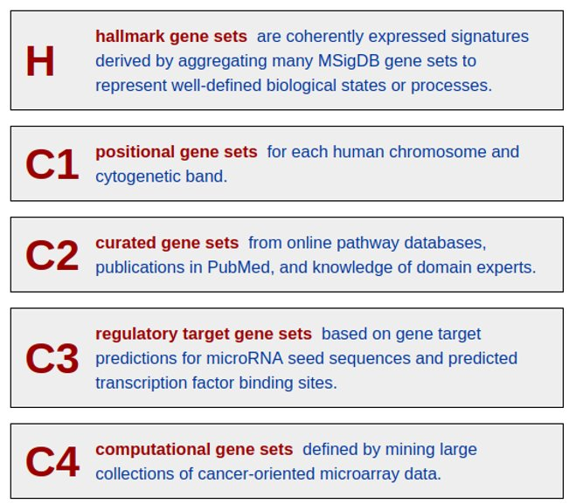
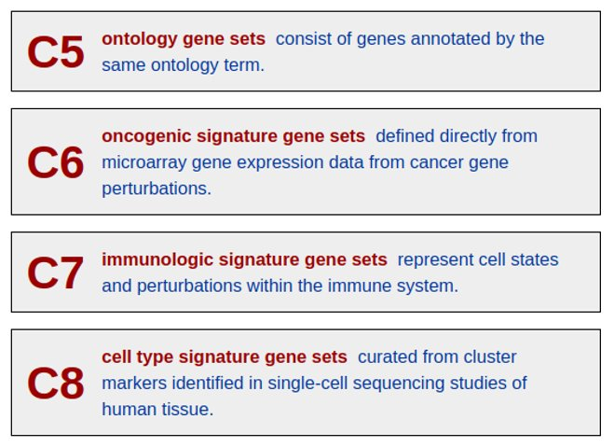
Enrichment analysis : mapping
MSigDB : http://www.gsea-msigdb.org/gsea/msigdb/index.jsp​
Human, mouse, and rat only

Slide 11
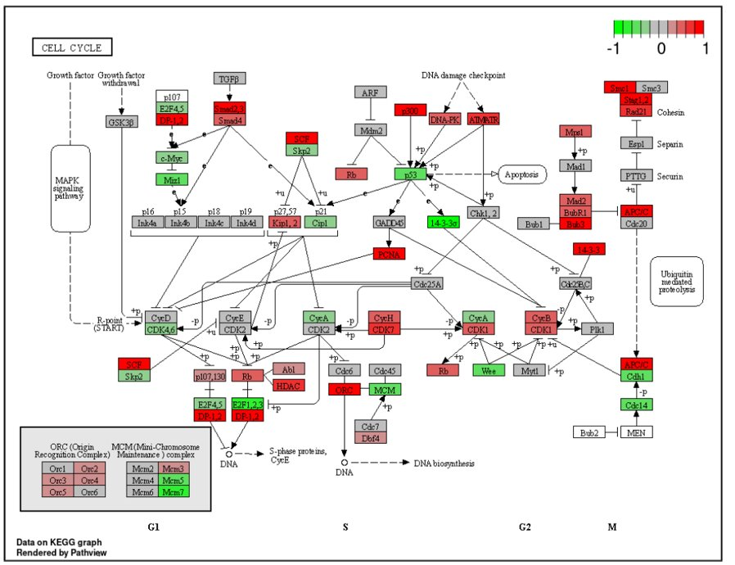
Enrichment analysis : mapping
KEGG : http://www.genome.jp/keggKEGG PATHWAY
Projection of DE data ​
onto a KEGG pathway map​
With R package pathview​
​
https://bioconductor.org/packages/release/bioc/html/pathview.html​

Slide 12
Enrichment analysis : mapping
Custom gene sets
Derived from specialized litterature
Tentative annotation
Very important in non-model organisms

Slide 13
Enrichment analysis : computing enrichment
2 main approaches
Over Representation Analysis (ORA)
Gene Set Enrichment Analysis (GSEA)

Slide 14
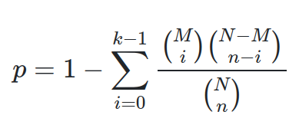
Enrichment analysis : computing enrichment
Over Representation Analysis (ORA)
Basically a Fisher's exact test with p-value correction
 | DE | Not DE
in gene set | A | B
not in gene set | C | D
N = A+B+C+D # total genes
M = A+B # genes in set
n = A+C # DE genes
k = A # DE genes in set

Slide 15
Enrichment analysis : computing enrichment
Gene Set Enrichment Analysis (GSEA)
Does not rely on 0/1 DE
Use ranking along a continuous measure (eg. log2FC)
Compute Enrichment Score
Estimate significance with a permutation scheme

Slide 16
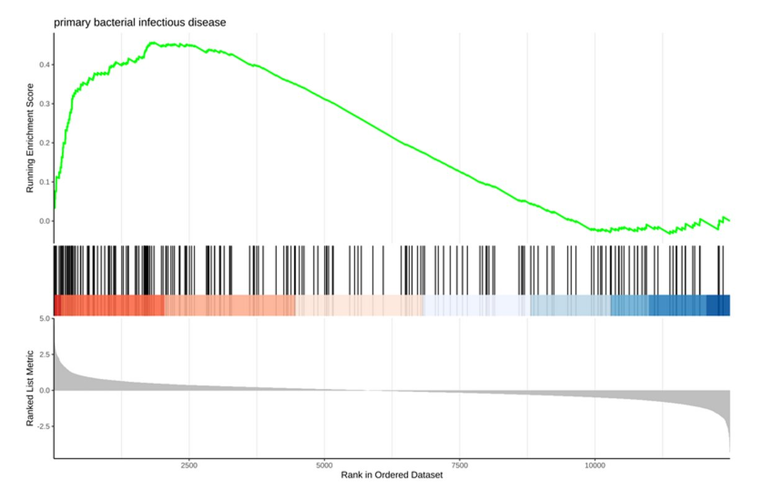
Enrichment analysis : computing enrichment
Enrichment Score visualized using functions from the R package enrichplot​

Slide 17
Enrichment analysis : computing enrichment
Going through the list of ranked genes
Gene :
In set --> move curve away from 0
Not in set --> move curve toward 0

Slide 18
Enrichment analysis : computing enrichment
Enrichment Score (ES): curve maximum
Leading
Edge
genes

Slide 19
Enrichment analysis : computing enrichment
Subramanian et al. 2005:
normalization by comparison with
many gene-label permuted sets
Korotkevich et al. 2021 : fGSEA
normalization with parallel evaluation +
score heuristic +
refinement of low p-values
ES

Slide 20
Enrichment analysis : computing enrichment
Subramanian et al. 2005:
normalization by comparison with
many gene-label permuted sets
Korotkevich et al. 2021 : fGSEA
normalization with parallel evaluation +
score heuristic +
refinement of low p-values
ES
~100x faster
Default in clusterProfiler

Slide 21
Enrichment analysis : computing enrichment
Many more methods or implementations
Signaling Pathway Impact Analysis
https://bioconductor.org/packages/release/bioc/html/SPIA.html
ISMARA (TF-based)
ismara.unibas.ch/mara

Slide 22
Practical

Slide 23
Thank you

