Slide 1
ENTERPRISE QUALITY ASSURANCE & KNOWLEDGE PLATFORM
Enterprise RAG System v3
Technical Architecture, StarUML Design Models, Multi-Batch QA Automation & Full Code Implementation
PROJECT METADATA & SPECIFICATION
Author: Enterprise AI Engineering Team | Date: 2026-08-28 | Version: 3.0.0 Enterprise
Core Stack: FastAPI | Celery & Redis | FAISS Vector Store | SentenceTransformers | Groq LPU | Streamlit | StarUML

Slide 2
ENTERPRISE RAG SYSTEM V3
Project Overview & Executive Architecture Summary
Enterprise Problem
• Complex PRD & technical documents require hours of manual QA analysis.
• Traditional QA test generation lacks consistency, boundary coverage, and structured formatting.
• Manual ingestion of large PDFs and DOCX files blocks API execution with long latencies.
• Fragile LLM integrations break during cloud rate limits (HTTP 429) or timeouts.
RAG System v3 Solution
• Decoupled asynchronous ingestion worker with Celery & Redis for zero API blocking.
• Persistent L2-normalized FAISS vector store with instant atomic index rebuild on deletion.
• Multi-Batch QA Generation Engine partitioning test creation across 4 dedicated scenarios.
• Enterprise OpenPyXL engine exporting professional, wrapped, and styled Excel workbooks.
Key Innovations
• Zero-Hallucination Guardrails: Strict system prompt enforces context-only answering.
• Resilient Multi-Tier LLM: Groq LPU primary with automatic LlamaIndex failover.
• SHA-256 Deduplication: Eliminates duplicate chunking and vector store bloat.
• End-to-End StarUML Modeling: Complete Use Case and Class Diagram specifications.

Slide 3
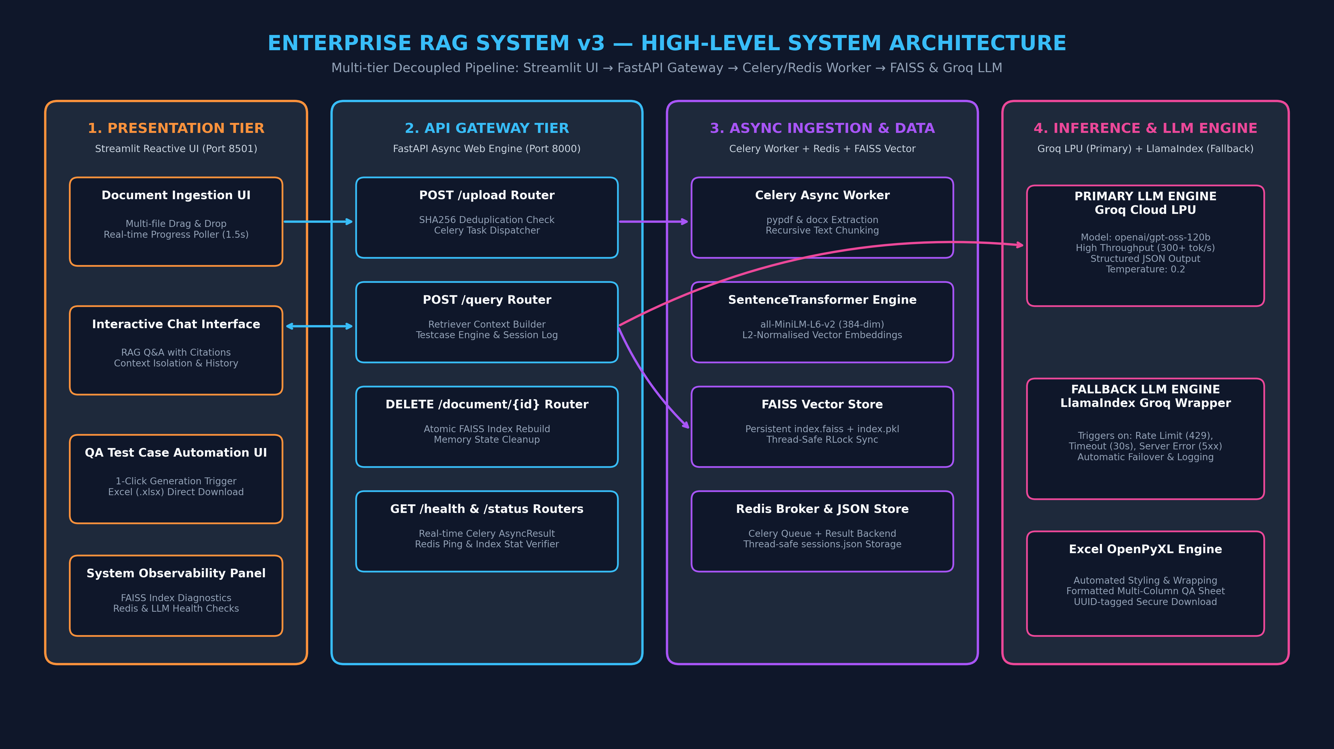
ENTERPRISE RAG SYSTEM V3
Multi-Tier Decoupled System Architecture

Slide 4
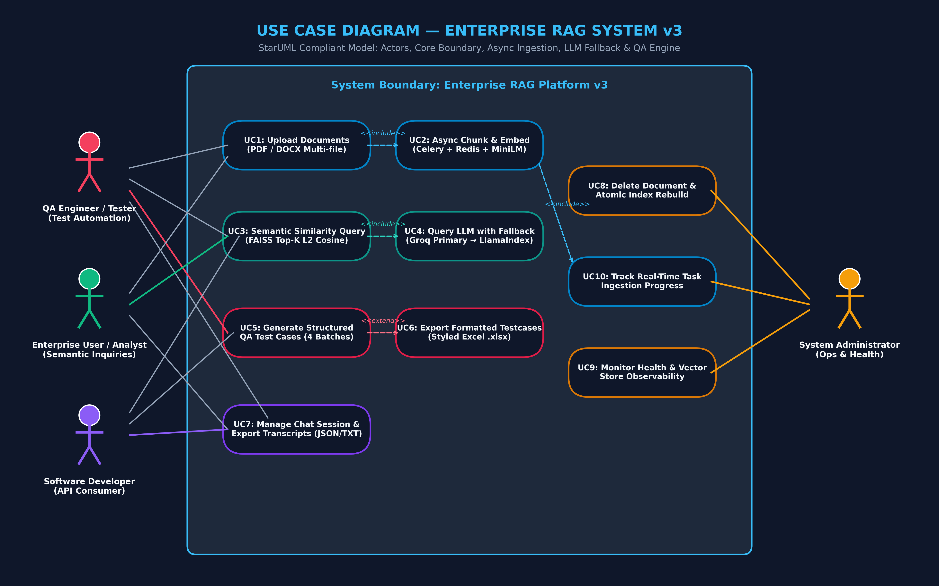
ENTERPRISE RAG SYSTEM V3
Design: UML Use Case Diagram (StarUML Specification)

Slide 5
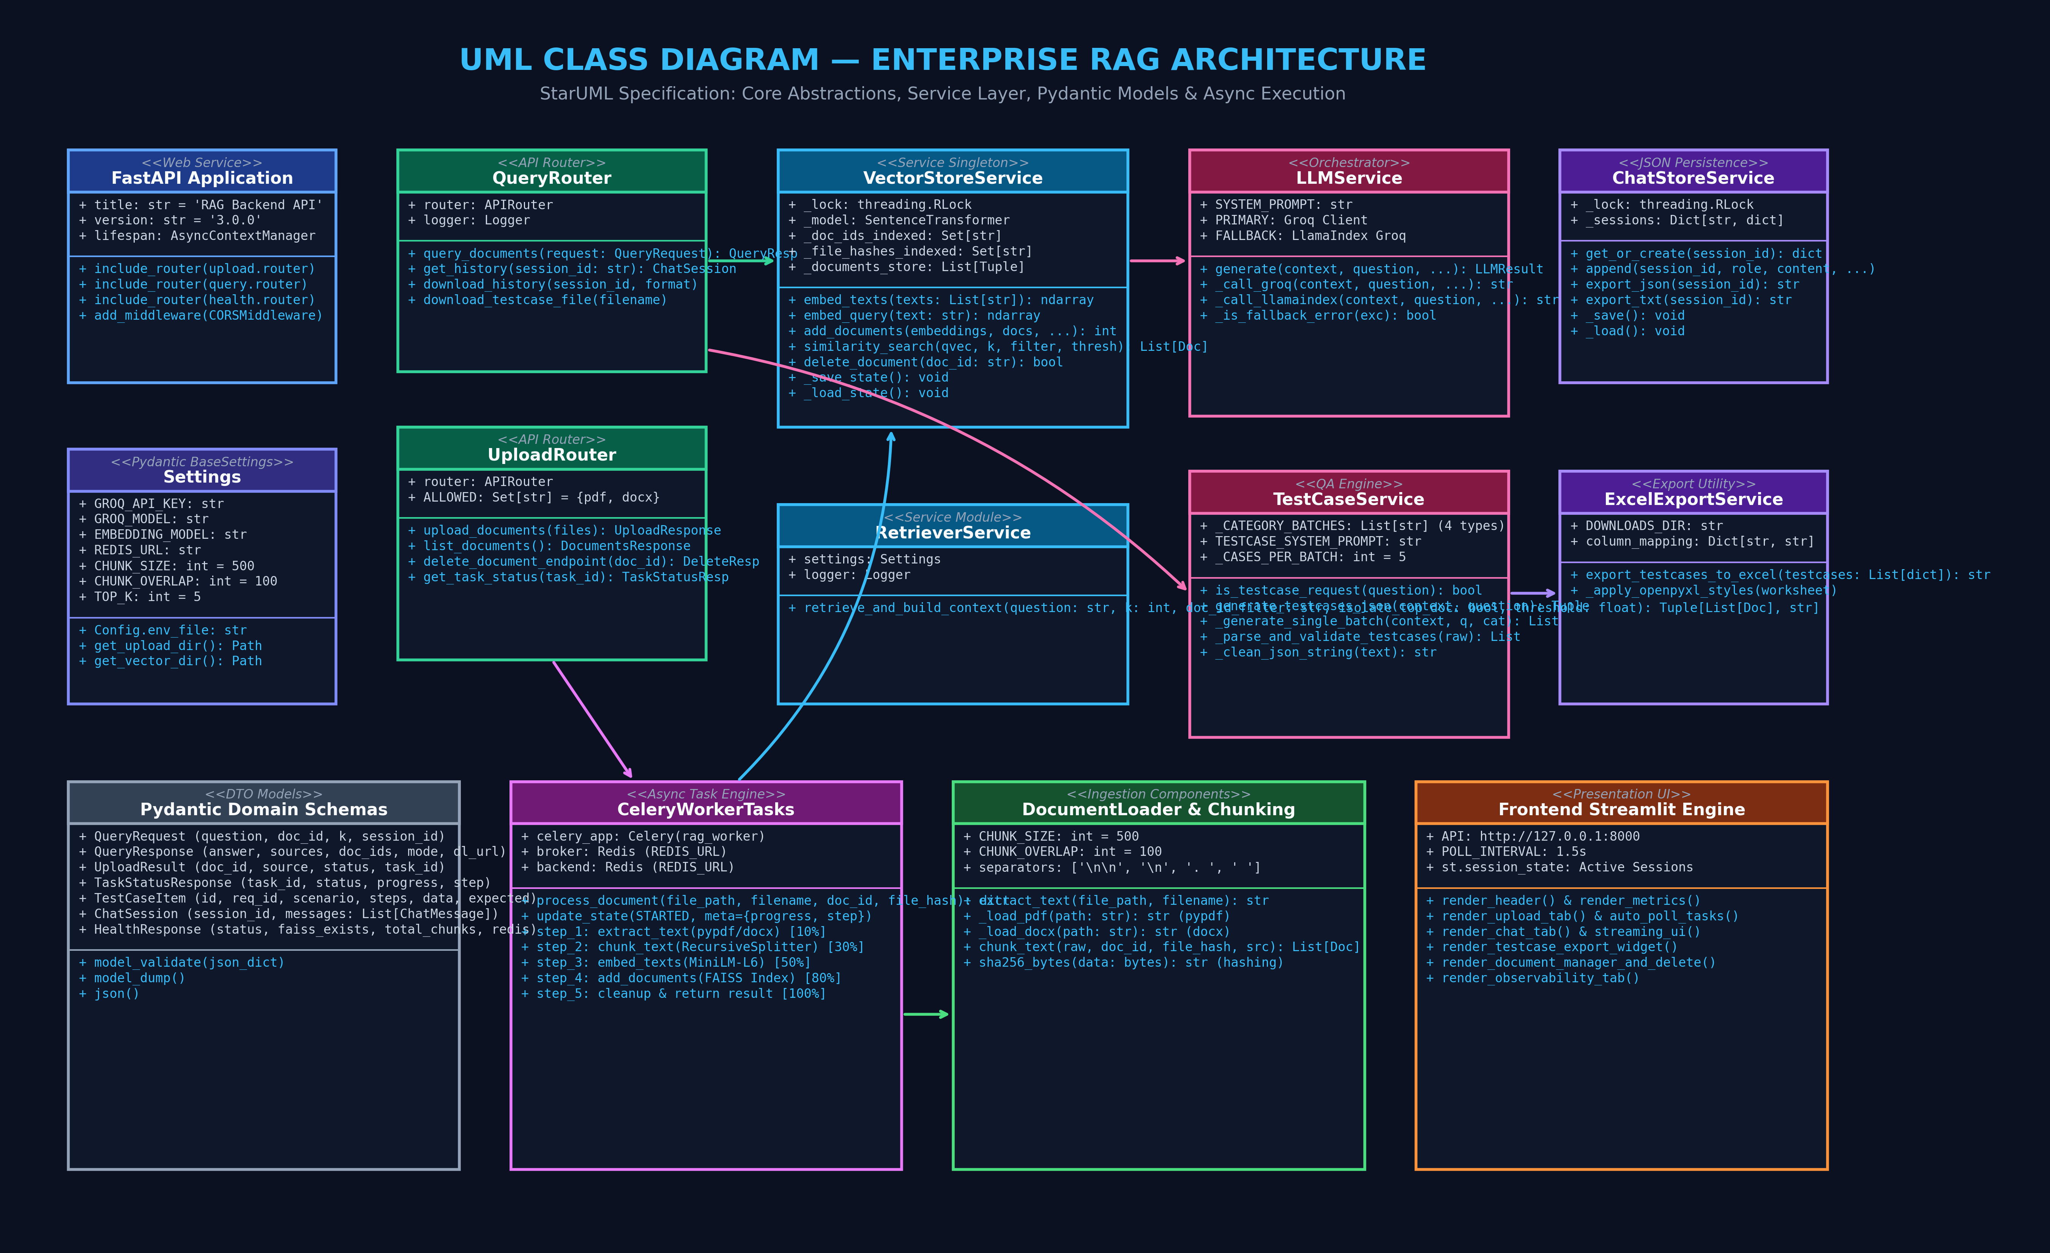
ENTERPRISE RAG SYSTEM V3
Design: UML Class Diagram (StarUML Specification)

Slide 6
ENTERPRISE RAG SYSTEM V3
Asynchronous Document Ingestion & Chunking Pipeline
1. File Intake & Hash
• Upload endpoints support PDF and DOCX files.
• SHA-256 byte digest generated immediately.
• Duplicate hash check prevents reprocessing identical files.
• Dispatches async task to Celery queue with unique doc_id.
2. Text Extraction
• pypdf extracts text across all pages with error tolerance.
• python-docx parses document paragraphs and headers.
• Reports real-time 10% progress state back to Redis.
• Handles multi-megabyte enterprise documents effortlessly.
3. Recursive Chunking
• Chunk size: 500 characters with 100 char overlap.
• Separators: [\n\n, \n, . , ' ', ''] maintain semantic coherence.
• Embeds rich metadata: source, doc_id, file_hash, chunk_id.
• Reports 30% progress step to worker status.
4. Vector Indexing
• SentenceTransformer all-MiniLM-L6-v2 produces 384-dim vectors.
• Applies L2-normalisation for fast inner-product cosine search.
• Appends to FAISS index with thread-safe RLock sync.
• Reports 80% -> 100% completion state.

Slide 7
ENTERPRISE RAG SYSTEM V3
Vector Store & Semantic Retrieval Engine
FAISS Index & Atomic Rebuild Mechanics
• L2 Normalisation: Vectors normalized to unit length; inner product FAISS search exactly equals cosine similarity.
• Persistent Storage: State serialized to index.faiss and index.pkl with atomic temporary file swapping.
• Atomic Deletion Rebuilding: FAISS lacks native row deletion; our store filters memory state and triggers an atomic index rebuild.
• Zero Downtime: API continues serving queries safely with RLock read-after-write consistency.
• Deduplication Set: Maintains in-memory set of file hashes and indexed doc_ids for O(1) query verification.
Smart Context Retrieval & Isolation
• Top-K Retrieval: Configurable chunk retrieval (default k=5) tailored for semantic precision.
• Document Isolation: Optional isolate_top_doc mode restricts context to the highest-scoring single document for QA purity.
• Similarity Thresholding: Filters out low-relevance noise with similarity_threshold=0.35 in test case workflows.
• Context Prompt Synthesis: Formats chunks with clean headers [Chunk N | source=... | doc_id=...] for LLM attribution.
• Strict Grounding: Enforces zero-hallucination policy when retrieved context is empty.

Slide 8
ENTERPRISE RAG SYSTEM V3
Multi-Batch QA Test Case Generation Engine
Multi-Batch Categorization Strategy
• Problem: Single-prompt generation hits LLM token limits and produces incomplete, shallow test suites.
• Innovation: System partitions generation into 4 dedicated, focused scenario batches:
• 1. Functional Happy Path Scenarios (Core workflows)
• 2. Negative and Error Handling Scenarios (Validation, 4xx/5xx)
• 3. Edge and Boundary Scenarios (Min/max, overflow, limits)
• 4. Security, Auth, & Concurrency Scenarios (RBAC, race conditions)
• Result: Produces 15-20 exhaustive, production-grade test cases per requirement document.
Schema Enforcement & Professional Export
• Pydantic Validation: Each test case is validated against TestCaseItem schema (ID, Req ID, Scenario, Steps, Data, Expected Result).
• JSON Self-Healing: Robust parser strips markdown fences, repairs truncated brackets, and handles malformed responses.
• Sequential ID Normalization: Auto-assigns TC_001 to TC_NNN for requirement traceability.
• OpenPyXL Styling Engine: Auto-generates branded Excel workbook (.xlsx) with bold headers, custom widths, and wrapped cells.
• Secure Download URL: Directly downloadable via REST endpoint /query/downloads/{filename}.

Slide 9
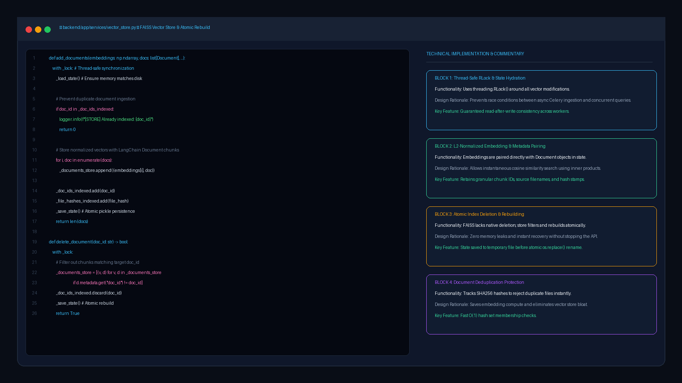
ENTERPRISE RAG SYSTEM V3
Implementation Code: Vector Store & Atomic FAISS Rebuild

Slide 10
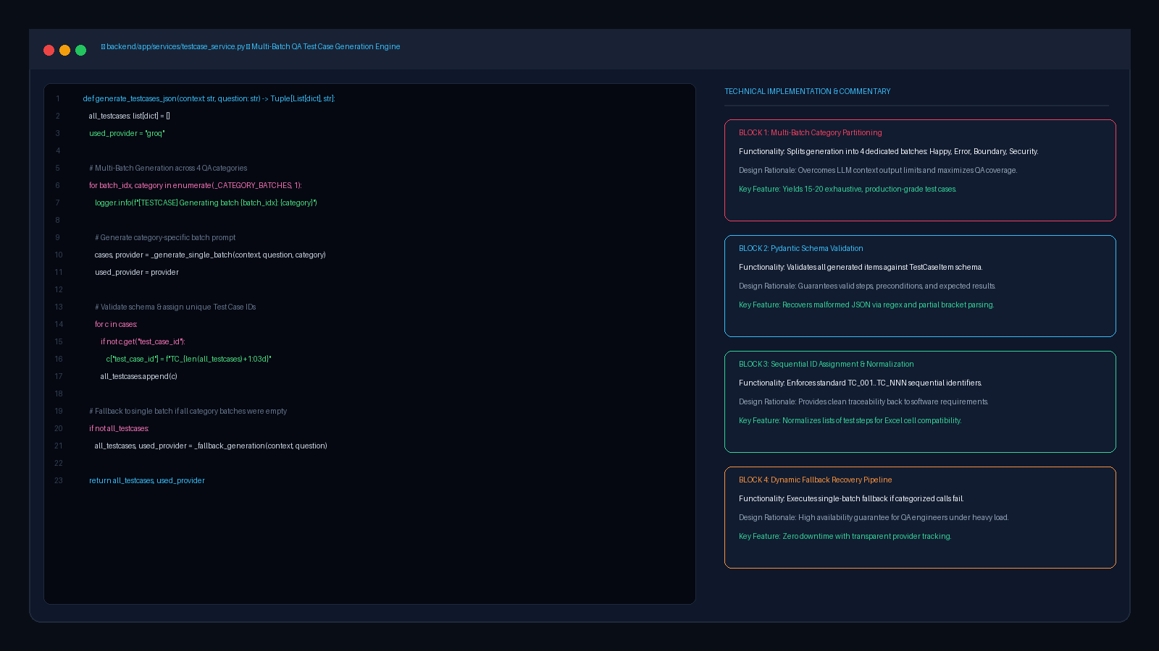
ENTERPRISE RAG SYSTEM V3
Implementation Code: Multi-Batch QA Test Case Engine

Slide 11
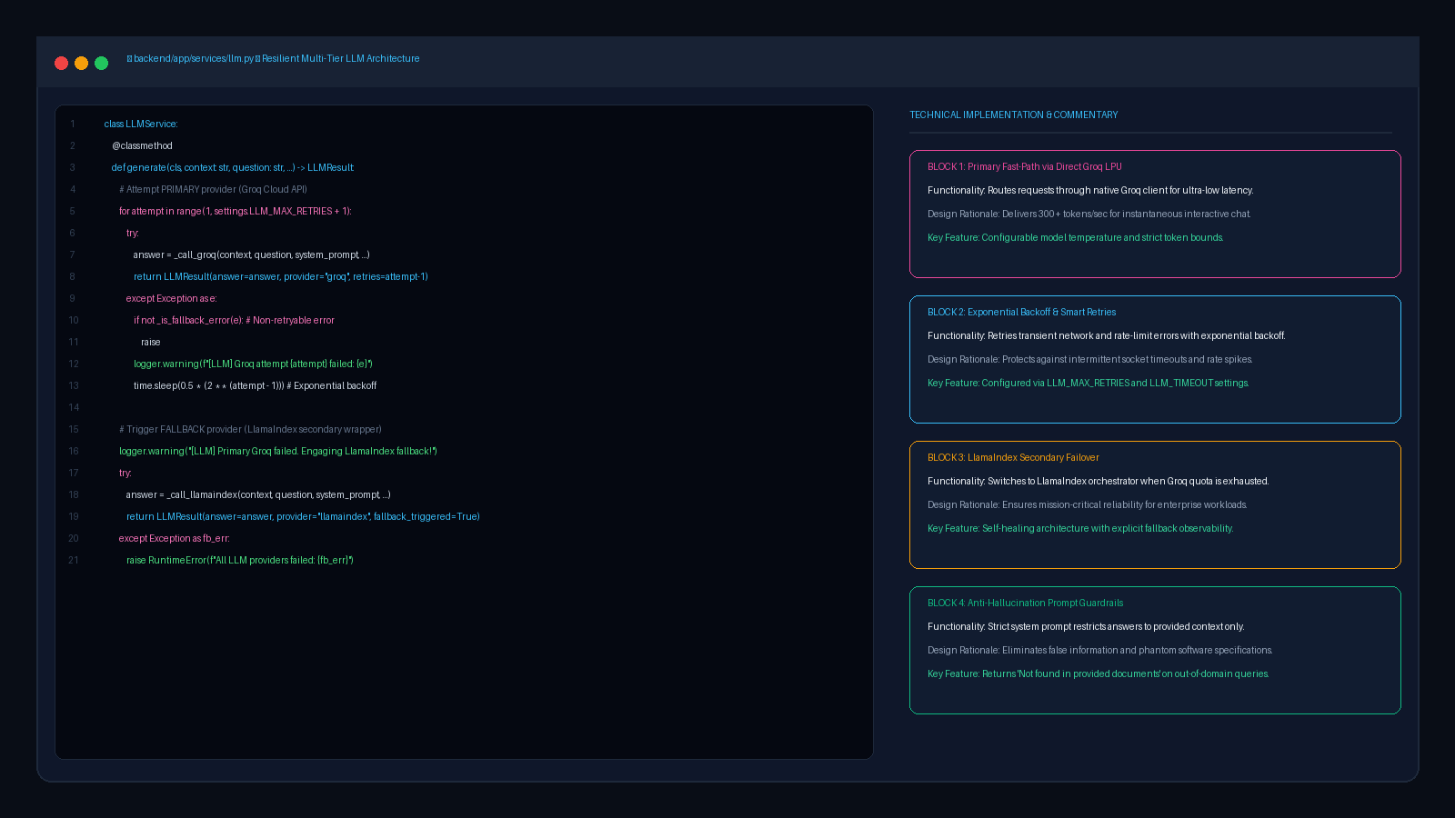
ENTERPRISE RAG SYSTEM V3
Implementation Code: Multi-Tier LLM Resilience & Fallback

Slide 12
ENTERPRISE RAG SYSTEM V3
Distributed Asynchronous Ingestion (Celery & Redis)
Celery Worker Architecture & Concurrency
• Decoupled Task Processing: Heavy extraction and embedding workloads offloaded to Celery background workers.
• Redis Broker: High-throughput message broker coordinates task queue and state distribution.
• Extended Task Metadata: Task state configured with result_extended=True and task_track_started=True.
• Automatic Fault Recovery: Tasks automatically retry up to 3 times (max_retries=3, delay=5s) on transient I/O exceptions.
• Temp File Lifecycle: Secure temporary file storage automatically cleans up after successful ingestion.
Real-Time Progress Tracking Lifecycle
• Stage 1 (10%): Text extraction started from source file.
• Stage 2 (30%): Recursive text chunking and metadata attachment.
• Stage 3 (50%): MiniLM 384-dimensional vector embedding generation.
• Stage 4 (80%): Indexing embeddings into FAISS and updating state.
• Stage 5 (100%): Ingestion complete; task status switches to SUCCESS.
• Frontend Auto-Polling: Streamlit poller queries GET /upload/status/{task_id} every 1.5s to render smooth UI progress bars.

Slide 13
ENTERPRISE RAG SYSTEM V3
Frontend Architecture & Interactive User Experience
Document Management Tab
• Multi-file drag-and-drop uploader supporting PDF & DOCX.
• Real-time task monitor with dynamic progress bars and step badges.
• Indexed documents inventory with chunk counts.
• One-click document deletion with confirmation dialog and index rebuild.
Interactive Chat & QA Tab
• Conversational AI interface with chat session history.
• Document filter dropdown to scope queries to single documents.
• Source attribution cards displaying source filenames and chunk citations.
• 1-Click 'Generate Test Cases' button triggering automated QA pipeline.
Export & Observability Tab
• Direct download widget for generated Excel test cases (.xlsx).
• Chat transcript export in both structured JSON and formatted TXT.
• Live system observability: Redis connection, FAISS status, active LLM.
• Dark-mode enterprise design system with custom CSS tokens.

Slide 14
ENTERPRISE RAG SYSTEM V3
System Observability, Diagnostics & Health Checks
Automated Health Check Diagnostics
• GET /health Endpoint: Performs real-time multi-component inspection.
• Redis Broker Ping: Checks Redis latency and socket connectivity (socket_timeout=2s).
• FAISS Index Verification: Verifies existence and chunk count in vector store.
• LLM Provider Probe: Confirms Groq API keys and checks LlamaIndex fallback availability.
• Health Status Logic: Returns 'healthy' if Redis and vector store are operational, otherwise 'degraded'.
Comprehensive Logging & Traceability
• Centralized Logger: Structured format (timestamp | level | module | message).
• Dual Stream Output: Logs simultaneously to console (INFO) and logs/rag_system.log (DEBUG).
• Session Persistence: Thread-safe JSON chat store (sessions.json) with RLock.
• Detailed Query Metrics: Logs LLM provider, latency (ms), retries, and fallback activation.
• Error Transparency: Clear HTTP status codes (400, 404, 500) with detailed error envelopes.

Slide 15
ENTERPRISE RAG SYSTEM V3
Summary of Technical Achievements & Future Roadmap
Key Technical Accomplishments
• Enterprise QA Automation: Multi-batch scenario engine generates complete, styled test suites from raw requirements in seconds.
• Zero-Blocking Architecture: Async Celery/Redis pipeline prevents UI freezes during heavy document ingestion.
• Mission-Critical Resilience: Multi-tier LLM architecture with Groq LPU primary and LlamaIndex fallback.
• Thread-Safe Vector Engine: Persistent FAISS storage with atomic deletion rebuilds and SHA256 deduplication.
• StarUML Standardized Design: Complete Use Case and Class diagrams matching industry UML specifications.
Future Roadmap & Enhancements
• Hybrid Search with BM25: Combine dense vector embeddings with sparse keyword search (BM25) for enhanced precision.
• Cross-Encoder Re-Ranking: Add a re-ranking stage (e.g., Cohere or BGE-Reranker) before prompt synthesis.
• Jira & Azure DevOps Integration: Directly publish generated test cases into enterprise QA management systems.
• Multi-Modal Document Parsing: Support OCR for scanned diagrams, architectural blueprints, and flowcharts.
• Distributed Vector Cluster: Scale from local FAISS index to distributed Milvus/Qdrant clusters for multi-tenant SaaS.

