Slide 1
IIOT Project
Monday,
11th Dec 2017

Slide 2
Members from RBCCPS
Prof. Rajesh Sundaresan
Prof. Bharadwaj Amruthur
Staffs-
Ashish Joglekar
Sridhar S
Neha Karanjkar
Venkatesh Prabhu
Sampad B Mohanty

Slide 3
Members from RBCCPS
1. Power Meters
2. Vibration Sensors
3. Proximity Sensors
4. Temperature Sensors

Slide 4
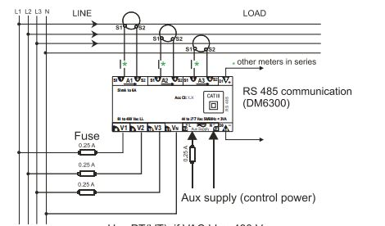
Power Meter

Slide 5
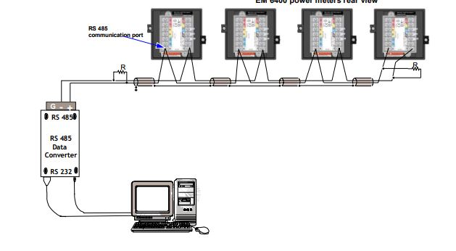
Data Acquisition over MODBUS

Slide 6
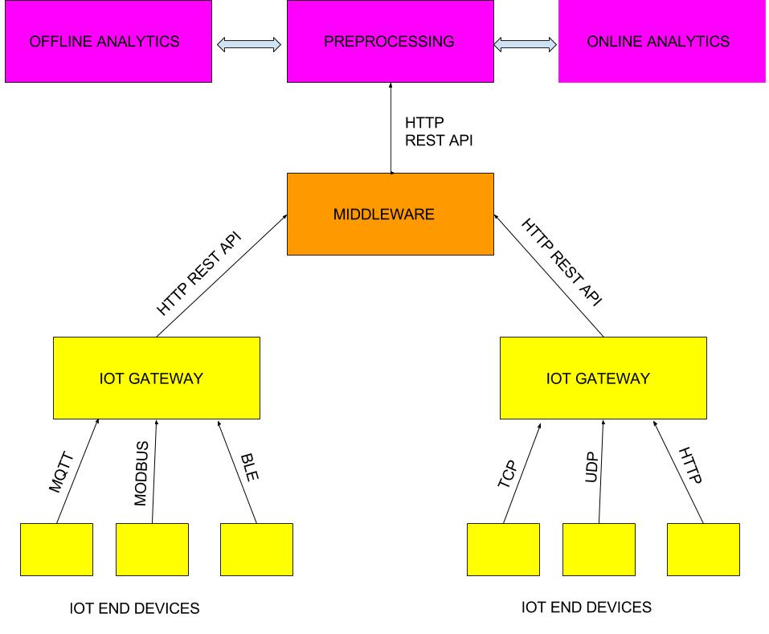
Middleware Integration Overview

Slide 7
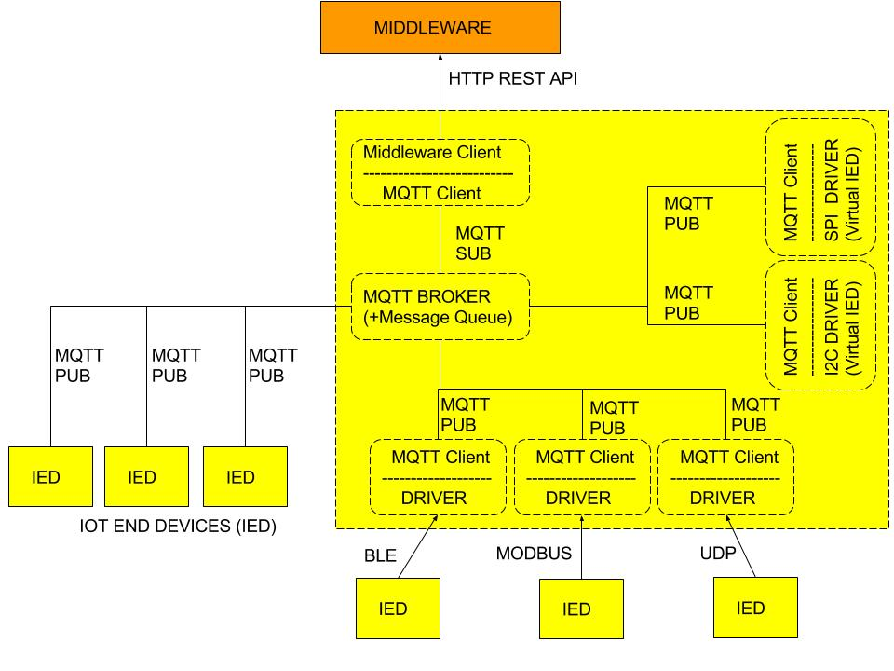
Gateway Details

Slide 8
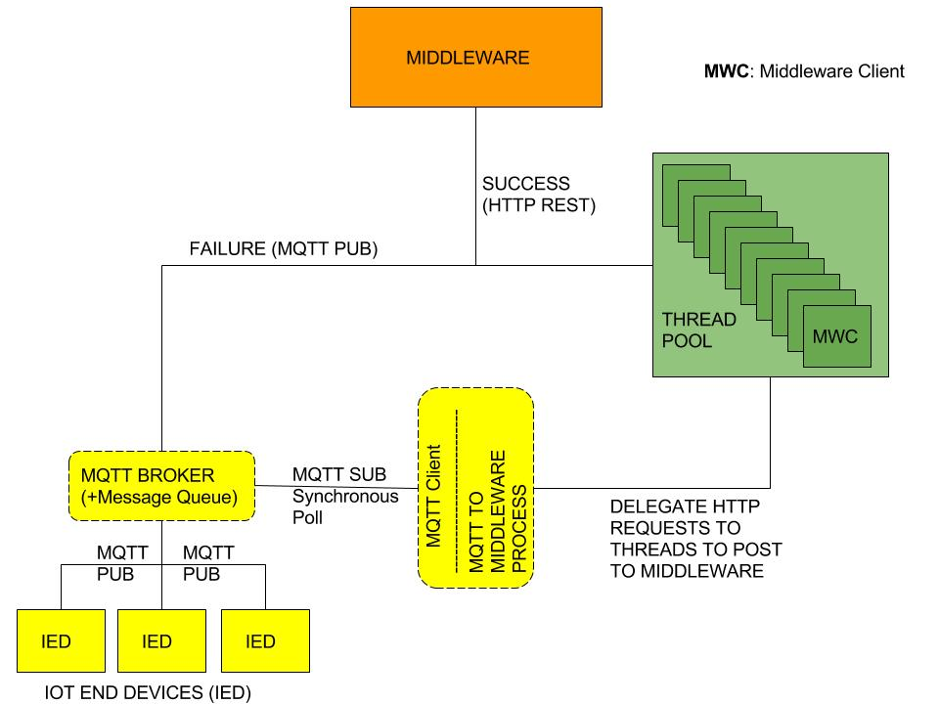
Gateway Internals

Slide 9
Middleware Components
Pushpin
Kong API Management
RabbitMQ
Elasticsearch,Logstash,Kibana
Catalogue + MongoDB
LDAP – Authentication,Authorization,Accounting

