Slide 1


Handwritten Arabic text recognition

Slide 2

Outline
Problem Statement
Related Work
Final Model Architecture
Results
Team Member Contribution
Live Demo
Conclusion
Proposed Model Architecture
Future work

Slide 3


Problem Statement

Slide 4
Problem statement
Recognize and extract Arabic handwritten text lines form images
A challenging problem !
More complex compared to handwritten Latin text recognition
Cursive script and joined writing
Same character variations
Large number of words and variations in font style

Slide 5

Related work

Slide 6
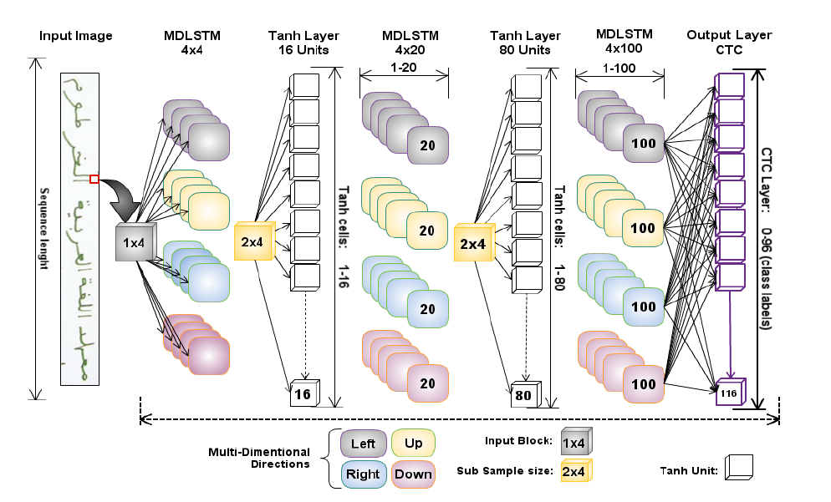
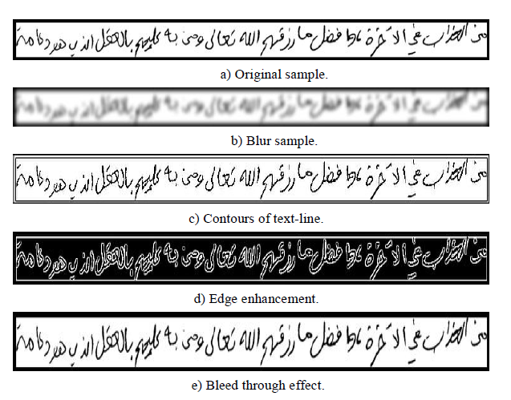
2 papers on khatt dataset (selected dataset)
Recognition rate was 75.8% , after applying data augmentation techniques increased to 80.02%

Slide 7
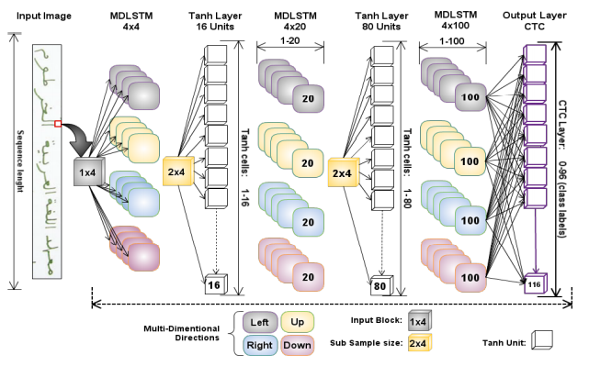
original model architecture of literature

Slide 8
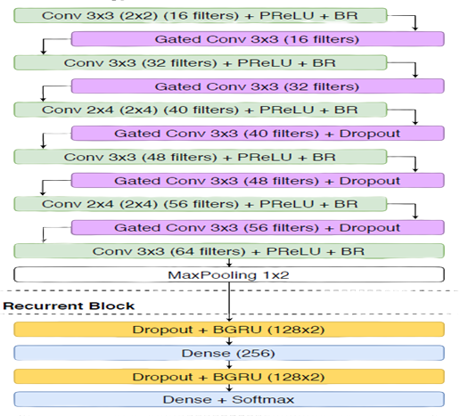
Original & Proposed model architecture

Slide 9
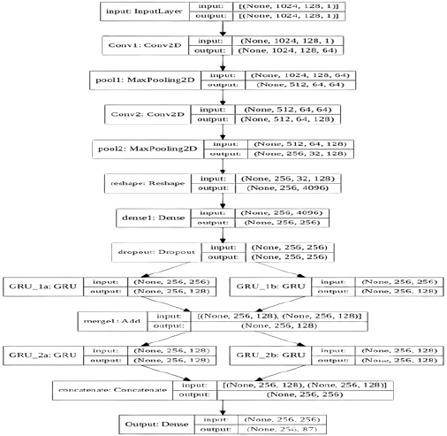
Final model architecture

Slide 10

result

Slide 11
Previous work
Preprocess khatt dataset.
Filter khatt dataset.
Applying proposed and final models on khatt dataset.

Slide 12
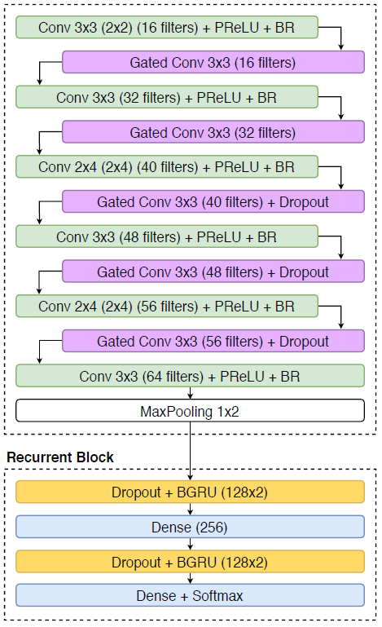
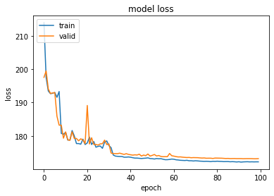
(Proposed model)
Valid loss
173.15
Train loss
172.22
CER
100%
WER
100%

Slide 13
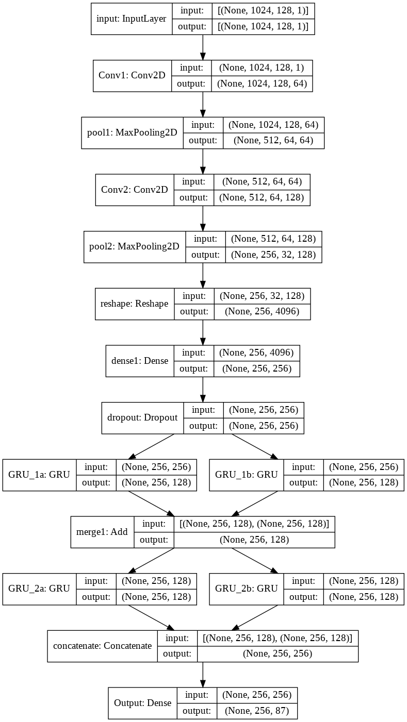
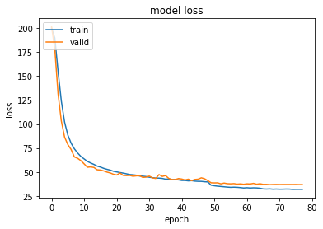
(final model)
Valid loss
36.74
Train loss
32.3
CER
18.93%
WER
59.81%

Slide 14
New work
Tune hyperparameters.
use attention mechanism.
Change in final model architecture.

Slide 15
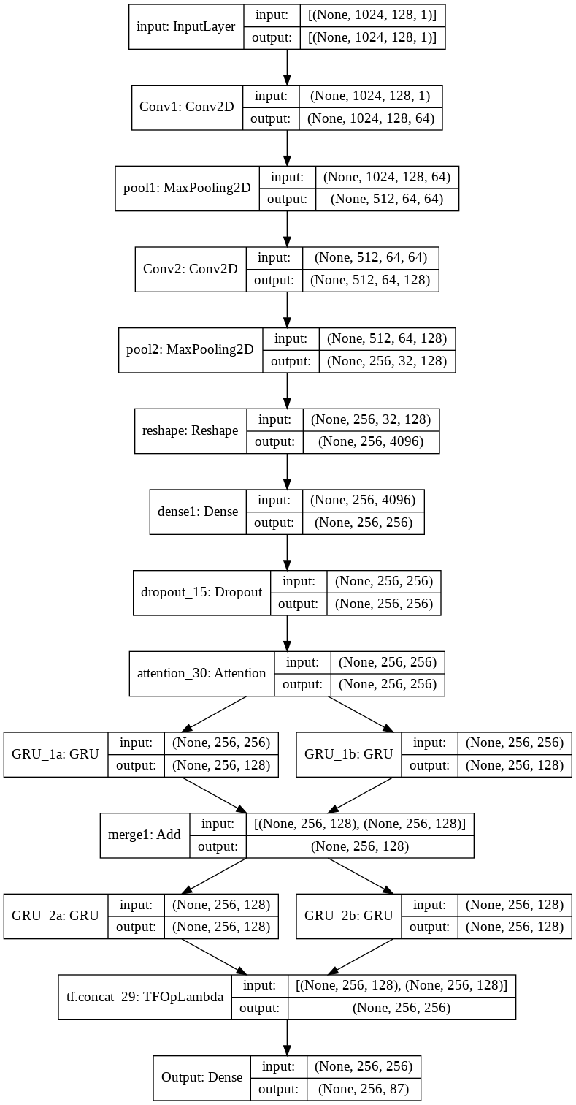
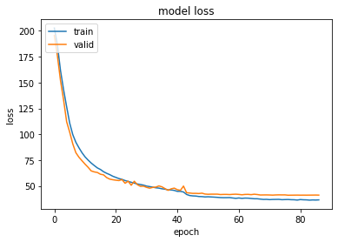
Model 1
- Add Attention Layer
Valid loss
41
Train loss
36.88
CER
20.96%
WER
64.74%

Slide 16
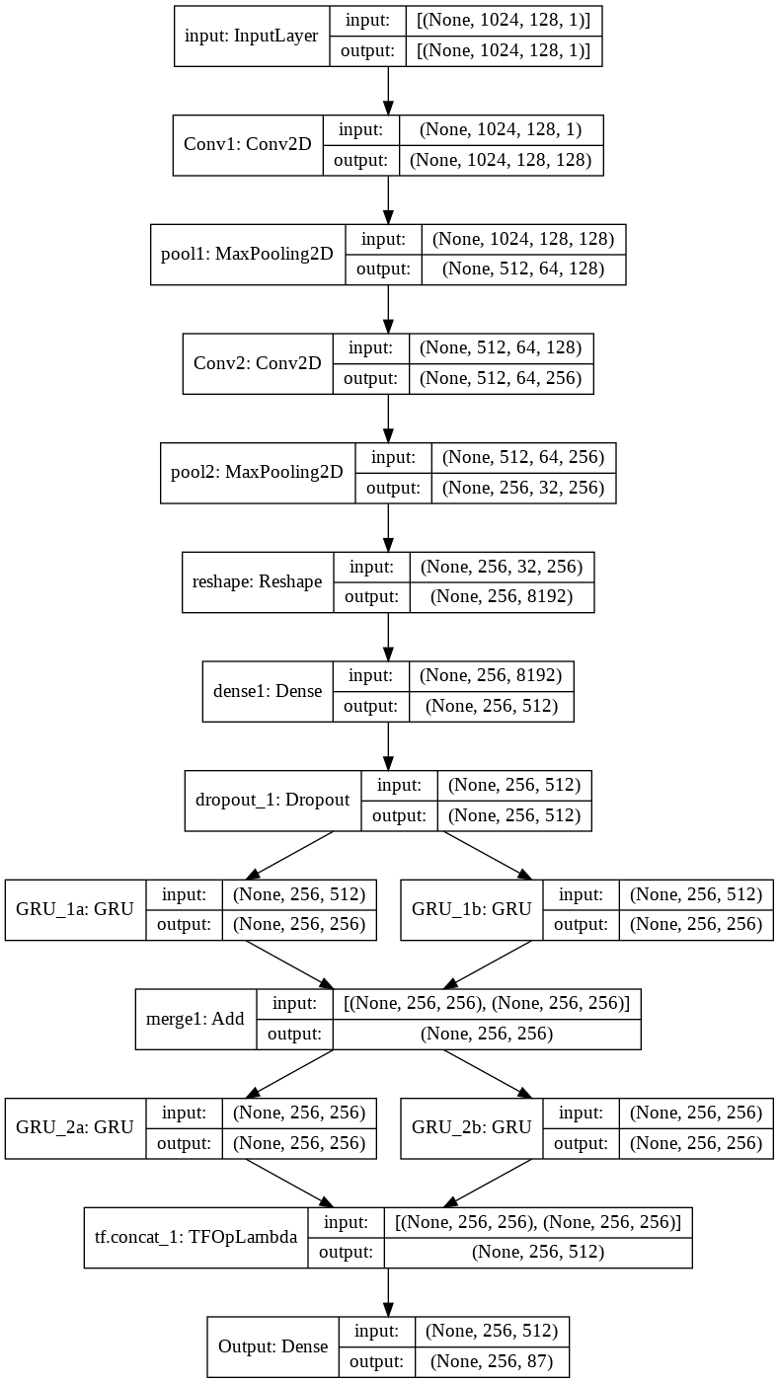
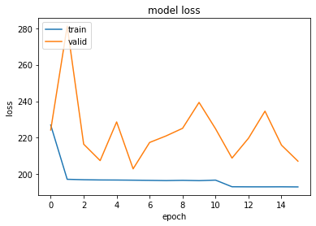
Model 2
- Increased #filters and #units
Valid loss
203
Train loss
196.77
CER
96.07%
WER
99.91%

Slide 17
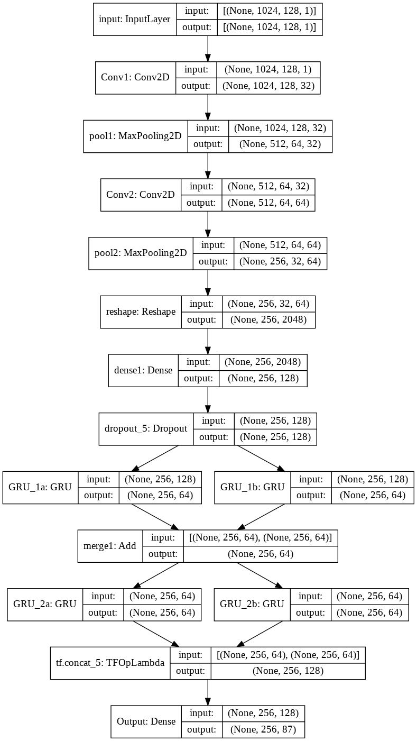
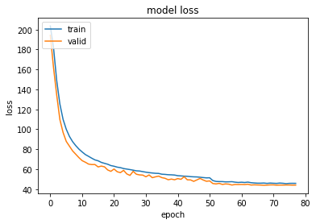
Model 3
- Decreased #filters and #units
Valid loss
43.86
Train loss
46.08
CER
21.93%
WER
66.96%

Slide 18
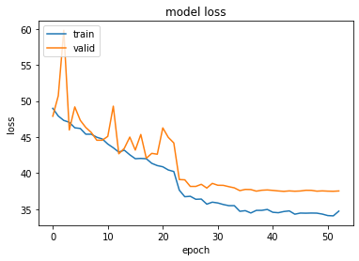
Model 4
- Increase batch size
Valid loss
37.47
Train loss
34.67
CER
19.04%
WER
61.14%

Slide 19
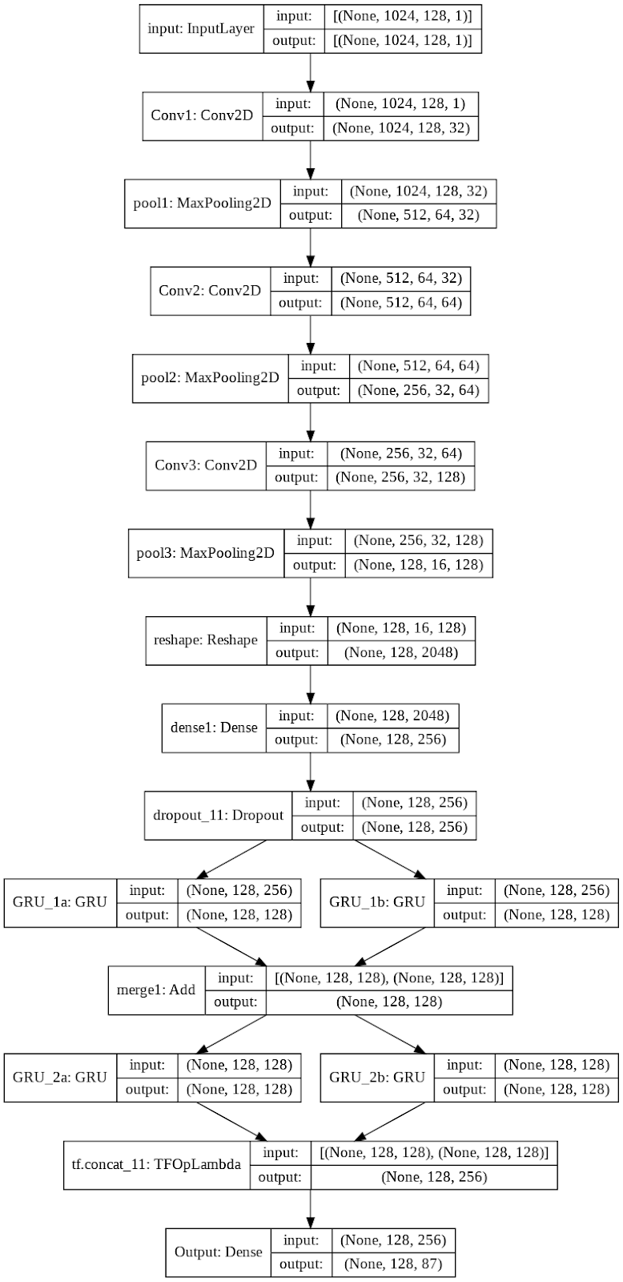
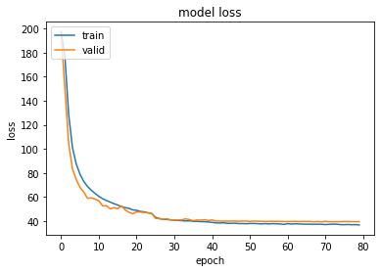
Model 5
- Add CNN Layer
Valid loss
39.27
Train loss
37.23
CER
19.40%
WER
61.09%

Slide 20
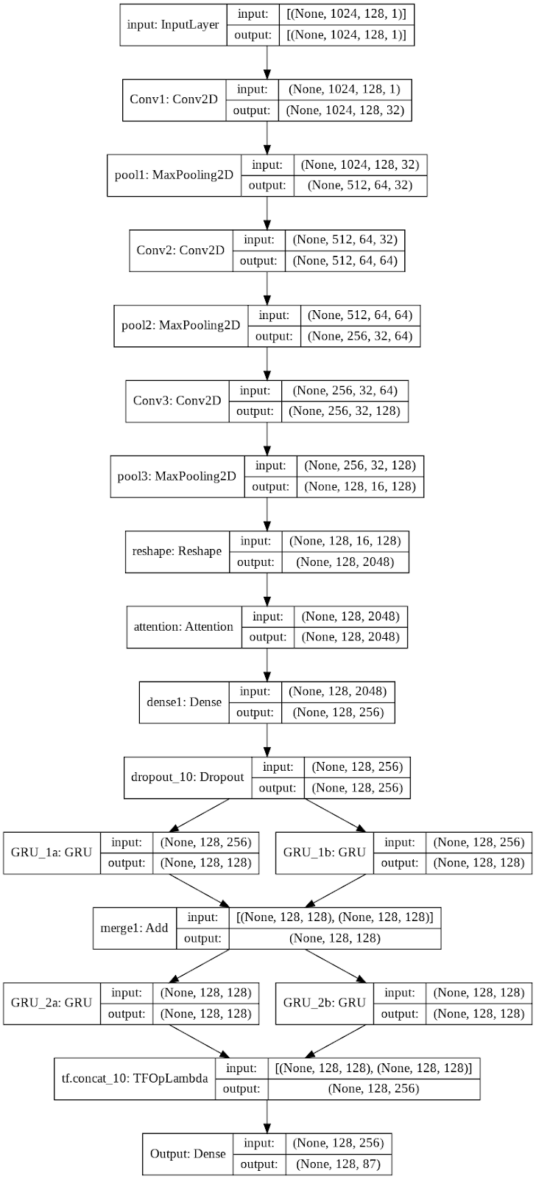
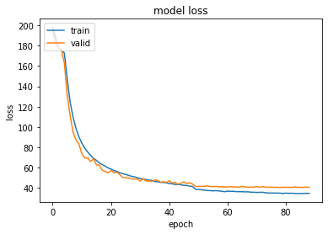
Model 6
- Add CNN Layer + Attention Layer
Valid loss
40.53
Train loss
35.01
CER
19.71%
WER
61.33%

Slide 21
Result Cont.
Model | Train loss | Valid loss | CER | WER
Proposed | 172.22 | 173.15 | 100 | 100
1 | 36.88 | 41 | 20.96 | 64.74
2 | 196.77 | 203 | 96.07 | 99.91
3 | 46.08 | 43.86 | 21.93 | 66.96
4 | 34.67 | 37.47 | 19.04 | 61.14
5 | 37.23 | 39.27 | 19.4 | 61.09
6 | 35.01 | 40.53 | 19.71 | 61.33
Final | 32.3 | 36.74 | 18.93 | 59.81

Slide 22
Result cont.

Slide 23

Conclusion

Slide 24


Data Augmentation increases result.
75.8% → 80.02%
Tune hyperparameters may lead to underfitting or get more better result .
The proposed model doesn’t give better result as excepted.
Less deep model may lead to better result than deeper.
Our final result:
CER → 18.93%
Recognition Rate → 81.07%

Slide 25
Future work

Slide 26
Increase dataset by mixing found datasets.
Tune more hyperparameters.
Try to change input to model to be a paragraph not a line.

Slide 27

Team member contribution

Slide 28
Merna El-Refaie (57)
Preprocess KHATT Dataset.
Train Proposed Model.
Neveen S.Nagy (61)
Filter KHATT Dataset.
Use attention mechanism.
Change in final model architecture.
Train Final Model.
We Both
Build and implement Proposed Model.
Search for other models to get best result.
Tune Hyperparameters.

Slide 29

Thank you

Slide 30

Live demo

