Slide 1
Proverbs
Nositelj: Dr. sc. Moira Kostić-Bobanović

Slide 2

Well known phrases or sentences that give advice or say something that is generally true
Metaphorical
Can be a maxim or an aphorism
Paremiology - study of proverbs

Slide 3
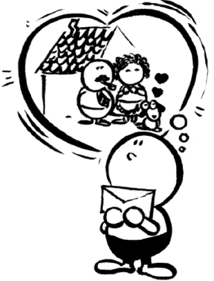
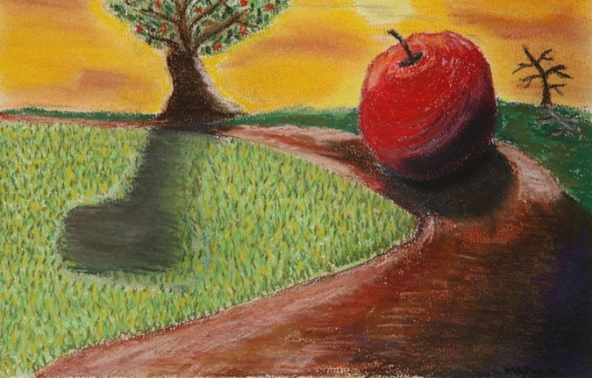
Absence makes the heart grow fonder
Used to say that when you are away from
somebody that you love, you love them
even more
The apple doesn’t fall/never falls far from the tree
A child usually behaves in a similar way to his/her parent(s)

Slide 4

If you can’t beat them, join them
If you can’t defeat somebody or be as successful as they are, then it is more sensible to join them in what they are doing and perhaps get some advantage for yourself by doing so
Beauty is in the eye of the beholder
People all have different ideas about
what is beautiful

Slide 5

You’ve made your bed and now you must lie in/on it
You must accept the results of your actions
Blood is thicker than water
Family relationships are stronger
than any others

Slide 6
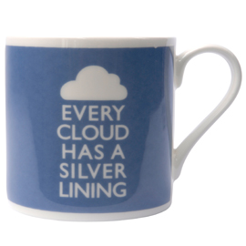
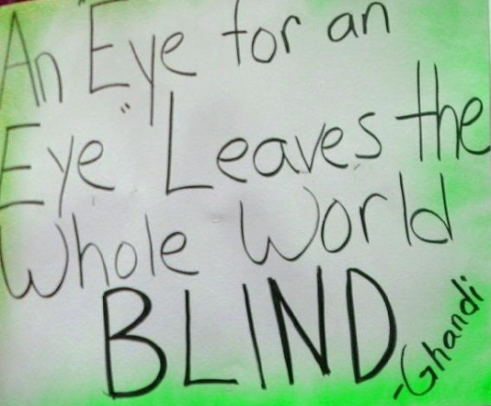
Every cloud has a silver lining
Every sad or difficult situation has
a positive side
An eye for an eye (a tooth for a tooth)
Used to say that you should punish sb by doing to them what they have done to you or to sb else

Slide 7
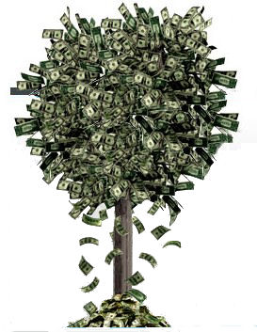
What goes around comes around
The way sb behaves towards other people will affect the way those people behave towards them in the future
Money doesn’t grow on trees
Used to tell sb not to use sth or spend
money carelessly because you do not
have a lot of it

Slide 8
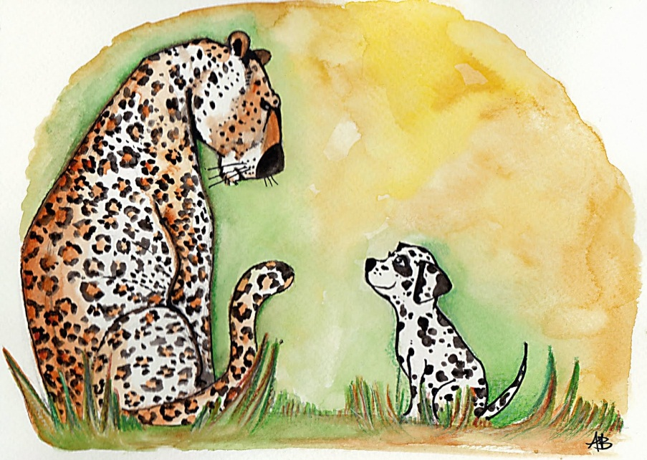
A leopard cannot change its spots
People cannot change their character, especially if they have a bad one
A penny for your thoughts
Used to ask sb what they are
thinking about

Slide 9

Better safe than sorry
Used to say that it is wiser to be too careful than to act too quickly and do sth you may later wish you had not
One step forward, two steps back
Used to say that every time you make
progress, sth bad happens that means
that the situation is worse than before

Slide 10
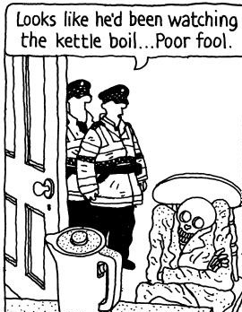
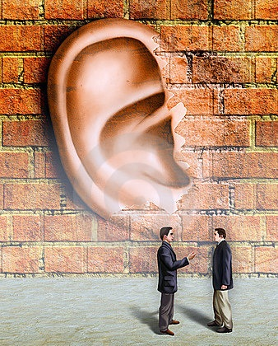
A watched pot never boils
Used to say that when you are
impatient for sth to happen,
time seems to pass very slowly
Walls have ear
Used to warn people to be
careful what they say because
other people may be listening

Slide 11
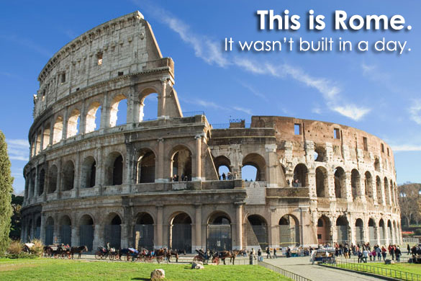
Easier said than done
To be much more difficult to do than to talk about
Rome wasn’t built in a day
Used to say that a complicated
task will take a long time and
needs patience

Slide 12

A friend in need is a friend indeed
A friend who gives you help when you need it is a true friend
Time is money
Time is valuable,
and should not be wasted

Slide 13
People say this when there is no choice and somebody must be satisfied with what is available
People of the same sort (are found together)
Used to say that somebody is very stupid
Bad or unfair methods of doing something are acceptable if the result of that action is good or positive

Slide 14
Exercise
People say this when there is no choice and somebody must be satisfied with what is available
Beggars can’t be choosers
People of the same sort (are found together)
Birds of a feather (flock together)
Used to say that somebody is very stupid
There’s one born every minute
Bad or unfair methods of doing something are acceptable if the result of that action is good or positive
The end justifies the means

Slide 15
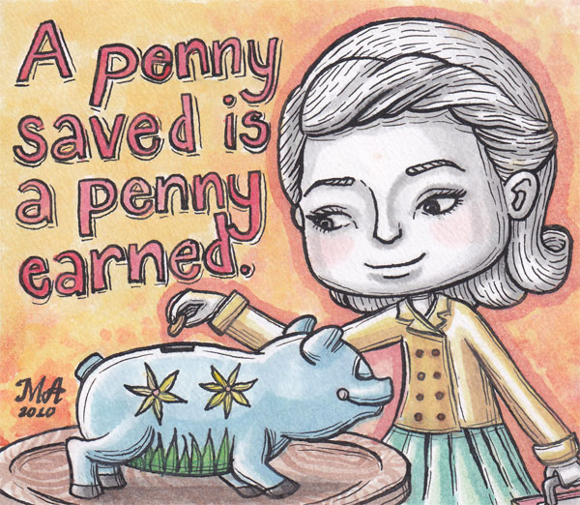
THANK YOU!!

