Slide 1
23CSE301 • CAPSTONE PROJECT • REVIEW 2
OPERATIONAL TELEMETRY
AI-Based Industrial
Machine Health & Failure Prediction
Classification benchmarking / Unsupervised operating-regime discovery
AI4I 2020 Predictive Maintenance Dataset
RECORDS
CLASSIFIERS
CLUSTERERS
10,000
10
2
M Anish Reddy • Maneesh Janjam • Tarun Manikanta
From failure classification to
label-free operating groups
Academic Year 2026–27
23CSE301 / MACHINE LEARNING CAPSTONE / AY 2026–27
REVIEW 2
01

Slide 2
ASSESSMENT MAP
What Review 2 is assessing
The deck follows the Review 2 rubric: algorithms, evaluation, integration, and the live explanation.
06 MARKS
08 MARKS
03 MARKS
08 MARKS
Classification — Part B
Clustering
Pipeline quality
Presentation & viva
Five additional classifiers, one consolidated 10-model table, and a justified tuned model.
K-Means + Agglomerative, three validation metrics, Elbow, dendrograms, PCA and t-SNE.
Clean notebooks, modular utilities, README, environment file and meaningful commits.
Problem → data → method → results → conclusion; all members can explain trade-offs.
Reminder: the rubric rewards a clear explanation of the actual work—not a list of algorithms without evidence.
23CSE301 / MACHINE LEARNING CAPSTONE / AY 2026–27
REVIEW 2
02

Slide 3
PROBLEM FRAMING
Two questions, one maintenance dataset
Supervised prediction and unsupervised grouping are related, but they answer different questions.
01 / CLASSIFICATION
02 / CLUSTERING
Can we flag machine failure?
What operating regimes appear?
Target: Machine failure (0 = normal, 1 = failure). The dataset is strongly imbalanced: about 96.61% normal records and 3.39% failures.
Group similar operational observations without using the failure label during model fitting. The label is reserved for post-hoc interpretation.
10,000
14
2,000
68
rows
columns
held-out test rows
failure events in test set
Source dataset: AI4I 2020 Predictive Maintenance • Classification target: Machine failure
23CSE301 / MACHINE LEARNING CAPSTONE / AY 2026–27
REVIEW 2
03

Slide 4
METHODS
The pipeline at a glance
A consistent split and train-fitted preprocessing keep the classifier comparison fair.
01
02
03
04
05
06
Load & audit
Prepare features
Split & transform
Train models
Evaluate
Explore groups
AI4I 2020
10k × 14
Drop IDs and
leakage flags
Stratified 80:20
random_state=42
10 classifiers
+ tuning
Metrics, ROC,
confusion matrices
K-Means +
Agglomerative
Leakage guardrails • Exclude UDI, Product ID and failure-subtype flags from X; fit preprocessing on training data only; keep clustering labels out of model fitting.
23CSE301 / MACHINE LEARNING CAPSTONE / AY 2026–27
REVIEW 2
04

Slide 5
CLASSIFICATION
Review 2 classification: five additional models
Part A models from Review 1 remain in the final consolidated comparison.
PART A / REVIEW 1
PART B / REVIEW 2
Logistic Regression
Random Forest
K-Nearest Neighbors
AdaBoost
Gaussian Naive Bayes
Gradient Boosting
Decision Tree
Bagging (Decision Tree base)
Support Vector Machine (SVC)
MLP Neural Network
Benchmark rule: evaluate all models on the same held-out split and report Accuracy, Precision, Recall, weighted F1, confusion matrix and ROC-AUC.
23CSE301 / MACHINE LEARNING CAPSTONE / AY 2026–27
REVIEW 2
05

Slide 6
CLASSIFICATION RESULTS
Consolidated comparison: all 10 classifiers
Held-out test set: 2,000 rows. Values transcribed from the current classification notebook output.
Model | Part | Accuracy | Precision (weighted) | Recall (weighted) | F1 (weighted) | ROC-AUC
Bagging (Decision Tree) | B | 0.9920 | 0.9918 | 0.9920 | 0.9917 | 0.9640
Gradient Boosting | B | 0.9910 | 0.9907 | 0.9910 | 0.9906 | 0.9756
Random Forest | B | 0.9905 | 0.9903 | 0.9905 | 0.9899 | 0.9754
Decision Tree | A | 0.9880 | 0.9876 | 0.9880 | 0.9871 | 0.9552
MLP Neural Network | B | 0.9850 | 0.9841 | 0.9850 | 0.9843 | 0.9773
K-Nearest Neighbors | A | 0.9765 | 0.9742 | 0.9765 | 0.9719 | 0.8799
Support Vector Machine | A | 0.9750 | 0.9728 | 0.9750 | 0.9692 | 0.9709
Logistic Regression | A | 0.9675 | 0.9581 | 0.9675 | 0.9591 | 0.9274
Gaussian Naive Bayes | A | 0.9545 | 0.9585 | 0.9545 | 0.9564 | 0.9060
AdaBoost | B | 0.9660 | 0.9332 | 0.9660 | 0.9493 | 0.9560
Part A = Review 1 • Part B = Review 2 • Weighted recall equals accuracy for this single-label classification task.
23CSE301 / MACHINE LEARNING CAPSTONE / AY 2026–27
REVIEW 2
06

Slide 7
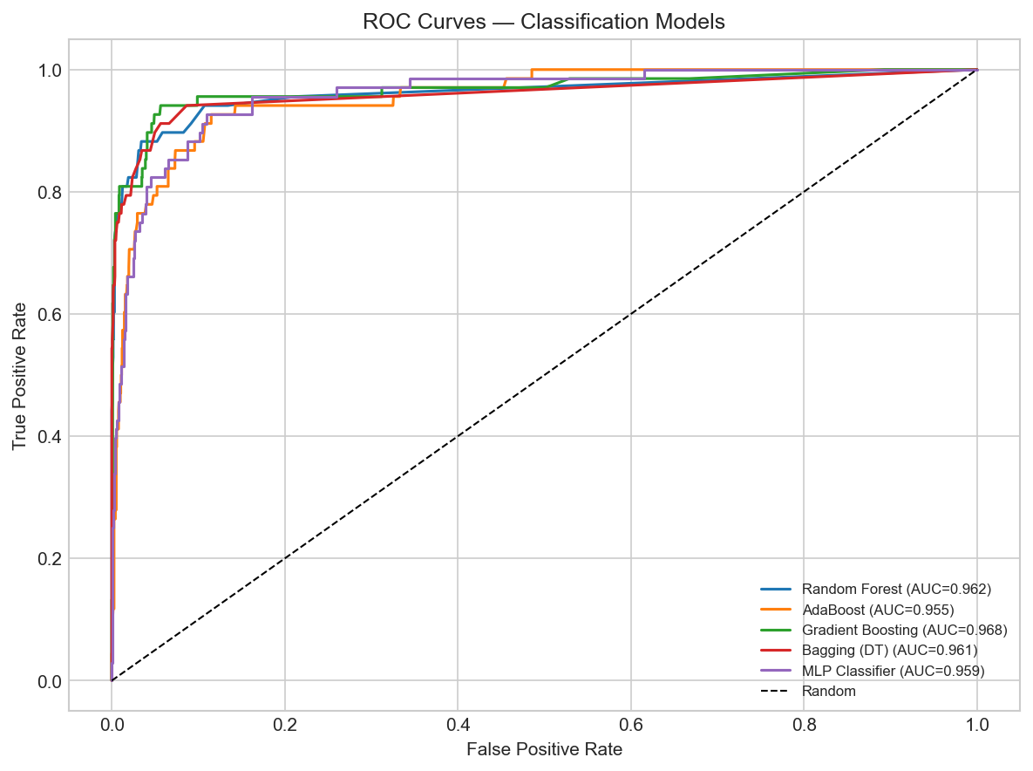
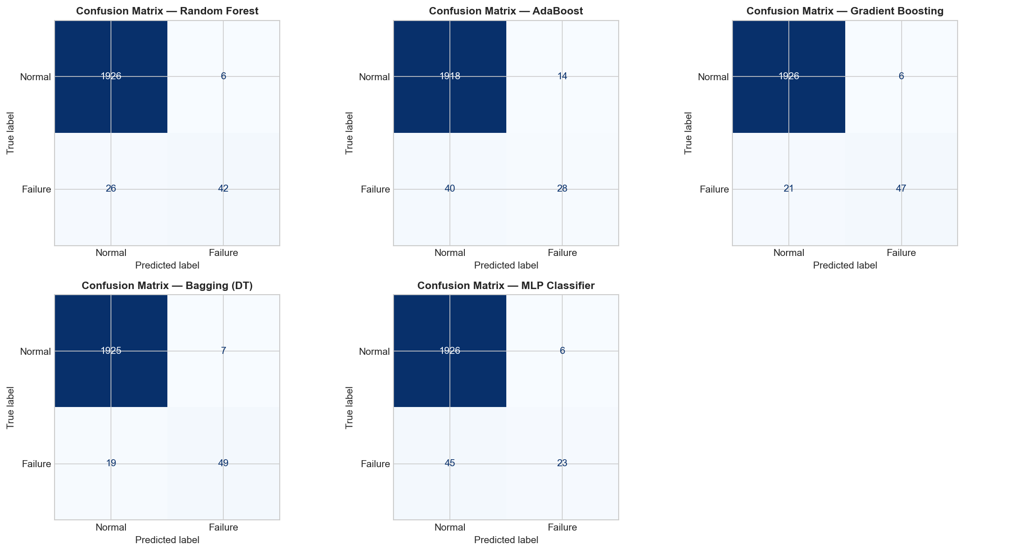
CLASSIFICATION EVALUATION
Read the minority class separately
Overall accuracy is high partly because normal operation dominates the dataset.
68
failure events in test set
80.88%
Bagging failure recall
0.9773
MLP ROC-AUC
When presenting: point to false negatives in the confusion matrices and explain what an AUC threshold curve does—and does not—tell us.
23CSE301 / MACHINE LEARNING CAPSTONE / AY 2026–27
REVIEW 2
07

Slide 8
CLASSIFICATION EVALUATION
Tuning and cross-validation
Current notebook outputs show leakage-safe 5-fold stratified CV and GridSearchCV for Gradient Boosting.
GRID SEARCH
SELECTED SETTINGS
CV SCORE
Gradient Boosting
100 / 0.05 / depth 4
0.9894 weighted F1
Search: n_estimators [100, 150]; learning_rate [0.05, 0.1]; max_depth [3, 4]; subsample [1.0].
Best parameters from current notebook: 100 estimators, learning rate 0.05, max depth 4, subsample 1.0.
Best cross-validation weighted F1 reported by GridSearchCV.
Configuration | Accuracy | Weighted F1 | ROC-AUC | Failure recall
Baseline Gradient Boosting | 0.9910 | 0.9906 | 0.9756 | 0.7794
Tuned Gradient Boosting | 0.9925 | 0.9922 | 0.9777 | 0.8088
Also reported by 5-fold CV: Gradient Boosting mean F1 = 0.9890 (±0.0022); Random Forest mean F1 = 0.9868 (±0.0028).
23CSE301 / MACHINE LEARNING CAPSTONE / AY 2026–27
REVIEW 2
08

Slide 9
CLUSTERING
Clustering: fit without failure labels
The two required algorithms create labels from operational features—not from known failure outcomes.
CENTROID-BASED
HIERARCHICAL
K-Means
Agglomerative clustering
Candidates k = 2…10; compare inertia and internal validity metrics. Selected configuration in the current benchmark: k = 3, k-means++, 10 initializations.
Bottom-up merges; Ward, Complete and Average linkage dendrograms are compared. The consolidated benchmark reports k = 3 with Ward linkage.
INPUT FEATURES
Air temperature • Process temperature • Rotational speed • Torque • Tool wear
Ground-truth failure labels are reserved for post-hoc interpretation/validation; they are excluded during clustering fit.
23CSE301 / MACHINE LEARNING CAPSTONE / AY 2026–27
REVIEW 2
09

Slide 10
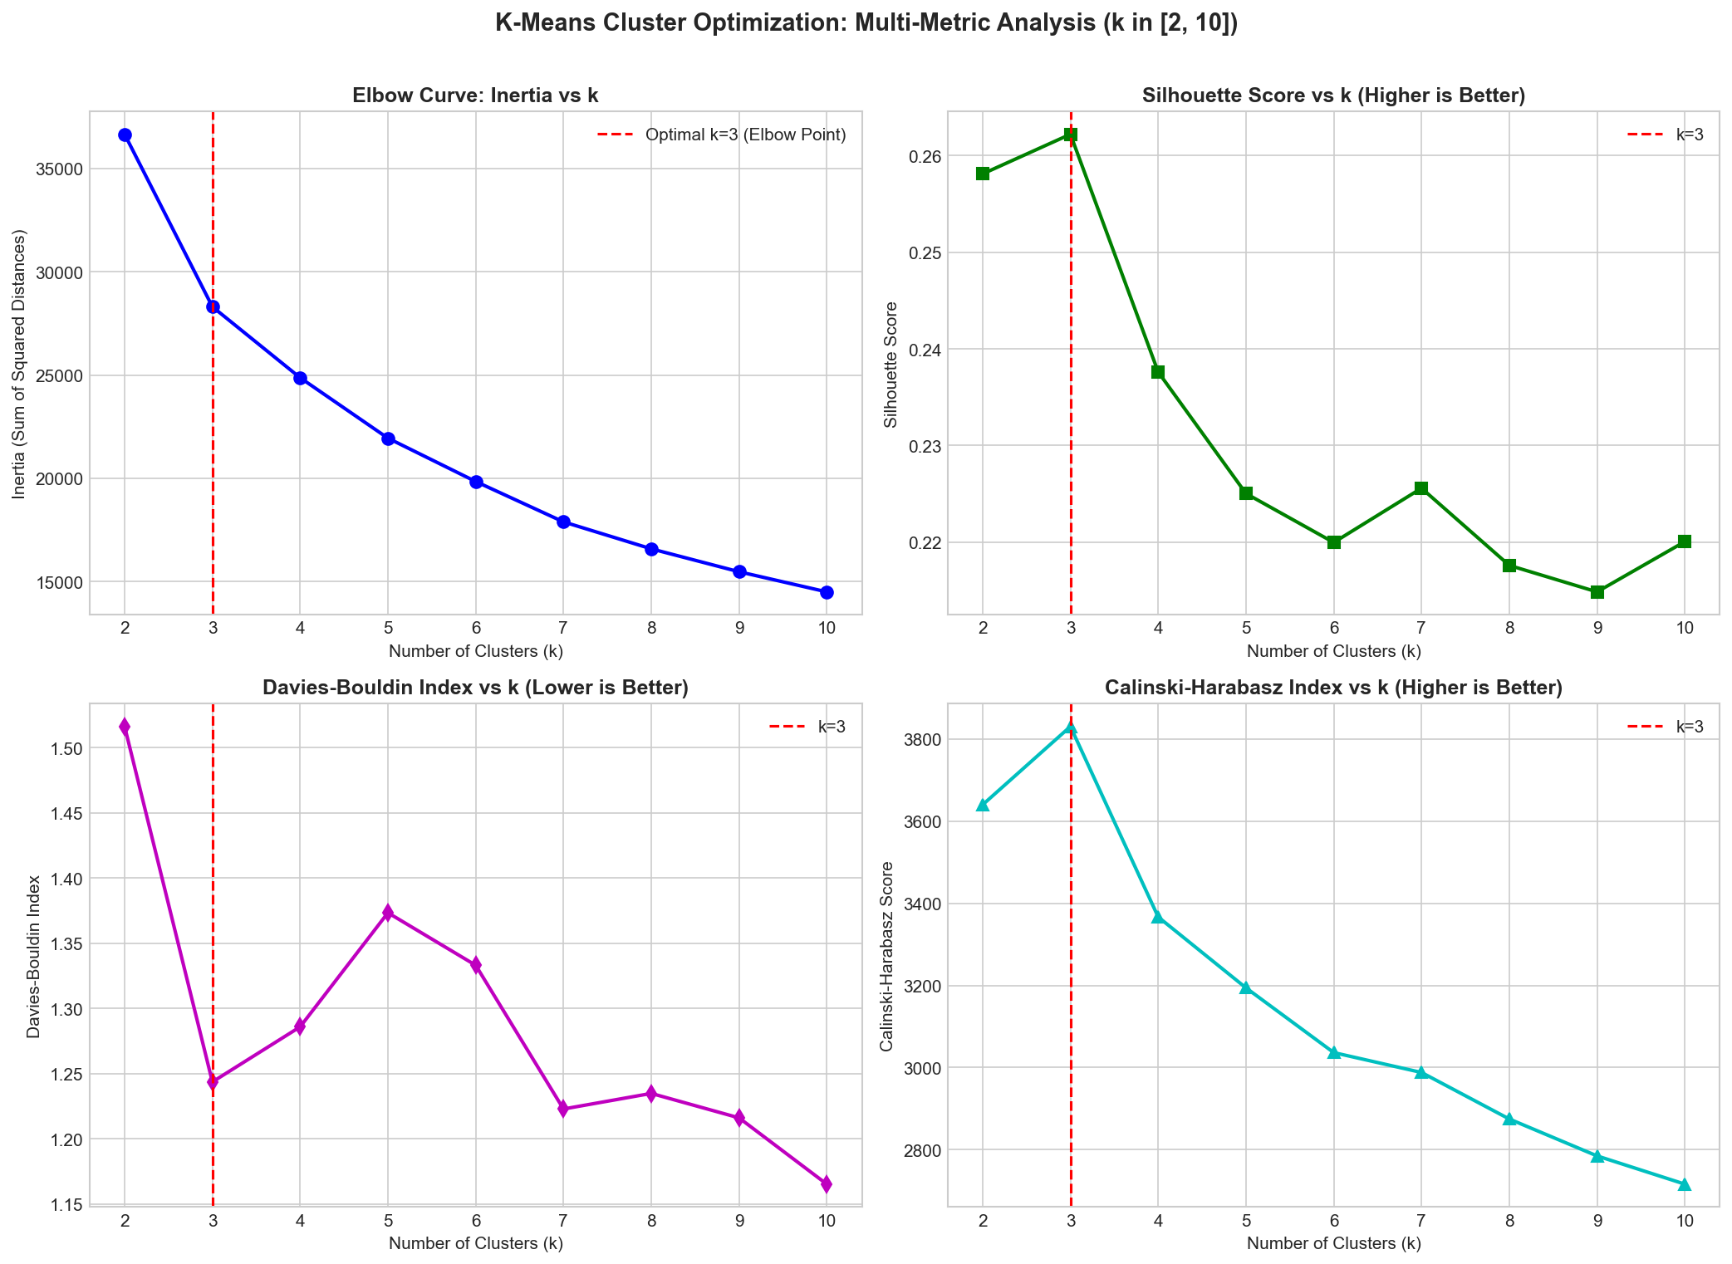
CLUSTERING RESULTS
K-Means: selecting the cluster count
The elbow curve and internal validation metrics are evaluated across candidate values of k.
SELECTED SETTING
k = 3
Silhouette
0.2622
Davies–Bouldin
1.2437
Calinski–Harabasz
3,831.0
Metric direction matters
23CSE301 / MACHINE LEARNING CAPSTONE / AY 2026–27
REVIEW 2
10

Slide 11
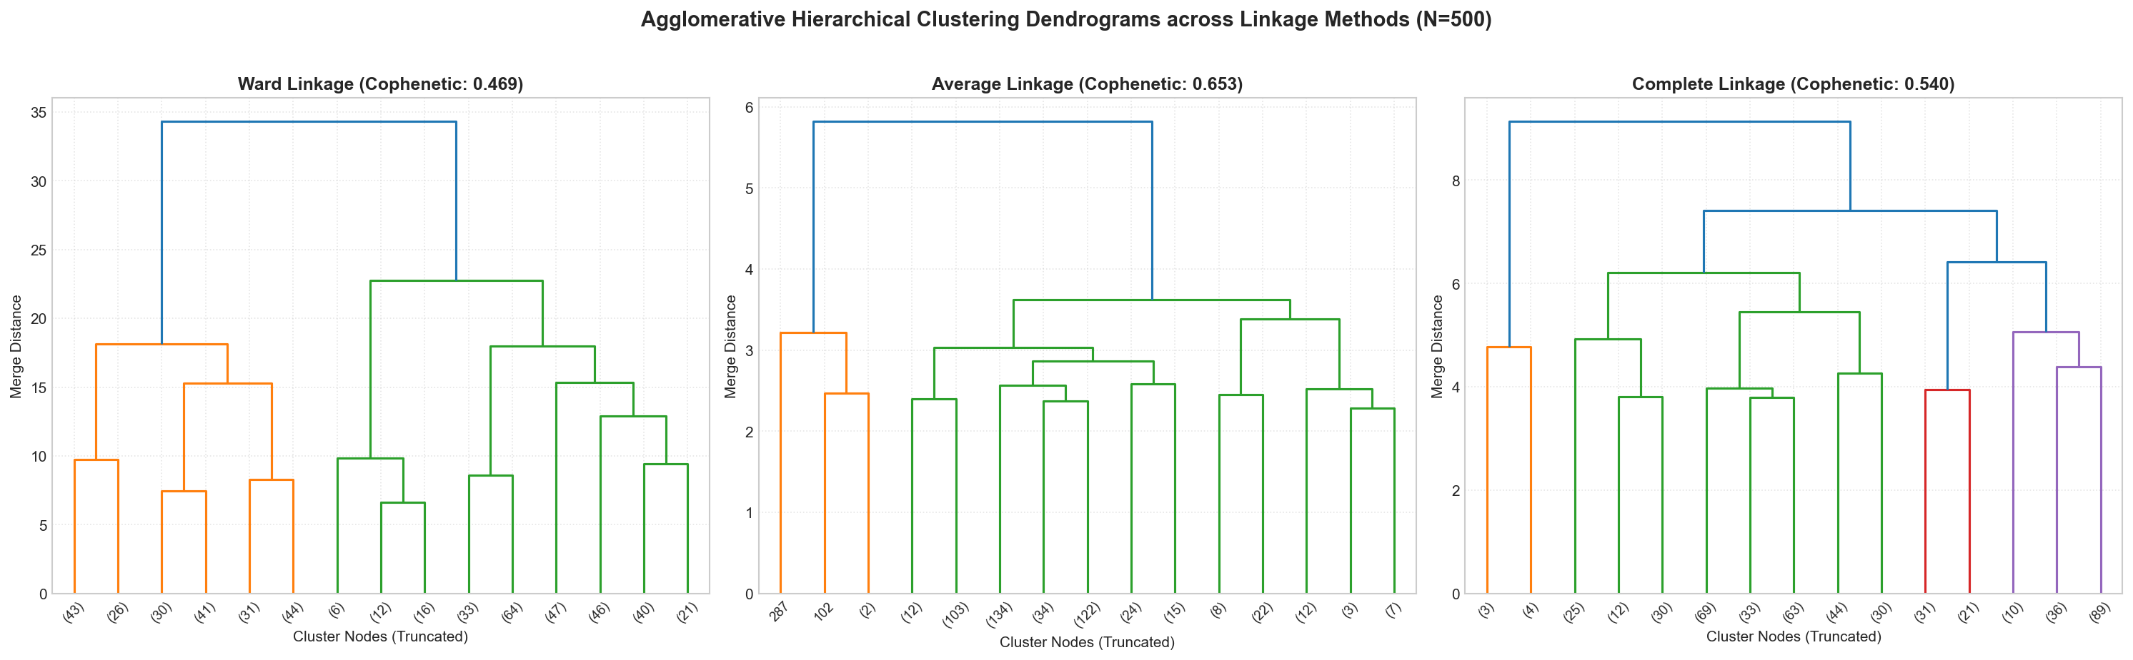
CLUSTERING RESULTS
Agglomerative clustering: linkage comparison
Dendrograms show how merges differ under Ward, Average and Complete linkage.
Ward: merges selected to minimise within-cluster variance.
Average and Complete use different distance summaries; keep the linkage choice and its criterion explicit in the viva.
23CSE301 / MACHINE LEARNING CAPSTONE / AY 2026–27
REVIEW 2
11

Slide 12
CLUSTERING RESULTS
Cluster validation: compare the metrics
Higher is preferred for Silhouette and Calinski–Harabasz; lower is preferred for Davies–Bouldin.
Algorithm / linkage | k | Silhouette ↑ | Davies–Bouldin ↓ | Calinski–Harabasz ↑
K-Means | k=3 | 0.2622 | 1.2437 | 3,831.0
Agglomerative — Ward | k=3 | 0.1639 | 1.6258 | 2,427.0
Agglomerative — Average | k=3 | 0.2831 | 0.8920 | 513.4
Agglomerative — Complete | k=3 | 0.1984 | 1.3788 | 1,424.4
Explain which metric or practical criterion your team prioritised when selecting a linkage. The metrics do not rank every linkage identically.
Values are taken from the clustering.ipynb linkage comparison and consolidated benchmark outputs.
23CSE301 / MACHINE LEARNING CAPSTONE / AY 2026–27
REVIEW 2
12

Slide 13
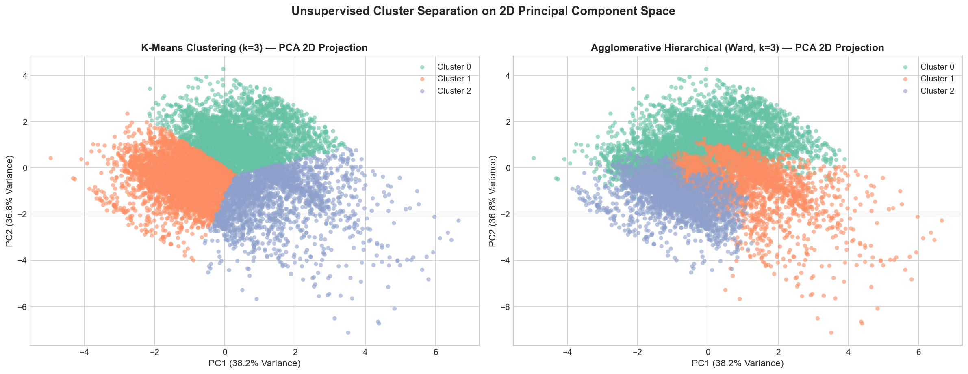
CLUSTERING VISUALISATION
PCA: view clusters in two dimensions
PCA is required by the rubric for both clustering algorithms.
38.21%
PC1 variance
36.82%
PC2 variance
75.03%
combined
23CSE301 / MACHINE LEARNING CAPSTONE / AY 2026–27
REVIEW 2
13

Slide 14
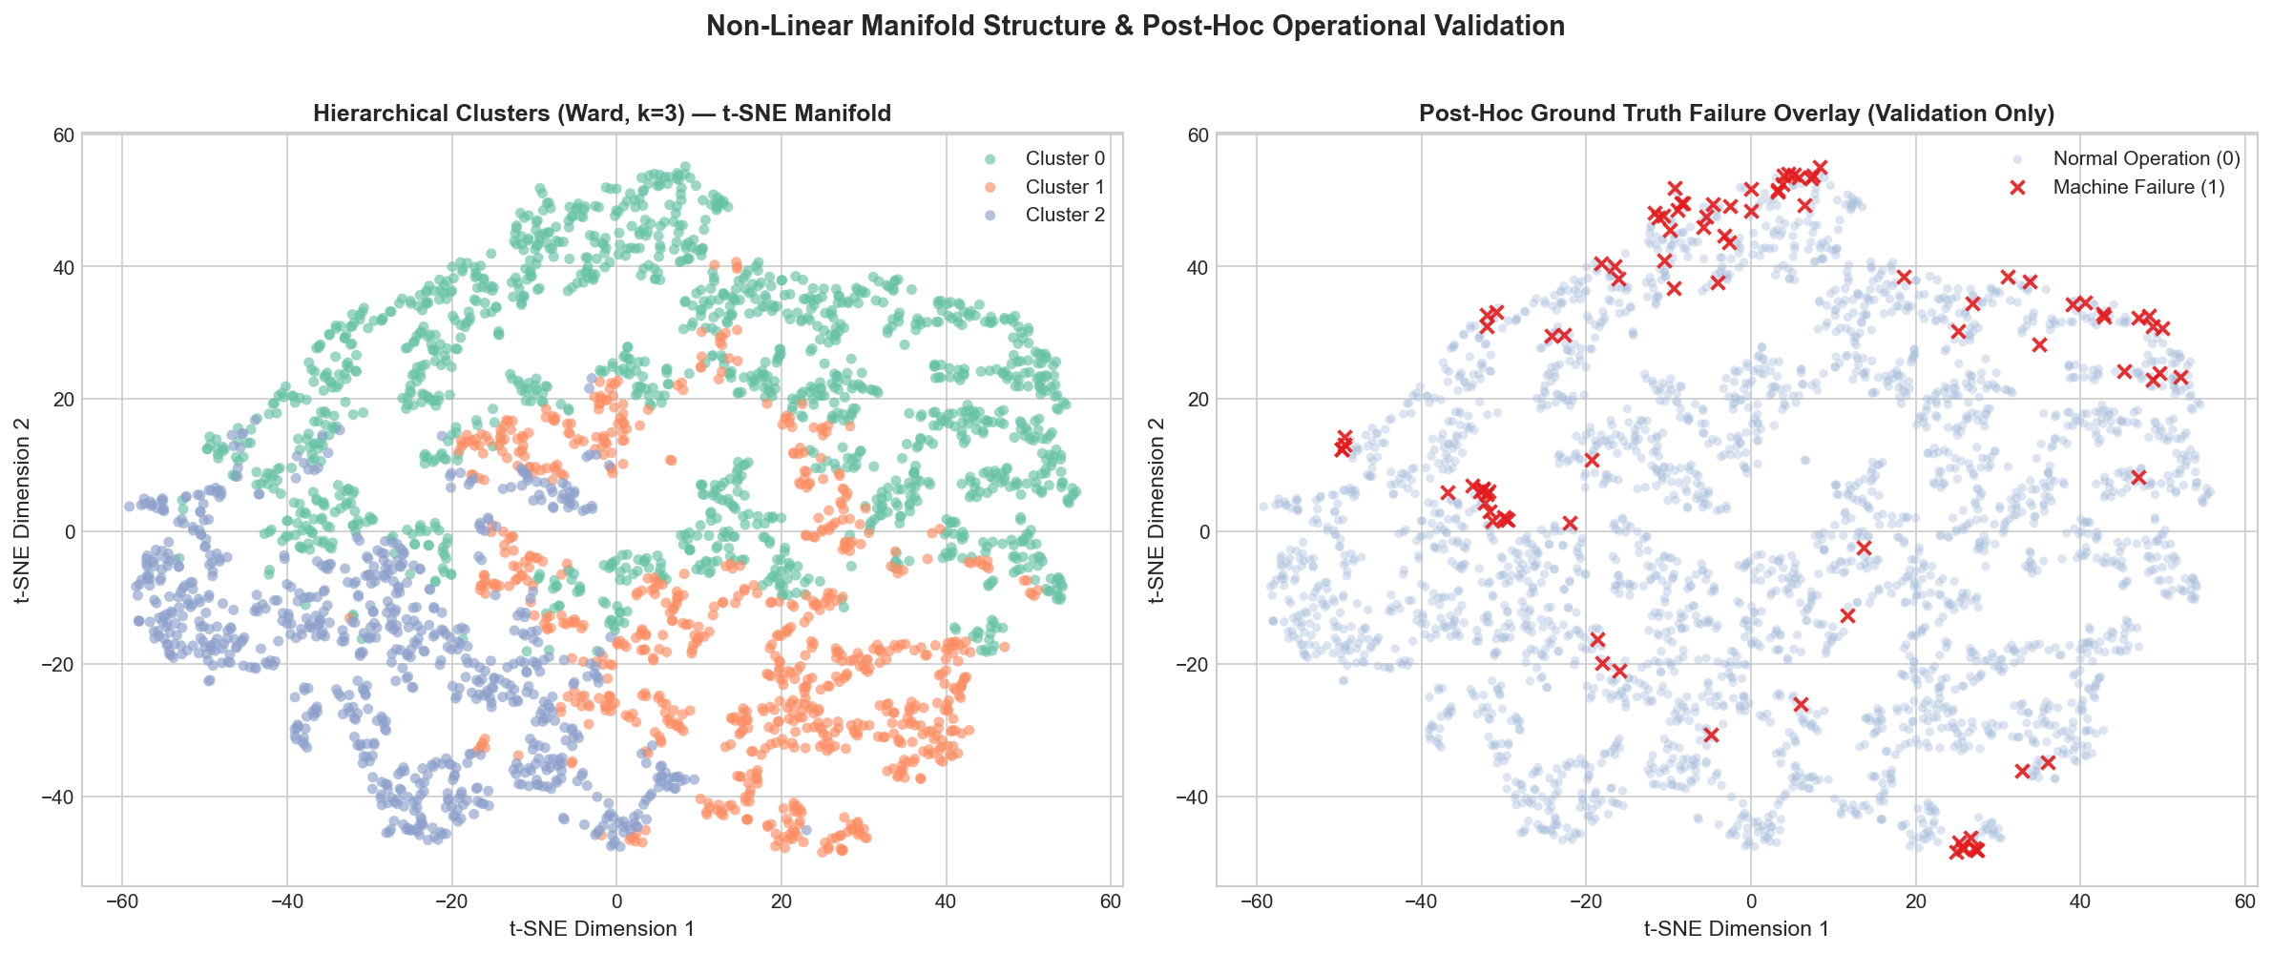
CLUSTERING VISUALISATION
t-SNE: a nonlinear view of the manifold
The project uses a 2D t-SNE projection on 3,000 samples (perplexity = 30).
Use this as a visual exploration tool—not as a standalone score proving clusters are correct.
23CSE301 / MACHINE LEARNING CAPSTONE / AY 2026–27
REVIEW 2
14

Slide 15
INTEGRATION & QUALITY
From notebooks to a runnable demo
The submitted project includes reusable code, saved classifier artifacts and a Streamlit interface.
NOTEBOOKS
UTILITIES
MODEL ARTIFACTS
DEMO APP
classification.ipynb
clustering.ipynb
regression.ipynb
eval_utils.py
cluster_utils.py
clustering_utils.py
best_classifier.pkl
scaler.pkl
app/app.py
Streamlit UI
Local demo command
streamlit run app/app.py
The ZIP contains app code but no public deployment URL; claim a live deployment only after testing and obtaining a working public link.
23CSE301 / MACHINE LEARNING CAPSTONE / AY 2026–27
REVIEW 2
15

Slide 16
FINAL READINESS
Review 2 checklist before presenting
A working notebook is not the same as a defensible viva: verify the evidence and practise the reasoning.
✓
All five Part B classifiers run without errors
✓
All notebook cells execute top-to-bottom with outputs visible
✓
One comparison table includes all ten classifiers and all required metrics
✓
README states dataset, problem, results, setup and run instructions
✓
GridSearchCV results and at least one metric improvement are shown
✓
requirements.txt or environment.yml is present
✓
K-Means and Agglomerative both produce cluster labels
✓
Git history contains meaningful milestone commits
✓
Silhouette, Davies–Bouldin and Calinski–Harabasz are reported
✓
Each teammate can explain algorithm choice and metric trade-offs
✓
Elbow, dendrogram, PCA for each algorithm, and at least one t-SNE plot are included
✓
Confirm app behavior; verify any claimed deployment URL live
23CSE301 / MACHINE LEARNING CAPSTONE / AY 2026–27
REVIEW 2
16

Slide 17
WRAP-UP
Close with evidence, then invite questions
Use this slide as a transition to the live notebook/app demo and viva.
REFERENCES & DISCLOSURE
THE PROJECT IN ONE MINUTE
AI4I 2020 Predictive Maintenance Dataset
Predictive maintenance
through two ML lenses
scikit-learn documentation (classification, clustering, metrics)
23CSE301 Capstone Guidelines, AY 2026–27
Classification evaluates failure alerts using several metrics. Clustering explores operating patterns without training on failure labels.
Project notebooks and figures in the submitted ZIP
AI-use disclosure: update README to acknowledge presentation-drafting assistance if this deck is used
Questions?
Team: verify and own every interpretation.
23CSE301 / MACHINE LEARNING CAPSTONE / AY 2026–27
REVIEW 2
17

