Slide 1
class HelloWorld
{
public static void main(String args[])
{
System.out.println("Hello TCP!"); //<-- THE MAGIC
}
}
INTRODUCTION TO PROGRAMMING
TCP 2017
Prof: Ian Glow
Deck 1 - Introduction

Slide 2
ThE “BLURB”
“In this class you will learn programming in Java, the basics of computer science, object-oriented programming, and what its like working in the tech world. The class will conclude with a day long battle royal of AIs written by students, and is taught by a TCP alumni and Microsoft/Minecraft employee. Expect 1-2 hours a night of work.”

Slide 3
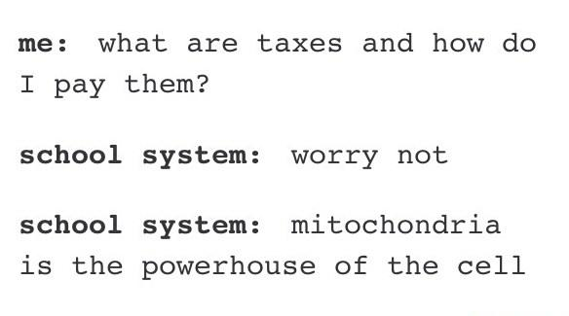
This Stuff is Real

Slide 4
MY GOAL
I want you to:
LEARN
HAVE FUN
WANT TO STUDY MORE COMPUTER SCIENCE
while(true)
{ fun++; }

Slide 5

About me
Ian Glow
Email: I.M.Glow101@gmail.com
TCP Alum 2013
Bachelors and Masters in CS from USC
1 internship at Grab Games making
- Neversmore
2 internships at Microsoft on
- Azure
- Edge

Slide 6
Some of My Projects
A Slime In Time - https://youtu.be/_2CnRmQrAHY
GPU DX11 Flocking - https://youtu.be/77AxBpBhAgs
Raw OpenGL - https://youtu.be/ZlhzD06iVhg
Pixel Power - https://youtu.be/hZDDTFuV8NQ
Grey - https://youtu.be/QQ1rnVuqj5w
Deferred Renderer - https://youtu.be/MkcNaeK2X1o

Slide 7
SPElwing
Only mention my bad spelling if you cant understand what I’m saying.
I’M REALLY BAD AT IT!

Slide 8
Colors
Green → Random Notes
EX: //This was actually invented in 2016
Yellow (and maybe other colors) → Pay Attention
EX: //Don’t forget your semicolons!
MY CODE WILL BE A RAINBOW

Slide 9
Why Colors
Margaret Pace Park is an 8-acre (3.2 ha) urban park located in the Omni and Edgewater districts of Greater Downtown Miami, Florida, U.S.A. The park is located on Biscayne Bay and has tennis courts as well as personal fitness equipment.[1] Just do North Bayshore Drive, three large condominium complexes that were built in the 2000s housing and economic bubble overlook the park. The park underwent a $4 million renovation during this time.[2] An even larger building is under construction adjacent the park As of 2015.[3] The historic Miami Women's Club building is located directly to the south of the park.

Slide 10
Why Colors PT. 2
public char rightInput() { char rightTemp = ' '; if(Gdx.input.isKeyPressed(Input.Keys.UP)) rightTemp = 'U'; else if(Gdx.input.isKeyPressed(Input.Keys.DOWN)) rightTemp = 'D'; else if(Gdx.input.isKeyPressed(Input.Keys.LEFT)) rightTemp = 'L'; else if(Gdx.input.isKeyPressed(Input.Keys.RIGHT)) rightTemp = 'R'; //THIS CONTROL FLOW SCARES ME if(rightTemp == lastRight) { lastRight = rightTemp; return ' '; } else { lastRight = rightTemp; return rightTemp; }
}

Slide 11
What is Computer Science
The scientific approach to computation (any type of calculation that follows a well-defined model understood and expressed as an algorithm) and its applications.
Not necessarily digital computers—the OG computers were people.
Helps everyone throughout all of society.

Slide 12
Programming
Coming up with a way to solve a problem ← Algorithms
Then telling a computer how to do it ← Programming

Slide 13
Programming BASIC HOW TO
Understand what the program must do
What are the inputs?
What are the outputs?
Identify the logical (discrete) steps needed to solve the problem
Translate those steps into a programming language

Slide 14
Programming HINTs
Identify things you do more than once ← Functions
Identify if you “loop” over things ← Loops
Has someone else made something to do this ← APIs
Figure out how to represent real world things ← Data Structures

Slide 15
COMPUTERS
All they do is math really fast on binary numbers
(+ take input and make outputs) //<-This is valid Lisp code ☺
IE: 0010 + 0110 = 1000
2 6 8

Slide 16
COMPILER and INTERPRETERS
Take a written human-readable (at least sorta) language and turns it into machine code (1/0 that the computer knows how to execute, also known as assembly).
Compilers – They do it for all your project ahead of time and produce and executables (e.g. .exe) – C++, C, BASIC, Fortran
Interpreter – Read and translate the source code at runtime line by line(ish) then execute the resulting machine code – Java Script, Lisp, Python
//NOTE: JAVA != JAVASCRIPT

Slide 17
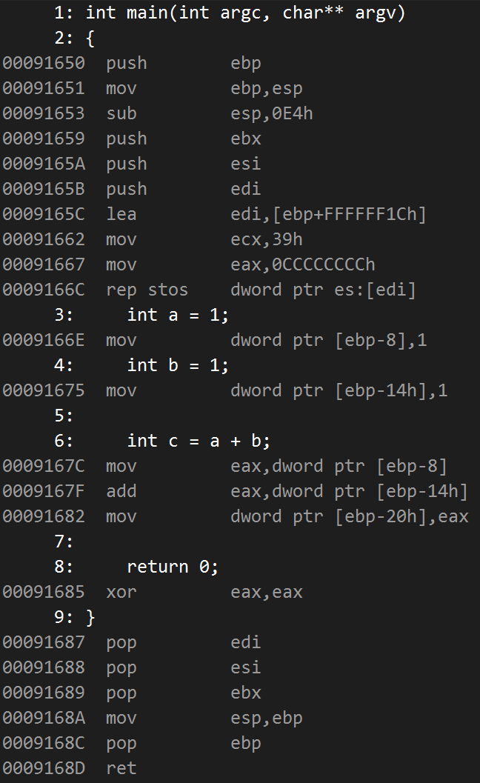
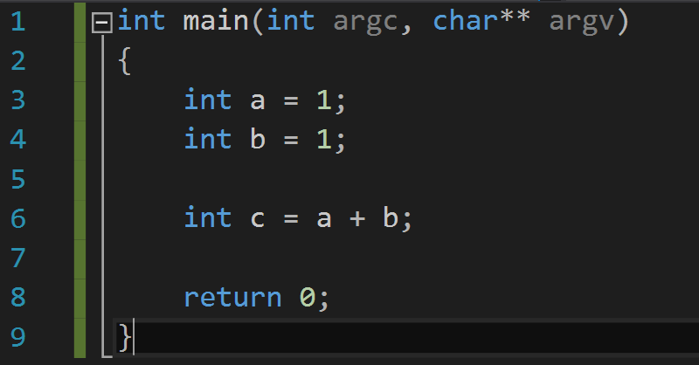
CompIlation

Slide 18
Videos
"Khan: What is Programming" – https://youtu.be/FCMxA3m_Imc
"Larry Wall: Computer Programming in 5 Minutes" -https://youtu.be/UScm9avQM1Y

Slide 19
Setting UP Your Environment
Download
Unzip into folder on desktop
LETS DO THIS!!!

Slide 20
TESTING Your EnvironmenT
Run the Open CMD.bat (In the unzipped folder, double-click it).
Change directory of the Command Prompt, and play around. Use these commands: $ dir ← Tells you where you are and what's there $ cd [folder] ← Moves your current directory to folder $ cd .. ← Moves your current directory up once to your parent

Slide 21
Why Java?
Fairly simple language.
Easy to get up and going.
Knowledge transfers to many other languages.
Used a lot of places.

Slide 22
Your First PROGRAM!
public class HelloWorld
{
public static void main(String[] args)
{
System.out.println("Hello World!");
}
}

Slide 23
Compiling and Running
1) Save file as HelloWorld.java
2) run command: javac HelloWorld.java
- This needs to be run while the command prompt’s working directory is the same as where the HelloWorld.java file is located.
- This will compile the .java source file written in Java using the Java compiler (javac) into Java Byte Code in a .class file.
3) Run command: java HelloWorld
-This tells java to run the .class file named HelloWorld.class

Slide 24
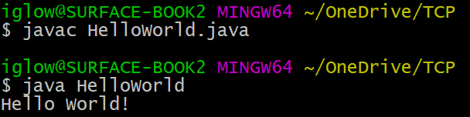
Result!

Slide 25
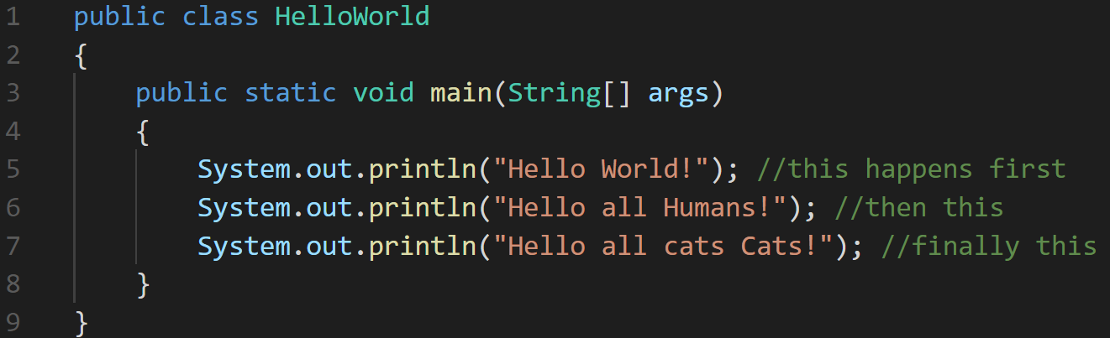
Anatomy of Baby Program!
Programs are made up of statements that are executed line by line and end in ; (semicolons)

Slide 26
Anatomy of Baby Program!
Things that follow a // (double forward slash) will be ignored by the compiler and are used for talking about what's happening in your code. They are called comments.
public class HelloWorld
{
public static void main(String[] args)
{
//The next line outputs Hello World to the console
System.out.println("Hello World!");
}
}

Slide 27
Anatomy of Hello World! 1/4
“public class HelloWorld” means that this file will be named HelloWold.java and everything enclosed within the matching brace are all considered part of the same class. A class is a collection of data (variables) and ways to manipulate that data (methods). //Don’t worry
public class HelloWorld
{ //Beginning of class HelloWorld
public static void main(String[] args)
{
System.out.println("Hello World!");
}
} //End of class HelloWorld

Slide 28
Anatomy of Hello World! 2/4
“public static void main(String[] args)” is a method signature. A method is reusable chunk of code that takes input (arguments) and can return some output. “main()” is a special method that tells java where the program starts. //Don’t worry
public class HelloWorld
{
public static void main(String[] args)
{
System.out.println("Hello World!");
}
}

Slide 29
Anatomy of Hello World! 3/4
“System.out.println("Hello World!");” is a method call. A method call means we ran the code inside the method (invoked). The stuff in between the () are the arguments and are used by the method to do its job. //Don’t worry
public class HelloWorld
{
public static void main(String[] args)
{
System.out.println("Hello World!");
}
}

Slide 30
Anatomy of Hello World! 4/4
The method System.out.println(“Hello World”) is used to output text to the command prompt. “Hello World” can be replaced with any other string literal. A string literal is text written directly in code that is surrounded by quotes. //Don’t worry
public class HelloWorld
{
public static void main(String[] args)
{
System.out.println("Hello World!");
}
}

Slide 31
Anatomy of Hello World! Recap
Code is executed line by line and must be compiled to run
- all code must be inside a class
- the file is named the class’s name + .java
- “public static void main(String[] args)” is a special method where the program starts
- The method System.out.println(String text) is used to output text to the command prompt.

Slide 32
HW1 – Hello world
Hw1 is on Moodle!
DUE TOMMOROW

Slide 33

WHAT CAN CODE DO?
“Increase Human Productivity”

Slide 34
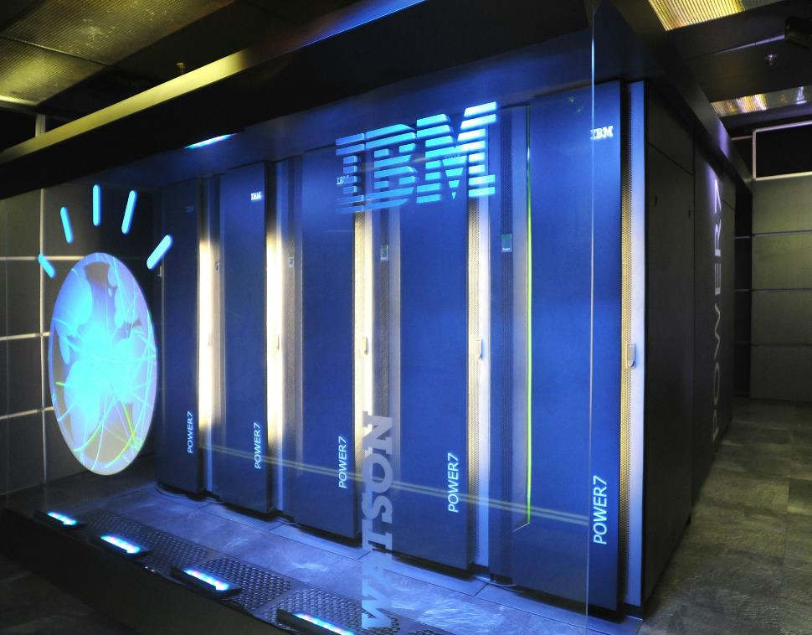
WHAT CAN CODE DO?
“Replace Human Productivity” //Look up universal basic income

Slide 35
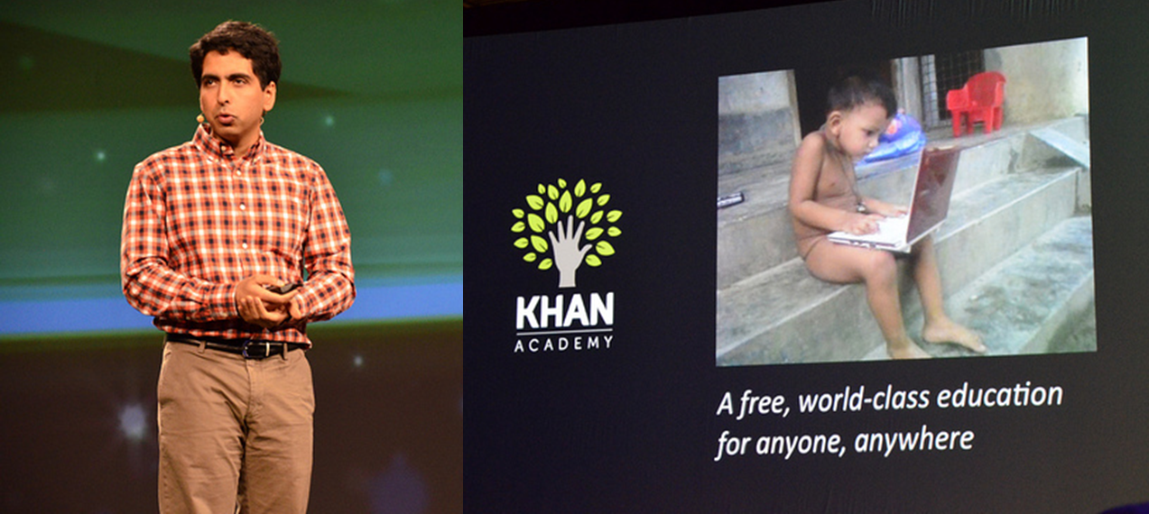
WHAT CAN CODE DO?
“Teach”
https://youtu.be/7vsCAM17O-M

Slide 36

WHAT CAN CODE DO?
“The Cloud and Machine Learning” //aka empowering business

Slide 37
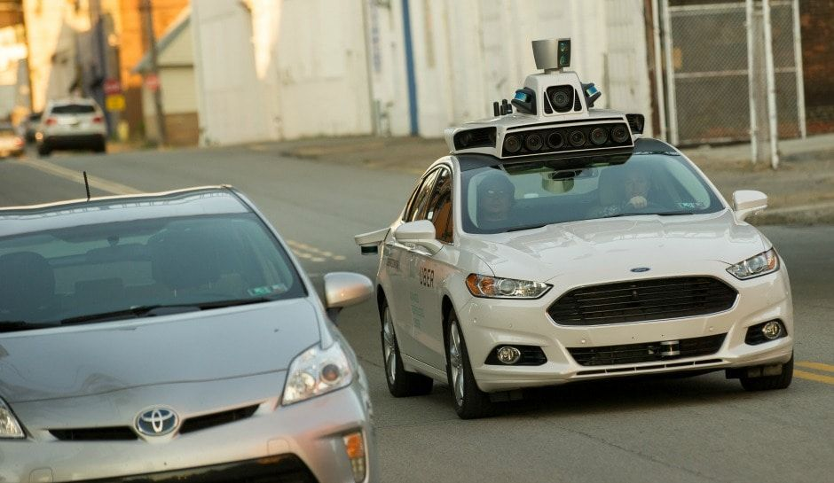
WHAT CAN CODE DO?
“Self-Driving Cars”
https://www.tesla.com/videos/full-self-driving-hardware-all-tesla-cars
https://www.youtube.com/watch?time_continue=78&v=9ydhDQaLAqM

Slide 38
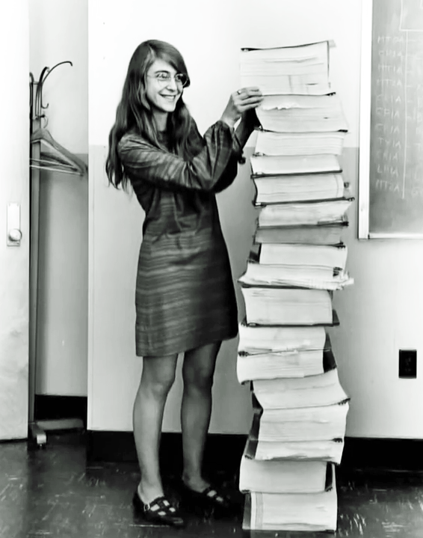
WHAT CAN CODE DO?
“Go To The Moon” //This is Margaret Hamilton

Slide 39
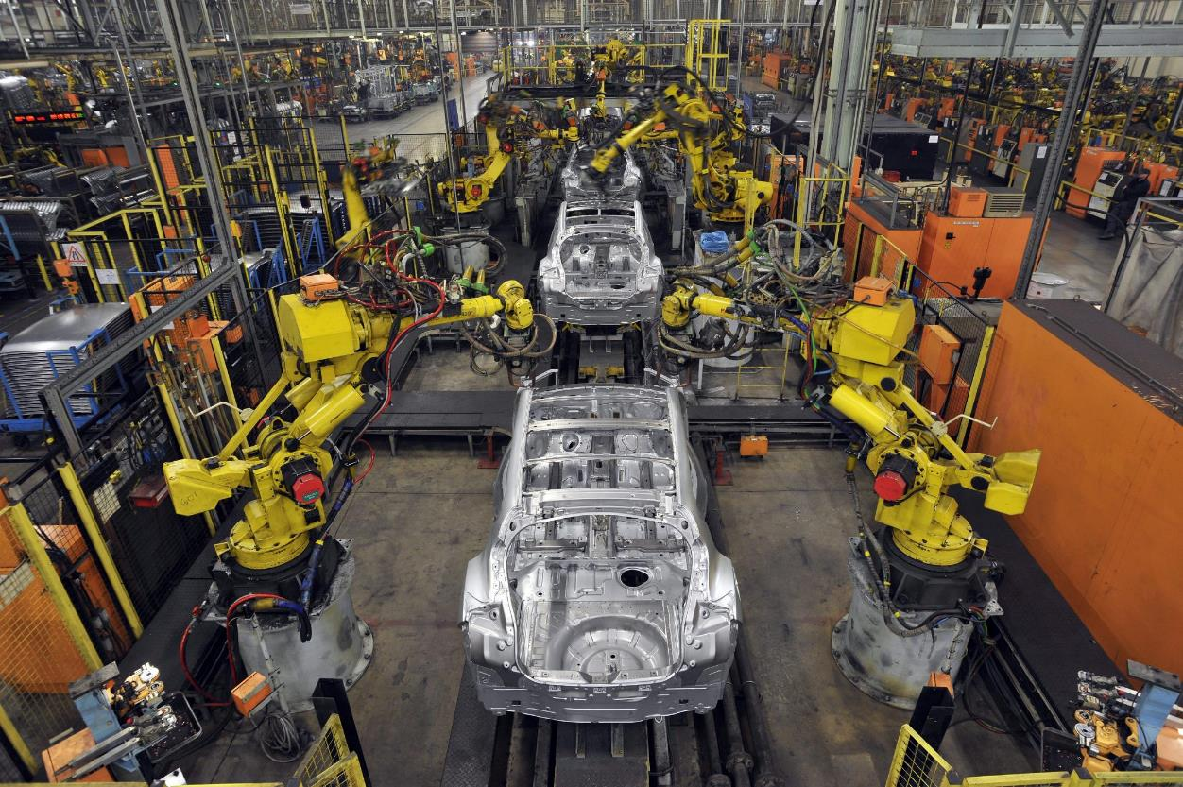
WHAT CAN CODE DO?
“Make things!”

Slide 40
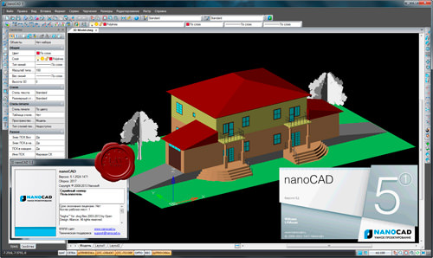
WHAT CAN CODE DO?
“Build things!”

Slide 41
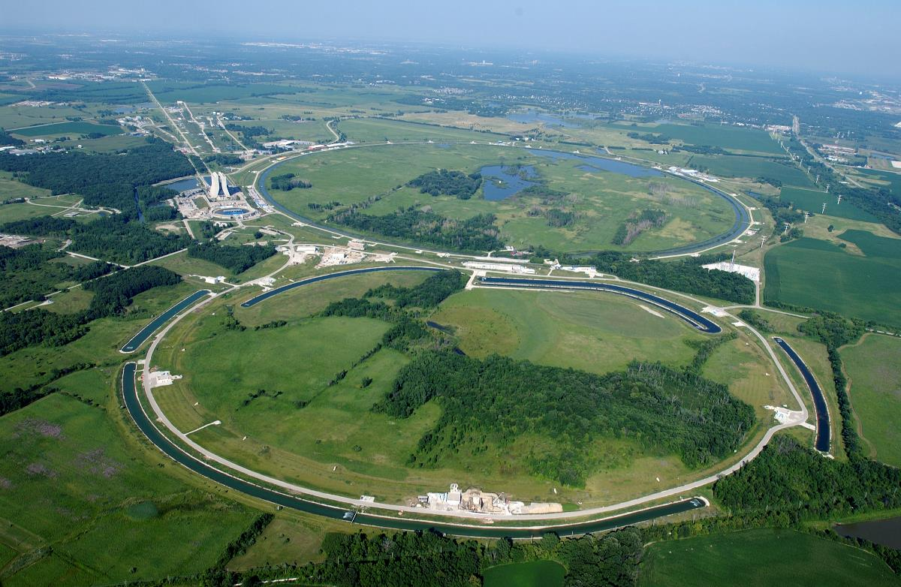
WHAT CAN CODE DO?
“Find the secrets of the universe.”

Slide 42
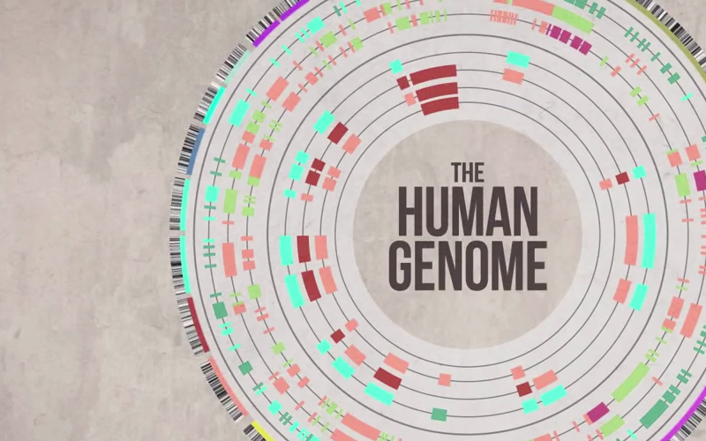
WHAT CAN CODE DO?
“Make us healthy.”

Slide 43

WHAT CAN CODE DO?
“The internet.”

Slide 44
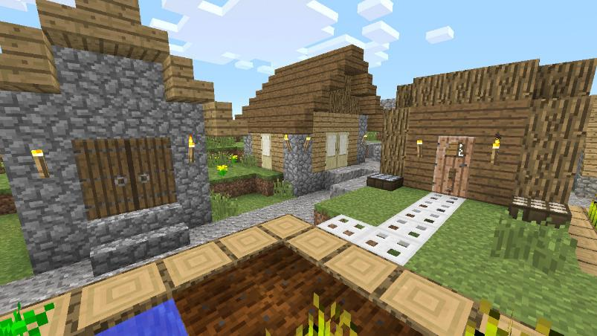


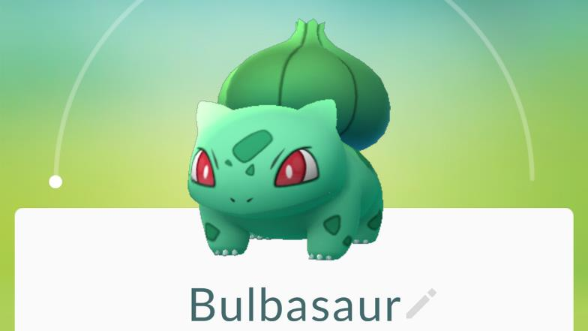
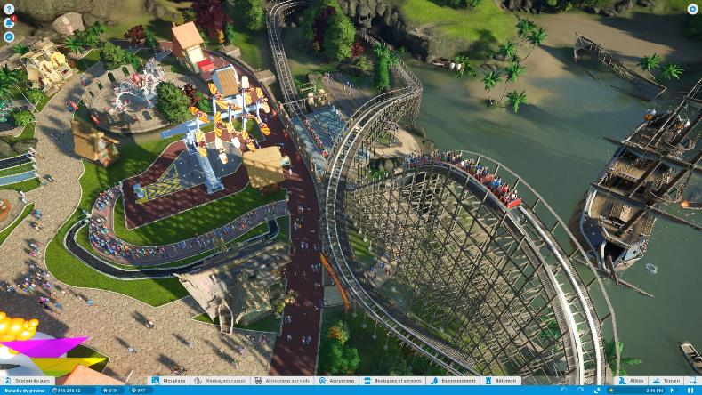
WHAT CAN CODE DO?
“Actively entertain us.”

Slide 45

WHAT CAN CODE DO?
“Passively entertain us.”

Slide 46
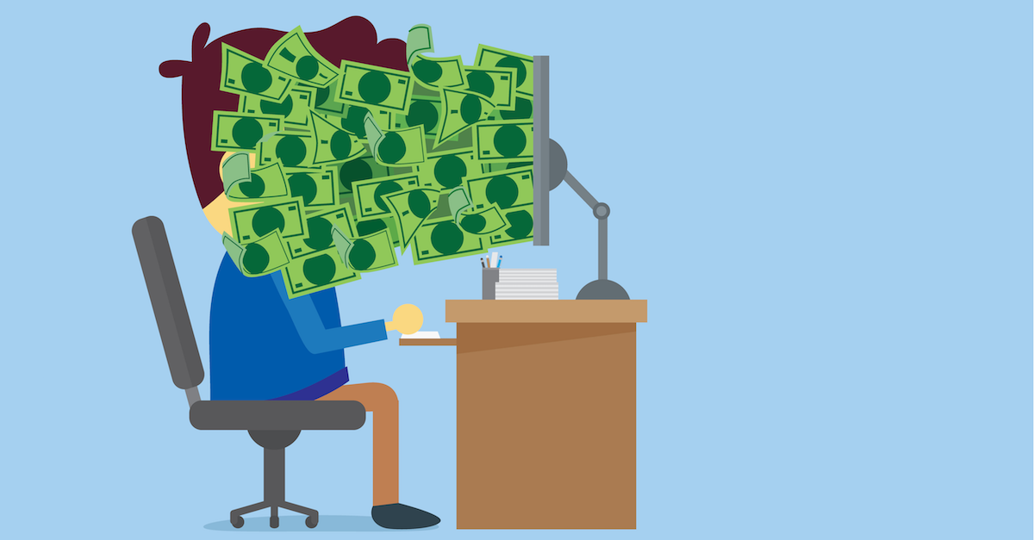
WHAT CAN CODE DO?
“Give you an amazing fairly automation-proof job.”

Slide 47
HW1 – Hello world
Hw1 is on Moodle!
DUE TOMMOROW

