Slide 1
public class Vars
{
public static void main(String[] args)
{
int a = 1;
int b = 1;
int c = a + b;
System.out.println("a + b = " + c);
}
}
INTRODUCTION TO PROGRAMMING
TCP 2017
Prof: Ian Glow
Deck 2 - Variables

Slide 2
VARIABLES
A piece of memory that contains a value.
EX:
int x = 42; System.out.println(“The variable x contains " + x); //Output to the console: //The variable x contains 42

Slide 3
Declaration
Telling the computer that you need a chunk of memory and what you plan on storing in that memory.
EX:
int x; <- This tells the computer that I want a block of memory, which I want to refer to as ‘x’, and I want ‘x’ to be of the type int (integer aka a whole number).

Slide 4
ASSIGNMENT
Assigns a value to the variable. We use the assignment operator = (the equals sign) to do this.
EX:
int x;
x = 42; <- This tells the computer that I want the memory referred to by the variable x to now be set to the value 42.

Slide 5
= properties
The assignment operator, = (the equals sign), sets the variable on the left equal to the value on the right
EX:
int x; //Declare X int y; //Declare Y x = 42; // x is now 42 x = 3; // x is now 3 y = x; // y and x are now 3 x = 15; // x is 15, but y is still 3

Slide 6
DEFINITION
Declaring and assigning at the same time
EX:
int myNumber = 7; <- This tells the computer that I want a block of memory, I want to be able to refer to it as ‘myNumber’, and I want ‘myNumber’ to be of the type int (a whole number) and I want to set its value to 7.

Slide 7
Naming
Variables can be named almost anything, and are case sensitive, i.e., “myInt” and “MYINT” are not the same thing. There are just a few rules:
1) The name cannot start with a number
2) Variable names cannot be equal to reserved keywords in Java. For instance, the words ‘int’ or ‘for’ are reserved words in Java. Therefore you cannot name your variables ‘int’ or ‘for’.
Example valid variable names:
Cat, poTat1o, friendlyNumber, x, x2, iiiiii

Slide 8
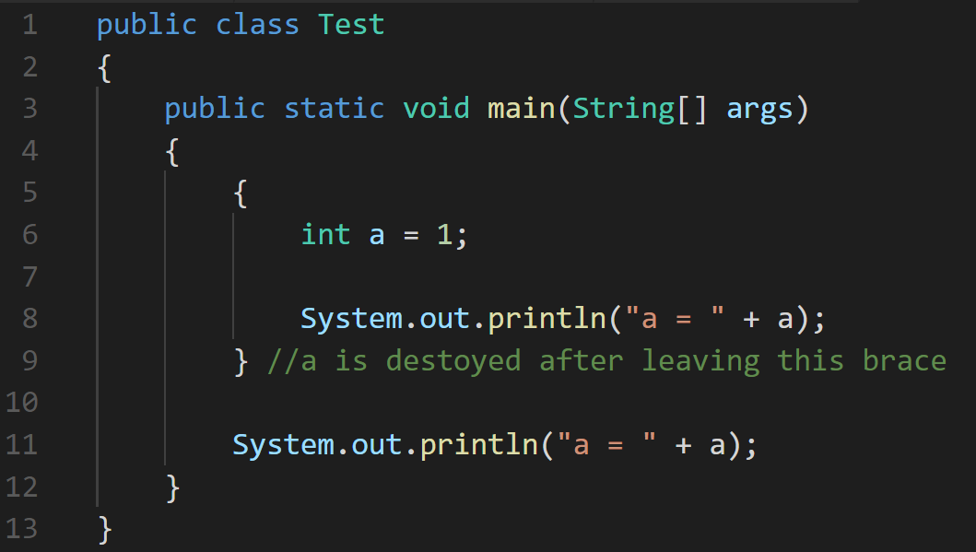
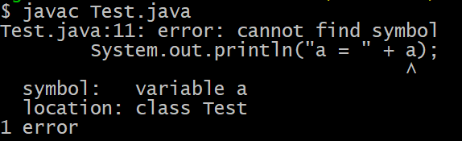
Scope
Variables only exist within the { } (block) that they were created in, and are destroyed after the closing bracket is reached. This is known as the variable’s scope.

Slide 9
Built In VARIABLE TYPES - Primitives
Whole number types: byte, short, int, long
0, 1, 2, …., 3457567, etc.
Floating point number types: float, double
0.0, 1.7423, 2.3, ….., 146x2^22, etc.
Characters: char
‘a’, ‘b’, ‘4’, ‘\n’
Boolean logic: boolean
True or False
http://docs.oracle.com/javase/tutorial/java/nutsandbolts/datatypes.html

Slide 10
Built In VARIABLE TYPES - Int
Most common whole number type: int
-12, 0, 1, 2, …., 3457567, ect
An int is 4 bytes = 32 bits in memory
An int’s range is -2,147,483,648 to 2,147,483,647
//A lot of numbers are in programming: banking, encryption, video games, graphics, and a lot of things depend on them

Slide 11
Int’s Operators
int has multiple operators: +,-,*,/,%
int a = 2;
int b = 3;
System.out.println(a + b); //Outputs 5
System.out.println(a - b); //Outputs -1
System.out.println(a * b); //Outputs 6
System.out.println(b / a);
//Outputs 1 (no remainder because the result is an int)
System.out.println(10 % 6);
//Outputs 4 (% is called modulus and it outputs the remainder)

Slide 12
Int’s Operators Pt2
int, also has ++ increment and -- operators;
--x; is translated to x = x – 1;
++x; is translated to x = x + 1;
int a = 2;
a++;
System.out.println(a); //Outputs: 3

Slide 13
Built In VARIABLE TYPES - Double
Most common floating point type number type: double
float is pretty common too.
-7.4, 0.0, 1.7423, 2.3, ….., 146.1347, etc.
An float is 4 bytes = 32 bits in memory
An double is 8 bytes = 64 bits in memory
With floating types, it’s not about range really—its about precision.
//We use doubles more often because Java’s built-in math class uses them.

Slide 14
double’s Operators
double, has multiple operators: +,-,*,/
double a = 1.5;
double b = 3.5;
System.out.println(a + b); //Outputs 5.0
System.out.println(a - b); //Outputs -2.0
System.out.println(a * b); //Outputs 5.25
System.out.println(b / a); //Outputs 2.3333333333333335

Slide 15
Math Class
https://docs.oracle.com/javase/7/docs/api/java/lang/Math.html
Example:
double x1 = 10.5, y1 = 7.0, x2 = 0.5, y2 = 2.0; //Multiple definitions
double xDiff = x1 - x2;
double yDiff = y1 - y2;
//distance = square root of ((x1 – x2)^2 + (y1-y2)^2) System.out.print(Math.sqrt(Math.pow(xDiff,2) + Math.pow(yDiff,2)));
//Outputs: 11.180339887498949

Slide 16
Built-In VARIABLE TYPES - String
A String is text made out of an array (a list) of characters
“Hello World”, “WooooooT”, “Hi 52345”
Can be concatenated with the + operator:
String a = "Hello all ";
String b = "TCP Students!";
String c = a + b;
System.out.println(c); //Outputs: Hello all TCP Students!
Other types can be converted to strings by concatenation:
String a = "You are a ";
int b = 10;
String c = a + b + "!";
System.out.println(c); //Outputs: You are a 10!

Slide 17
Built In VARIABLE TYPES - CHAR
Characters: char
‘a’, ‘b’, ‘4’, ‘\n’
An char is 4 bytes = 32 bits in memory, the same size as an int
Can be concatenated to strings:
String a = "Potato";
char b = '!';
String c = a + b;
System.out.println(c); //Outputs: Potato!
Can be cast (converted) to their corresponding int and vise versa:
int num = 100;
char charOfNum = num; //Implicit cast
System.out.println(charOfNum); //Outputs: d
System.out.println((char) num); //Explicit cast, outputs: d
//We are saying “Yo computer, I know num is a int but treat it as a char plz!

Slide 18
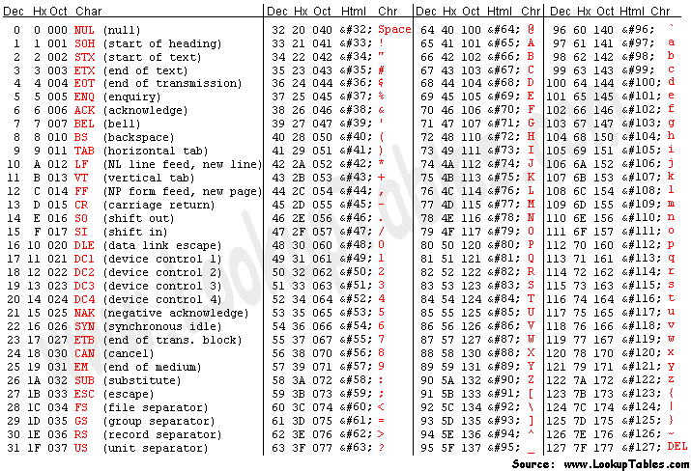
ASCII - American Standard Code for Information Interchange

Slide 19
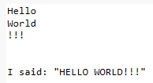
ESCAPED Chars
Escaped chars are special 2 typed letter combinations that start with a ‘\’ that are treated by the computer as a single char and do special things.
\n adds a line break at that point
\" lets you have quotes inside a string literal
String a = "Hello\nWorld\n!!!";
System.out.println(a);
System.out.println('\n');
String b = "I said: \"HELLO WORLD!!!\"";
System.out.println(b);

Slide 20
Built In VARIABLE TYPES - Boolean
A boolean is either true or false
true, false
We use these in in control statements like if, for, while, do, switch, etc.
boolean a = true;
boolean b = false;
boolean c = a && b; //&& is AND so c is false

Slide 21
Boolean OPERATORS
A boolean is operator takes booleans and returns booleans
|| is OR
&& is AND
We use these in control statements like if, for, while, do, switch, ect
boolean a = true || true; //a is true
boolean b = true || false; //b is true
boolean c = false || true; //c is true
boolean d = false || false; //d is false
boolean e = true && true; //e is true
boolean f = false && true; //f is false
boolean g = true && false; //g is false
boolean h = false && false; //h is false
boolean i = (false && true) || true;

Slide 22
Boolean OPERATORS - NOT
The ! boolean is operator takes booleans and returns booleans
! is NOT
//Order of operations: http://introcs.cs.princeton.edu/java/11precedence/
boolean a = (false && true) || true; //true
boolean b = true;
boolean c = true && !b; //false

Slide 23
comparison Operators
An operator that compares and returns true of false (aka a boolean)
http://docs.oracle.com/javase/tutorial/java/nutsandbolts/operators.html
== → Equality
!= → Inequality
> → Greater than
< → Less than
>= → Greater than or equal to
<= → Less than or equal to

Slide 24
== (The equality OPERATOR)
Returns true if left side equals right side, false otherwise:
(0 == 0) //this evaluates to true
(1 == 1) //this evaluates to true
(0 == 1) //this evaluates to false
(3 - 2 == 1) //this evaluates to true
(2 - 2 == 1) //this evaluates to false
(3 - 2 == 2 - 1) //this evaluates to true
//IMPORTANT: == does not work the way you would expect with strings

Slide 25
!= (The Inequality OPERATOR)
Returns false if left side equals right side, true otherwise:
(0 != 1) //this evaluates to true
(10 != 1) //this evaluates to true
(1 != 1) //this evaluates to false
(3 - 1 != 1) //this evaluates to true
(2 - 2 != 0) //this evaluates to false
(3 - 2 != 2 - 2) //this evaluates to true
//IMPORTANT: != does not work the way you would expect with strings

Slide 26
Comparison OPERATORs
boolean a = (true == true); //a is true
boolean b = (true != false); //b is true
boolean c = 7 > 8; //c is false
boolean d = 7 < 8; //d is true
boolean e = 8 <= 8; //e is true
boolean f = 2 >= 3; //f is false
But how are these useful?

Slide 27
CONDITIONS
An expression that returns true of false, used in control flow EX:
int x = 5; int y = 3; if(x - 2 == y) //x-2 == y is an expression {
//Goes in here if true System.out.println("X is 2 bigger than Y"); } else {
//Goes in here if false System.out.println("X is NOT 2 bigger than Y"); }

Slide 28
IF
if is used to create branches in code, where depending on some boolean, some code is executed or not.
boolean y = true;
boolean x = (2 == 2);
if(x && y)
{
System.out.println("WOW!");
}
System.out.println("POW!");

Slide 29
IF, ELSE
You can add an else block after your if block, and the code inside it will be executed if the if condition evaluates to false
if(10 > 100)
{
System.out.println("WOW!");
}
else
{
System.out.println("POW!");
}

Slide 30
IF, ELSE IF, ELSE
You can add an else if block after your if block but before your else block, and the code inside it will be executed if the if condition evaluates to false and the else if evaluates to true.
int x = 60;
if(x < 10)
{
System.out.println("X is Small!");
}
else if(x < 100)
{
System.out.println("X is Average!");
}
else
{
System.out.println("X is Big!");
}

Slide 31
NESTED IF STATMENTS
All control statements can be nested. Please use proper indenting.
int x = 60;
if(x < 10)
{
System.out.println("X is Small!");
}
else if(x < 100)
{
System.out.println("X is Average and");
if(x % 2 == 0)
{
System.out.println("Even");
}
else
{
System.out.println("Odd");
}
} //No Else

Slide 32
SCOPE
Primitive variables (if non-member and non-static) only exist in the block { } they were created in, and when resolving the variable, java picks the most nested variable with that name. This is called scope. //Use good indenting!
static void main(String[] args)
{
if(2 == 2)
{
int a = 10;
if(a == 10)
{
int a = 200; //Declare another variable named a
System.out.println("a is: " + a); //Outputs: 200
}
//The inner 'a' now doesn’t exist
System.out.println("a is: " + a); //Outputs: 10
}
//'a' does not exist out here
}

Slide 33
WHile
Sometimes you want to do something multiple times based on a condition. We call this kind of control statement a loop. The most basic loop is a while loop.
static void main(String[] args)
{
int x = 10;
while(x > 0)
{
System.out.println(x + "!");
x = x - 1;
}
System.out.println("Blast off!!!");
}

Slide 34
For
The for loop lets you initialize scoped variables, test the condition, and increment a counter all in one control statement.
for(initialize statement; conditional; after loop code){};
static void main(String[] args)
{
for(int i = 0; i < 100; i++)
{
System.out.println("Cat!");
}
System.out.println("Dog!");
}

Slide 35
DO
Same as while loop but is guaranteed to execute once. Not used often.
int num;
do
{
System.out.println("Enter a number between 0-10");
num = SomeMagicFunctionThatGetsAValueFromTheConsole();
} while (num > 0 && num < 10);
System.out.println("Congratulations! You can follow directions!");

Slide 36
Wait Something is missing…
Computers do 3 general things:
Take input //Ohhh yeah...
Do lots of math really fast
Produce output
Hmmm I can look this up on StackOverflow.com…
https://stackoverflow.com/questions/11871520/how-can-i-read-input-from-the-console-using-the-scanner-class-in-java

Slide 37
SCANNER
Scanner is an object that lets you get input from the command line:
import java.util.Scanner; //import lets us use another class in this class
public class Hello
{
public static void main(String[] args)
{
Scanner input = new Scanner(System.in);
System.out.println("Enter a number: ");
int num = input.nextInt();
System.out.println("Ohh " + num + " squared is: " + (num * num));
}
}

Slide 38
EXAMPLE TIME!
Quadratic formula
Midpoint algorithm
Fibonacci
Triangle on cmd
MORE?

Slide 39
HW2
‘HW2 – Pythagorean’ is on Moodle.
Due tomorrow!

